Slide 1
OGE Inclusivity & Accessibility Workshop Developing and Delivering Effective Ethics Education 2023

Slide 2
Let’s Meet!

Slide 3
Workshop Overview
Developing and Delivering Effective Ethics Education

Slide 4
Inclusivity
“Diversity is a mix and inclusion is making the mix work.” – Andrés Tapia, Global Diversity and Inclusion Strategist

Slide 5
Inclusivity: Key Concepts of Ethics Education
Who is your audience?
How relevant and engaging is your content delivery?
Is it inclusive?
How effective is your program?

Slide 6
Brainstorming: Inclusivity

Slide 7
Inclusivity
●Race ●Language
●Gender ●Age
●Sexuality ●Socio Economic
●Identity ●Culture
●Religion ●Pronouns
●Learning Difference ●Bias
●Disability ●Discrimination
●Career/Profession

Slide 8
Inclusivity

Slide 9
Breakout!
Who is your audience?
How relevant and engaging is your content delivery?
Is it inclusive?
How effective is your program?

Slide 10
Post Breakout
Tell us about it.

Slide 11
Accessibility
“I wish more people understood that you can’t just tell by looking at a person if they are disabled or not.” ― Sammi Hampton, Independent Living Coordinator
“We need to make every single thing accessible to every single person with a disability.” ― Stevie Wonder

Slide 12
Accessibility: Key Concepts of Ethics Education
Who is your audience?
How engaging is your content and delivery?
Is it accessible?
How effective is your training overall?

Slide 13
Brainstorming: Accessibility

Slide 14
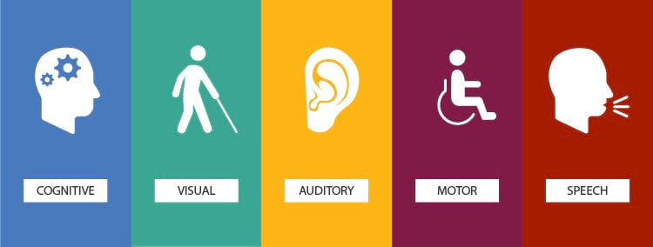
Accessibility

Slide 15
Break

Slide 16
Are Your Training Materials Accessible
Things to consider:
Are you using ALT text to describe images and graphics?
Do you provide materials in advance?
Is the color contrast ratio between text and background sufficient
Is your font size consistent of 20-24 pts or greater?
Are you using a sans serif font such as Arial, Calibri, or Tahoma?
Is there enough white space on the slide?
Have you used PowerPoints built-in accessibility checker ?
Notes:
Things to consider:
Are the examples you create, and the question you ask relevant to the work being performed? Do they reflect the experience of your audience?
Is the diversity of the audience reflected in the content (names, images, examples, language etc.) ?
Do the instructors understand the needs of the audience, and are they able to effectively and credibly communicate them?
Do the delivery methods vary to accommodate different learning styles?
Are you materials accessable?
Do you provide materials in advance,…..

Slide 21
Creating accessible training website tour

Slide 22
Breakout!
Who is your audience?
How relevant and engaging is your content delivery?
Is it accessible?
How effective is your program?

Slide 23
Post Breakout
Tell us about it.

Slide 24
How inclusive and accessible is your program?
Here are some tools you can use to take the pulse of your program:
Needs assessment surveys (supervisors and employees).
Informal discussions with groups of managers and groups of employees.
Meeting with a Section 508 compliance coordinator and your agency’s DEIA Team.
Post-education evaluations that assess relevance, inclusivity and accessibility.
Discussions with agency leaders and employees to evaluate whether the training they received supported them.

Slide 25
Resources
U.S. Office of Personnel Management Diversity, Equity, Inclusion, and Accessibility: https://www.opm.gov/policy-data-oversight/diversity-equity-inclusion-and-accessibility/
Accessibility Practices: https://www.usability.gov/what-and-why/accessibility.html
DEIA Guidance: https://www.section508.gov/manage/deia-guidance/
Section 508 PowerPoint Checklist: https://www.ssa.gov/accessibility/checklists/docs/PrintablePowerPointCheckSheet.pdf
Creating PowerPoint Templates: https://www.section508.gov/training/presentations/creating-powerpoint-templates/
Color Contrast Analyzer (CCA): https://developer.paciellogroup.com/color-contrast-checker/

Slide 26
THANK YOU
My father literally fought his entire life to ensure the inclusion of all people because he understood that we are intertwined and connected together in humanity.
― Bernice King
“Part of the problem is that we tend to think that equality is about treating everyone the same, when it’s not. It’s about fairness. It’s about equity of access.” ― Judith Heumann, Disability Rights Activist. From Being Heumann: An Unrepentant Memoir of a Disability Rights Activist

