Slide 1
CY19 Annual Agency Ethics Program Questionnaire: Benchmark your Program
July 2019
Wendy Pond, Senior Desk Officer
Office of Government Ethics

Slide 2
Agenda
Background
Program Practices: how do other agencies assess and evaluate?
Benchmarking: key compliance rates
OGE consultation for agency-specific benchmarking

Slide 3
Background
Annual Questionnaire fulfills statutory reporting requirement
Individual responses posted online
Summary posted online

Slide 4
Agenda
Background
Program Practices: how do other agencies assess and evaluate?
Benchmarking: key compliance rates
OGE consultation for agency-specific benchmarking

Slide 5
No

Slide 6
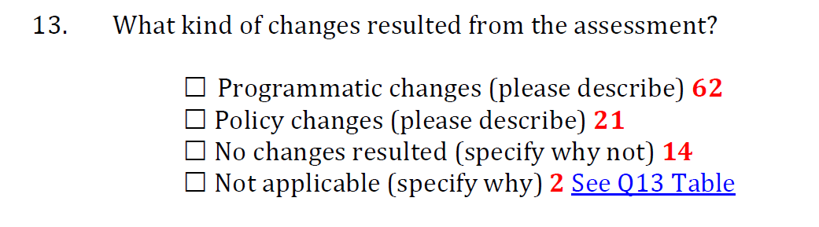
All responses are in the Summary Report

Slide 7
Examples of Assessment Results
Substantive determinations
Considered adoption of a supplemental ethics rule
Officials considered whether the current recusal policy is too broad
Updates related to the application of 18 USC 205 to agency activities

Slide 8
Examples of Assessment Results
Training
For the initial ethics training, the plan is to offer the course three times each month (instead of once a month) to ensure new employees receive the training within 90 days
For the annual training, the Directorates…will conduct "all hands meetings" with leaders assisting representatives from OGC to discuss current ethical concerns and cover the requisite training topics
Enterprise risk management assessment that resulted in revisions to the format and content of annual training, and development of a new ethics communication plan for 2020

Slide 9
Examples of Assessment Results
Technology
Instituted SharePoint tracker to track incoming requests for ethics advice and opinions.
Automating ethics programs for easy information storage, retrieval, and utilization. Examples include: greater use of ethics inter and intranet websites, connecting different databases such as HR employee records and ethics records tracking systems
IT network access will be disabled for any employee who does not complete mandatory ethics training by the required due date

Slide 10
Examples of Assessment Results
Staffing
Assigned additional attorneys to assist with OGE 450 reviews again since last year's first time was determined to be a success.
The DAEO made policy changes with regard to which attorneys would be identified as ethics counselors. Only those actually attending ethics training and working ethics issues on a consistent basis would be so designated.
Agency leadership has agreed to allow the Ethics Office to recruit various employees from other offices to serve in a temporary capacity until we are able to hire full-time staff to replace staff that separated from the Agency

Slide 11
Examples of Assessment Results
Intra-Agency Coordination
Working to have to have Compliance and Business Integrity staff serve as ethics advisors on basic government ethics issues. This will leverage assets in place at Medical Centers, increasing access to local ethics advisors. OGC ethics officials will remain the primary government ethics advisors.
MOU between the DAEO and HR to notify new employees for training and filing, new supervisors and terminations of OGE 278 and appointments of OGE 278. Also implemented a bi-weekly notices from HR to OGC regarding all new employees to ensure we catch all new filers and track all new training requirements. resulted in…increasing staffing and resources across the ethics program

Slide 14
Agenda
Background
Program Practices: how do other agencies assess and evaluate?
Benchmarking: key compliance rates
OGE consultation for agency-specific benchmarking

Slide 15
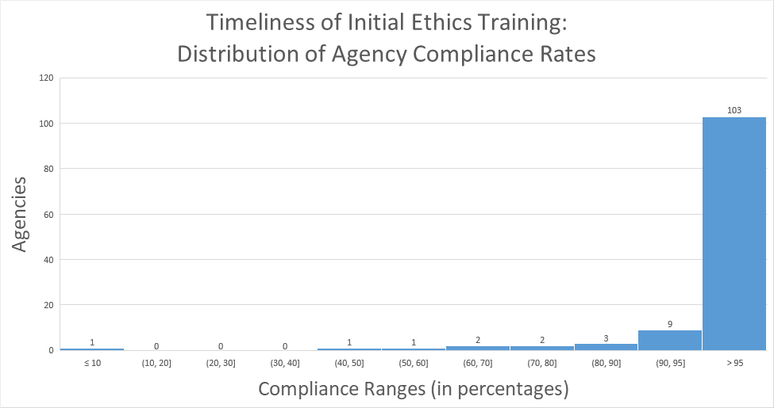

Slide 16
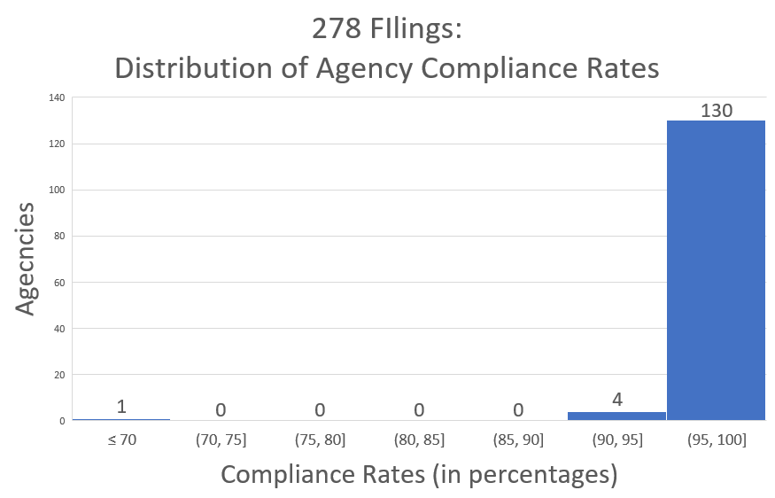
* The Questionnaire asks whether 278s were filed, but does not ask whether they were filed timely

Slide 17
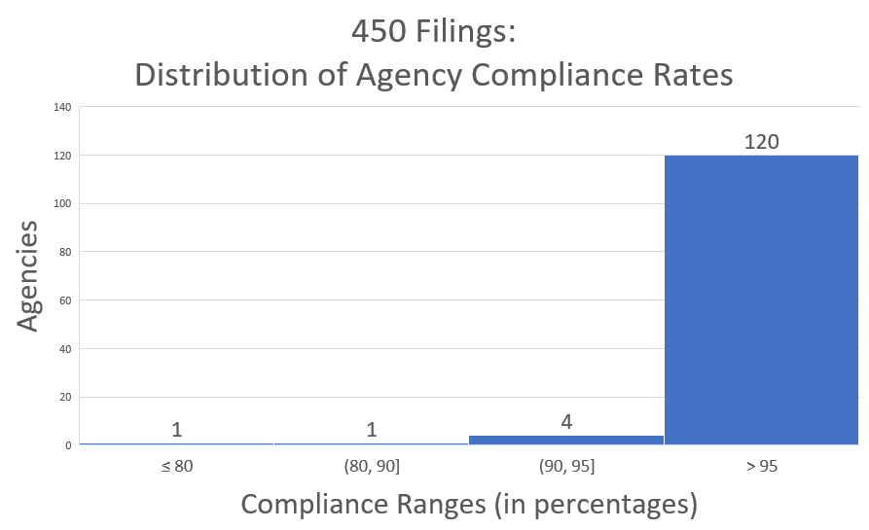
* The Questionnaire asks whether 450s were filed, but does not ask whether they were filed timely

Slide 18
Agenda
Background
Program Practices: how do other agencies assess and evaluate?
Benchmarking: key compliance rates
OGE consultation for agency-specific benchmarking

Slide 19
Benchmarking – what do you want to know?
For similarly-sized agencies
For agencies with similar missions (regulatory, financial, medical, etc.)
Percent of time A/DAEOs report spending on ethics?
Staffing?
Use of contractors?
Frequency of waivers?
Frequency of financial disclosure extensions, fee waivers?
SGE filing requirements?
Something else?

Slide 20
OGE consultation on benchmarking… What do you want to know?
Wendy Pond
Senior Desk Officer
wgpond@oge.gov
Notes:
Election

