Slide 1
Communicating with Incoming Leadership

Slide 2
The big picture.
Audiences
Messengers
Messages
Methods
Frequency

Slide 3
Audience: Incoming Officials
Agency Head
Other PAS
Other Appointees

Slide 4
Messages: Start at the beginning.
Unique character of public service
Significance of the oath of office
Importance of your agency’s mission
Value of the public’s trust

Slide 5
“I commit to decision making on the merits and exclusively in the public interest, without regard to private gain or personal benefit.”
-E.O. 13989

Slide 6
“While we each took our oath of office individually, with that oath we joined a community of
public servants. One of our most important responsibilities as leaders is to ensure that the public
servants we lead understand and are fully committed to our singular duty: to serve the public.
With this in mind, I encourage you to regularly remind your team of this duty; to reiterate that
your agency has dedicated and well-supported ethics officials to help with the tough issues; and to
always consider your own oath as you carry out your important duties.”
-OGE Director’s Letter to Incoming PAS Officials

Slide 8
Messages: Get to know my friend Monroe.
Facts
Law
Analysis
Conclusion

Slide 9
Messages: Get to know my friend Monroe.
Facts
Law
Analysis
Conclusion
Attention
Problem/Need
Solution/Satisfaction
Visualization
Call to Action

Slide 10
Attention
Problem
Solution
Visualization
Call to Action

Slide 11
Messages: Get to know my friend Monroe.
Attention: Public service is different!
Problem: Without the public’s trust we cannot succeed. (all the bad stuff)
Solution: We must work together to ensure the public trusts our motives by (ways ethics office can help).
Visualization: In (unit of time) time we can look back at (agency accomplishment).
Call to action: You can help us protect trust by (whatever you need them to do).

Slide 12
Messages: Get to know my friend Monroe.
Attention: Using social media improperly could get you fired!
Problem: Failing to follow ethics rules on social media is dangerous for your career and our organization.
Solution: Come to ethics training for social media users.
Visualization: Imagine, after training you can confidently use social media at work and in your personal capacity without fear.
Call to action: Register now.

Slide 13
Methods and Messengers
Briefings (EOs)
Memos (DAEO, Agency Head, Other Leadership)
Speeches (Agency Head, Other Leadership)
Reminders (EOs, Supervisors, Others)
Training (DAEO, EOs)

Slide 14
Frequency
Short messages and nudges often.
Longer messages less often.

Slide 15
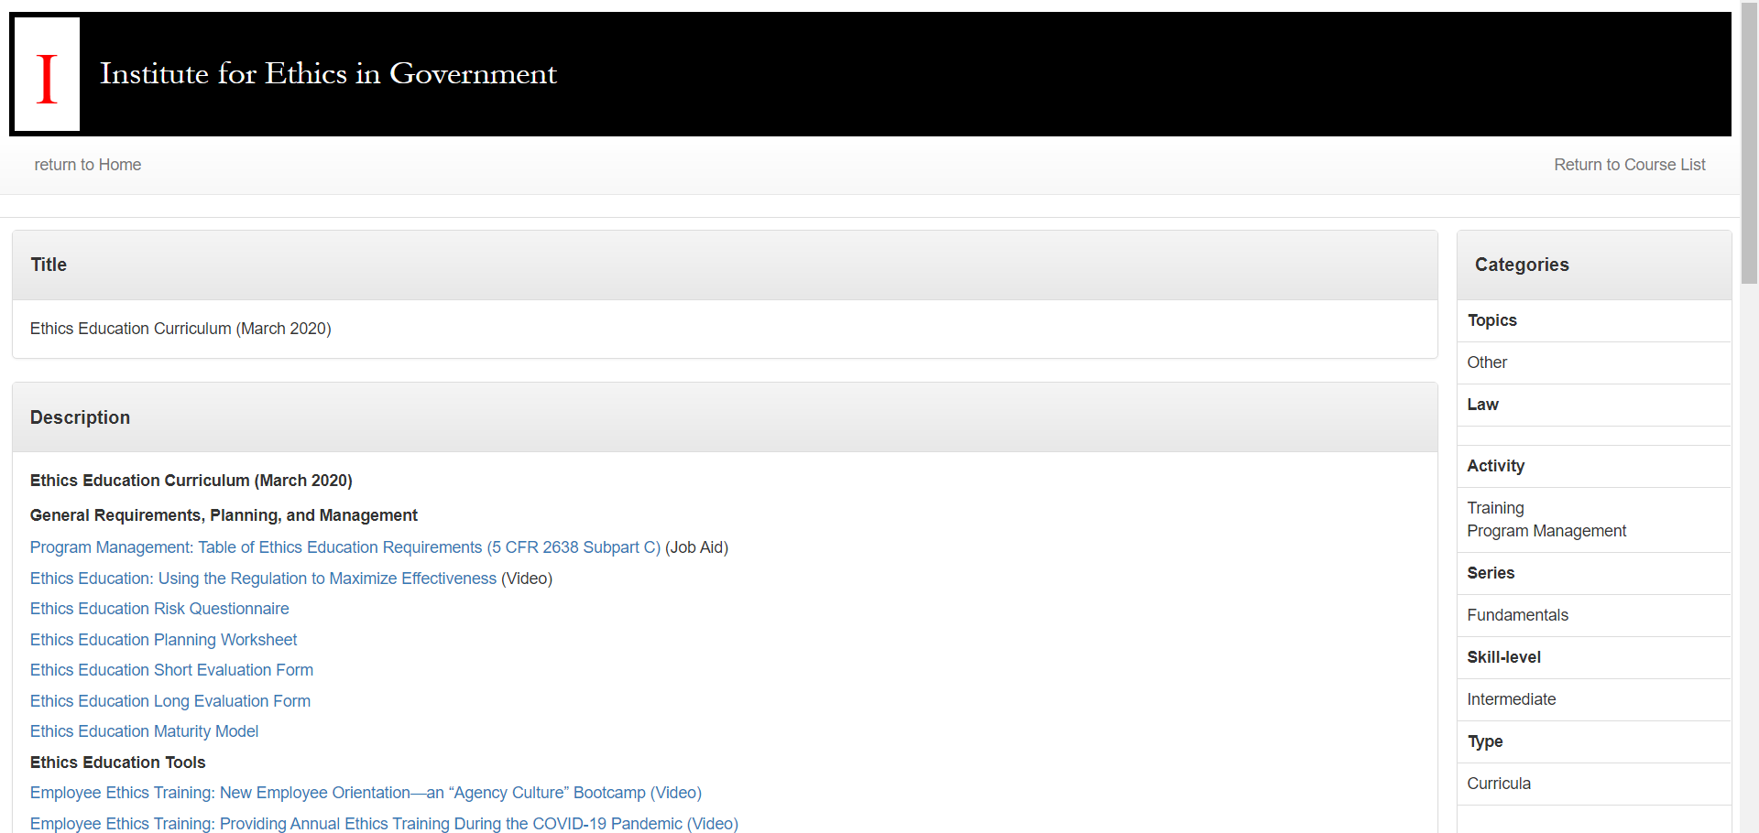
Resources

Slide 16
Resources

Slide 17
Resources

Slide 18
OGE is here to help.
For DAEOs/ADAEOs: Register below for an individualized consultation with the IEG instructors.
Consultations can help your agency:
Identify key audiences
Develop messages
Identify appropriate messengers
Plan strategic communications
Think through appropriate communication tactics

Slide 19
Final thoughts.
This work is about persuasion.
We’re trying to change the way people act in the workplace and beyond.
We’re helping to create and reinforce culture.
We should use the correct tools for this task.
OGE can help.

Slide 20
Thank you.

