Slide 1
Making Sense of
Particular Matters
Helen Eisner
Kim Sikora Panza

Slide 2


Matters
Particular Matters of General Applicability
Particular Matters Involving
Specific Parties

Slide 3
Matters
Particular Matters
of General Applicability
Particular Matters
Involving Specific
Parties

Slide 4
Matters
= Really Broad Matters
Matters
Particular Matters
of General Applicability
Particular Matters
Involving Specific
Parties

Slide 5
Matters
= Really Broad Matters
Matters
Particular Matters
of General Applicability
Particular Matters
Involving Specific
Parties
Advisory Panel Deliberations on Tax Reform
Regulations changing method of calculating depreciation

Slide 6
Particular Matter
Matters
Particular Matters
of General Applicability
Particular Matters
Involving Specific
Parties

Slide 7
Particular Matter
Matters
Particular Matters
of General Applicability
Particular Matters
Involving Specific
Parties

Slide 8
Particular Matters of General Applicability
Matters
= Narrower matters that are focused on a discrete and identifiable class
Particular Matters
of General Applicability
Particular Matters
Involving Specific
Parties

Slide 9
Particular Matters of General Applicability
Matters
= Narrower matters that are focused on a discrete and identifiable class
Particular Matters
of General Applicability
Particular Matters
Involving Specific
Parties
Truck safety regulations
Legislation focused on compensation and working conditions of AUSAs

Slide 10
Particular Matters Involving Specific Parties
Matters
= A very limited group of identified parties is involved in the matter
Particular Matters
of General Applicability
Particular Matters
Involving Specific
Parties

Slide 11
Particular Matters Involving Specific Parties
Matters
= A very limited group of identified parties is involved in the matter
Particular Matters
of General Applicability
Particular Matters
Involving Specific
Parties
Review of proposed merger between 2 companies
Approval of certain drug company’s application

Slide 12
Matters
Particular Matters
of General Applicability
Particular Matters
Involving Specific
Parties

Slide 13
Matters
Particular Matters of General Applicability
Particular Matters Involving Specific Parties

Slide 14
Matters
Particular Matters
of General Applicability
Particular Matters
Involving Specific
Parties

Slide 15
Matters
Particular Matters
of General Applicability
Particular Matters
Involving Specific
Parties

Slide 16
Matters
Particular Matters
of General Applicability
Particular Matters
Involving Specific
Parties

Slide 17


Slide 18
Matters - 207(c) (d), 807(a)(2)(i)(E)(1)
Matters
Particular Matters
of General Applicability
Particular Matters
Involving Specific
Parties

Slide 19
Particular Matters - 203, 205, 208, 502(a)(2)
Matters
Particular Matters
of General Applicability
Particular Matters
Involving Specific
Parties

Slide 20
Particular Matters Involving Specific Parties - 207(a), 205(c), & 203(c)
Matters
Particular Matters
of General Applicability
Particular Matters
Involving Specific
Parties

Slide 22
Particular Matter
Matters
Particular Matters
of General Applicability
Particular Matters
Involving Specific
Parties

Slide 23
Particular Matters of General Applicability
Matters
Particular Matters
of General Applicability
Particular Matters
Involving Specific
Parties

Slide 24
5 C.F.R. § 2640.102
A particular matter of general applicability means a particular matter that is focused on a discrete and identifiable class of persons, but does not involve specific parties.

Slide 25
Particular Matter of General Applicability: Components
Discrete and Identifiable Class
  - Shared characteristics or traits, distinguishable from the general population

Slide 26

Particular Matter of General Applicability: Components
Discrete and Identifiable Class
  - Shared characteristics or traits, distinguishable from the general population
The Matter is Focused

Slide 27


Slide 28


Slide 29


Slide 30

Roadmap for Analysis
  How broad or narrow is the focus of the matter? Is the matter directed to a group of individuals or entities?
  Is the class that the matter focuses on discrete and identifiable from the general population?
  Does the matter have a distinct impact on a class that is separate from the impact of the matter on the general population?

Slide 31
Matters
Particular Matters
of General Applicability
Particular Matters
Involving Specific
Parties

Slide 32
Particular Matters Involving Specific Parties
Matters
Particular Matters
of General Applicability
Particular Matters
Involving Specific
Parties

Slide 33
Matters
Matters
Particular Matters
of General Applicability
Particular Matters
Involving Specific
Parties

Slide 34


Slide 35
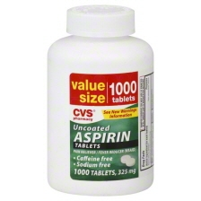

Aspirin Example

Slide 37
Particular Matter Analysis Stands Alone!

Slide 38
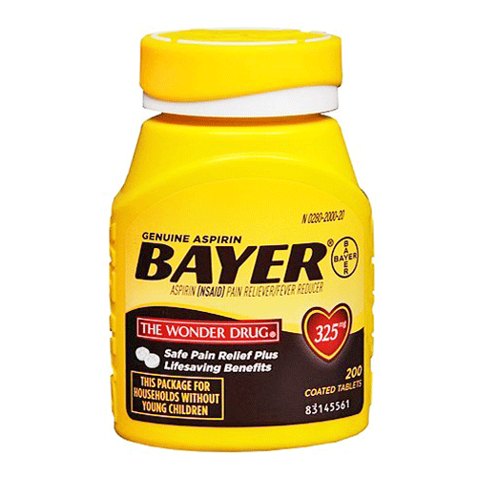
Aspirin Example

Slide 39
Breaking Matters Up is Generally Not Required
Prescription Coverage
Hospital Reimbursement Rates
Clinical Standards
Health Care Legislation

Slide 40
18 U.S.C. § 208
Federal Open Market Committee
  Impact outside class doesn’t take it out of Particular Matter territory
Matters
Particular Matters
of General Applicability
Particular Matters
Involving Specific
Parties

Slide 41
18 U.S.C. § 208
Federal Open Market Committee
  Impact outside class doesn’t take it out of Particular Matter territory
Matters
Particular Matters
of General Applicability
Particular Matters
Involving Specific
Parties
Kuwait
  - Response to invasion different than decision to seize a particular oil field or tanker

Slide 42
5 C.F.R. § 2635.502
Matters
Particular Matters
of General Applicability
Particular Matters
Involving Specific
Parties

Slide 43
18 U.S.C. § 205
Matters
Assistant United States
Attorneys
  Discrete and
  identifiable by “virtue
  of their employing
  agency, their profession,
  and their position.”
Particular Matters
of General Applicability
Particular Matters
Involving Specific
Parties

Slide 44
18 U.S.C. § 207(a)
Matters
Particular Matters
of General Applicability
Particular Matters
Involving Specific
Parties

Slide 45
18 U.S.C. § 207(a)
Matters
Desegregation criteria
  Court-ordered criteria
  for six states vs.
  General criteria for
  investigative guidelines
Particular Matters
of General Applicability
Particular Matters
Involving Specific
Parties

Slide 46
Transitions
Case by Case analysis
  A Particular Matter arises when the deliberations turn to specific actions that focus on a certain person or a discrete and identifiable class of persons
  Specific Party Matter usually arises when the government receives an expression of interest from a prospective party

Slide 47
Matters
Particular Matters
of General Applicability
Particular Matters
Involving Specific
Parties

