Slide 1
Letters of Recommendation
Office of Government Ethics
Institute for Ethics in Government

Slide 2
Resources
5 CFR 2635.702(b)
18 USC § 205
OGE Legal Advisories
OGE 07X7
OGE 98x18

Slide 3
Misuse of Position – 5 CFR 2635.702(b)
§ 2635.702 Use of public office for private gain
An employee shall not use his public office for his own private gain, for the endorsement of any product, service or enterprise, or for the private gain of friends, relatives, or persons with whom the employee is affiliated in a nongovernmental capacity, including nonprofit organizations of which the employee is an officer or member, and persons with whom the employee has or seeks employment or business relations. The specific prohibitions set forth in paragraphs (a) through (d) of this section apply this general standard, but are not intended to be exclusive or to limit the application of this section.

Slide 4
Misuse of Position – 5 CFR 2635.702(b)
(b) Appearance of governmental sanction. Except as otherwise provided in this part, an employee shall not use or permit the use of his Government position or title or any authority associated with his public office in a manner that could reasonably be construed to imply that his agency or the Government sanctions or endorses his personal activities or those of another. When teaching, speaking, or writing in a personal capacity, he may refer to his official title or position only as permitted by § 2635.807(b). He may sign a letter of recommendation using his official title only in response to a request for an employment recommendation or character reference based upon personal knowledge of the ability or character of an individual with whom he has dealt in the course of Federal employment or whom he is recommending for Federal employment.

Slide 5
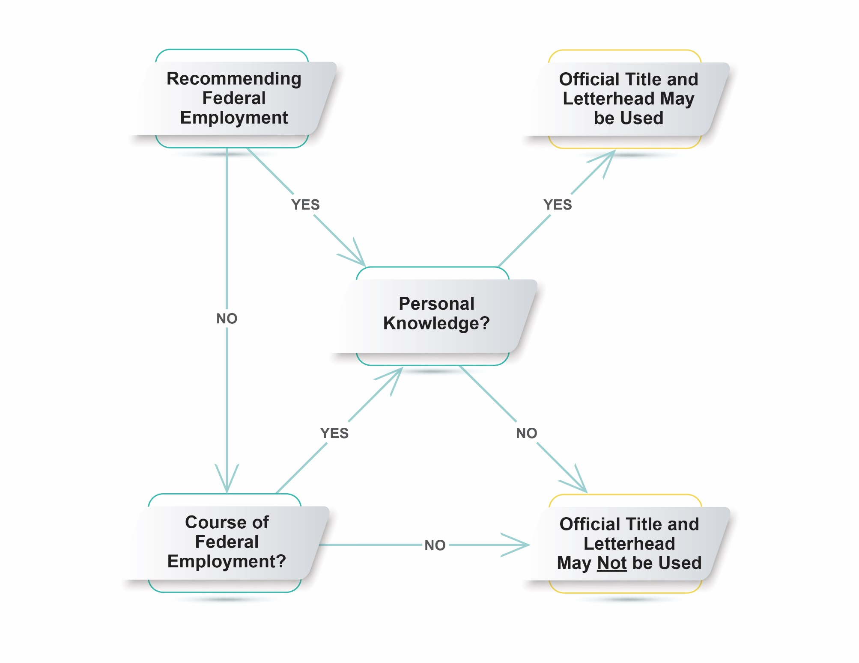

Slide 6
Can official title/letterhead be used?
Former colleague applying to work for FTC
Junior associate from a previous law firm applying to a bank
Fellow attendee at a work conference requests a recommendation for a position at a university

Slide 7
18 USC § 205
Activities of officers and employees in claims against and other matters affecting the Government
(a)Whoever, being an officer or employee of the United States in the executive, legislative, or judicial branch of the Government or in any agency of the United States, other than in the proper discharge of his official duties—
(1)acts as agent or attorney for prosecuting any claim against the United States, or receives any gratuity, or any share of or interest in any such claim, in consideration of assistance in the prosecution of such claim; or
(2)acts as agent or attorney for anyone before any department, agency, court, court-martial, officer, or civil, military, or naval commission in connection with any covered matter in which the United States is a party or has a direct and substantial interest;
shall be subject to the penalties set forth in section 216 of this title.

Slide 8
Immigration Support Letters
OGE 07x7 – Immigration Support Letters and 18 USC § 205
“… when determining whether a Federal employee acted as another’s agent for purposes of Section 205 by writing and submitting an immigration support letter, the critical factor to consider is whether the Federal employee was under the control of the alien on whose behalf the letter was submitted.”

Slide 9
Further Considerations with Letters
Are they acting as an agent or attorney?
18 USC § 205
Are they receiving compensation for representational services?
18 USC § 203
Are they being compensated by an outside source for performing their official duties?
18 USC § 209

Slide 10
Other Support Letters
OGE 98x18 – Letters of support for former supervisor in connection with sentencing proceedings against the former employee
Such letters are of the ilk of “character references” and involve “self-representation”
Not subject to control or direction by former supervisor
No 18 USC § 205 issue
Federal employees may use title and letterhead

Slide 11
Exercise 1
Yolanda is a scientist at the National Science Foundation. At her previous university job, she supervised James, another scientist. James is applying for a position at the Food and Drug Administration and asks Yolanda if she would be willing to submit his prospective supervisor at FDA a written reference for him.
Is Yolanda permitted to write the reference for James on NSF letterhead? May she sign the letter using her official title?
Does 18 USC § 205 prohibit Yolanda from writing the reference for James?

Slide 12
Exercise 2 – Inquiry from Colleague
I wanted to run a question by the ethics office. I recently got an e-mail from a high school classmate. He’s following up from our twenty year reunion. He was very interested in my work at the IRS. He’s asking if I would be willing to provide a letter of recommendation for his application with the Virginia Department of Taxation.
Can I give him a letter? How about a character reference?

Slide 13
Exercise 3 – Inquiry from Agency Deputy Director
I recently gave a presentation on our agency’s work and mission for a group of local university students. One of the attendees reached out to me to thank me for the presentation. She also requested a letter of recommendation for her application to graduate school this fall.
I’d appreciate your thoughts on this situation.

Slide 14
Exercise 4
Toni receives a request for a letter of recommendation for a leadership position at Meta. Would this be permissible?
What information should you obtain in order to give advice and make a determination?

Slide 15
Exercise 5 – Inquiry from Colleague
I received the below inquiry from a former colleague. Please advise.
I wondered if you could help me out with my visa application. My immigration attorney says that a letter from you, as a respected expert in our field, would be very helpful in demonstrating US interest to keep me in the country so that I can finish my research. If you’re willing, my attorney can draft the letter for you. I don’t want to bother you too much with this.

Slide 16
Debrief of the exercises to follow

Slide 17
Thank you!

