Slide 1
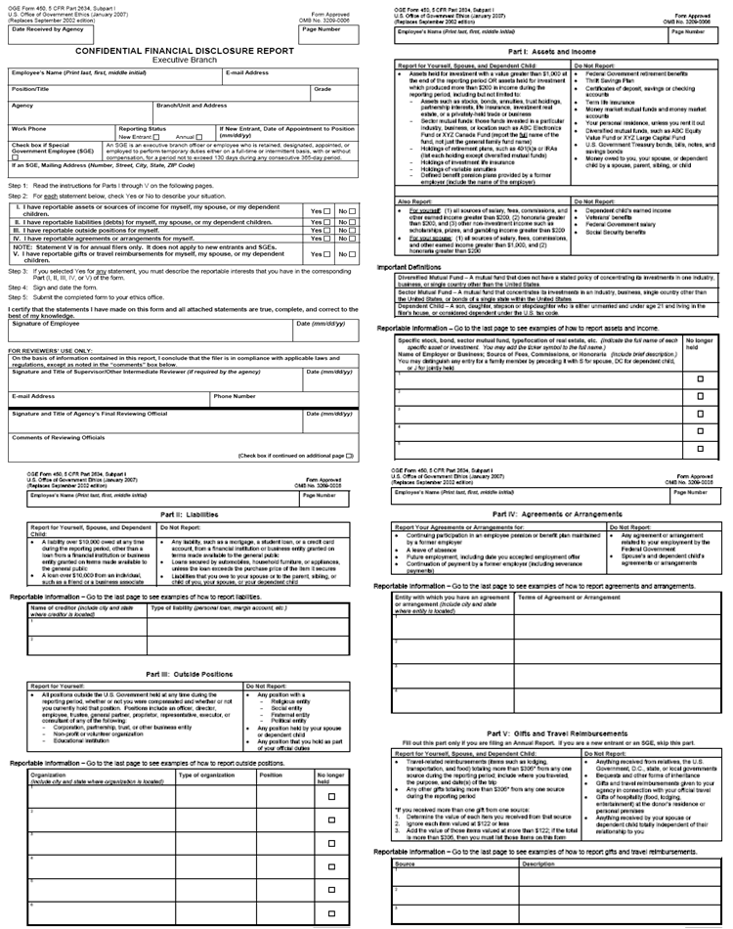
Review
Government
Duties
Org. Active
Participant
INVOLVE
Former
Employer
AFFECT
Relative’s
Employer
Household
Member or
Relative
Person with
Household
Financial Tie
Financial
To Filer
Interest
5 CFR 2635.502
IMPARTIALITY IN PERFORMING OFFICIAL DUTIES

Slide 2
Why are household financial
interests important?
Notes:
Briefly go over list.

Slide 3
Notes:
Briefly go over list.

Slide 4
Why are “covered relationships” important?
Notes:
Briefly go over list.

Slide 5
Personal and Business Relationships Analyses
Covered Relationships 5 CFR § 2635.502(a) | 502 Financial Interests 5 CFR § 2635.502(a) | Other Appearances 5 CFR § 2635.502(a)(2)
Is there a particular matter involving specific parties? | Is there a particular matter involving specific parties?
Is there a covered relationship? | Is the matter likely to have a direct and predictable effect on household member’s financial interest?
Is the person with whom the employee has a covered relationship a party to the matter? OR Does the person with whom the employee has a covered relationship represent a party to the matter?
Would a reasonable person with knowledge of the relevant facts question the employee’s impartiality? | Would a reasonable person with knowledge of the relevant facts question the employee’s impartiality? | Would a reasonable person with knowledge of the relevant facts question the employee’s impartiality? (optional)

Slide 6
Covered Relationship
Reasonable Person
Question
Notes:
Briefly go over list.

Slide 7
Household $ Interest
Reasonable Person
Question
Notes:
Briefly go over list.

Slide 8
??????????
Reasonable Person
Question
Notes:
Briefly go over list.

Slide 9
Review
Review
Government
Duties
Org. Active
Participant
Filer’s Financial
AFFECT
INVOLVE
Interest
Former
Employer
AFFECT
Spouse, Child
Relative’s
GP Financial
Employer
Interest
Household
Organization’s
Member or
Financial
Relative
Interest
Future
Person with
Employer’s
Household
Financial Tie
Interest
Financial
To Filer
Interest
208
502
FINANCIAL
IMPARTIALITY

