Slide 1
Prepare for Success
Instructor approaches for better ethics training
Patrick shepherd
Cheryl Kane-Piasecki

Slide 2
Teaching is as much an exercise in public listening
as public speaking.

Slide 3
Objectives
Do you create objectives for yourself as an instructor?

Slide 4
Objectives
Take a moment to write down some objectives for yourself.
What would you like to see happen during the session?
How would you like to interact with participants?

Slide 5
Objectives
Do you create objectives for yourself as an instructor?
Participant-Centered Verbs | Instructor-Centered Verbs
Help | Cover
Show | Get through
Learn | Present
Confirm | Say
Listen | Tell
Evaluate | Deliver
Correct | Explain

Slide 6
Notes
What are they good for?
How do we make sure we get where we need to go?
Who’s class is this?

Slide 7
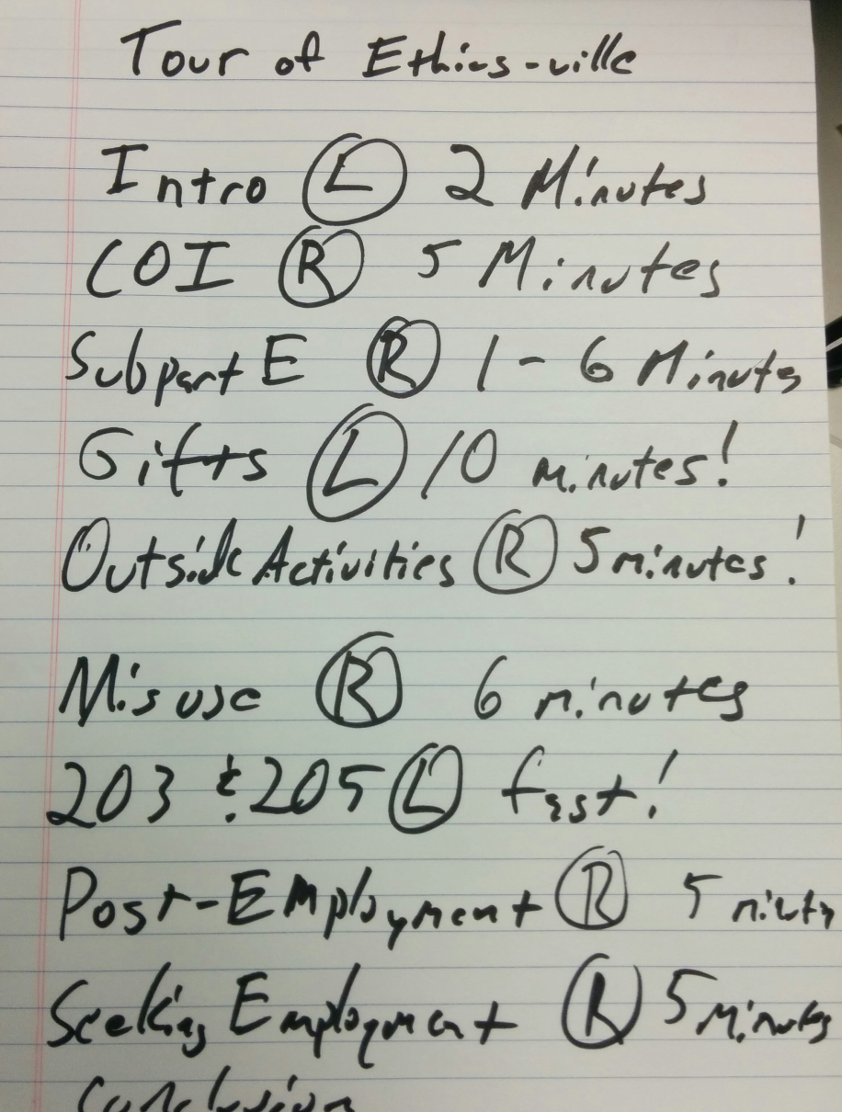
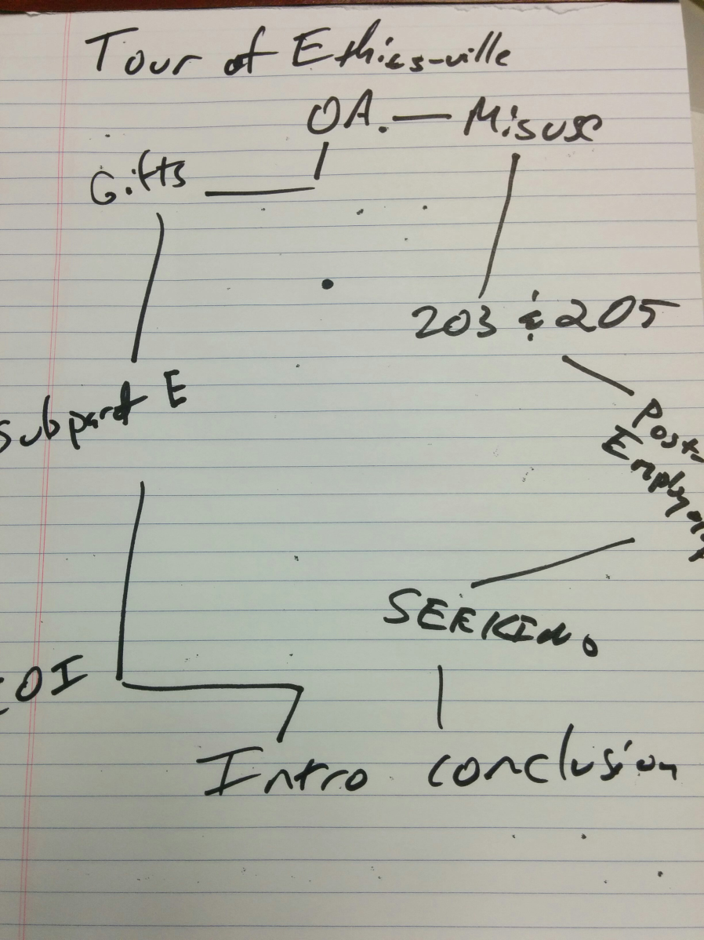
Notes
Notes:
Okay—so is this a good model?

Slide 8
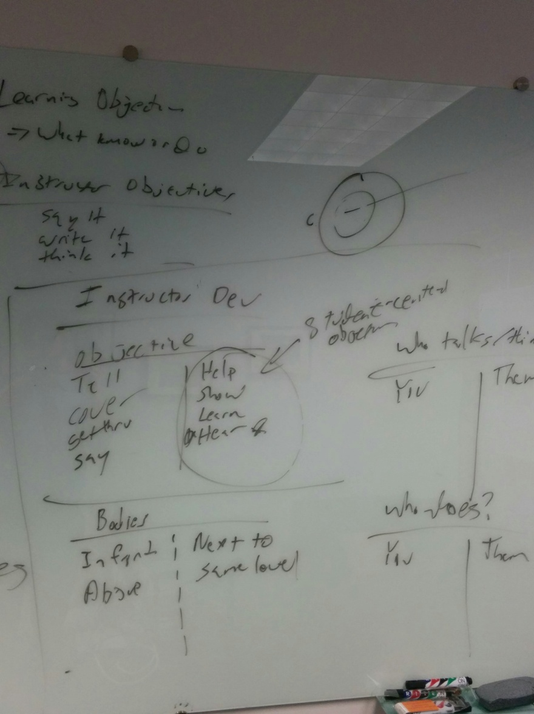
Notes

Slide 9
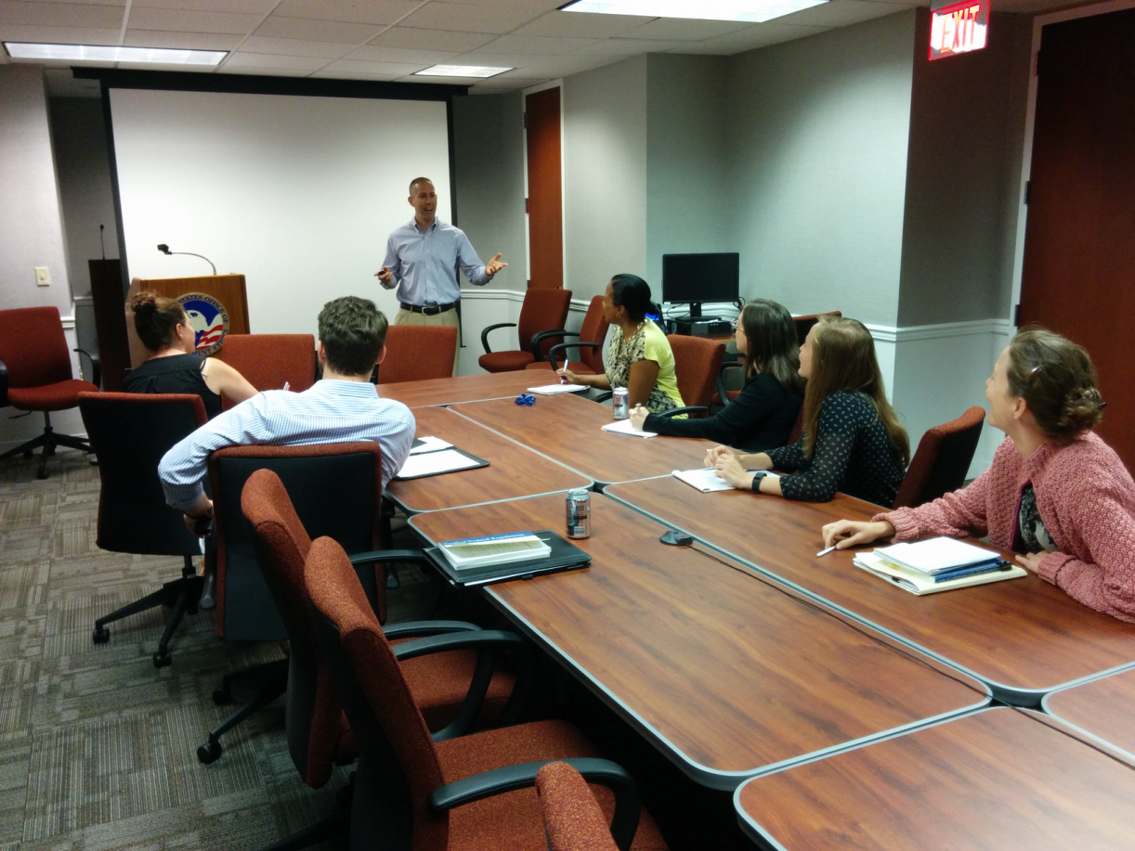
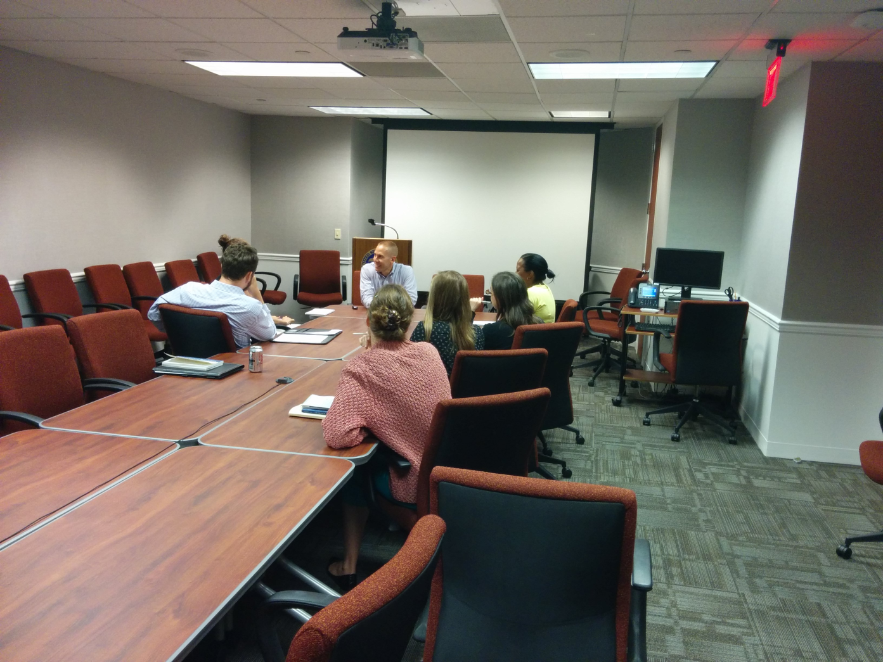
Posture and Position

Slide 10
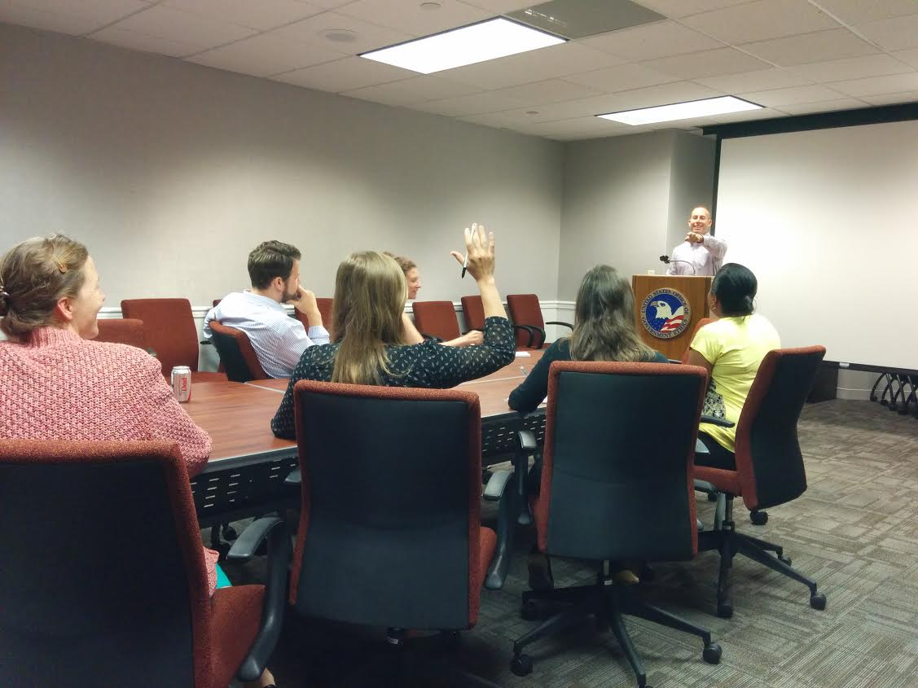
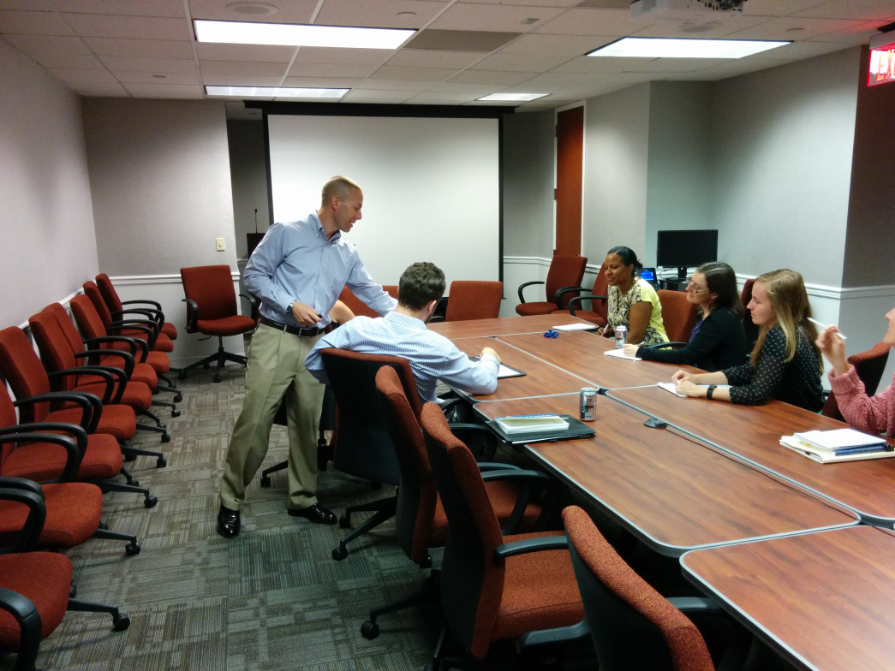
Posture and Position

Slide 11
Questions
Scary | Not Scary

Slide 12
Questions
Scary | Not Scary
Is that allowed? | What would you do first?
What is the threshold? | Does that seem okay?
What is the right answer? | What questions might we ask?
Can you do that? | Is there a principle that might help?

Slide 13
Questions
Question Sequence (Engagement) | Question Sequence (Assessment)
General (Not Scary) | Very Specific (Scary)
More Specific (Less Scary) | More Specific (Less Scary)
Very Specific (Scary) | General (Not Scary)

Slide 14
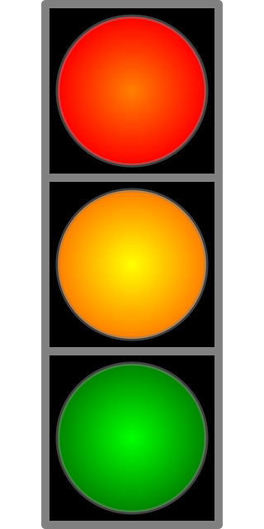
A Model
1. Intuition | 2 Principle | 3 Rule
 | Conflict of interest Public office for private gain Divided loyalty | Standards of conduct COI statute Agency supplemental Other authority

Slide 15
Your spirit of volunteerism has called you to a non-profit organization where you will assist low-income residents of DC with language interpretation and other representational services before various federal and local governmental agencies.
Serious problem
Caution warranted
No problem

Slide 16
Your spirit of volunteerism has called you to a non-profit organization where you will assist low-income residents of DC with language interpretation and other representational services before various federal and local governmental agencies.
Are there any ethics principles that might help us?

Slide 17
Your spirit of volunteerism has called you to a non-profit organization where you will assist low-income residents of DC with language interpretation and other representational services before various federal and local governmental agencies.
Divided loyalty
Influence peddling by virtue of position or information

Slide 18
Your spirit of volunteerism has called you to a non-profit organization where you will assist low-income residents of DC with language interpretation and other representational services before various federal and local governmental agencies.
Are there any specific laws or regulations that might be implicated?

Slide 19
Your spirit of volunteerism has called you to a non-profit organization where you will assist low-income residents of DC with language interpretation and other representational services before various federal and local governmental agencies.
Representational Bar—18 USC Section 205
May not act as agent or attorney for 3rd party before an employee of the US or a court or court-martial of the US
In connection with a matter in which US is party or has an interest
Subpart G of 2635—Misuse of Position

Slide 20
Works Cited
The Pen Is Mightier Than the Keyboard
Advantages of Longhand Over Laptop Note Taking
Pam A. Mueller1
Daniel M. Oppenheimer2 http://pss.sagepub.com/content/early/2014/04/22/0956797614524581.abstract

