Slide 1
18 U.S.C. § 207(a)(1)
An Overview

Slide 2
Roadmap
Introduce the Elements of 207(a)(1)
Summarize the Restrictions
Introduce a Process for Providing Prospective Advice
Assign Exercise and Provide Instructions

Slide 3
What are the elements?
18 U.S.C. § 207(a)(1)

Slide 4
Elements of 18 U.S.C. § 207(a)(1)
Permanent Ban
(Former) Employee Knowingly Make Appearance or Communication Intent to Influence To or Before an Employee of US On Behalf of Any Other Person Particular Matter Involving Specific Parties U.S. is a Party or Has a Direct and Substantial Interest Same Particular Matter
Where Participated Personally and Substantially

Slide 5
Where are the elements defined?
18 U.S.C. § 207(a)(1)

Slide 6
Implementing Regulation
5 CFR Part 2641
Subpart A - General Provisions (2641.101-106)
2641.104 - Definitions
Subpart B - Prohibitions (2641.201-207)
2641.201 - 18 USC 207(a)(1) Permanent Ban
Subpart C - Exceptions and Waivers (2641.301)

Slide 7
What does (a)(1) bar?
18 U.S.C. § 207(a)(1)

Slide 8
§ 207 (a)(1) Representational Bar
No communications or appearances
Back to employee of US
With intent to influence USG
On behalf of 3rd parties
In connection with:
Specific party matters employee worked on while USG employee

Slide 9
§ 207 (a)(1) Misconceptions
Does not bar self-representation
Does not bar behind-the-scenes assistance
Does not restrict where you can work
DOES apply to uncompensated activities

Slide 10
What is the purpose?
18 U.S.C. § 207(a)(1)

Slide 11
Purpose of § 207(a)(1)
Prevent employees from “switching sides” on the same Government matter

Slide 12
Who is covered and how long?
18 U.S.C. § 207(a)(1)

Slide 13
§ 207(a)(1) Coverage
Who is Covered: Employees who worked on specific party matters for the Government
How Long: For the lifetime of the specific party matter

Slide 14
What do I need to know to give advice?
18 U.S.C. § 207(a)(1)

Slide 15
18 USC § 207(a)(1) Simplified
Employee’s Duties Involving Specific Party Matters
Cannot Represent Others to the Government on the Same Matters
Federal Government Employment
Post- Government Employment

Slide 16
Step 1 : Identify Any Specific Party Matters
Did employee’s duties involve specific party matters?
Federal Government Employment

Slide 17
Step 2 : Identify Any Prohibited Post Employment Activities Regarding Same Matter
Will employee represent others to the Government on the same matters?
Post- Government Employment

Slide 18
FDA Employee Works on Drug Application

Slide 19
Employee’s Prospective Employer
Manufacturer of

Slide 20
No Post-Employment Communication to Government on Behalf of Another Regarding Same Matter
Federal Courts

Slide 21
How do I conduct my analysis?
18 U.S.C. § 207(a)(1)

Slide 22
Elements of 18 U.S.C. § 207(a)(1)
Permanent Ban
(Former) Employee Knowingly Make Appearance or Communication Intent to Influence To or Before an Employee of US On Behalf of Any Other Person U.S. is a Party or Has a Direct and Substantial Interest Particular Matter Involving Specific Parties Same Particular Matter
Where Participated Personally and Substantially

Slide 23
18 USC § 207(a)(1) -- The Process
Government Duties--Identify any specific party matters in which the former employee participated personally and substantially while a Government employee.
Post-employment Activities—Identify any post-employment activities employee may be contemplating.
Post-employment Matters—Identify any post-employment matters that will be subject to the restrictions.

Slide 24
18 USC 207(a)(1) -- The Process
1. Government Duties
Employee
Particular Matter Involving Specific Parties
Personal and Substantial Participation
2. Post-employment Activities
Appearance or Communication
Intent to Influence
On Behalf of Any Other Person
To or Before an Employee
3. Post-employment Matter
Same Particular Matter
US is Party or has Interest

Slide 25
Implementing Regulation
5 CFR Part 2641
Subpart A - General Provisions (2641.101-106)
2641.104 - Definitions
Subpart B - Prohibitions (2641.201-207)
2641.201 - 18 USC 207(a)(1) Permanent Ban
2641.201 includes additional definitions
Subpart C - Exceptions and Waivers (2641.301)

Slide 26
Practice Exercise
18 U.S.C. § 207(a)(1)
Materials

Slide 27
Exercise -- Susan at PTO

Slide 28
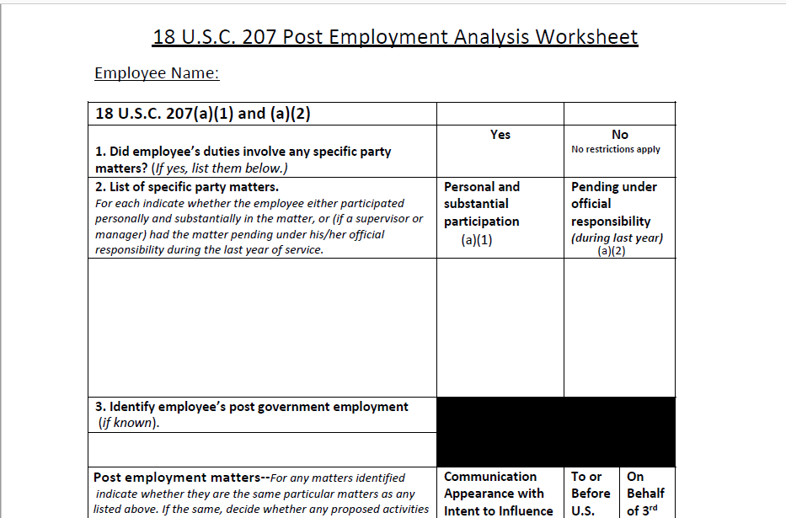
Worksheet—Only analyze (a)(1)

Slide 29
5 CFR Part 2641

Slide 30
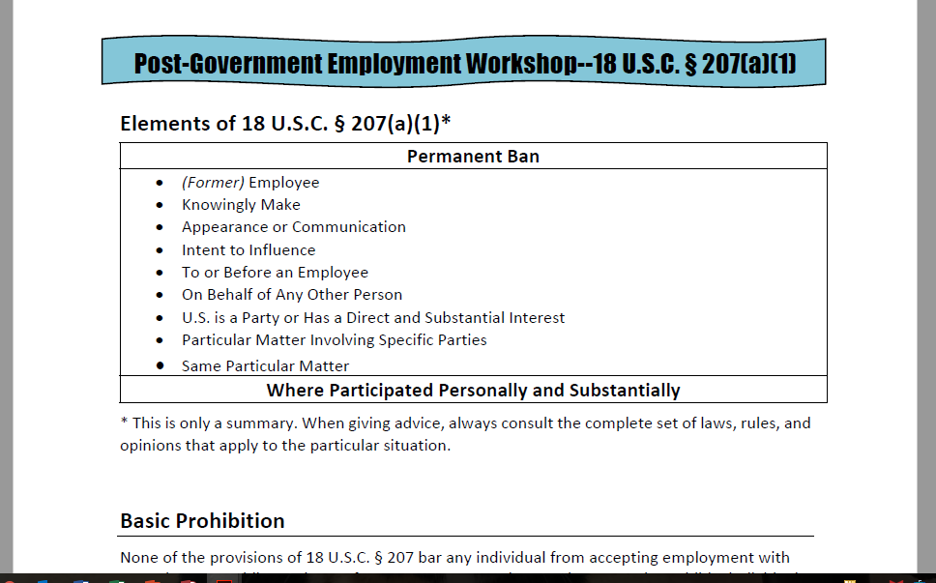
Summary of 2641

Slide 31
Practice Exercise
18 U.S.C. § 207(a)(1)
Methodology

Slide 32
Is Susan an employee?
for purposes of 18 USC § 207(a)(1)
Employee
Particular Matter Involving Specific Parties
Personal and Substantial Participation

Slide 33
Did Susan’s duties include any
particular matters involving specific parties?
Employee
Particular Matter Involving Specific Parties
Personal and Substantial Participation

Slide 34
Did Susan participate personally and substantially in any
specific party matters?
Very Low Threshold
Employee
Particular Matter Involving Specific Parties
Personal and Substantial Participation

Slide 35
What is an
appearance or communication?
Appearance or Communication
Intent to Influence
On Behalf of Any Other Person
To or Before an Employee

Slide 36
When is there an intent to influence?
Appearance or Communication
Intent to Influence
On Behalf of Any Other Person
To or Before an Employee

Slide 37
On whose behalf might Susan be making the appearance or communication?
Appearance or Communication
Intent to Influence
On Behalf of Any Other Person
To or Before an Employee

Slide 38
Whom may Susan NOT appear before or communicate with?
Appearance or Communication
Intent to Influence
On Behalf of Any Other Person
To or Before an Employee

Slide 39
What is the same
particular matter?
Same Particular Matter
US is Party or has Interest

Slide 40
When is the U.S. a party or does the U.S. have a direct and substantial interest?
Same Particular Matter
US is Party or has Interest

Slide 41
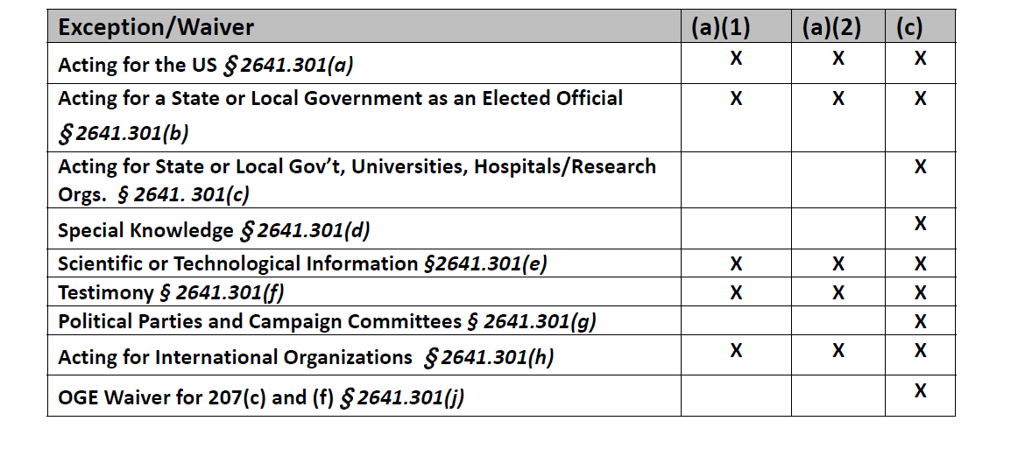
Are there any applicable exceptions?

Slide 42
Practice Exercise
18 U.S.C. § 207(a)(1)
Once you have completed the exercise proceed to the exercise debrief.

Slide 43
18 U.S.C. § 207(a)(1)
Thank You
Notes:
In our debrief of the exercise we will be using the following methodology and answering the following questions.

