Slide 1
Practice Exercise
18 U.S.C. § 207(a)(2)
Debrief

Slide 2
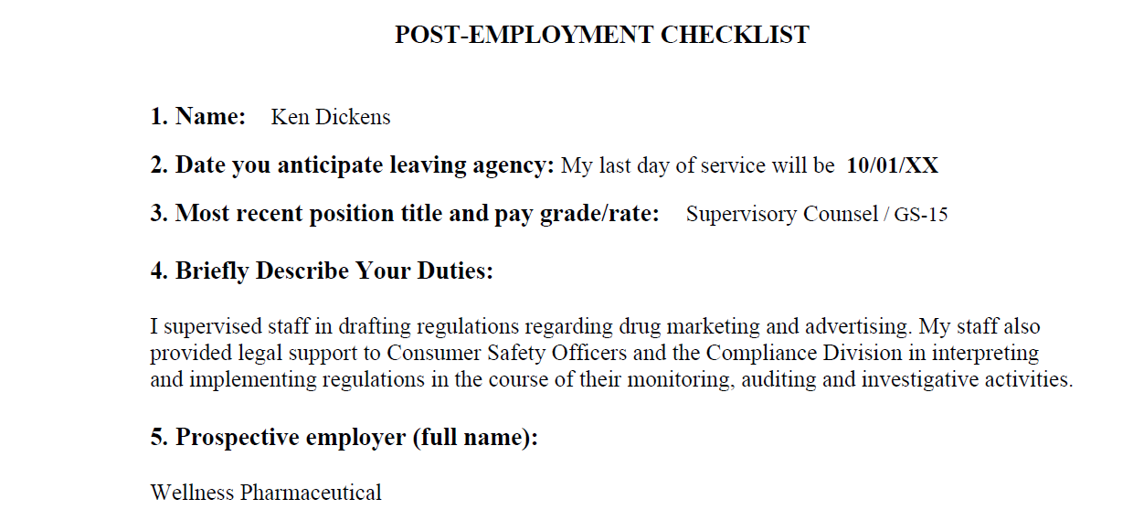
Exercise – Ken Dickens at FDA
10/01/20

Slide 3
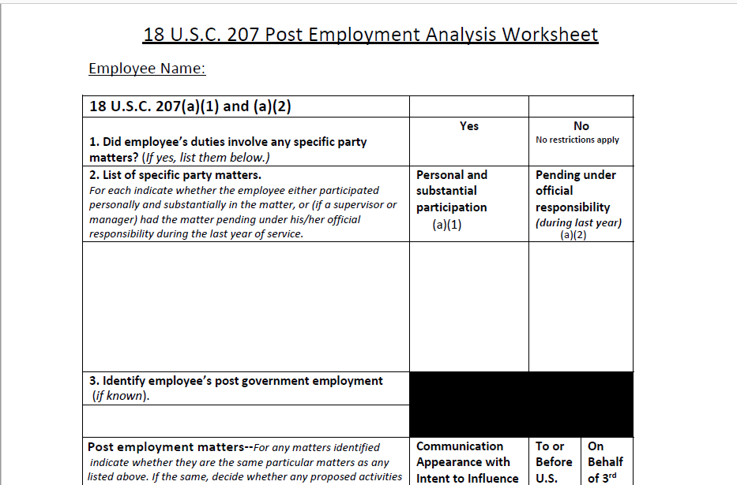
Worksheet— (a)(1) and (a)(2)

Slide 4
5 CFR Part 2641

Slide 5
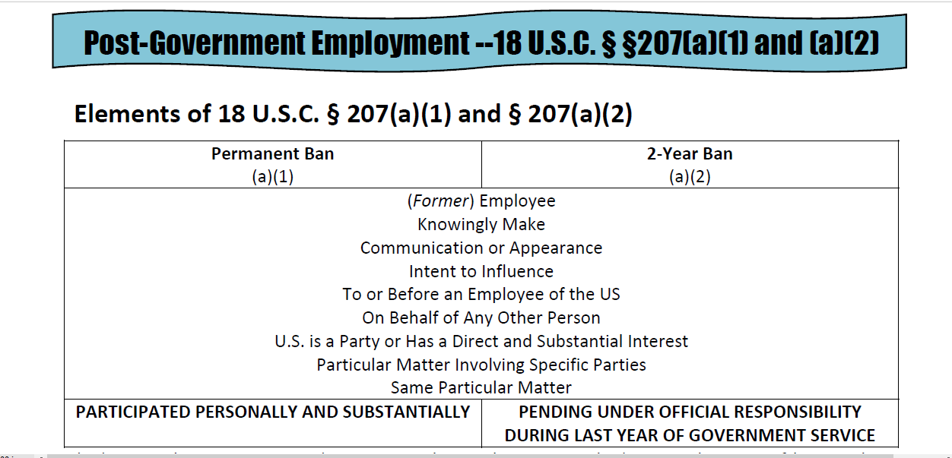
Summary of 2641

Slide 6
Practice Exercise
18 U.S.C. § 207(a)(2)
Step 1:
Identify Employee’s Government Duties

Slide 7
Is Ken an employee?
for purposes of 18 USC § 207(a)(2)
Employee
Particular Matter Involving Specific Parties
Pending Under Official Responsibility

Slide 8
Were any
specific party matters
pending under Ken’s official responsibility?
Employee
Particular Matter Involving Specific Parties
Pending Under Official Responsibility

Slide 9
Exercise – Ken Dickens at FDA
10/01/20

Slide 10
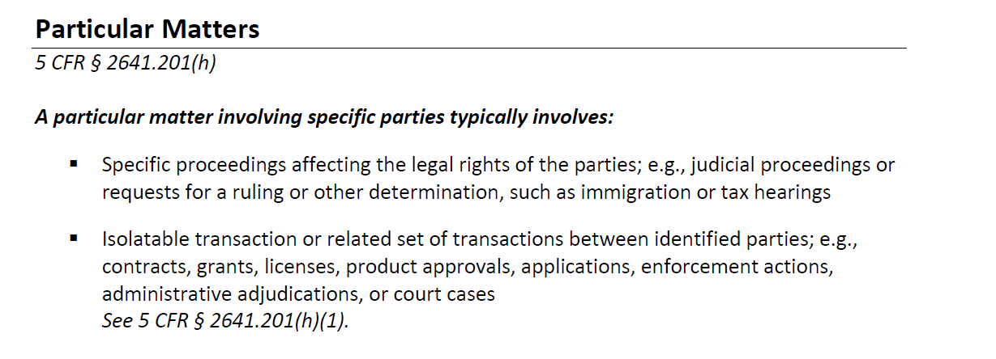
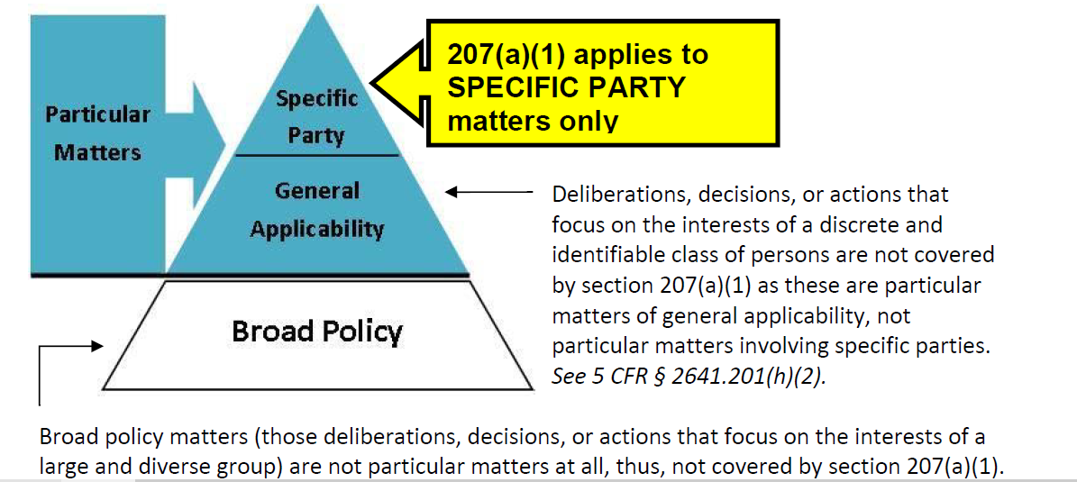

Slide 11
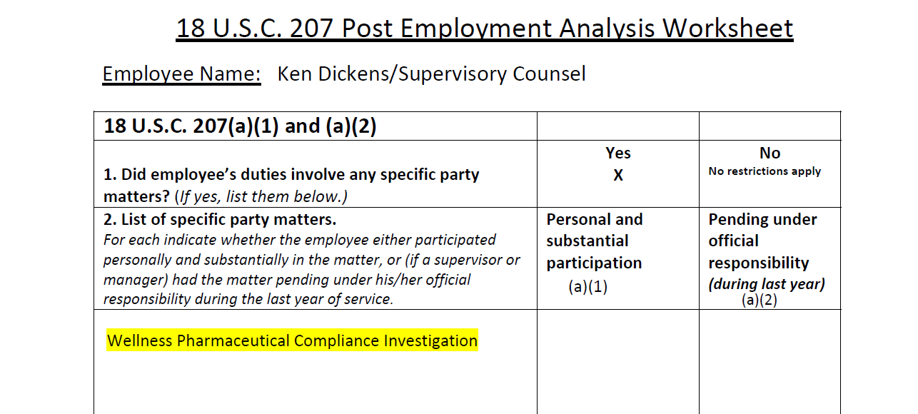

Slide 12
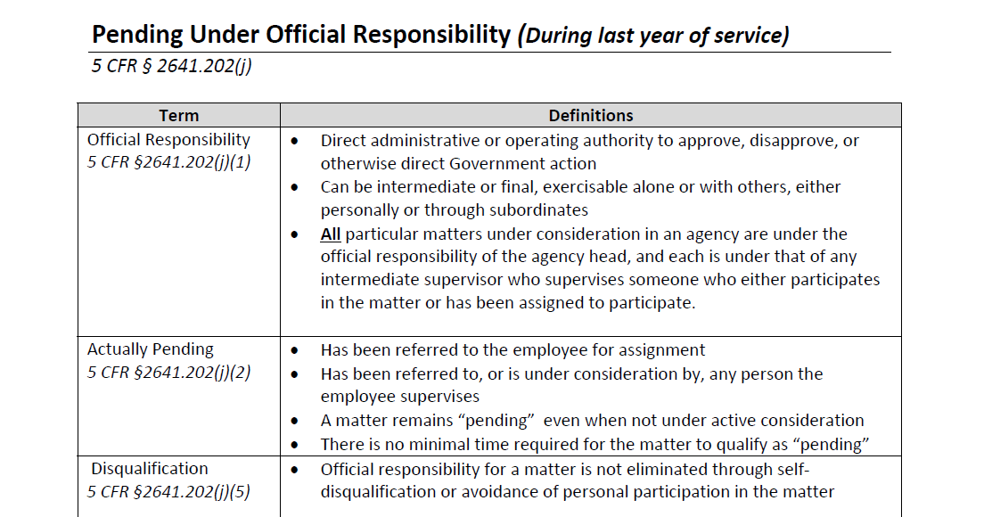
Actually pending is NOT affected by:
Leave status—see 2641.202(j)(4)
Disqualification—see 2641.202(j)(5)

Slide 13
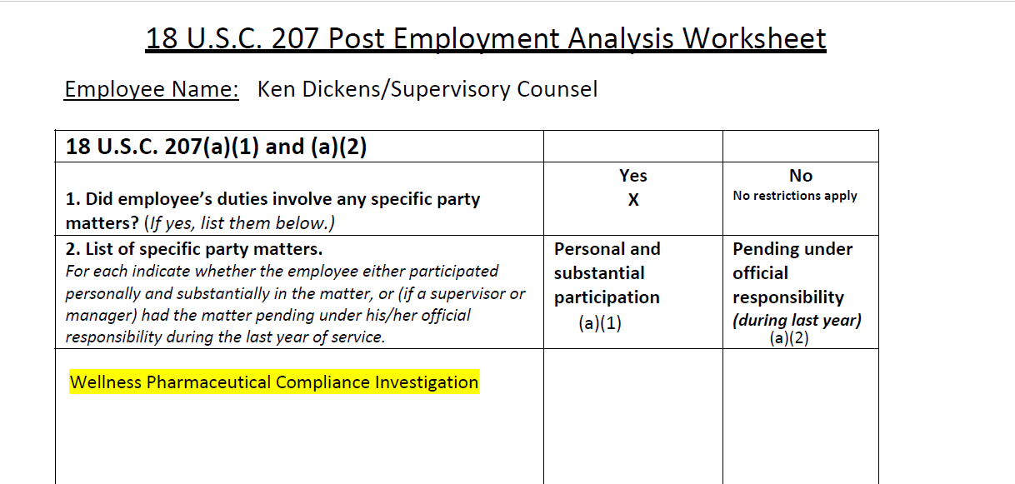
Dates
10/1/19
To 10/1/20
Questions:
What additional information do we need regarding the Wellness investigation?

Slide 14
Critical Distinctions for Supervisors
Personal and substantial
Official responsibility
Includes matters where employee has engaged in “direct and active supervision” of a subordinate
Matters employee has received for assignment to others
Matters that have been referred to or are under consideration by any person employee supervises

Slide 15
Ken’s involvement??
Questions:
What additional information do we need regarding the Wellness investigation?

Slide 16
Did Ken participate personally and substantially in any
specific party matters?
Very Low Threshold
Employee
Particular Matter Involving Specific Parties
Personal and Substantial Participation

Slide 17
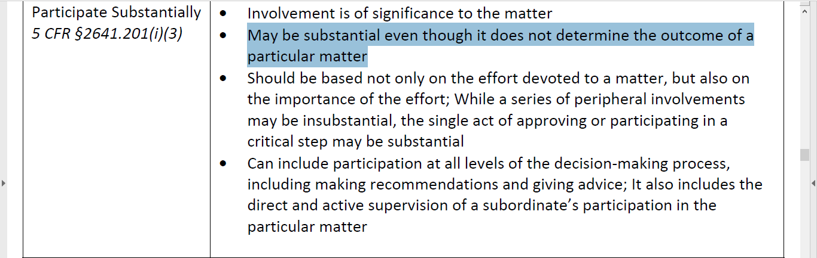

Slide 18
X?
Questions:
What about the regulatory matters that Ken and his staff worked on?

Slide 19
Matters of General Applicability
Not Covered—see 2641.201(h)(2)

Slide 20
Practice Exercise
18 U.S.C. § 207(a)(2)
Step 2:
Analyze post-employment
matters/potential restrictions

Slide 21
What is an
appearance or communication?
Appearance or Communication
Intent to Influence
On Behalf of Any Other Person
To or Before an Employee

Slide 24
Third Party Intermediary

Slide 25
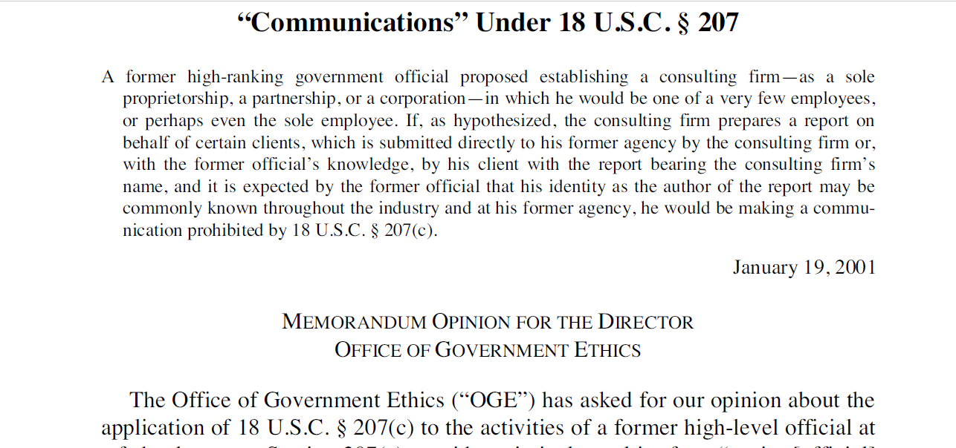
OLC Opinion-Vol 25
January 19, 2001

Slide 26
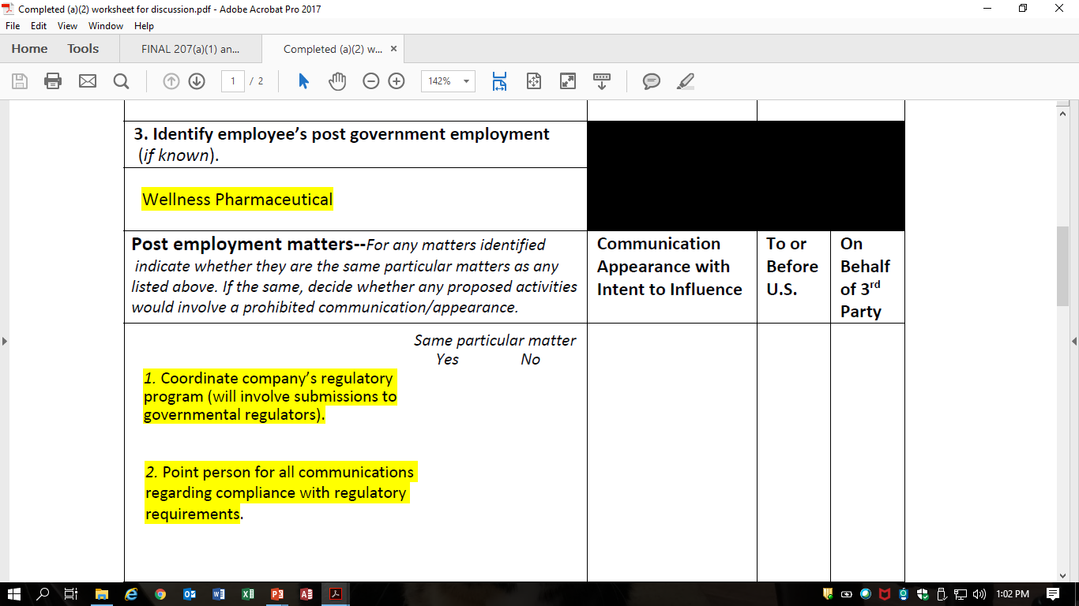
Questions:
May Ken communicate with FDA/HHS about the regulations he and his staff worked on?
May Ken submit comments on behalf of Wellness on new regulations HHS issues?
May Ken communicate with Government auditors and investigators about the Wellness compliance program?

Slide 27
When is there an intent to influence?
Appearance or Communication
Intent to Influence
On Behalf of Any Other Person
To or Before an Employee

Slide 28
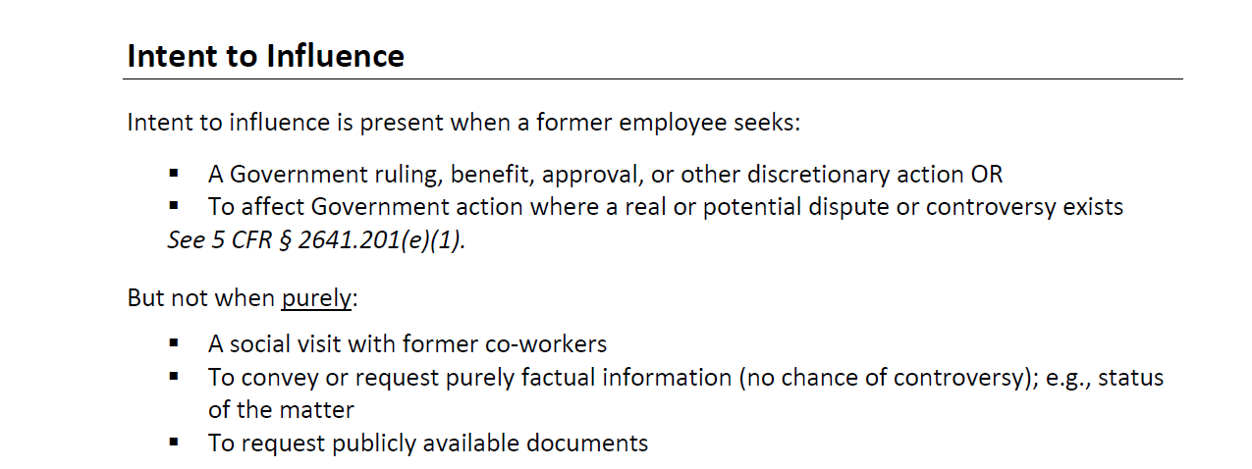

Slide 29
Intent to Influence

Slide 30
Questions:
What if Ken attends a meeting but does not speak?

Slide 31
Mere Physical Presence Intended to Influence—See 2641.201(e)(4)

Slide 32
On whose behalf might Ken be making the appearance or communication?
Appearance or Communication
Intent to Influence
On Behalf of Any Other Person
To or Before an Employee

Slide 33
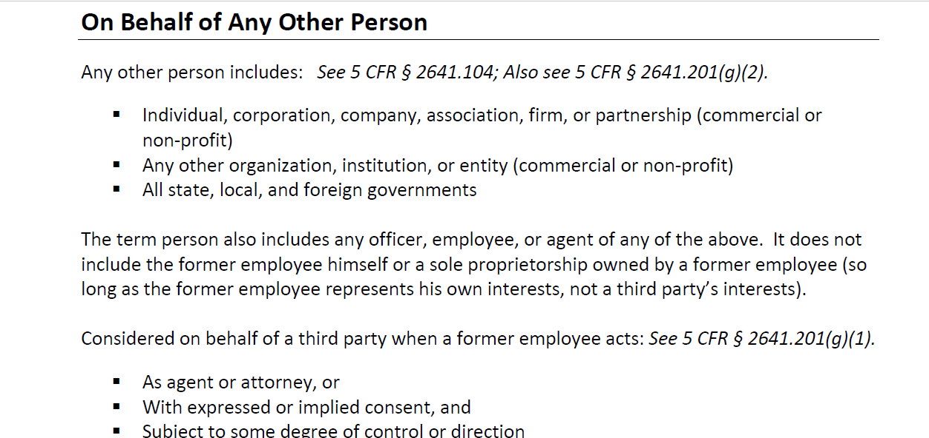

Slide 34
Preamble to Final Rule Federal Register /Vol. 73, No. 123 /Wednesday, June 25, 2008 /Rules and Regulations 36175

Slide 35
Questions:
When might Ken be deemed to be representing himself?

Slide 37
Whom may Ken NOT appear before or communicate with?
Appearance or Communication
Intent to Influence
On Behalf of Any Other Person
To or Before an Employee

Slide 38
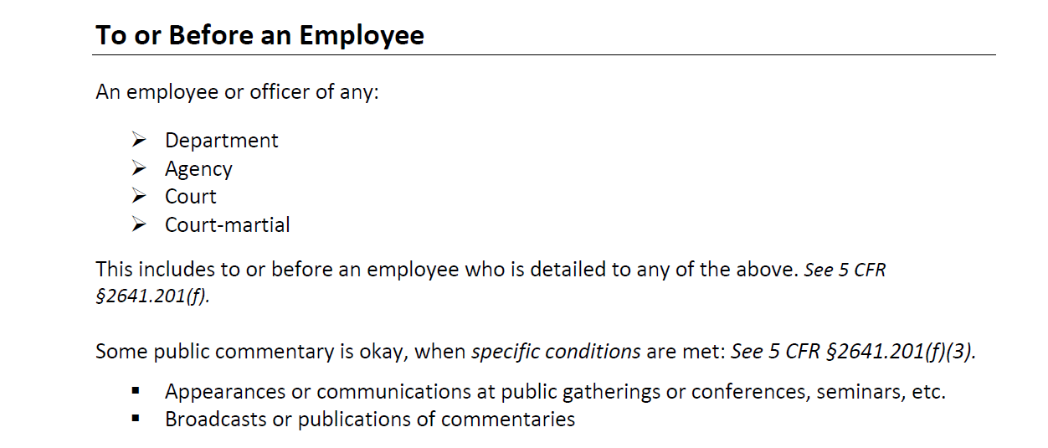

Slide 39
Questions:
Are Ken’s communications restricted only as to FDA?

Slide 40
What is the same
particular matter?
Same Particular Matter
US is Party or has Interest

Slide 42
Questions:
Might Ken have any restrictions with respect to any administrative or judicial proceeding against Wellness based upon the investigation?

Slide 43
Same specific party matter

Slide 44
When is the U.S. a party or does the U.S. have a direct and substantial interest?
Same Particular Matter
US is Party or has Interest

Slide 45
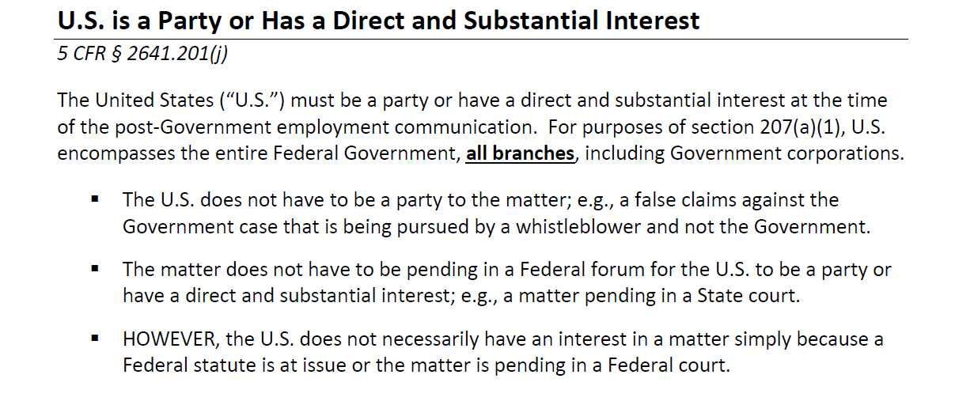

Slide 46
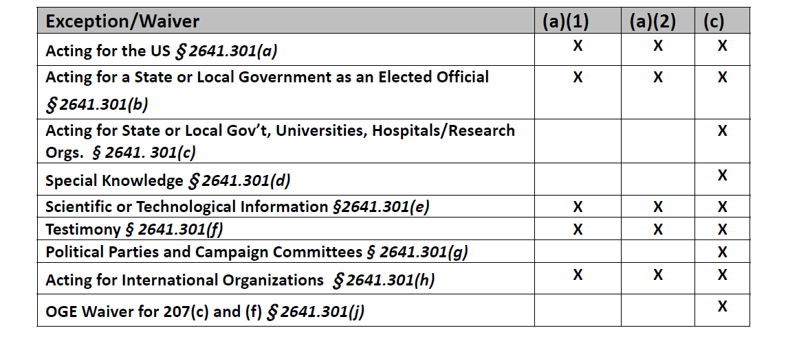
Are there any applicable exceptions?

Slide 48
Highlights of 207(a)(2)
Only applies to supervisors/managers
Applies for two-years from date of termination from government service
Applies only to matters pending under official responsibility during one year prior to termination
Restrictions otherwise are identical to (a)(1)
Can’t avoid (a)(2) through disqualification
Direct and active supervision means an (a)(1) bar

