Slide 1
new year Broadcast
OGE’s Institute for Ethics in Government Discusses its Plans for 2026

Slide 2
Closing out 2025
Apply for your 2025 Professional Ethics Practitioner (PEP) certificate by January 31.

Slide 3
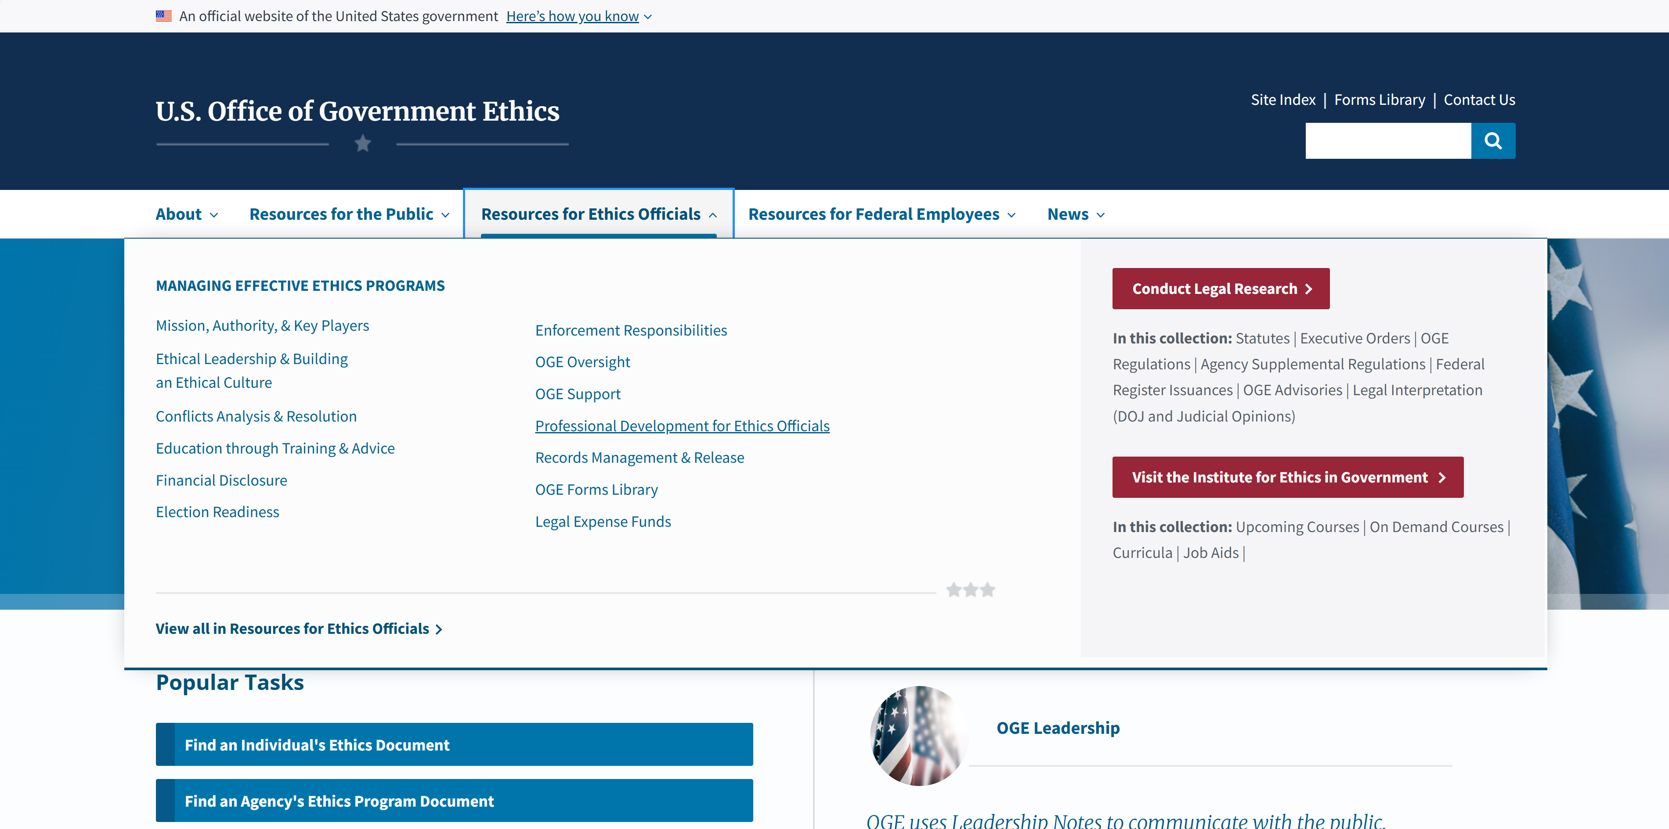
Locating Application Step 1

Slide 4
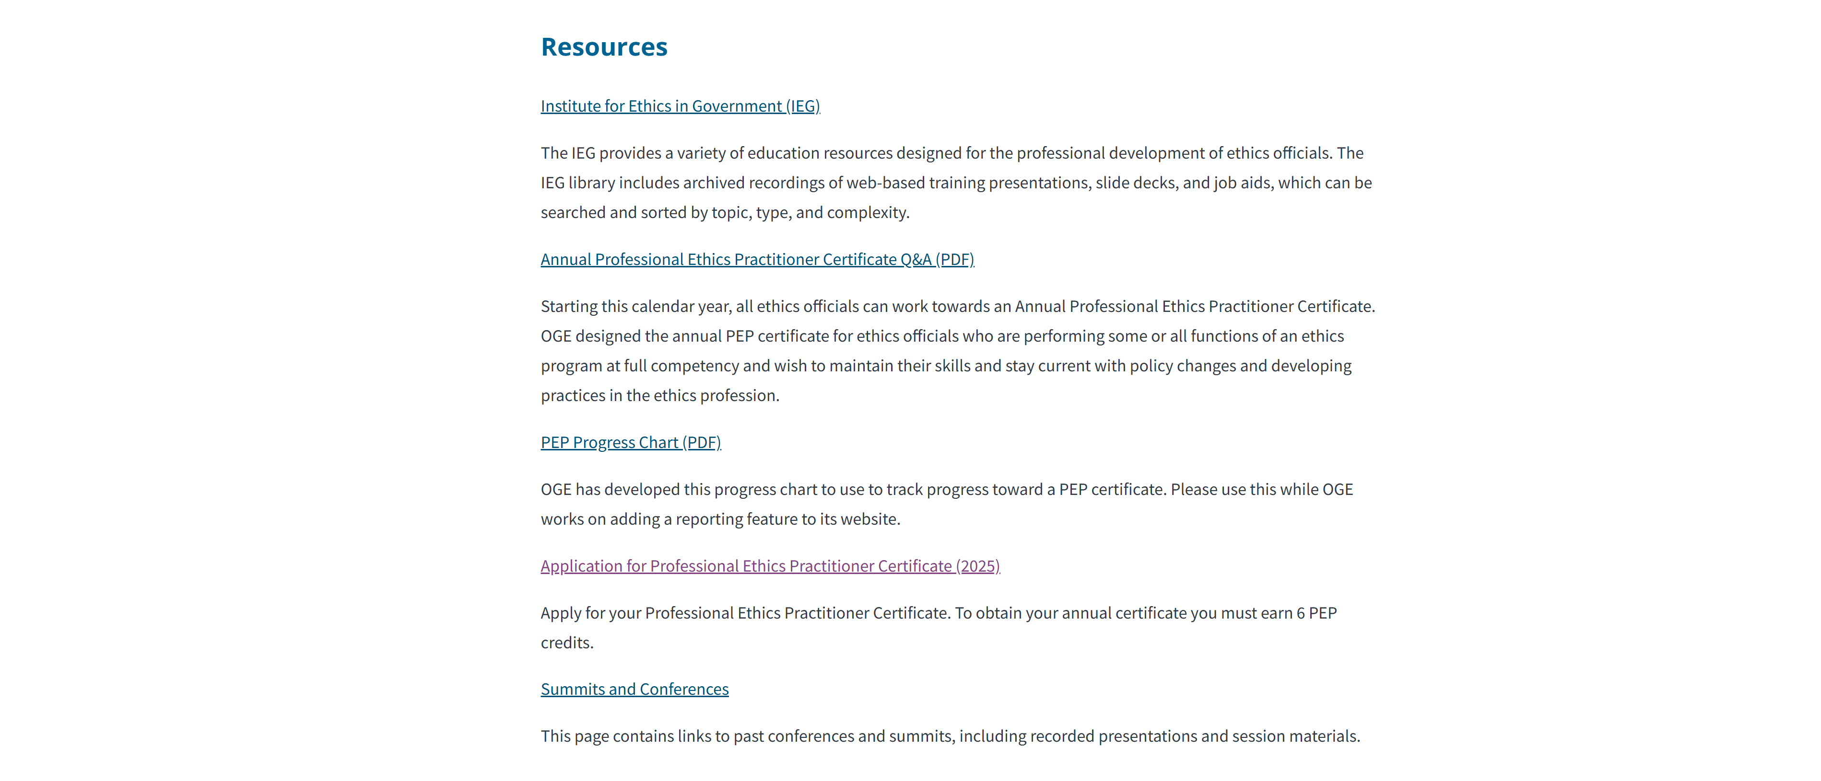
Locating Application Step 2

Slide 5
What’s new for 2026?
New Delivery Method: Live Broadcasts
New Offering: Live Course of Study
New Ways to Support the Professional Development of Ethics Program Leaders
Agency Spotlights

Slide 6
What’s new for 2026? (
2 of 4)
New Delivery Method: Live Broadcasts
New Offering: Live Course of Study
New Ways to Support the Professional Development of Ethics Program Leaders
Agency Spotlights

Slide 7
What’s new for 2026?
(3 of 4)
New Delivery Method: Live Broadcasts
New Offering: Live Course of Study
New Ways to Support the Professional Development of Ethics Program Leaders
Agency Spotlights

Slide 8
What’s new for 2026?
(4 of 4)
New Delivery Method: Live Broadcasts
New Offering: Live Course of Study
New Ways to Support the Professional Development of Ethics Program Leaders
Agency Spotlights

Slide 9
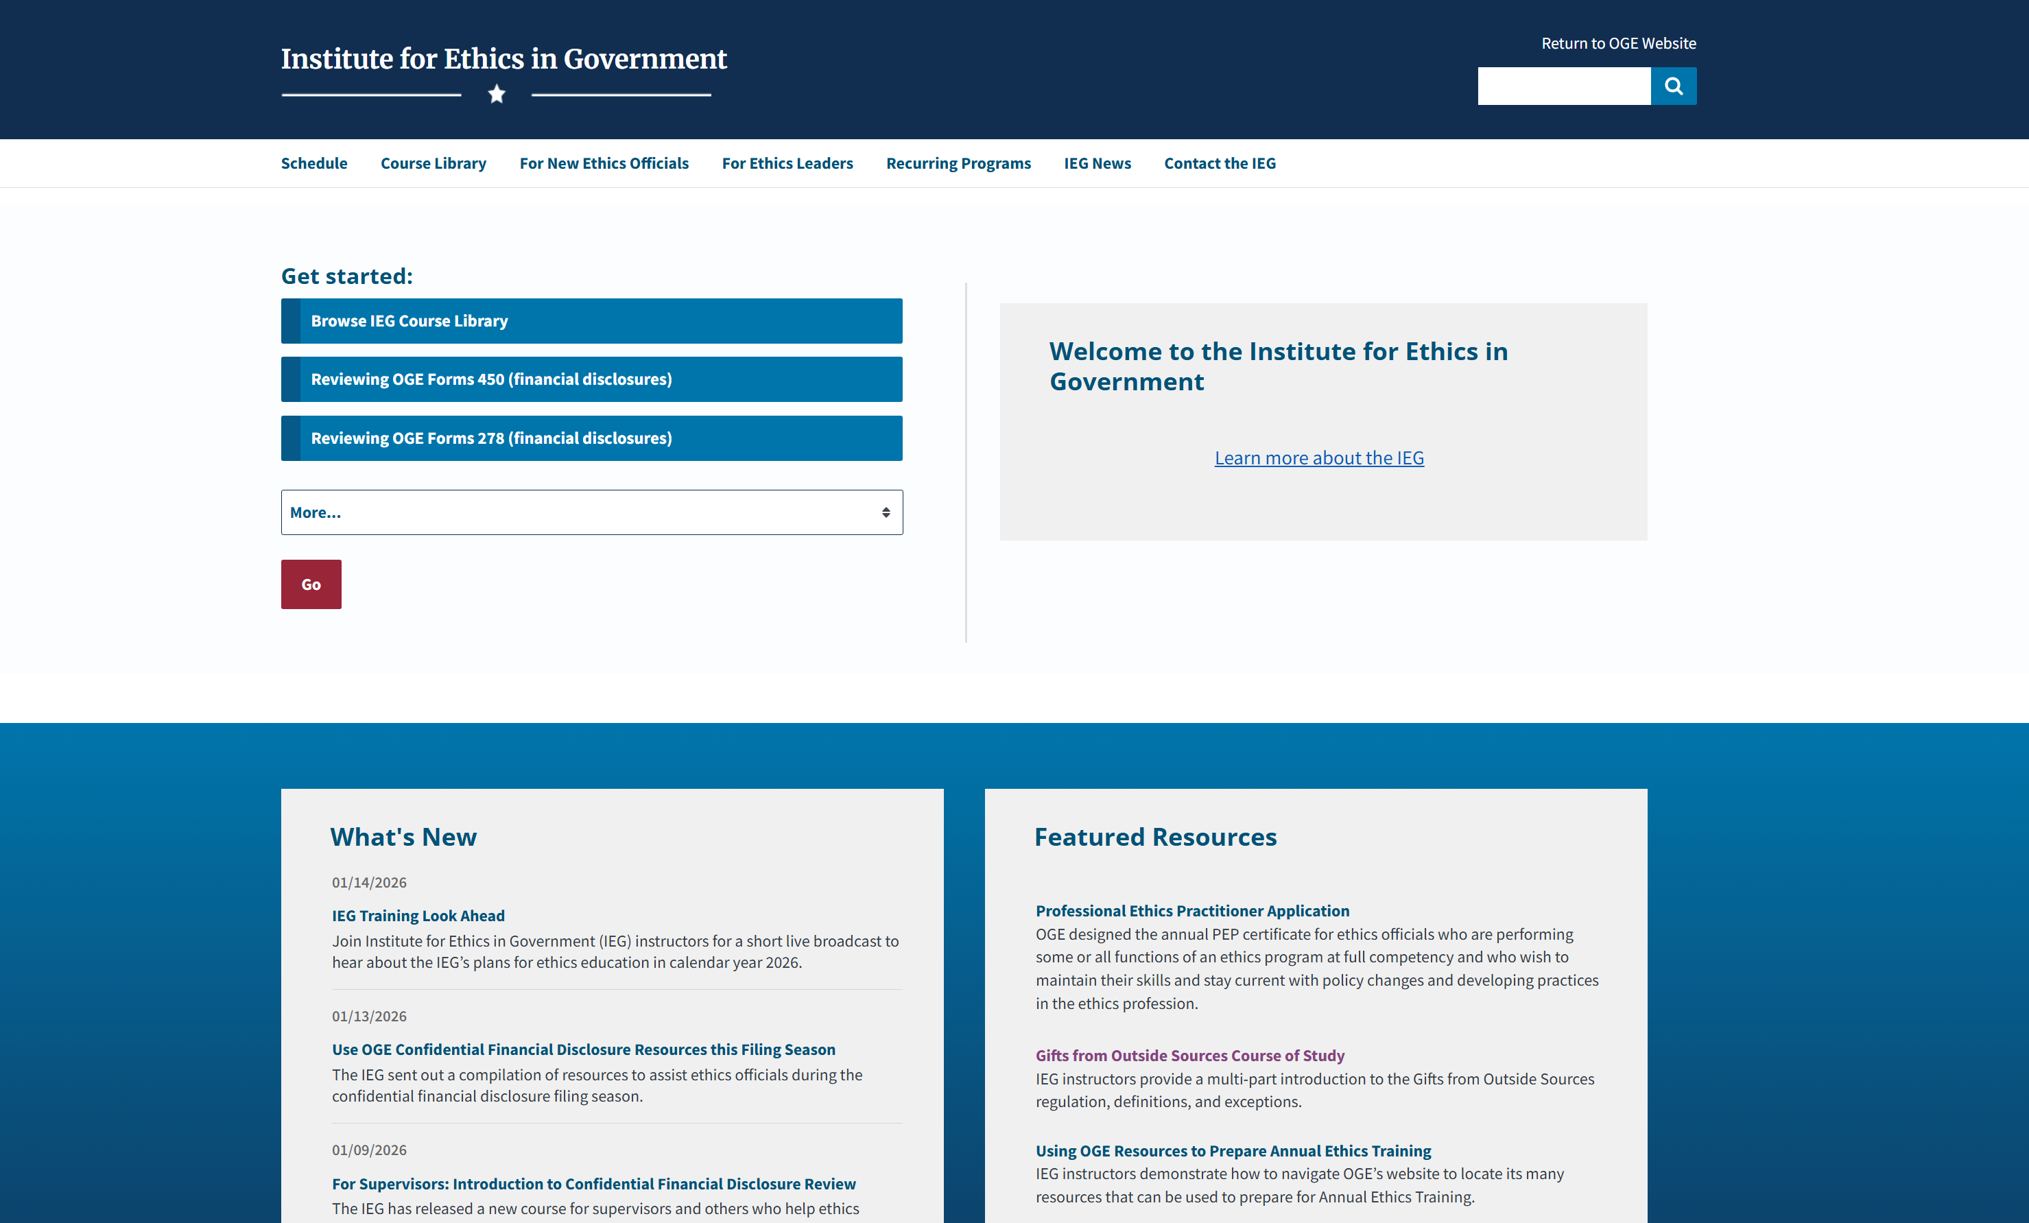
Locating News Items on IEG Homepage

Slide 10
Save the year
A Seasonal Look Ahead at IEG Offerings

Slide 11
Winter | Confidential Financial Disclosures (450s)
Demo: Navigating to OGE’s 450 Resources – January 22 at 1pm EST
Lecture: 18 U.S.C. 208(a) Elements: Introductory Training to the 18 U.S.C. 208(a) Job Aid and How-To Session
  How-To Session – January 28 at 1pm EST
Microlearning Series: For Supervisors: Introduction to Confidential Financial Disclosure Review
How-To Sessions: Reviewing Challenging Entries on Annual 450s – February

Slide 12
Winter | Confidential Financial Disclosures (450s) In Focus
Demo: Navigating to OGE’s 450 Resources – January 22 at 1pm EST
Lecture: 18 U.S.C. 208(a) Elements: Introductory Training to the 18 U.S.C. 208(a) Job Aid and How-To Session
  How-To Session – January 28 at 1pm EST
Microlearning Series: For Supervisors: Introduction to Confidential Financial Disclosure Review
How-To Sessions: Reviewing Challenging Entries on Annual 450s – February

Slide 13
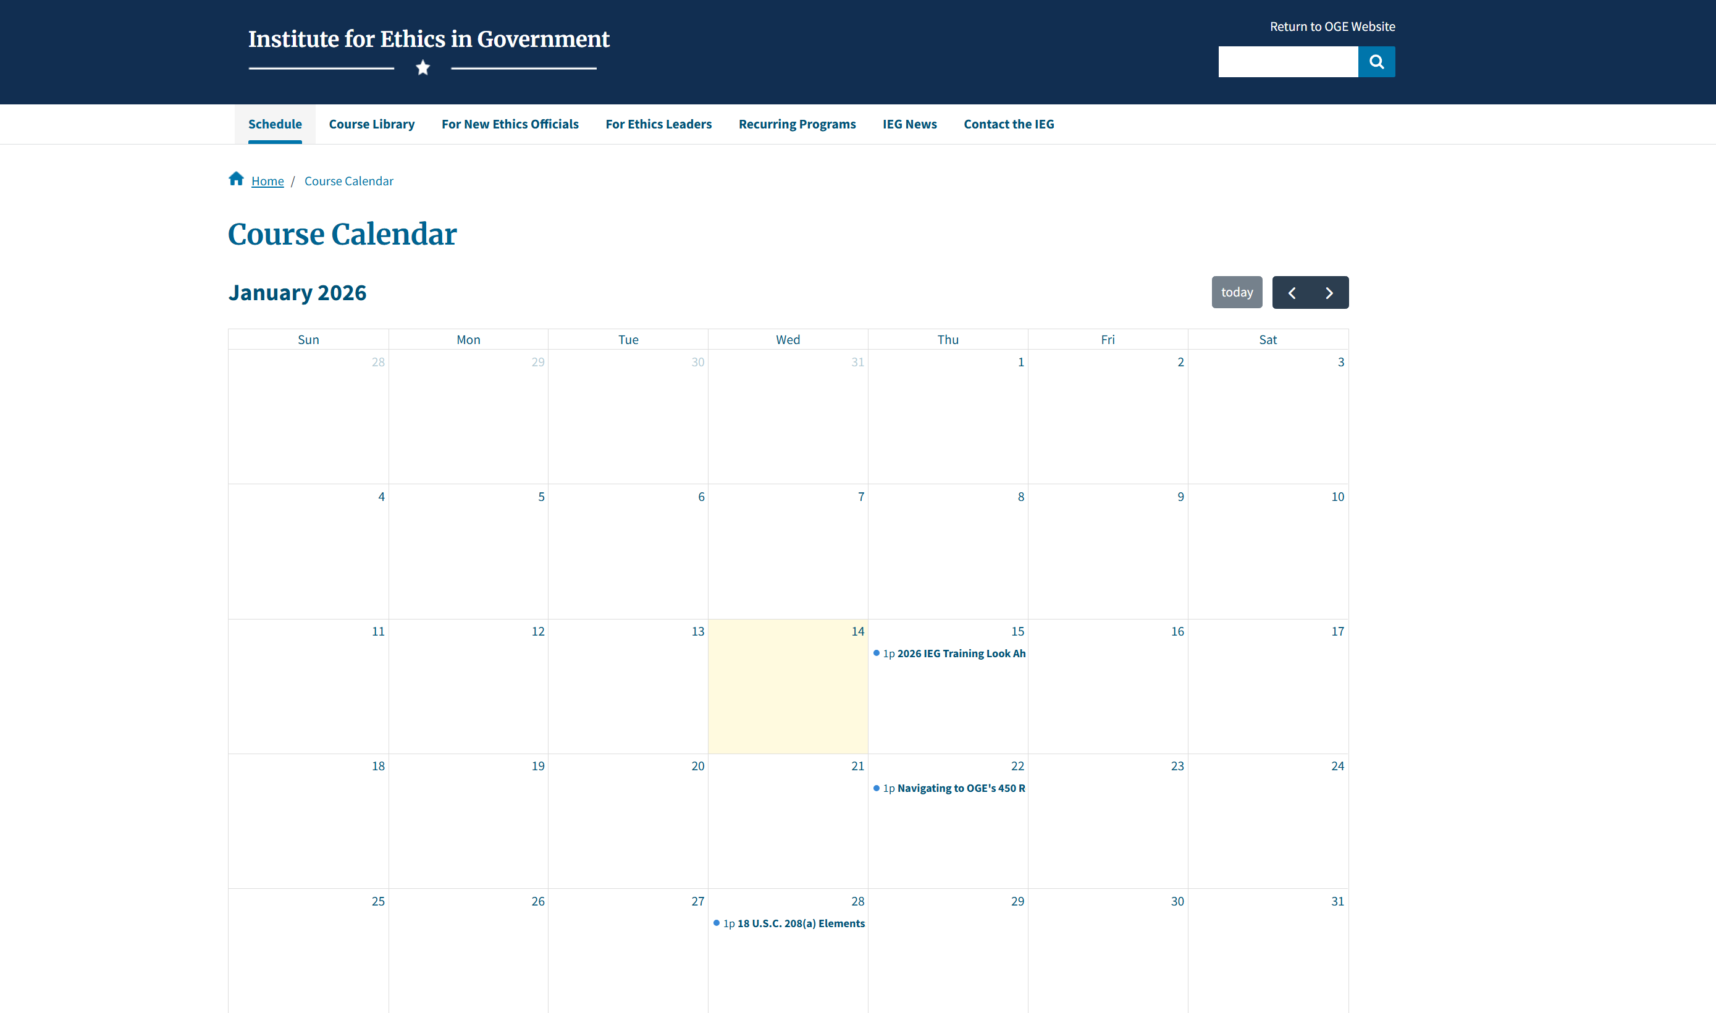
IEG Schedule

Slide 14
Spring | building a culture of ethics and public financial disclosures (278s)
Demo: Navigating OGE’s 278 Resources
How-To Sessions: Reviewing Annual 278s
Lecture: Incoming Leadership: Communication Strategies for Building a Culture of Ethics
Microlearning: Shifting from Reviewing 450s to 278s
Orientation for New Designated Agency Ethics Officials and Alternates (DAEOs and ADAEOs)
Workshop: Issue Spotting

Slide 15
Spring | building a culture of ethics and public financial disclosures (278s) In Focus
Demo: Navigating OGE’s 278 Resources
How-To Sessions: Reviewing Annual 278s
Lecture: Incoming Leadership: Communication Strategies for Building a Culture of Ethics
Microlearning: Shifting from Reviewing 450s to 278s
Orientation for New Designated Agency Ethics Officials and Alternates (DAEOs and ADAEOs)
Workshop: Issue Spotting

Slide 16
Summer | Advice and counsel and outside activities
Gathering for New and Experienced DAEOs and ADAEOs
How-To Sessions: Analyzing Outside Activity Requests
Lecture: Gifts Between Employees
Live Course of Study: Advice and Counsel

Slide 17
Summer | Advice and counsel and outside activities In Focus
Gathering for New and Experienced DAEOs and ADAEOs
How-To Sessions: Analyzing Outside Activity Requests
Lecture: Gifts Between Employees
Live Course of Study: Advice and Counsel

Slide 18
Fall | Ethics education and Preparing for 2027
Accelerated Curriculum in Ethics (ACE) Alumni Event
Demo: Navigating OGE’s Website for Ethics Education Resources
Orientation for New DAEOs and ADAEOs
Peer-to-Peer (P2P) Workshop: Ethics Education Planning for 2027
Quick Start Guide: Employee Training

Slide 19
Fall | Ethics education and Preparing for 2027 In focus
Accelerated Curriculum in Ethics (ACE) Alumni Event
Demo: Navigating OGE’s Website for Ethics Education Resources
Orientation for New DAEOs and ADAEOs
Peer-to-Peer (P2P) Workshop: Ethics Education Planning for 2027
Quick Start Guide: Employee Training

Slide 20
Questions? Other feedback?
Contact the IEG at trainingregistration@oge.gov.

