Slide 1
How OGE and the Ethics Community Support the Office of Inspector General
Federal COI, Impartiality, and Misuse of Position Investigations

Slide 2
OGE
Who We Are & How We Can Help
    Focus of Presentation
    OGE in General
    Primary Prevention Role

Slide 3

How OGE Helps Investigators 1
How OGE Helps Investigators
Big picture
OGE is an independent agency
Involvement in criminal referral process

Slide 4
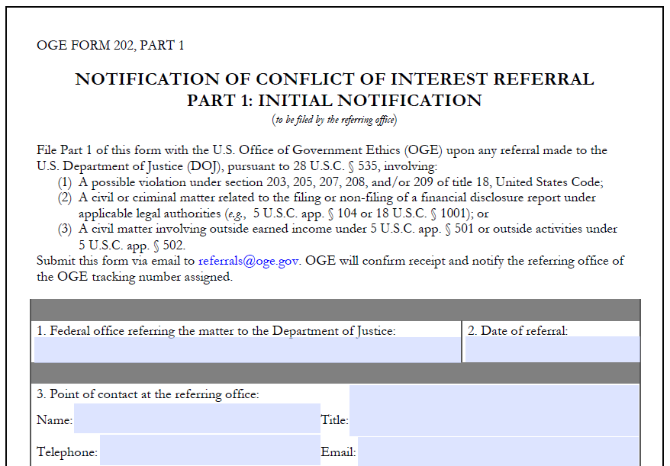
How OGE Helps Investigators 2
How OGE Helps Investigators

Slide 5

How OGE Helps Investigators 3
How OGE Helps Investigators
Assistance in Understanding:
Criminal COI Laws
Standards of Conduct
Ethics Documents

Slide 6
Ethics Documents To Know
Public Financial Disclosure Reports (OGE 278)
Confidential Financial Disclosure Reports
(OGE 450, alternatives)
Ethics Agreements
Ethics Pledge
Outside Activity Prior Approval Forms
Conflict of Interest Waivers
Training Files
Advice Files & Opinion Letters

Slide 7
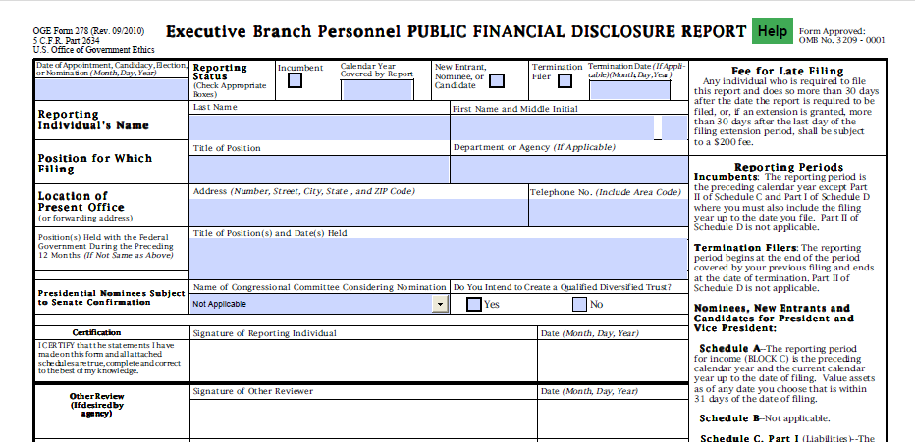
Ethics Documents 1
Ethics Documents
Public Financial Disclosure Reports
(OGE 278)

Slide 8
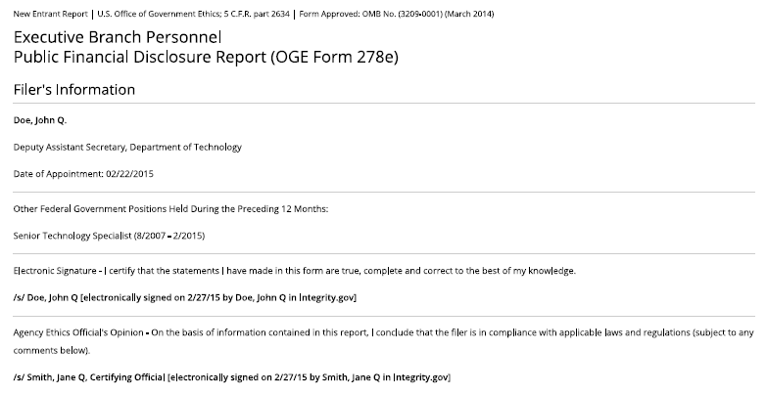
Ethics Documents 2
Ethics Documents
Public Financial Disclosure Reports
(OGE 278)

Slide 9
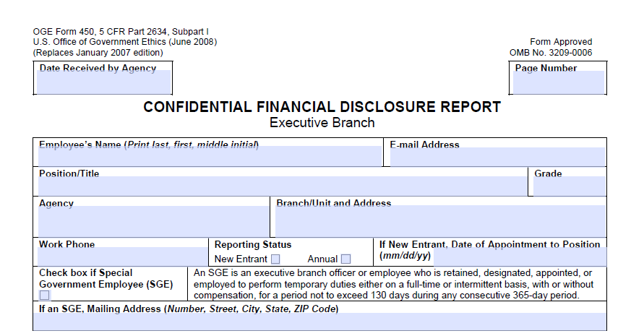
Ethics Documents 3
Ethics Documents
Confidential Financial Disclosure Reports (OGE 450)

Slide 10
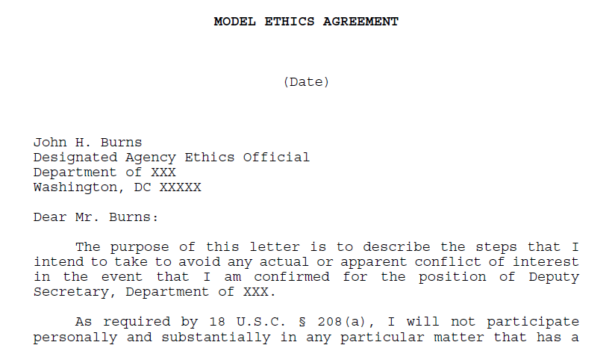
Ethics Documents 4
Ethics Documents
Ethics Agreements

Slide 11
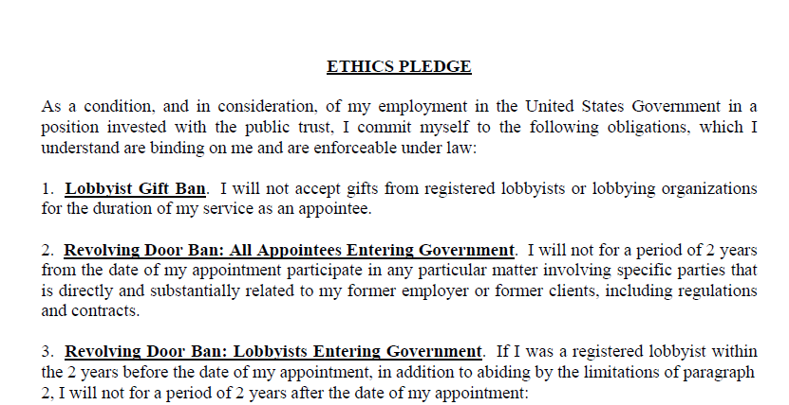
Ethics Documents 5
Ethics Documents
Ethics Pledge

Slide 12
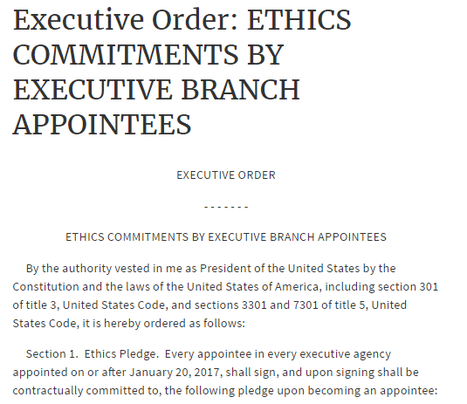
Ethics Documents 6
Ethics Documents
Ethics Pledge

Slide 13
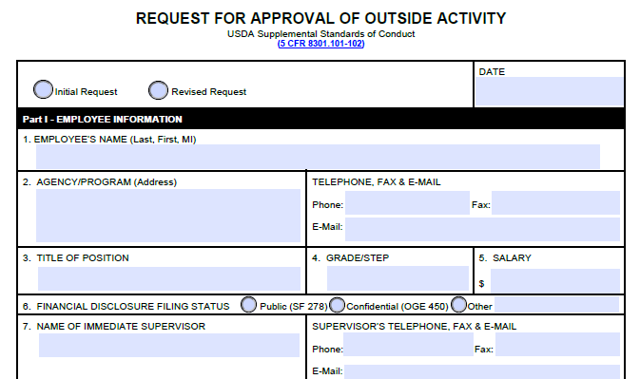
Ethics Documents 7
Ethics Documents
Outside Activity Prior Approval Forms

Slide 14
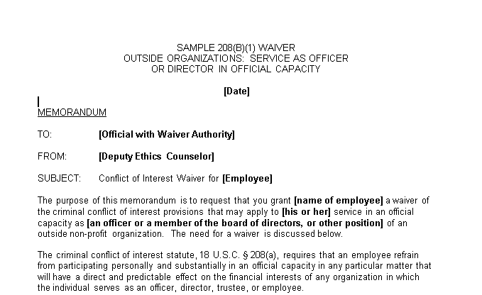
Ethics Documents 8
Ethics Documents
Conflict of Interest Waivers

Slide 15

Ethics Documents 9
Ethics Documents
Training Files

Slide 16

Ethics Documents 10
Ethics Documents
Advice Files

Slide 17
Investigating Financial Conflict of Interest and Impartiality Allegations

Slide 18
Financial Conflict and Impartiality Rules
Law | Source
18 U.S.C. 208 (Financial Conflicts) -5 CFR 2640 (implementing regulation) -5 CFR 2635.402 (implementing regulation) | Criminal Law
5 C.F.R. 2635.101 (Principles related to impartiality and misuse) | Principles of Ethical Conduct (Executive Ord. 12674)
5 C.F.R. 2635.502 (Avoidance of Appearance of COI) | Standards of Ethical Conduct (5 C.F.R. part 2635)
5 C.F.R. 2635.702 (Misuse of Position) | Standards of Ethical Conduct

Slide 19

18 U.S.C. 208
An officer or employee may not participate personally and substantially in a particular matter in which, to the employee’s knowledge, they have a financial interest*
*Including those imputed to the employee.

Slide 20
18 U.S.C. 208 Cont.
18 U.S.C. 208
1. Is there a particular matter ?
If YES, go to #2.
If NO, employee may participate.
2. Is the employee’s participation personal and substantial ?
If YES, go to #3.
If NO, employee may participate.
3. Does the employee have a disqualifying financial interest ?
If NO, employee may participate.
If YES, participation is prohibited unless an exemption applies.

Slide 21
Waivers & Exceptions
18 U.S.C. 208(b)(1), (3): Individual Waivers. On file with agency.
18 U.S.C. 208(b)(2): OGE regulations excluding certain interests. Exceptions at found in 5 CFR 2640 subpart B.
Exceptions commonly used: Mutual Funds; small stock holdings; employee benefit plans

Slide 22
Principles of Ethical Conduct
Exec. Ord. 12674
5 C.F.R. 2635.101
Subpart A

Slide 23
Principles of Conduct Related to Impartiality
Principles 7, 8, and 14 most related to impartial service.
***
(7) Employees shall not use public office for private gain.
(8) Employees shall act impartially and not give preferential treatment to any private organization or individual.
***
(14) Employees shall endeavor to avoid any actions creating the appearance that they are violating the law or the ethical standards set forth in this part. Whether particular circumstances create an appearance that the law or these standards have been violated shall be determined from the perspective of a reasonable person with knowledge of the relevant facts.

Slide 24
Principles – Enforceability
“Where a situation is not covered by the standards . . . employees shall apply the principles set forth in this section in determining whether their conduct is proper.” 5 C.F.R. 2635.101(b)

Slide 25
Disciplinary Actions Taken on Basis of SOC Violation Bar Graph

Slide 26
Impartiality
5 C.F.R. 2635.502
Subpart E

Slide 27
2635.101(b)(8) & (14): Underlying Obligation
“Employees shall act impartially and not give preferential treatment to any private organization or individual.”
“Employees shall endeavor to avoid any actions creating the appearance that they are violating the law or the ethical standards set forth in this part.”
Question: How do we prevent folks from being partial or providing preferential treatment?

Slide 28
2635.502: Avoiding Appearance of Impartiality
Answer: Require employees to think about whether their involvement is appropriate when certain persons are involved in a government matter.
Purpose: Help employees on the front end avoid situations in which there could appear to be a conflict of interest.

Slide 29
Required Process Under .502(a)
If employee is asked to participate in a
particular matter involving specific parties
502(a)
That the employee knows is likely to have a direct and predictable effect on the financial interests of a household member
In which the employee knows a person with whom the employee has a “covered relationship” is or represents a party to the matter
502(a)
And the employee determines a reasonable person would question the employee’s impartiality
Or an agency designee with independent information of the facts determines a reasonable person would question the employee’s impartiality
502(c)
502(e)
Then the employee must recuse from the particular matter
Unless authorized to participate by an agency designee
502(d)

Slide 30
Other Instances
2635.502(a)(2): An employee may look to the reasonable person test in any situation not covered by the general prohibition.
Not applying the test in these cases is not, however, an ethical lapse. See OGE 01 x 8 (discussing romantic relationship: “even if it were now determined, in hindsight, that a reasonable person with knowledge of the circumstances would have questioned the attorney's impartiality, we cannot say that she violated the impartiality rule.”)

Slide 31
Misuse of Position
5 C.F.R. 2635.702
Subpart G

Slide 32
2635.101(b)(7): Underlying Obligation
“Employees shall not use public office for private gain.”
Private Gain: Often financial gain, but not so limited. Benefits need not be pecuniary in nature. See OGE LA-11-06 (discussing the use of office to induce person to vote for employee in non-partisan election).

Slide 33
Misuse of Position
5 C.F.R. 2635 Subpart G
.702: Misuse of Public Office for Private Gain
  Coercion or Inducement of Benefits
  Appearance of Government Sanction
  Endorsement of Private Products/Services
  Appearance of Misuse of Position
.703: Misuse of Nonpublic Information
.704: Misuse of Government Property
.705: Misuse of Official Time

Slide 34
Case Study Part 1
Case Study
Jessica is the Executive Director for the Forest Health Protection Biological Control of Invasive Forest Pests Program (Program). The program aims to protect and improve the health of America’s rural, wildland, and urban forests from invasive forest pests.
Jessica’s office recently prepared a funding opportunity announcement that would provide successful grantees with funds to develop technologies to prevent and track invasive species.
There is a finite amount of funds available, and Jessica’s team plans to choose only three grantees out of the fifteen organizations that applied.
A month after the grantee selection, your office is contacted by a whistleblower who is concerned about Jessica’s involvement. They believe she may have a conflict of interest.
What ethics documents do you want to look for as you begin your review?

Slide 35
Case Study Part 2
Case Study
After reviewing Jessica’s ethics documents, you are aware that her husband owns stock in one of the companies that responded to the funding opportunity announcement.
What laws should you be concerned about?
What additional questions do you need to ask?

Slide 36
Case Study Part 3
Case Study
During your interview with a witness, you learn that one of the grantees has been renting a room from Jessica and staying in her house. The witness also states that Jessica was overheard talking about how the grantee was always late with rent payment and that they really needed to get a handle on their finances.
What laws should you be concerned about?
What additional questions do you need to ask?

Slide 37
Contact Information
Seth Jaffe
Chief, Ethics Law and Policy Branch
202-482-9303
Maura Leary
Associate Counsel
202-482-9266
www.oge.gov

