Slide 1

Receipt of Payments Prior to—and During—Government Service:
5 C.F.R. § 2635.503 and 18 U.S.C. § 209

Slide 2
18 U.S.C. § 209
Supplementation of
Salary

Slide 3
Prohibition
Whoever receives any salary, or any contribution to or supplementation of salary, as compensation for his services as an officer or employee of the executive branch of the United States Government . . . from any source other than the Government of the United States . . . ; or
Whoever, whether an individual, partnership, association, corporation, or other organization pays, makes any contribution to, or in any way supplements the salary of any such officer or employee under circumstances which would make its receipt a violation of this subsection—
Shall be subject to the penalties set forth in section 216 of this title.
18 U.S.C. § 209(a)
Payee
Payor

Slide 4
Elements:
18 U.S.C. § 209 prohibits:
An officer or employee of the executive branch,
from receiving salary or any contribution to or supplementation of salary,
as compensation for services as an employee of the United States
from any source other than the United States.

Slide 5

Let’s take a closer look…

Slide 6
(1) An officer or employee of the executive branch
Must be an employee at the time the payment is made
    Crandon v. United States, 494 U.S. 152 (1990)
    See OGE Informal Advisory Opinion 91 x 2
Includes Government-owned corporations
    United States v. Morse, 292 F. 273 (S.D.N.Y. 1922)
What about appointees who have not begun service?
    26 Op. O.L.C. 32 (2002)
      Conflicts of interest rules apply when the appointee begins the duties of his or her office, which is the same determination as the time when the official begins to accrue his or her salary.
      Based on the definitions of “officer” and “employee” in Title 5 of the United States Code.
    OGE Informal Advisory Opinion 02 x 3

Slide 7
(2) From receiving salary or any contribution to or supplementation of salary
Anything of monetary value
    Cash or in-kind payments
Coverage extends to lump sum and periodic payments
    United States v. Project on Gov’t Oversight, 616 F.3d 544 (D.C. Cir. 2010)

Slide 8
(3) As compensation for services as an employee of the United States
INTENT OF THE PARTIES
United States v. Project on Gov’t Oversight, 616 F.3d 544 (D.C. Cir. 2010)
Need a direct linkage between the thing of value paid and the official services rendered by the employee
      OGE Informal Advisory Opinion 81 x 31
      24 Op. O.L.C. 170 (2000)

Slide 9
(4) From any source other than the United States
Source = any person or organization
    for-profit and non-profit organizations
    trade associations
    corporations
Compensation paid to an employee by the U.S. Government does not violate 209 even if the funds can be traced back to a private entity
    Ex. Federal Technology Transfer Act (15 U.S.C. §§ 3701-3717)
      Government agencies are required to pay an employee/inventor a certain percentage of royalties that the agency receives from any licensing agreement for an invention.
      Because these payments are paid to the employee by the Government, there is no violation of 209, even if the funds originated from others.
      17 Op. O.L.C. 46 (1993)

Slide 10
Key Concerns
Payment
To a government employee
From someone who has business before the employee’s agency and
The payment was not made as part of some established policy

Slide 11
Exceptions
Payments from state or local governments
Employee pension or benefit plans
Special Government Employees (SGEs) or uncompensated employees
Contributions under the Government Employees Training Act
(5 U.S.C. § 4111)
Executive exchange or fellowship programs
Persons injured during the commission of certain offenses
Private sector employees assigned to an agency as part of the IT Exchange Program (5 U.S.C. § 3701, et seq.)
Pay to members of the reserve components of the armed forces called to active duty that would have been paid in absence of call to active duty

Slide 12
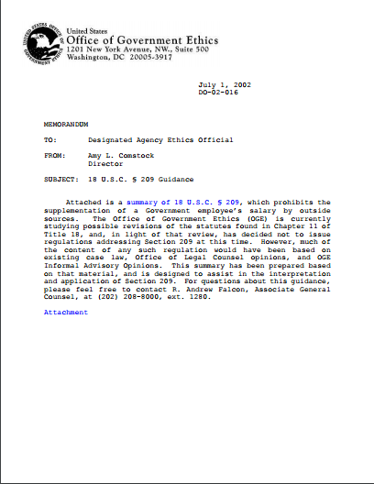
Guidance
DO-02-016 / Informal Advisory Opinion 02 x 4 remain OGE’s most thorough guidance on this statute
Other OGE Legal Advisories
Department of Justice OLC opinions
Judicial opinions
OGE Desk Officers

Slide 13
5 C.F.R. § 2635.503
“Extraordinary Payments”

Slide 14
Regulatory History
An extraordinary payment from a former employer received prior to beginning Federal service raises a legitimate concern, and thus an appearance, that the employee may not act impartially in particular matters to which the former employer is a party or represents a party. The disqualification requirement that would be imposed by § 2635.503 is intended to address those appearance issues. 56 FR 33778

Slide 15
Elements: Who is covered by 2635.503?
Any individual who, prior to entering government,—
Receives any item or thing of value worth more than $10,000;
That is being provided on the basis of a determination made after it became known to a former employer that the individual was being considered for or had accepted a Government position; and
Other than pursuant to the former employer’s established compensation, partnership, or benefits programs.

Slide 16
Elements Con’t: “Established” Program
Other than pursuant to the former employer’s established compensation, partnership, or benefits programs
“Established” means—
    The program is in writing; or
    There is a history of similar payments made to others not entering government.

Slide 17
Prohibition: What is the Coverage?
An employee covered by 2635.503 shall not:
Participate in a particular matter in which the former employer is a party or represents a party; and
The disqualification runs for two years from the date the payment is received by the employee.

Slide 18
Exception– Agency Determination
The requirement to recuse may be waived if:
The head of an agency makes a finding
In writing
That the amount of the payment was not so substantial as to cause a reasonable person to question the employee’s ability to act impartially

Slide 19
Time for a Hypothetical…
An individual is soon entering government service and her current employer has a policy of giving severance payments to departing employees, with these payments being based on a formula that factors in the years the employee spent with the company and the compensation the employee received in her final year with the company. The company will pay severance to any employee who goes on to work for the federal government. The employee is going to work for the Department of Homeland Security (DHS), and the approximate value of the payment is $60,000. The current employer, a DHS contractor, knows that the individual intends to work for the Executive Branch but does not know in which Department or Agency.

Slide 20

Morris Barren
Assistant Counsel
mbarren@oge.gov
202-482-9266

