Slide 1
WAG MOOC—Part 2
OGE Institute for Ethics in Government
June 29, 2017

Slide 2
Question #1
Q. Do the values of gifts accepted under other exceptions in Subpart B have to be counted toward the $50/year cap in .204(a)?

Slide 3
Question #2
Q. Does the phrase “present information” refer just to giving a speech? Does it also refer to participating on a panel? Does it include manning a booth at an expo to answer questions, etc.?

Slide 4
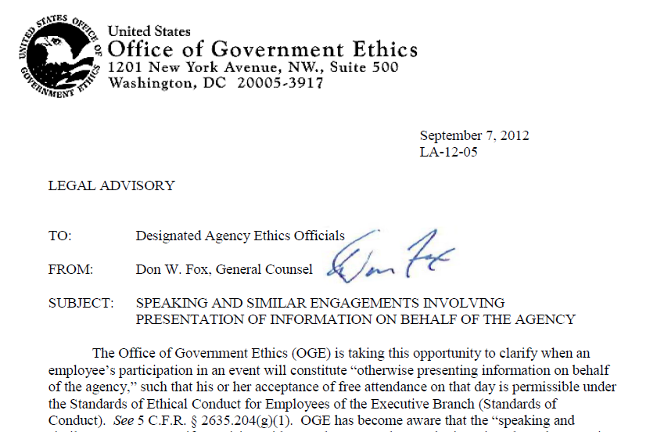
See LA-12-05

Slide 5
Question #3
Q. What does this mean?
“For an employee who is subject to a leave system,
attendance at the event will be
on the employee’s own time or, if
authorized by the employee’s agency, on
excused absence pursuant to applicable
guidelines for granting such absence, or
otherwise without charge to the
employee’s leave account.” (2635.204(g)(1))

Slide 6
Step 1: Impartiality/Integrity
Value: Is the gift expensive or relatively cheap?
Timing: Is the gift given at a time when the donor is seeking or has business before the agency?
Identity: Is the donor someone who has interests affected by the employee’s official duties?
Access: Is the gift going to provide the donor with significantly disproportionate access to the employee and the agency?

Slide 7
Other Authorities
Agency Gift Acceptance Authority
Agency has statutory authority to solicit or accept gifts
31 U.S.C. 1353
Travel payments from Non-Federal sources
Acceptance of travel and related expenses to attend a meeting or similar function away from duty station
5 U.S.C. 4111
Government Employees Training Act
Acceptance of expenses for attendance at training or meetings
5 USC 7342
Foreign Gifts and Decorations Act
Acceptance of gifts from foreign governments of less than $390

