Slide 1
UNIT 4—Part 2
Post-Government Employment

Slide 2
Task 4.3 Identify Programmatic and Substantive Issues
Notes:
Review the email exchanges
Identify any administrative or policy and procedure issues raised in the exchange
Identify all substantive ethics concerns

Slide 3
Email 2
Administrative/Policy
Substantive
Notes:
Email #2 Administrative/Policy Issues
Termination 278e—when to file, reporting periods given recent annual/Integrity issues if filed after leaving
PE counseling—what form will it take
Ethics clearances for off-boarding
PE Counseling for staff
Proactive issues:
Anyone Acting post-termination (>60 days)
Review of current FD form for potential COI with new duties
Substantive Issues
Same entity as Notification
Recusals for 208
Subpart G
PE Restrictions—207/Pledge
Proactive issues:
COI and other ethics issues for Acting

Slide 4
Post-employment ethics: Why so many restrictions?
Notes:
Participants assigned to view PE curriculum in IEG
Review LA-22-07
Alert them to job aids

Slide 5
Task 4.4 Summarize the Primary 18 USC 207 Restrictions

Slide 6
For 207(a)(1), (a)(2) and (c) [PRIORITY]
Begin to record on the worksheet provided:
1. The purpose of each restriction
2. To whom the restriction applies
3. The activities that are restricted
4. The length of the restriction
Notes:
Divide into groups with different parts assigned to report out on:
(a)(1) and (2)
(c) and Pledge paragraph 4
(f) And Pledge paragraph 6
(c) And (d)
Pledge paragraph 5

Slide 7
Debrief 4.4 Summarize the Primary 18 USC 207 Restrictions
Notes:
Screen share group summaries

Slide 8
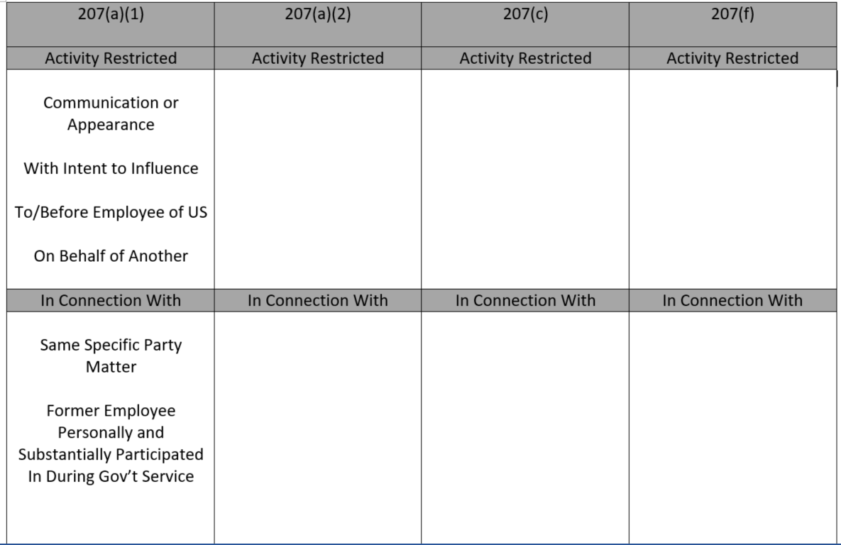

Slide 9
Task 4.5
Giving Post-Employment Guidance
Notes:
Employee/Prospective Employer
Prospective advice--Puts employee on notice, Provides general guardrails, NOT safe harbor for either the employee or employer
Fact-specific PE guidance—direct application of law to specific facts, may provide some mitigating relief see 2641.105(c) (Slide 16)
Prospective employers have liability See Note to 2641.103 (Slide 17)
Agency
Required by 2638
Protect integrity of programs against undue influence/switching sides

Slide 10
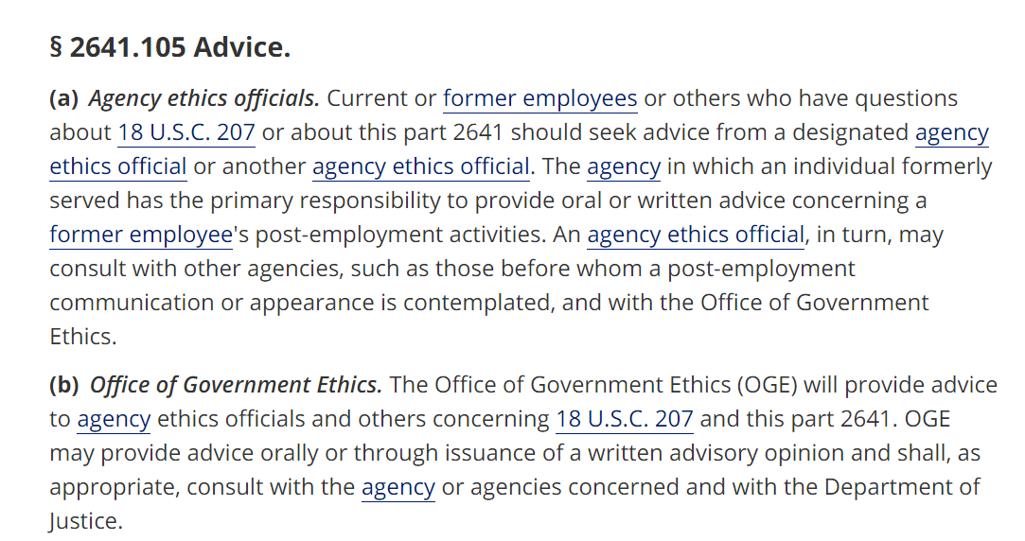
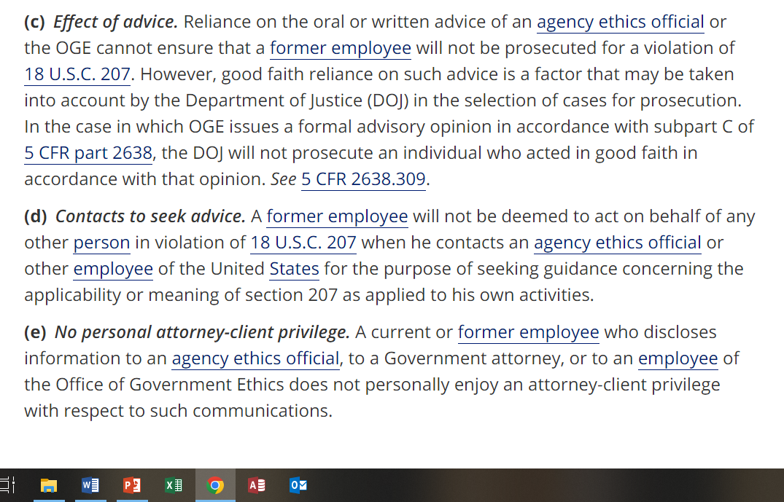
No safe harbor
No privilege
Notes:
Employee/Prospective Employer
Current employees need prospective advice--Puts employee on notice, provides general guardrails for future reference, NOT safe harbor for either the employee or employer
Former employees need fact-specific PE guidance—direct application of law to specific facts, may provide some mitigating relief see 2641.105(c) (Slide 16)
Prospective employers have liability See Note to 2641.103 (Slide 17)
Agency
Required by 2638
Protect integrity of programs against undue influence/switching sides

Slide 11
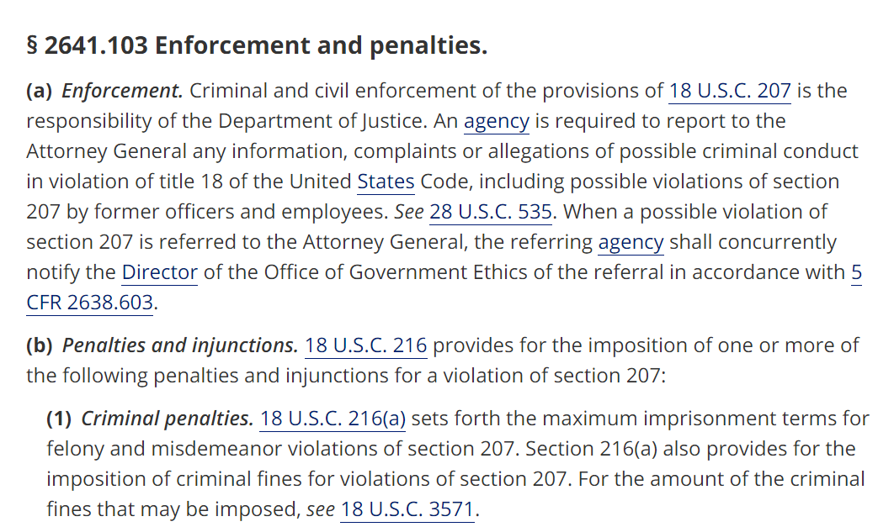
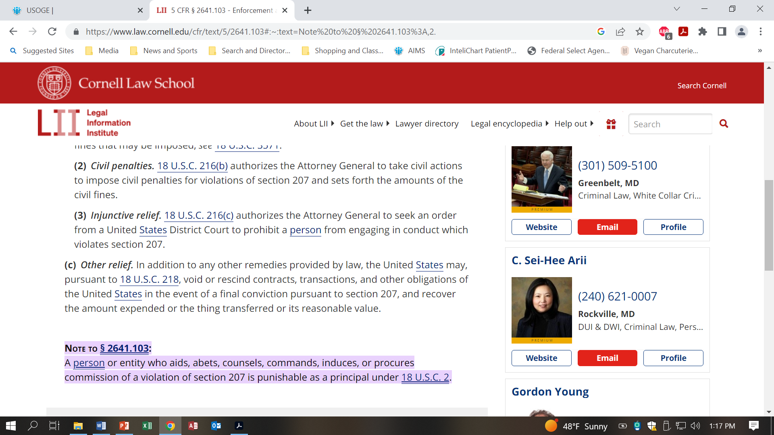
Employer liability

Slide 12
TWO TYPES—
Post Employment Customers
Current Gov’t Employees
Prospective Advice
Former Gov’t Employees
Specific “Fact-Heavy” Advice

Slide 13
Information Gathering for PE Memo
What information do you need at a minimum to prepare prospective post-employment guidance for Dr. Singh-Smith?
Notes:
Employee grade level (senior, very senior, appointee for Pledge, supervisor) -–with this alone you can provide generic advice
Prospective employer and/or proposed activities—likelihood of particular PE issues/any waivers or applicable exceptions
For (a)(1 () and a)(2) SP matters employee worked on or supervised—to provide relevant examples in advice

Slide 14
Prospective Advice—Information Gathering

Slide 15
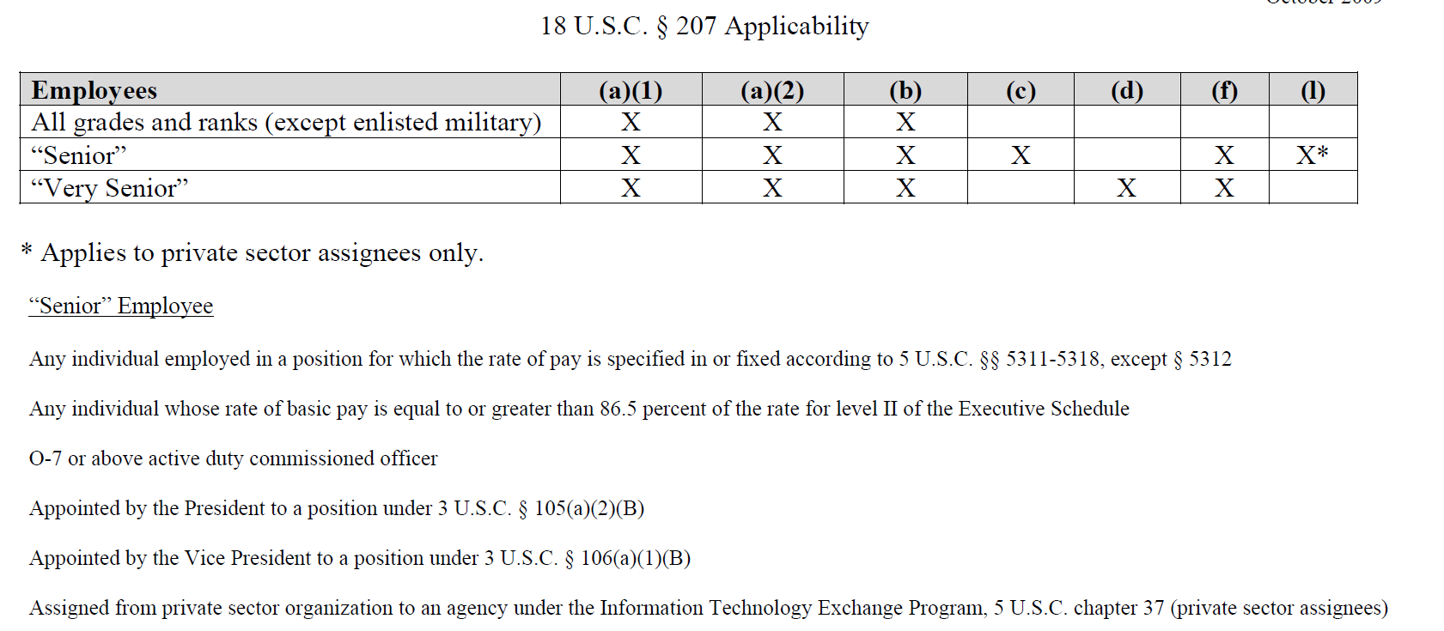
Notes:
Employee grade level (senior, very senior, appointee for Pledge, supervisor) -–with this alone you can provide generic advice

Slide 16
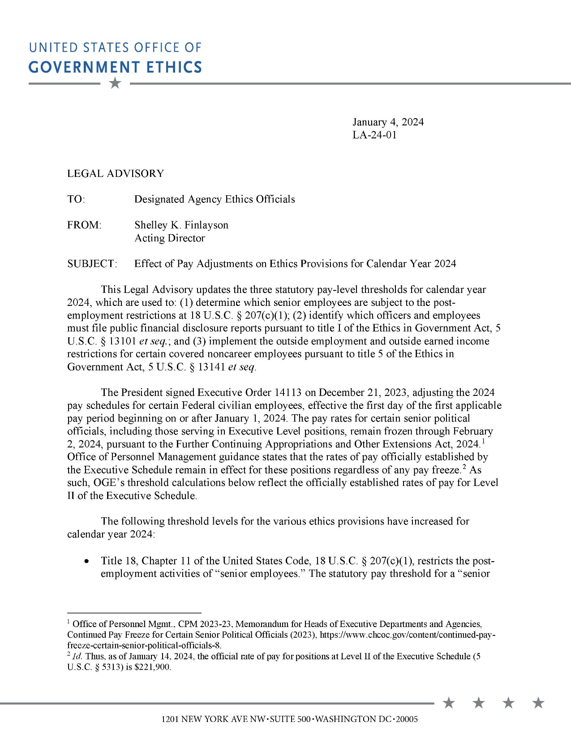

Slide 19
Task 4.5 Review Information and Begin Analysis for Counseling Email

Slide 20
Email from Dr. Singh-Smith
Using the information you have been given:
Identify which 207 provisions may apply and whether any Pledge restrictions may apply
Begin a preliminary post employment analysis using the worksheet for 207 and the summary of Pledge restrictions and prepare talking points
Notes:
Assign in small groups

Slide 21
18 USC 207(a)(1) -- The Process
1. Government Duties
Employee
Particular Matter Involving Specific Parties
Personal and Substantial Participation
2. Post-employment Activities
Appearance or Communication
Intent to Influence
On Behalf of Any Other Person
To or Before an Employee
3. Post-employment Matter
Same Particular Matter
US is Party or has Interest

Slide 22
18 USC 207(a)(2) -- The Process
1. Government Duties
Employee
Particular Matter Involving Specific Parties
Pending Under Official Responsibility
2. Post-employment Activities
Appearance or Communication
Intent to Influence
On Behalf of Any Other Person
To or Before an Employee
3. Post-employment Matter
Same Particular Matter
US is Party or has Interest

Slide 23
18 USC 207(c) -- The Process

Slide 24
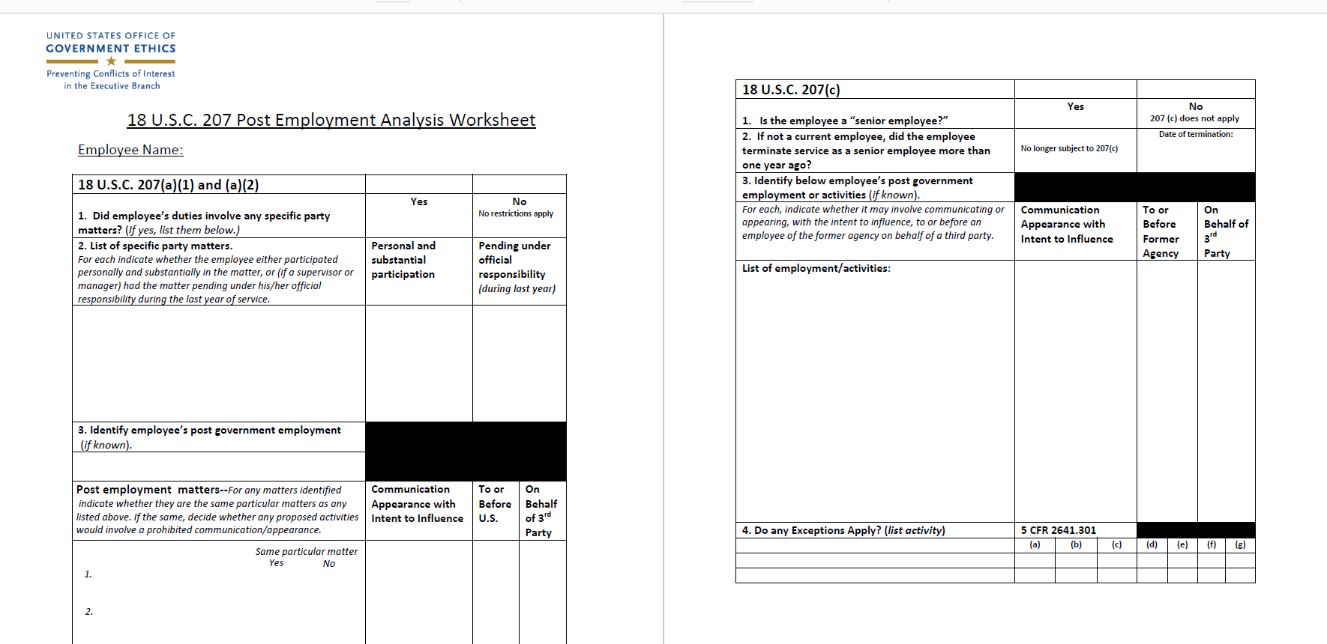

Slide 25
Pledge Restrictions
Pledge Paragraph 4
Is employee subject to 207(c)?
Pledge Paragraph 5
Will former employee be offering or engaged in “lobbying activities” involving making communications or appearances, or providing material support for such contacts by others, to covered executive branch officials?
Pledge Paragraph 6
Will former employee lobby any covered executive branch official or non- career Senior Executive Service appointee, or engage in any activity on behalf of any foreign government or foreign political party which, would require registration under the Foreign Agents Registration Act?

Slide 26
Task 4.6 Post Employment Advice
Notes:
Graded assignment

Slide 27
Task 4.6—Post Employment Advice
Individual assignment to draft post employment advice
Each participant should prepare prospective post-employment written advice for Rory
Use the BFLACO template to deliver the advice
Advice submitted to ACE inbox by start of class on August 28
Using the PE authority chart you created, prioritize the order in which each authority (207 and the Pledge) will be discussed in the advice—e.g. most likely to be an issue to least likely to be an issue.

