Slide 1
UNIT 5
New Entrant Public Financial Disclosure

Slide 3
What purpose does New Entrant filing and review serve?

Slide 4
For the agency | For the employee | For the public
Notes:
Front of room discussion and brainstorm—Possible responses
Agency– identify risks to programs, prevent problems before they occur, establish expectations, raise awareness, pre-emptive screening, prevents surprises for everyone, etc.
Employee—Preview of obligations and sacrifices, ethics education/awareness, sufficient notice for remediation, prevent unknowing violations, etc
Public—Transparency, evidence of conflicts and other ethics vetting, etc.

Slide 5
Why does timing matter?

Slide 6
By regulation, when must NE filing and review occur?
Notes:
We all must minimally adhere to the compliance requirements for filing and review of FD reports.
What are those for NEs?
Is that “timely” given what we just discussed about the purpose?
How “early” can we get and use the NE PFD for the purposes we discussed?
How soon should we do so?

Slide 7
§ 2634.201 General requirements, filing dates, and extensions.
30 days
+ 45
+ 45

Slide 8
+ 60

Slide 9
Do the math:
30+45+45+60 = Compliant
BUT WAY Too Late

Slide 10
How can we intervene sooner with potential new hires?

Slide 11
Task 5.1 Create a list of points of intervention for ethics in the hiring/onboarding process

Slide 12
Points of Intervention
Pre-Hire through Post-Appointment
Notes:
Conclusion after exercise:
Consider the level of risk in your own agency
Review your agency’s policies and procedures for collecting and reviewing both NE PFD and CFD reports
Consider whether collection and review, pre-appointment, would be beneficial for your agency

Slide 13
Debrief 5.1 Points of intervention in the hiring/onboarding process

Slide 14
Points of intervention

Slide 15
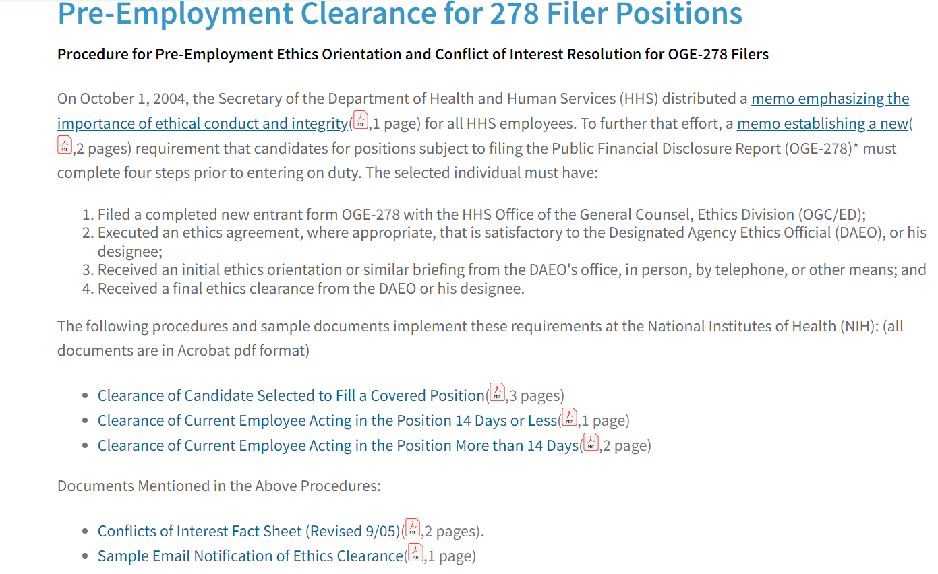
https://ethics.od.nih.gov/PreEmp278

Slide 16
Task 5.2 Review Initial Draft

Slide 17
Keshia’s Pre-Appointment Draft NE 278e
Primary Resources You Will Use for Review
Keshia’s Draft 278e
Position Description
Resume
Reviewer’s Guide
Conflict of Interest Analysis Webpage
Internet
Notes:
Front of Room—
Let’s all look at Keshia’s submitted draft
Before we begin looking at her draft:
Remind yourself of the duties of her position—
Review her resume and use it to identify anything you should expect to see on the report
Look to the Reviewer’s Guide for any information about how a particular type of interests should be disclosed on the form and where
Consult the COI webpage for any information about potential substantive concerns with anything listed (e.g. look at university employment for clues to other types of interests an academic might have that are or are not currently reported)
Look for information concerning the nature of organizations identified/holdings, etc.

Slide 19
For Thursday—Finish the initial review

Slide 20
Prioritize the substantive review…
Conduct a detailed review of Keshia’s draft NE 278e. Use the resume to identify any technical deficiencies, missing information and note any potential conflicts of interest or other ethics concerns.
Technical guiding questions:
“Do I have enough information to determine definitively that an entry will, or will not pose a potential conflict?”
“Is information missing?”
Substantive guiding question:
“Is there a nexus between entry reported and the duties of the filer?”
Notes:
For Homework—
Begin an initial review using the worksheet provided
Do a line by line review
Identify technical deficiencies, missing information, potential conflicts or other ethics issues

