Slide 1

NATIONAL
March 12
2020
GOVERNMENT ETHICS
SUMMIT
Certificates of Divestiture (CDs)
Elaine Newton, Office of Government Ethics (OGE)
Danae Serrano, Securities and Exchange Commission (SEC)

Slide 2
Certificates of Divestiture (CDs)
A certificate of divestiture allows an eligible person to defer paying capital gains taxes on the sale of property to comply with conflict of interest requirements. 26 U.S.C. § 1043(a). To qualify for a certificate of divestiture, the requesting employee must follow the procedures set out in OGE’s implementing regulations, 5 C.F.R. § 2634.1001, et seq.

Slide 3
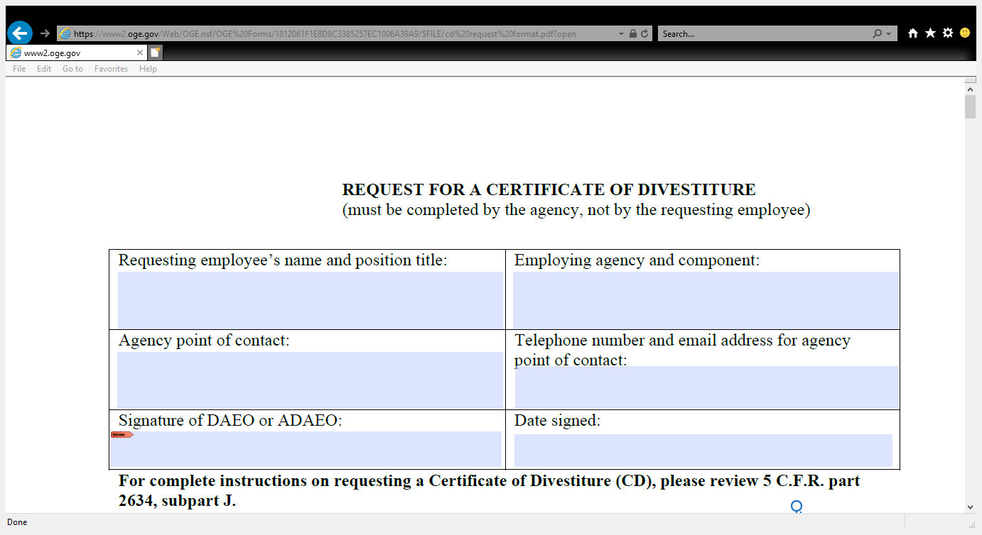
Revised CD Format
PA-19-10 (8/27/19)

Slide 4
Format Changes
Substantive Changes:
- Employee informed of their obligation to recuse
- Other financial holdings “similar or related” to the property being divested
Procedural Changes:
- Number of holdings that can be listed on the format is limited to six (6)
- Moved continuation page to the end of the format

Slide 5
“Similar or Related” Property
LA-18-03 (2/8/18)
The regulation at 5 C.F.R. § 2634.1007(c) requires the sale of all “similar or related” property to prevent employees from using the CD program to receive favorable tax treatment without fully resolving the underlying conflict of interest concerns.

Slide 6
When is property considered “similar or related?”
Properties are considered “similar or related” if they pose the same or similar conflict of interest concerns.
For example, if an employee is required to sell assets per a statute or regulation prohibiting the ownership of such assets, OGE treats all such property as “similar or related.” As a result, OGE will only issue a Certificate of Divestiture if all such assets will be divested.

Slide 7
SEC Supplemental Regulation
(5 C.F.R. part 4401)
§ 4401.102 Prohibited and restricted financial interests and transactions

Slide 8
Pursuant to 18 U.S.C.
§ 208(a)
When considering whether any other property is “similar or related” to the original property that is being divested for purposes of 18 U.S.C. § 208, agency ethics officials should consider the reason that the original property is being divested and whether the same reason for divestiture would apply to any other property.

Slide 9
The Nexus is the Key
What constitutes “similar or related” property will generally depend on the nexus between the employee’s duties and the type of disqualifying financial interests presented by the employee’s financial holdings and relationships.

Slide 10
Reasonably Necessary
LA-18-04 (3/29/18)
In general, the “reasonably necessary” requirement is not satisfied where an Executive branch employee knows he will be leaving the Government shortly.
The CD statute requires that the sale of the property be undertaken by an “eligible person.”

Slide 11
Other Timing Issues
5 C.F.R. § 2634.802(b) Time limit. The ethics agreement will specify that the individual must complete the action which he or she has agreed to undertake within a period not to exceed three months from the date of the agreement (or of Senate confirmation, if applicable). Exceptions to the three-month deadline can be made in cases of unusual hardship, as determined by the Office of Government Ethics, for those ethics agreements which are submitted to it (see § 2634.803), or by the designated agency ethics official for all other ethics agreements.

Slide 12
Other Timing Issues (part 2)
5 C.F.R. § 2635.403(d) Reasonable period to divest or terminate. Whenever an agency directs divestiture of a financial interest under paragraph (a) or (b) of this section, the employee shall be given a reasonable period of time… to comply with the agency's direction. Except in cases of unusual hardship, as determined by the agency, a reasonable period shall not exceed 90 days from the date divestiture is first directed. However, as long as the employee continues to hold the financial interest, he remains subject to any restrictions imposed by this subpart.

Slide 13
Trusts
• 26 U.S.C. § 1043(b)(5) -- special rules for trusts
• 95 x 6 (5/22/95) – Congressional committee’s intent was to limit who benefits from a CD

Slide 14
Contact Information
Elaine Newton
Associate Counsel
U.S. Office of Government Ethics
enewton@oge.gov
202-482-9265
Danae Serrano
Ethics Counsel
U.S. Securities and Exchange Commission
serranoD@sec.gov
202-551-7934

Slide 15
THANK YOU

