Slide 1
Reconciling Ethics Agreements with the Annual 278e
May 10, 2018

Slide 2
Agenda
  Divestiture of Conflicting Assets
  De Minimis & Retention of Holdings
  Prior Employer-Related Interests
  Closing a Business
  Resignations
  Managed Accounts

Slide 3
Certification Standard
Agency Ethics Official's Opinion
On the basis of information contained in this report, I conclude that the filer is in compliance with applicable laws and regulations…

Slide 4
Legal Compliance
  Title 18 of USC §§202-209
  Standards of Conduct
  EIGA Reporting Requirements
    Including Ethics Agreement Requirements and Compliance (5 CFR 2634 Subpart H)

Slide 5
A Financial Disclosure Report
Is a Request for
Advice and Counsel

Slide 6
Conflicts Analysis—18 USC 208
Is There A Nexus?
Particular Government Matter
Financial holding or other interest
208

Slide 7
Conflicts Analysis—18 USC 208
Particular Government Matter
What will the employee
be working on?
Any new projects/duties?

Slide 8
Conflicts Analysis—18 USC 208
Financial holding or other interest
New assets with nexus to duties?
Repurchased conflicting or
similar assets?

Slide 9
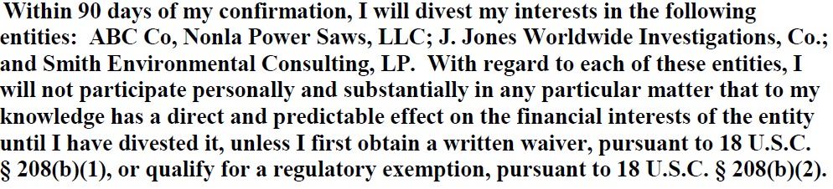
Divestitures--EA

Slide 10
Divestitures
  * Divestitures complete?
  * Repurchases of conflicting assets?
  * Purchases of similar assets to those divested? (e.g. same industry, products, services, or new private equity or venture capital funds)

Slide 11
Divestitures and Recusals
  * Timeliness of divestitures
  * Recusals effectuated until divestiture complete
  * Recusals effectuated if same or similar assets purchased until divestiture complete

Slide 12
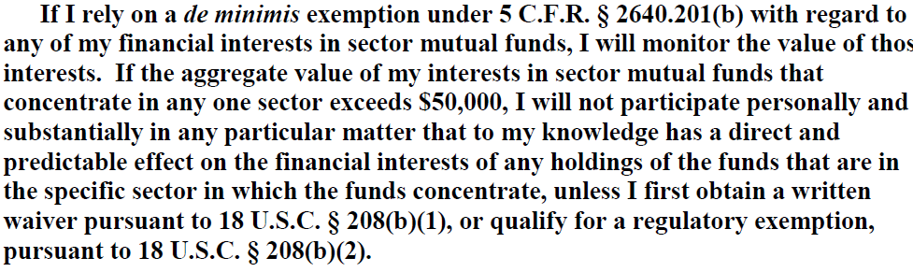
De Minimis for Retained Sector Fund Holdings--EA

Slide 13
Use of De Minimis for Retained Sector Fund Holdings (5 CFR 2640.201(b)(2)(i) and (ii)
* Do potentially conflicting sector fund holdings remain below the de minimis?
* Any new purchases of funds in the same sector?

Slide 14
Sector Fund Holdings
See 5 CFR 2640.201(b)(2)(i) and (ii)
  De minimis dollar value = $50,000 or less*
  *the aggregate market value of the employee’s interests in all sector mutual funds that concentrate in the same sector and have one or more holdings that might be affected by the particular matter

Slide 15
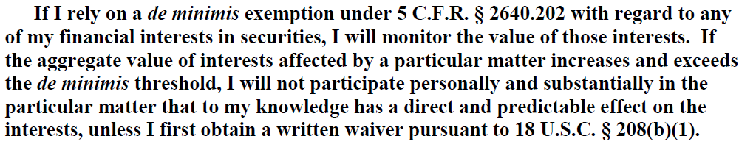
De Minimis for Retained Securities--EA

Slide 16
Use of De Minimis for Retained Securities (5 CFR 2640.202(a), (b), and (c)
* Do potentially conflicting securities remain below the de minimis?
* Any new purchases of similar assets?

Slide 17
Publicly Traded Securities—
5 CFR 2640.202(a),(b) and (c)
  Type of Particular Matters
Specific Parties 2640.202(a) and (b) | General Applicability 2640.202(c)
No more than $15,000 aggregate in all affected parties No more than $25,000 aggregate in all affected parties and non-parties | No more than $25,000 in one affected entity No more than $50,000 aggregate in all affected entities

Slide 18
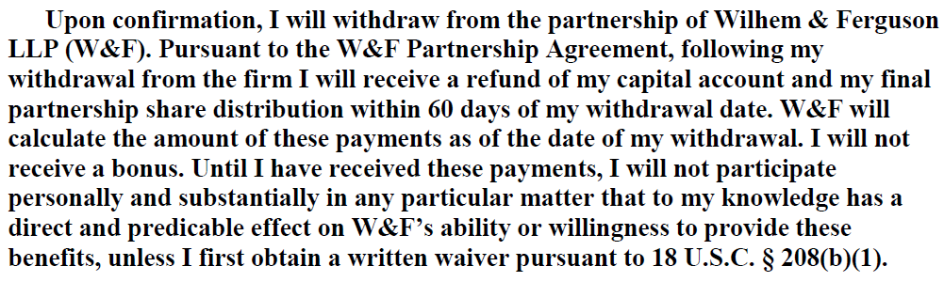
Payouts from Former Employer--EA

Slide 19
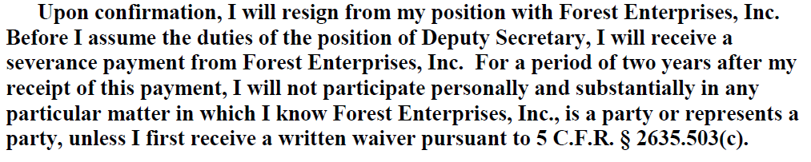
Payouts from Former Employer--EA

Slide 20
Payouts from Former Employer
  * Are any distributions, bonuses, severances or similar payments reported?
      * Any changes in amounts, timing or terms ?

Slide 21
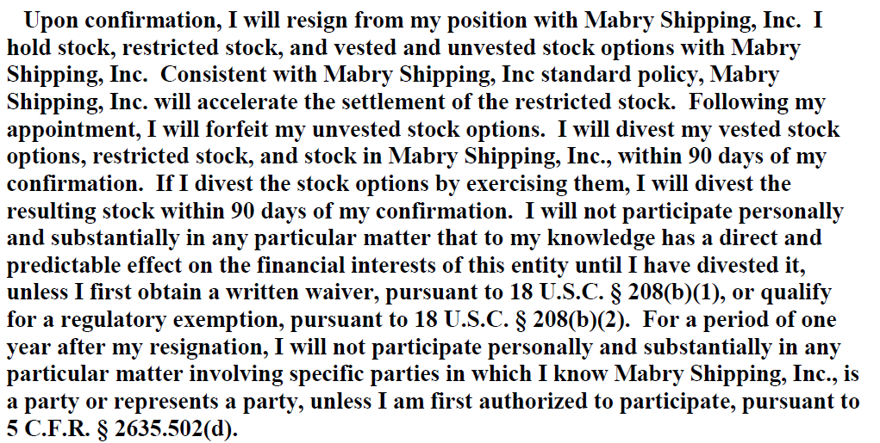
Stock and Stock Options from Former Employer--EA

Slide 22
Stock and Stock Options from Former Employer
  * Was stock sold?
      * Were vested stock options exercised and stocks sold?
      * Were unvested stock options forfeited?
      * Did restricted stock vest/become regular stock and was it sold?

Slide 23
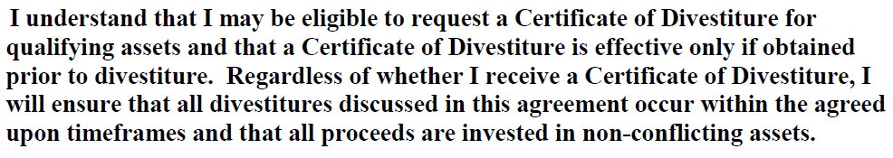
Certificates of Divestiture (CD)

Slide 24
Certificates of Divestiture (CD)
  Filers cannot receive additional CDs for:
  1. repurchases of same securities or funds for which they already received a CD
  2. new purchases of similar holdings to those for which they already received a CD.

Slide 25
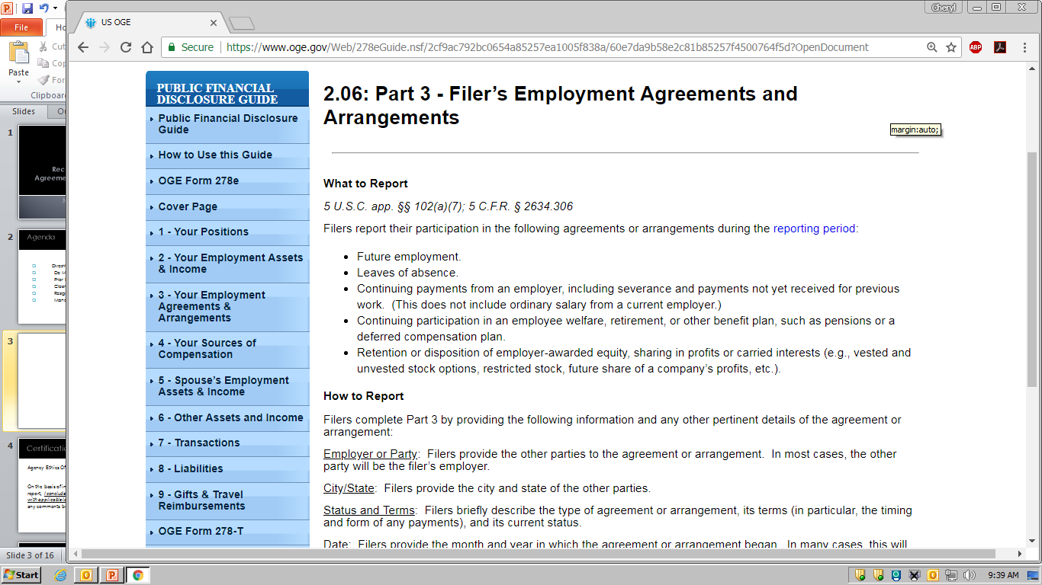

Slide 26
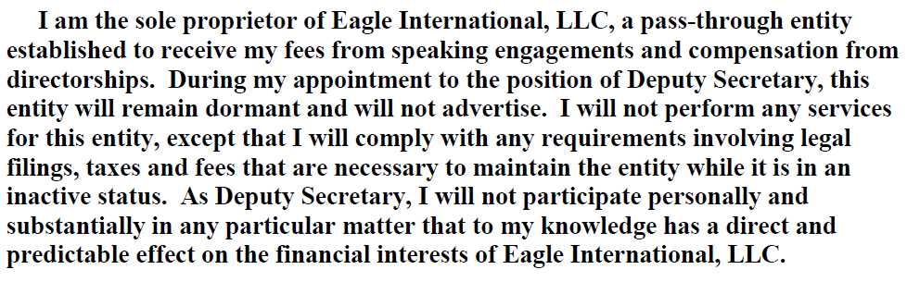
Closing a Business--EA

Slide 27
Closing a Business
  * Outside Position
  Filer should indicate status of business
  (e.g. dormant since appointment). It will remain a reportable outside position.
  * Assets and Income
      Filer should report any remaining equity interest and any income prior to appointment.

Slide 28
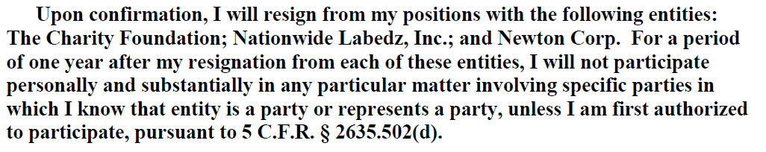
Resignations--EA

Slide 29
Resignations
  * Confirm resignations from outside positions
      * May still be reportable given reporting period covered

Slide 30
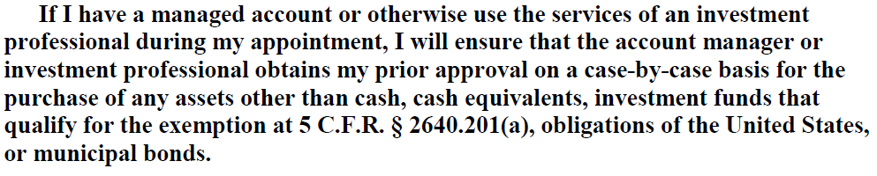
Managed Accounts--EA

Slide 31
Managed Accounts
  * Any accounts that require the services of an investment professional
      * Filer must give prior approval for certain
      purchases

