Slide 1
New Employee Orientation: Part 2 Answering the Question, How Do we do our work with Integrity?

Slide 2
Identity—Purpose—belonging

Slide 3
Multi-layered identity
Executive Branch Public Servant
Department/Agency
Bureaus/Agencies/Sub-Components
Professions/specialized work

Slide 4
Who are we?
What do we do?
What do we Value and believe?
How do we do our work consistent with our values and beliefs?

Slide 7
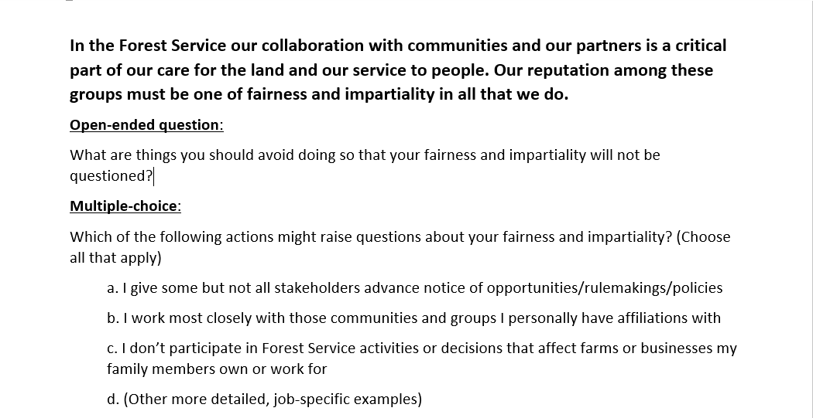

Slide 8
MISSION-FOCUSED
Highlight high risk or high frequency issues
Create examples that show how ethics issues actually arise in day-to-day work

Slide 9
Guide for Customizing Handbooks

Slide 11
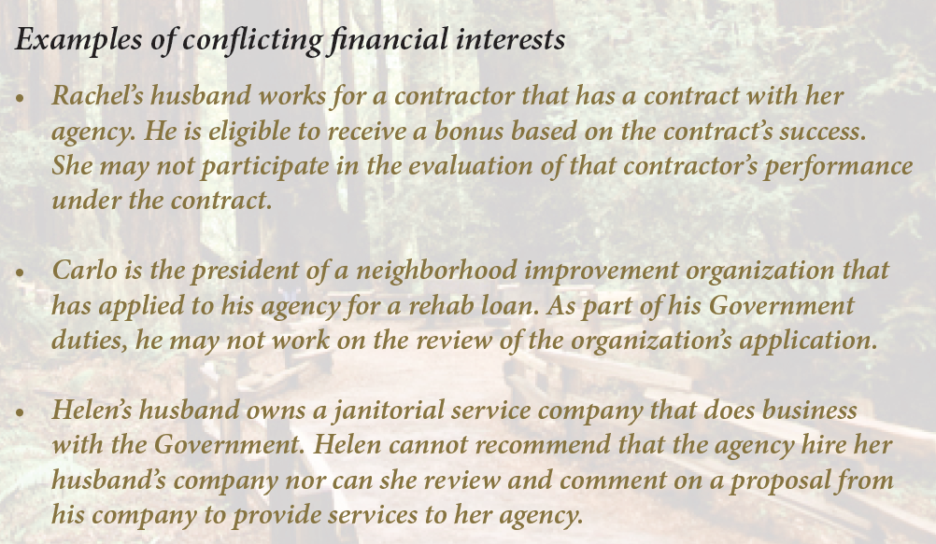

Slide 12
ETHICAL SERVICE
Your spouse’s employer (does business with/ is regulated by/ is a grantee of) is affected by the work of our agency.
IS IT A CONFLICT OF INTEREST*?
WHAT WILL YOU DO?
*See pp 10-11 of SOC Summary

Slide 14
New to government
Highlight federal public service as a distinct identity with obligations
Address practices that differ between private and public sectors

Slide 16
Address practices that differ between private and public sectors

Slide 17
Telework-related
Highlight distinct challenges telework creates
Provide opportunities to practice decision-making

Slide 18
Highlight distinct challenges telework creates

Slide 19
GETTING HELP
Identifying When and From Whom
Identify Processes and Why

Slide 20
Identifying When and From Whom

Slide 21
Identify Processes and Why

Slide 22
Financial disclosure filers
Filing process is the vehicle for orientation
Show the relationship between the form and coi, impartiality, misuse, gifts
Explain why required to file, how information is relevant to ethics, what employee’s responsibilities are post-filing

Slide 23
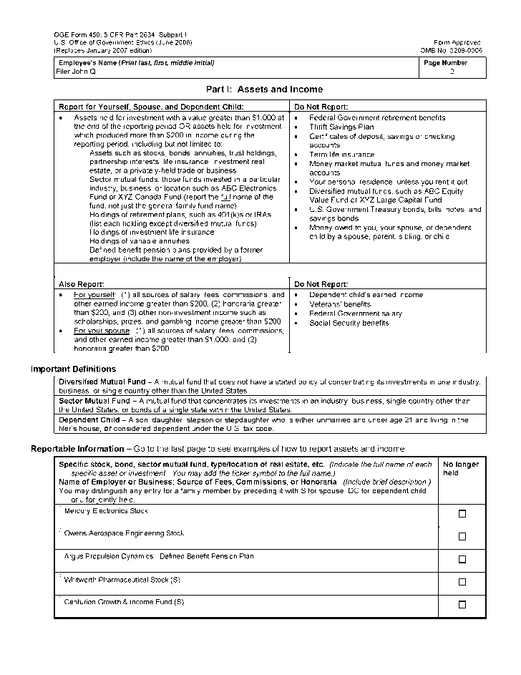
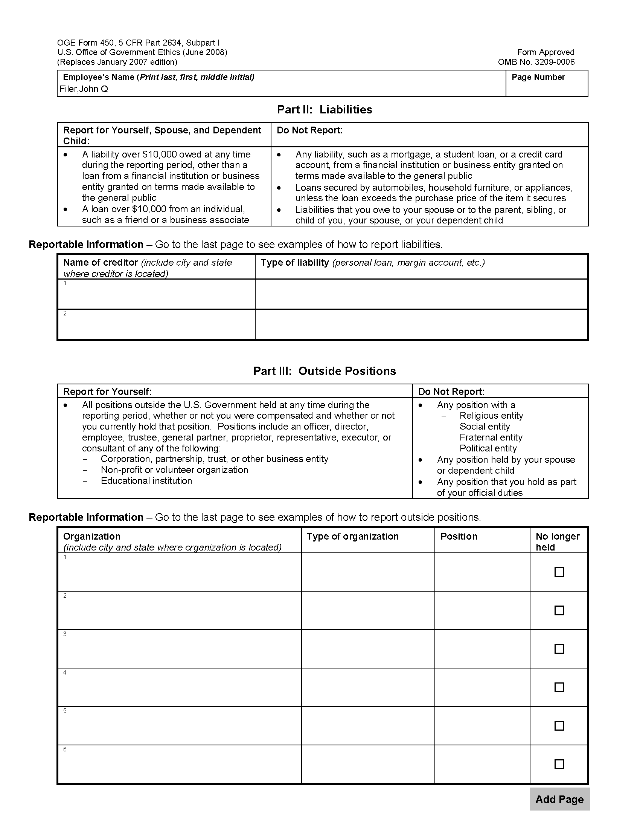
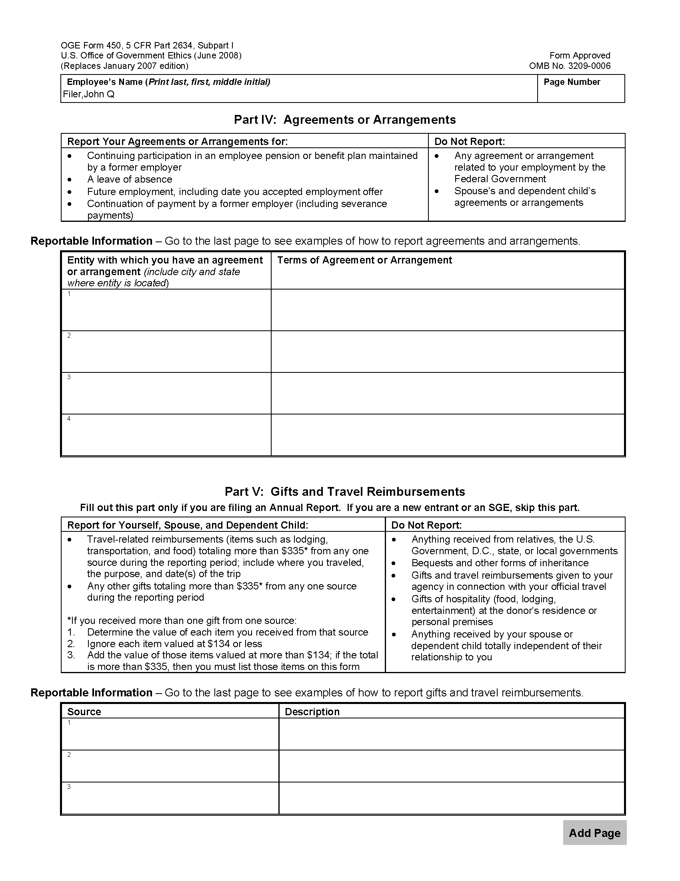
Standards of Conduct
& Agency Supplemental Standards
5 CFR 2635 et seq.
Gifts/Impartiality
Prohibited Holdings
Impartiality
Outside Activities
Seeking Employment
Outside Activities
Misuse of Position
Impartiality
Impartiality
Gifts

Slide 24
Criminal Conflicts
18 U.S.C. 201-209
208 Financial Interest
208 Financial Interest
209 Supplemented Salary
207 Post-Employment
203 Representation
208 Financial Interest
205 Representation
209 Supplemented Salary
208 Financial Interest
209 Supplemented Salary

Slide 25
Who are we?
How do we do our work consistent with our values and beliefs?

Slide 26
What is our?

