Slide 1

NATIONAL
GOVERNMENT ETHICS
SUMMIT
New Employee Orientation: An Agency Culture Bootcamp
Cheryl Kane-Piasecki
Institute for Ethics in Government
OGE

Slide 2
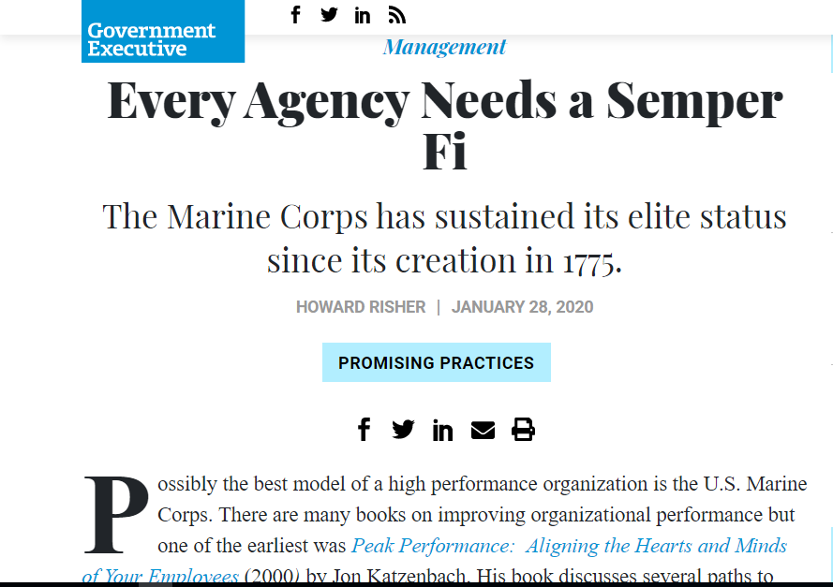

Slide 3
Identity—Purpose—belonging

Slide 4
https://www.govexec.com/workforce/2019/12/survey-less-half-feds-would-keep-their-jobs-if-offered-similar-position-elsewhere/161930/[2/27/2020 10:01:25 AM]

Slide 5
https://www.govexec.com/workforce/2019/12/survey-less-half-feds-would-keep-their-jobs-if-offered-similar-position-elsewhere/161930/[2/27/2020 10:01:25 AM]

Slide 6
Identity—Purpose—belonging

Slide 7
NEO: Part 1
Answering the Question,
Who Are We?

Slide 8
Multi-layered identity
Executive Branch Public Servant
Department/Agency
Bureaus/Agencies/Sub-Components
Professions/specialized work

Slide 9
Who are we?
What do we do?
What do we Value and believe?
How do we do our work consistent with our values and beliefs?

Slide 10
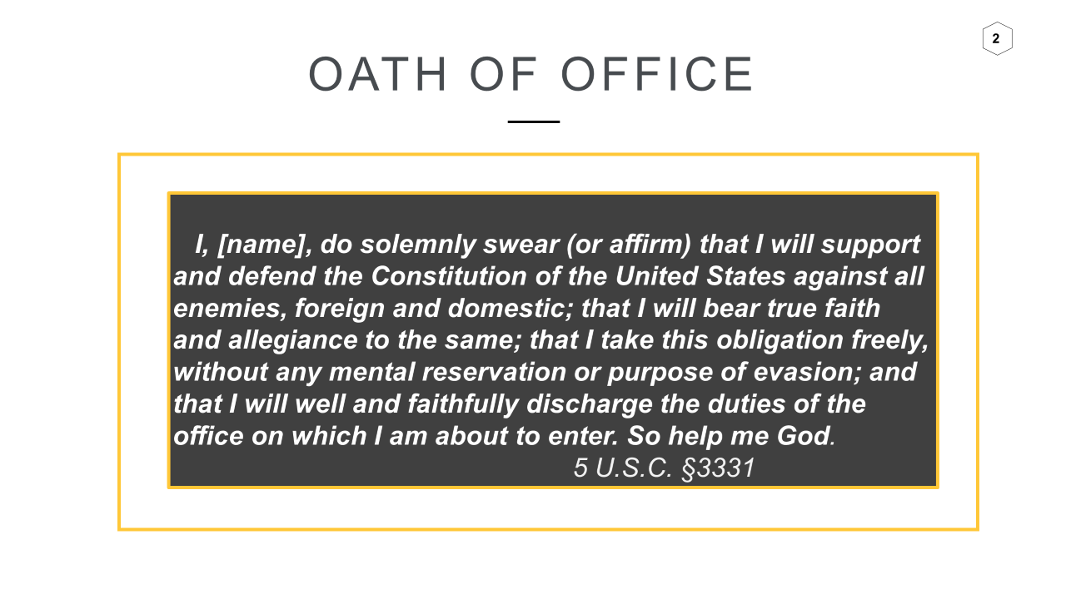

Slide 11
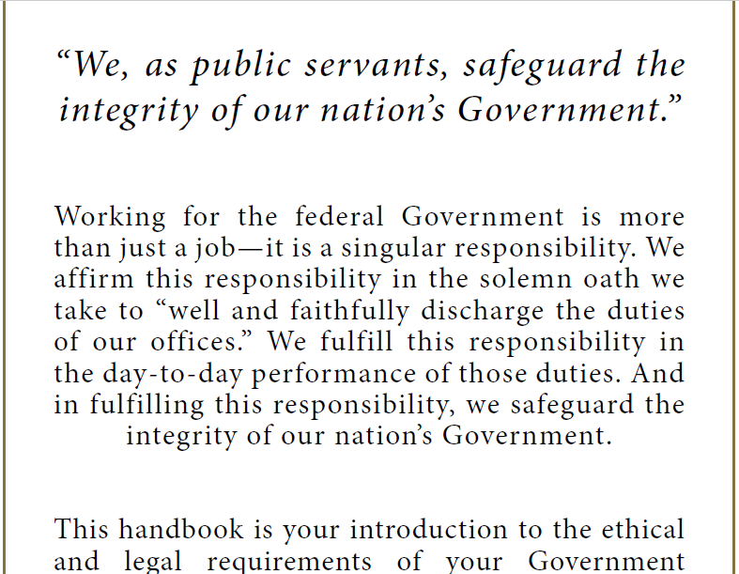
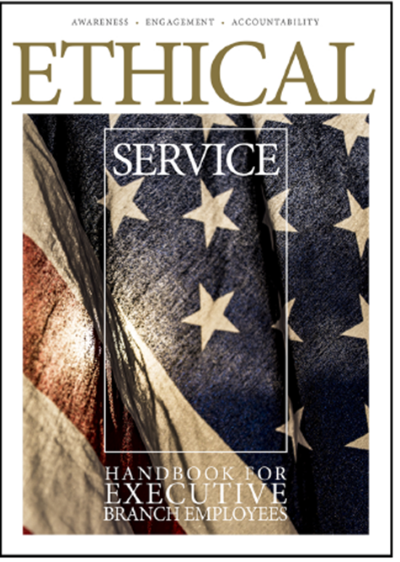
Employee Handbook

Slide 12



GENERAL PRINCIPLES
RESPECT THE RULE OF L AW
DO NOT MISUSE YOUR PUBLIC POSITION FOR PRIVATE GAIN
BE RESPONSIBLE IN THE USE OF YOUR TIME AND RESOURCES
LOYALTY TO LAW
SELFLESS SERVICE
RESPONSIBLE STEWARDSHIP

Slide 13
Who are we?
What do we do?
(Agency mission/vision/goals/purpose)
What do we Value and believe?
How do we do our work consistent with our values and beliefs?

Slide 14
Who are we?
What do we do?
What do we Value and believe?
How do we do our work consistent with our values and beliefs?

Slide 15
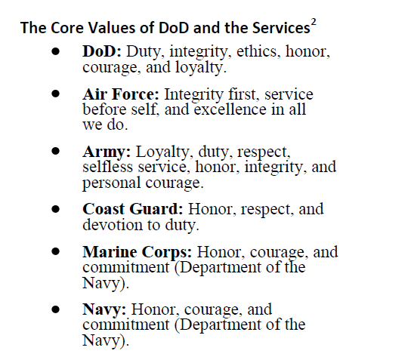
DOD AND THE SERVICES

Slide 16
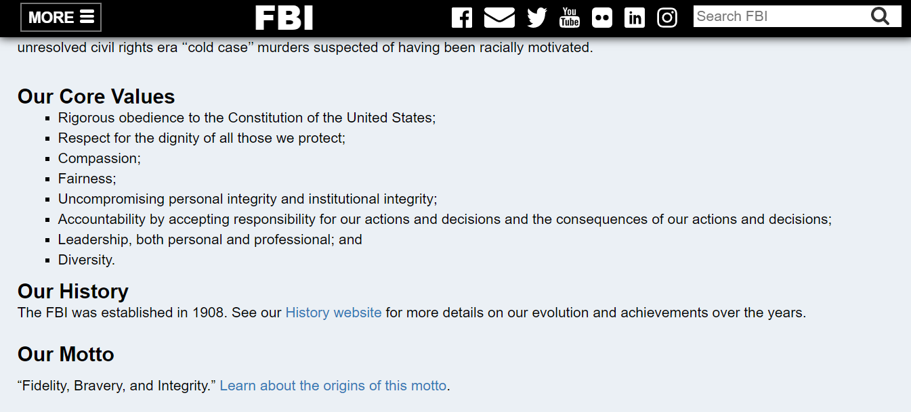

Slide 17
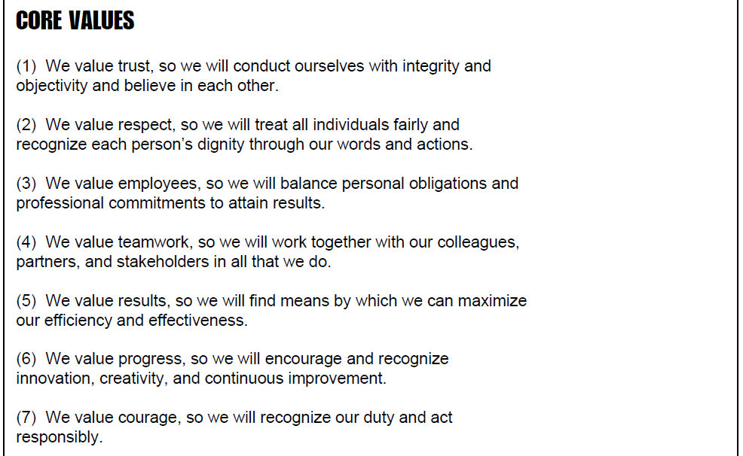
USDA OIG

Slide 18
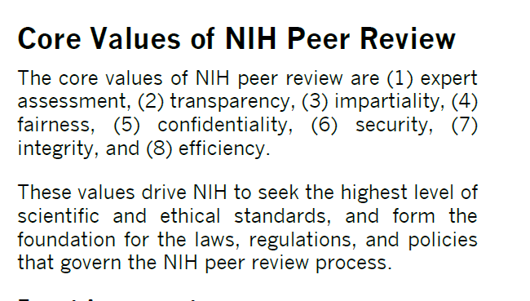

Slide 19
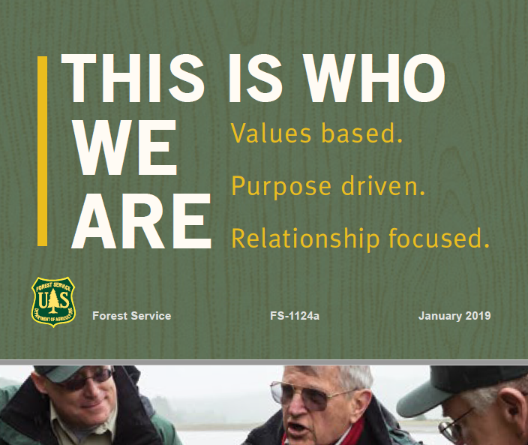
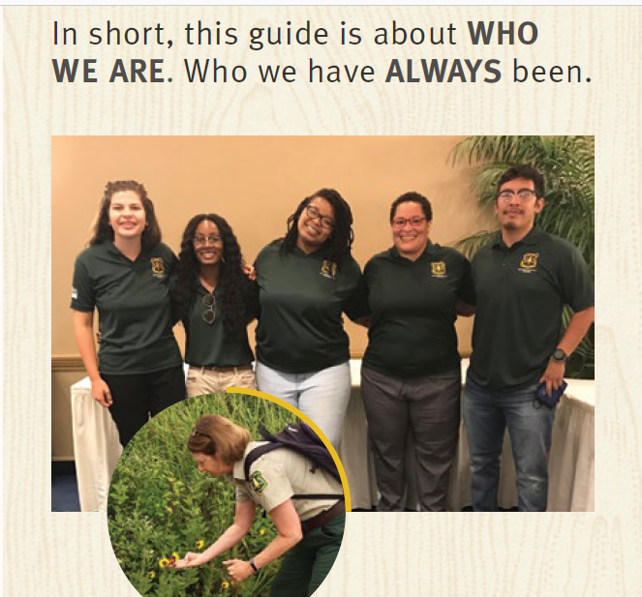

Slide 20
Who are we?
What do we do?
What do we Value and believe?
How do we do our work consistent with our values and beliefs?

Slide 21
NEo: Part 2
Answering the Question, hoW Do We Do our work with integrity?

