Slide 1
Applying Commonly Used Exemptions at 5 CFR part 2640
Cheryl Kane-Piasecki
Patrick Shepherd
March 2, 2017

Slide 2
18 U.S.C. § 208
Government employees are prohibited from participating personally and substantially in a particular government matter that will have a direct and predictable effect on their financial interests, including the financial interests of others, which are attributed to the federal employee.
Purpose: To prevent an employee’s personal interests from influencing Government decisions

Slide 3
18 U.S.C. § 208
There is no Government-wide restriction on holding certain assets .

Slide 4
18 U.S.C. § 208
Particular Government Matter
Financial holding or other interest
208

Slide 5
Conflict Remediation
Particular Government Matter
Financial holding or other interest
208
Two Ways to Remedy Conflict:
1. Remove employee from matter
2. Remove disqualifying financial interest in matter

Slide 6
Conflict Remediation 1
Particular Government matter
Financial holding or other interest
Recusal
Recusal removes employee’s participation in the
particular Government matter

Slide 7
Conflict Remediation 1
Particular Government matter
Financial holding or other interest
Recusal
No Nexus = No § 208
Recusal removes employee’s participation in the
particular Government matter

Slide 8
Conflict Remediation 2
Particular Government Matter
Financial holding
Divestiture
Written Waiver
[§ 208 (b)(1)]
2640 Exemption
[§ 208 (b)(2)]
Disqualifying nature of the financial interest is remediated

Slide 9
Conflict Remediation 2
Particular Government Matter
Financial holding
Divestiture
Written Waiver
[§ 208 (b)(1)]
2640 Exemption
[§ 208 (b)(2)]
No Nexus = No § 208
Disqualifying nature of the financial interest is remediated

Slide 10
A few words about exemptions
Only OGE is authorized to issue
Housed in 5 CFR 2640
Apply automatically (absent statute or regulation that trumps them)
Eliminates both 208 conflict AND any appearance concerns

Slide 11
  Agenda
Use a process for determining if the following exemptions apply:
  mutual funds and unit investment trusts (diversified and sector)
  publicly traded securities
  employee benefit plans
Apply the process to specific examples
Identify useful resources to assist the analysis

Slide 12
Analysis Process
Will outcome of Government matter have an effect on the identified interest?
Is there a potential exemption?
Does the exemption cover type of financial interest?
Does the exemption cover type of particular matter (if applicable)?
Where applicable, does the $ value meet the de minimis thresholds?
Are all other elements of the exemption met?

Slide 13
MutuAl Funds and Unit Investment Trusts

Slide 14
  Applying the Exemptions
  Exercise 1
Your CIO will be working on various contracts for IT hardware, software and services. The CIO’s investment portfolio consists of:
  $200,000 invested in the Wells Fargo Advantage Endeavor Select Fund
  $12,000 invested in Vanguard Information Technology Index
  $65,000 invested in Ishares US Industrials

Slide 15
1
Will the outcome of the matter affect the holding?
Matters:
Contracts for IT hardware, software and services
Interests:
Pooled investment vehicles

Slide 16
2
Which exemption might apply?
5 CFR 2640.201
Exemptions for interests in mutual funds,
unit investments trusts and employee benefit plans

Slide 17

3
Is it a mutual fund?
Mutual fund means an entity which is registered as a management company under the Investment Company Act of 1940, as amended (15 U.S.C. 80a–1 et seq. ). For purposes of this part, the term mutual fund includes open-end and closed-end mutual funds and registered money market funds.
5 CFR § 2640.102(k)

Slide 18
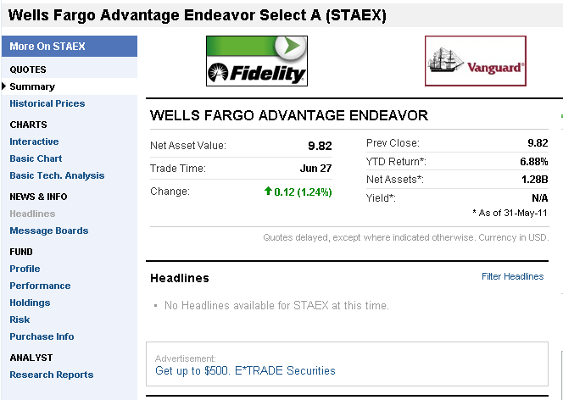

Description
The investment seeks long-term capital appreciation. The fund normally invests at least 80% of its total assets in equity securities; and up to 25% of the fund's total assets in equity securities of foreign issuers through ADRs and similar investments. It invests principally in the equity securities of approximately 30 to 40 companies that the advisor believes offer the potential for capital growth.
Fund filings (PDF) »

Slide 19
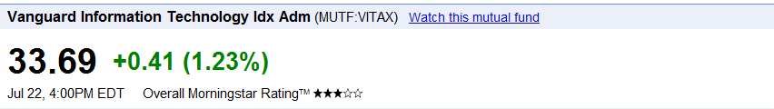

Slide 20
Is it a mutual fund?
Pay attention to the ticker symbol!
Wells Fargo Advantage Endeavor Select Fund: STAEX
Vanguard Information Technology Index: VITAX
5 letters
Last letter is X

Slide 21
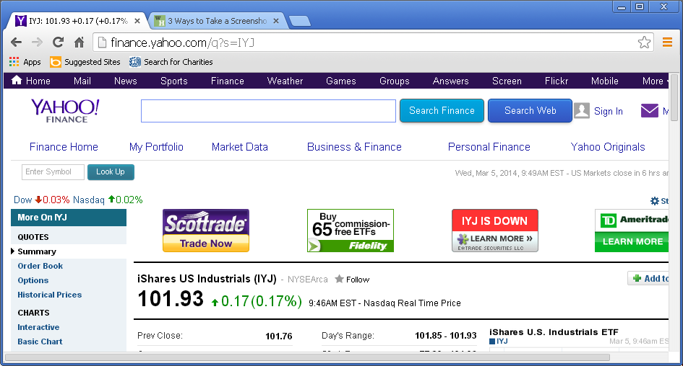
Is an ETF a mutual fund?
????

Slide 22
Exchange Traded Funds (ETFs)
Most exchange-traded funds:
    are organized either as open-end investment management companies or as unit investment trusts
    are registered with the Securities and Exchange Commission (SEC) under the same statutory authorities as traditional mutual funds
    qualify for the exemptions in 5 C.F.R. Part 2640 for mutual funds and unit investment trusts.
  Source: Public Financial Disclosure: A Guide to Reporting Selected Financial Instruments

Slide 23
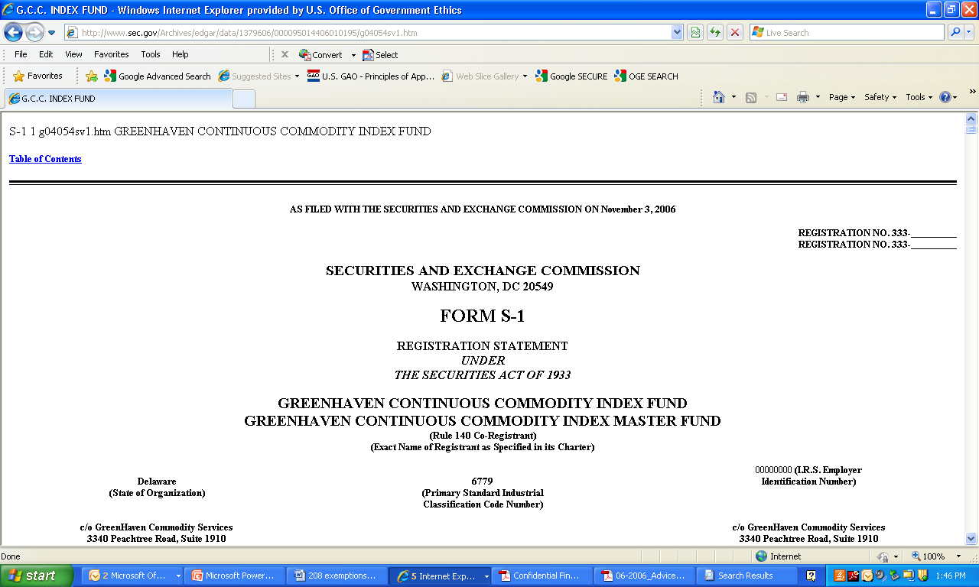
ETFs Invested in Commodities and Commodity Futures
Do Not Meet the Definitions for Mutual Fund or
Unit Investment Trust

Slide 24
Is it a mutual fund?

Wells Fargo Advantage Endeavor Select Fund

Vanguard Information Technology Index

iShares U.S. Industrials
status check

Slide 25
4
Is it diversified or sector?
Does the mutual fund have a stated policy of concentrating its investments in an industry, business, single country other than the United States, or bonds of a single State within the United States?
5 CFR § 2640.102(a)

Slide 26
Diversified vs. EIF
Diversified | Excepted Investment Fund
Conflict of Interest Concept Determines if Fund is Exempted from 18 USC 208 | Financial Disclosure Concept Determines if Holdings of Fund are Reportable under the EIGA Financial Disclosure requirements
Defined in 5 CFR § 2640.102(a) | Defined in 5 CFR 2634.310(c)(2)
A mutual fund registered with the SEC that has no stated policy of concentrating investments in any one industry, business, country other than the US, or bonds of a single State within the US | 3-prong test: Widely held Publicly traded or available, OR widely diversified Independently managed
Important: Just because something qualifies as an EIF does not mean that it automatically qualifies as a diversified mutual fund that is exempt from 18 U.S.C. § 208. You must check to see that it qualifies for the diversified mutual fund exemption.

Slide 27
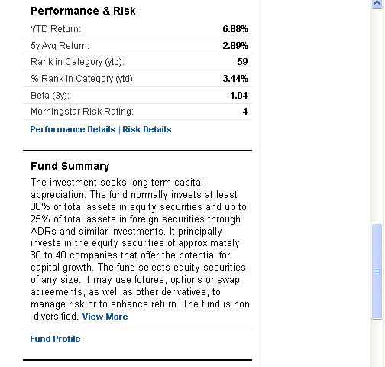
Wells Fargo Advantage Endeavor Select Fund: STAEX

Slide 28
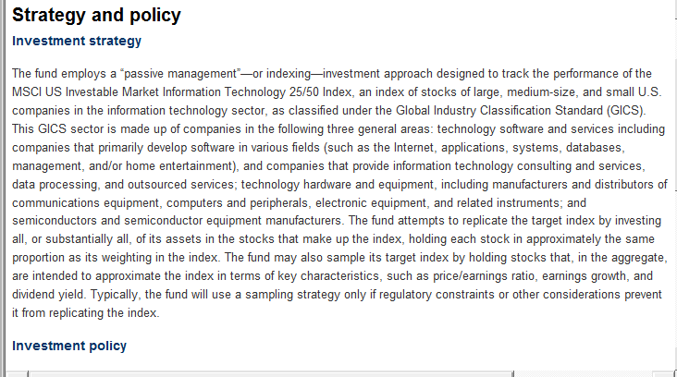
Vanguard Information Technology Index: VITAX

Slide 29
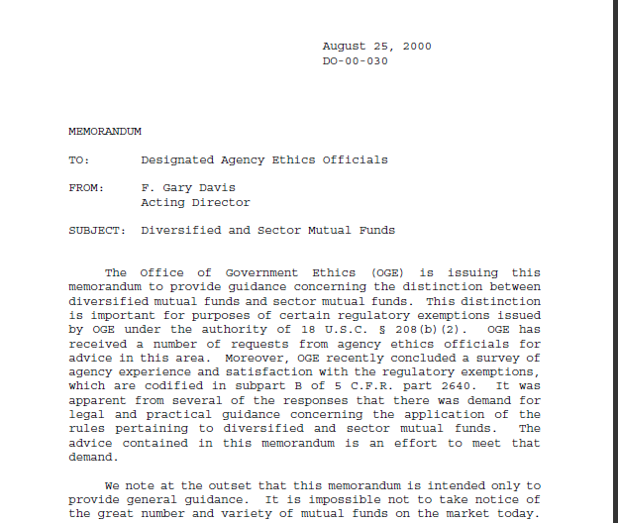
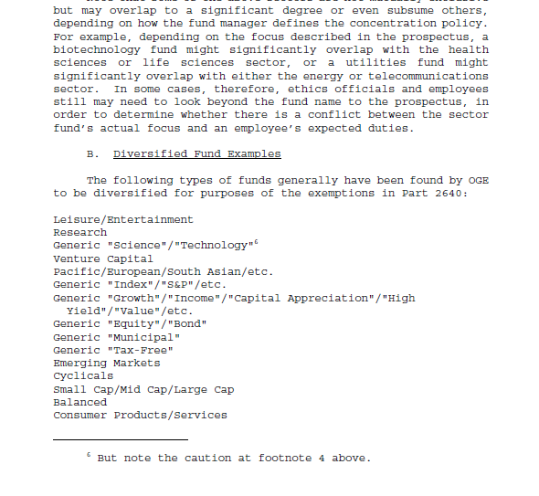
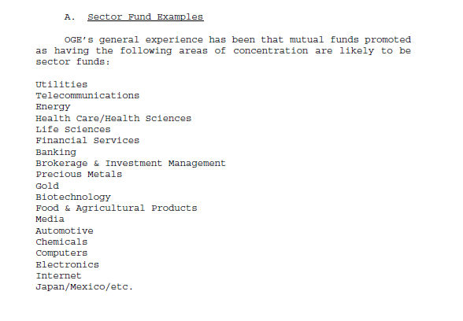
DO-00-030
ProgramResources

Slide 30
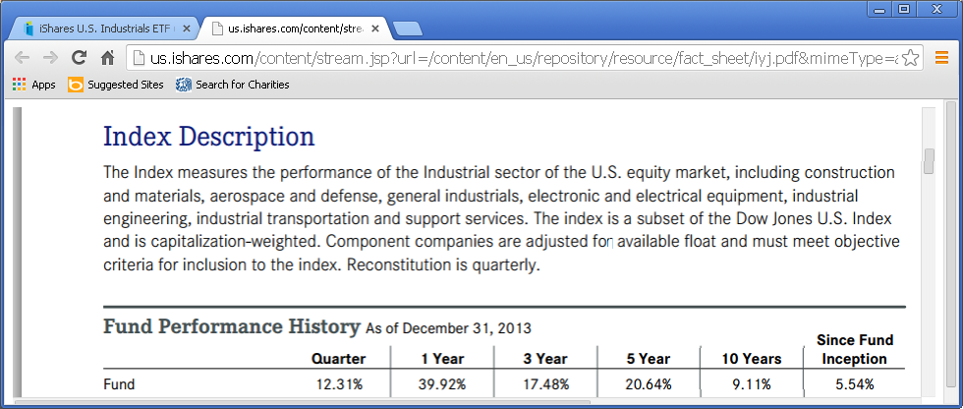
Ishares US Industrials

Slide 31
Is the fund diversified?

Wells Fargo Advantage Endeavor Select Fund
X
Vanguard Information Technology Index-
Sector fund not eligible for diversified exemption

iShares U.S. Industrials
status check

Slide 32
Does the value of the interest meet the de minimis?
5
Is the aggregate market value of the employee’s interests in all sector mutual funds that concentrate in the same sector and have one or more holdings that might be affected by the particular matter $50,000 or less?
5 CFR § 2640.201(b)(2)

Slide 33
Exemptions for sector funds

Vanguard Information Technology Index
$12,000 is below the de minimis for sector funds
status check

Slide 34
A word about the “other” sector fund exemption…
5 CFR 2640.201(b)(1)
Example:
Our CIO’s only conflicts are with the IT industry. Let’s say the employee owns a sector fund that concentrates its investments in Banking, but the fund also happens to hold securities in one or two IT companies.
This sector fund qualifies for the exemption.

Slide 35
PUBLICLY TRADED SECURITIES

Slide 36
  Applying the Exemptions
  Exercise 2
  One of your employees will be assigned to work on a regulation to set standards to reduce harmful bacteria at facilities that manufacture frozen dinners.
  The employee’s spouse and 12 year old son inherited $2,500 each in ConAgra stock last year when the employee’s father-in-law died. The employee also has $12,000 worth of stock in Nestlé.

Slide 37
1
Will the outcome of the matter affect the holding?
Matter:
Standard-setting regulation for frozen food manufacturing
Interests: Stock
  ConAgra Foods (manufacturer of Healthy Choice
  and Banquet frozen meals)
  Nestlé S.A. (manufacturer of Stouffers and Lean Cuisine frozen meals)

Slide 38
18 U.S.C. § 208
Standard setting regulation for frozen foods
Stock ConAgra Foods
Nestlé S.A.
Matter
Interest
208
Potential for gain or loss to the employee

Slide 39
?
How do we analyze “stock holdings?”
Stocks represent an ownership interest in a company, therefore any matter that affects the issuing company’s prosperity is presumed to directly and predictably affect the financial interests of its stockholders.
Source: Public Financial Disclosure: A Reviewer’s Reference

Slide 40
2
Which exemption might apply?
5 CFR 2640.202
Exemptions for interests in securities

Slide 41
3
Is it a publicly traded security?
A security is… 5 CFR 2640 .102(r)
Security means common stock, preferred stock, corporate bond, municipal security, long-term Federal Government security, and limited partnership interest…
Publicly traded… 5 CFR 2640.102(p)
means a security (as defined in (r)) that is..."Registered with the Securities and Exchange Commission pursuant to section 12 of the Securities Exchange Act of 1934 (15 U.S.C. 78 ) and listed on a national or regional securities exchange or traded through NASDAQ“

Slide 42
What do these companies have in common?
Dell Bechtel
Enterprise Mars
Toys R Us Sheetz
Perdue Cargill
Not publicly traded.

Slide 43
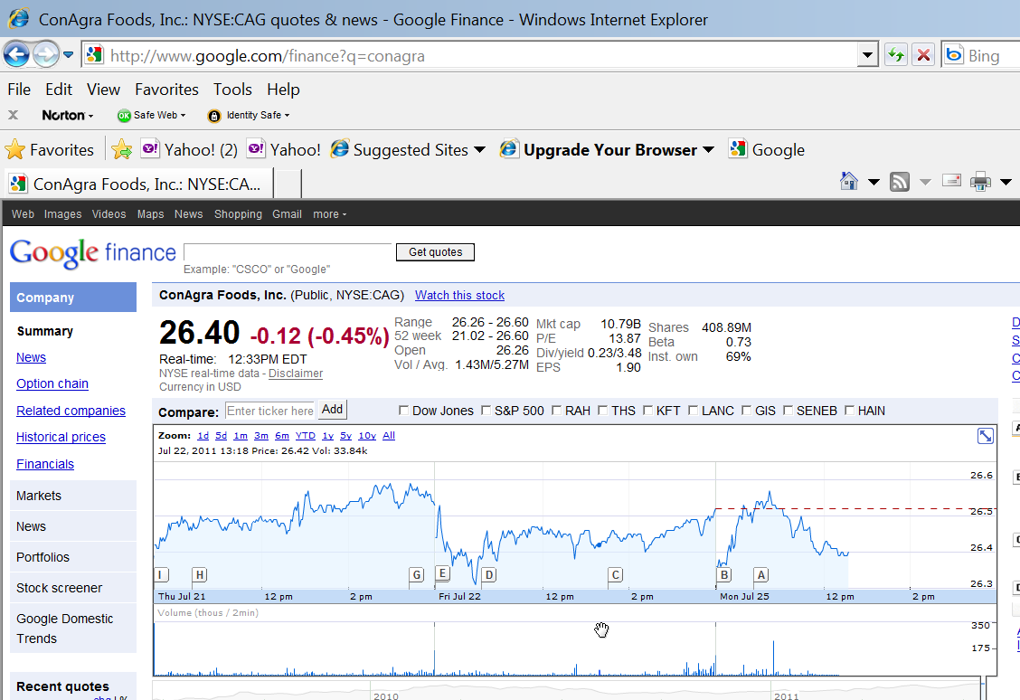

Slide 44
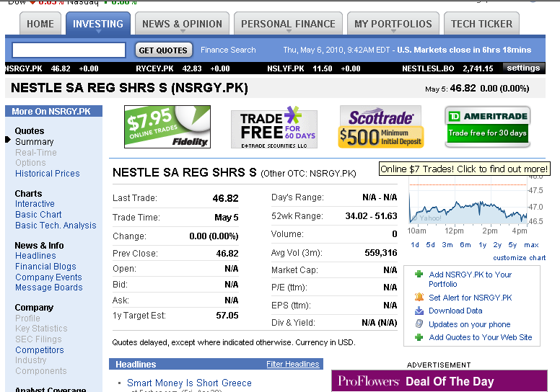

Slide 45
American Depositary Receipt (ADR)
An American depositary receipt is a certificate representing shares of foreign securities. It is a form of indirect ownership of the foreign securities that are not traded directly on a national exchange in the US. Financial institutions purchase the underlying securities on foreign exchanges. Through their foreign branches, the financial institutions hold legal title to the underlying stock.
Eligible for the exemption:
ADRs that are registered with the Securities and Exchange Commission (SEC) and traded on national exchanges, such as the New York Stock Exchange or the American Stock Exchange are eligible for the exemptions for publicly traded securities.
NOT eligible for the exemption:
ADRs that are not registered and traded on national exchanges. Investors have to purchase these non-registered American depositary receipts directly from their issuers or through other private trades (i.e., “over the counter”).
Source: Public Financial Disclosure: A Guide to Reporting Selected Financial Instruments

Slide 46
Example 1: ADR traded on an American Exchange
BTI$110.45-0.66(-0.59%)
British American Tobacco p.l.c. (American Depositary Receipts) - NYSEMKT
Example 2: ADR NOT traded on an American Exchange
Nestle Sa-Spons Adr
(NSRGY:OC Markets Group Inc)

Slide 47
Publicly traded securities

Conagra Foods, Inc.
X
Nestle—Stock OTC or ADR OTC, neither qualify
status check

Slide 48
4
What is the “particular matter” ?
  Particular matters involving specific parties (contracts, grants, litigation, etc.)
OR
  Particular matters of general applicability (regulations, policies, etc. that focus on the interests of a discrete and identifiable class of persons)

Slide 49
Does the value meet the de minimis?
5
Specific Parties | General Applicability
No more than $15,000 aggregate in all affected parties No more than $25,000 aggregate in all affected parties and non-parties. | No more than $25,000 in one affected entity; no more than $50,000 aggregate in all affected entities.

Slide 50
Matter of General Applicability
    Interests:
    $12,000 in Nestlé stock
    (No exemption; another remedy needed)
    $5,000 in ConAgra stock
X

$25,000 or less in any single affected entity

$50,000 or less in all affected entities

Slide 51
?
How do we analyze “stock options?”
Stock options represent the same concern as actual stock ownership because their values are closely related to the underlying stock.
Any matter that affects the issuing company’s prosperity is presumed to directly and predictably affect the financial interests of those who hold options to buy or sell the company’s stock.
NOT eligible for “publicly-traded securities” exemptions

Slide 52
?
How do we analyze “corporate bonds?”
Bonds are a corporation’s fixed debt obligation.
Question is whether a matter will have potential to alter either:
  • the market resale value of a bond (by affecting market interest rates or the corporation’s credit rating, for example); or
  • the corporation’s ability or willingness to repay the debt (by affecting its financial stability).

Slide 53
EMPLOYEE BENEFIT PLANS

Slide 54
  Applying the Exemptions
  Exercise 3
You investigate discrimination complaints in HUD’s Office of Fair Housing in the Philadelphia Regional Office. You previously worked for the City of Philadelphia and have retained an interest in its 457 Deferred Compensation Plan.
One of your investments through the plan is in the T Rowe Price Real Estate Fund. It invests 80% of its assets in the equity securities of real estate companies.

Slide 55
?
Which exemption might apply?
5 CFR 2640.201(c)(1)(ii)
Exemptions for interests in employee benefit plans

Slide 56
5 C.F.R. 2640.201(c)(1)(ii)
You may participate in any matter where the disqualifying financial interest arises from the underlying holdings of a pension plan established by a State Government or a subdivision of the State for State/local employees.

Slide 57
Does the Exemption Apply?
You investigate discrimination complaints in HUD’s Office of Fair Housing in the Philadelphia Regional Office. You previously worked for the City of Philadelphia and have retained an interest in its 457 Deferred Compensation Plan.
One of your investments through the plan is in the T Rowe Price Real Estate Fund. It invest 80% of its assets in the equity securities of real estate companies.

Slide 58
  Applying the Exemptions
  Exercise 4
You are an attorney at the Consumer Product Safety Commission. Prior to that, you were in-house counsel at Sharpe Toys, Inc. Sharpe Toys provided its employees with a 401(k) plan administered by Integrity, Inc.
Through that 401(k) you have selected various individual stock holdings. You are invested in $14,000 in XYZ Corp. Now CPSC has asked you to participate in litigation against XYZ Corp.

Slide 59
5 C.F.R. 2640.201(c)(1)(iii)
“…where a particular pooled investment fund meets the definition of “diversified” in part 2640…an employee may rely on the exemption as to that fund when the employee …holds the fund through a qualifying employee benefit plan.”
“In contrast, an employee may not rely upon the employee benefit plan exemption with regard to any non-diversified pooled investment fund or other individual asset… .”
Source: LA-15-06 Employee Benefit Plans…

Slide 60
Does the Exemption Apply?
You are an attorney at the Consumer Product Safety Commission. Prior to that, you were in-house counsel at Sharpe Toys, Inc. Sharpe Toys provided its employees with a 401(k) plan administered by Integrity, Inc.
Through that 401(k) you have selected various individual stock holdings. You are invested in $14,000 in XYZ Corp. Now CPSC has asked you to participate in litigation against XYZ Corp.

Slide 61
Resources www.oge.gov
5 C.F.R. part 2640 (§ 208 Interpretation, exemptions, waivers)
DAEOgrams/Legal Advisories
DO-00-030 Diversified and Sector Mutual Funds
DO-06-029 “Particular Matter Involving Specific Parties,” “Particular Matter,” “Matter”
LA-15-06 Employee Benefit Plans
Financial Instruments
Nominee & New Entrant 278 Guide
Public Financial Disclosure: A Guide to Reporting Selected Financial Instruments

