Slide 1


Understanding sector funds
Departmental Ethics Office | Office of the Solicitor

Slide 2

PRESENTERS
Ed Bowen, Team Lead, Financial Disclosure Team
Kelsey Gaddy, Attorney-Adviser, Financial Disclosure Team
Michael Gleason, Attorney-Adviser, Advice and Counsel Team

Slide 3
Understanding sector funds roadmap
Sector Fund Introduction
Understanding Sector Funds – The Legal Side
Understanding Sector Funds – The Practical Side
Sector Identification and Categorization
Discussion/Questions

Slide 4
Understanding sector mutual funds – the legal side
18 U.S.C. § 208 – Basics
Investment Funds – Conflict Concerns
Sector Fund Exemptions and Examples
OGE Resources

Slide 5
18 U.S.C. § 208
The criminal statute at 18 U.S.C. § 208 prohibits an employee from participating personally and substantially in an official capacity in any particular matter that the employee knows would have a direct and predictable effect on the employee's own financial interests or imputed interests (i.e., persons or organizations whose interests are imputed to the employee).
Notes:
Reminder that this is a criminal statute with potential criminal penalties – up to 1 year in prison, or 5 if willful, and fines. 18 U.S.C. 216.
Imputed interests: spouse, minor child, general partner, organization the employee serves as officer, director, trustee, general partner or employee, or any person or organization with whom the employee is negotiating or has any arrangement concerning prospective employment.

Slide 6
Conflict concerns with investment fund ownership
Investment Fund Definition (from Investopedia):
  “A financial product that pools capital from multiple investors to purchase a portfolio of securities.”
  Types: mutual funds, money market funds, exchange-traded funds, unit investment trusts, business development companies, private investment funds, hedge funds…

Slide 7
Why do ethics officials care about investment funds?
Investment funds are very popular (2023 stats):
54% of U.S. households (71.5 million) invest in mutual funds, UITs, ETFs and similar investment companies to meet financial goals
Mutual funds are by far the most common (68.7 million households; 116 million individuals)
Mutual fund owners are from all age and income groups
Many common financial products own interests in mutual funds (brokerage account, 401(k), IRA, 529 plan, and even through the TSP mutual fund window)
Majority of mutual fund-owning households hold more than half of their financial assets in mutual funds
(Source: Investment Company Institute, www.ici.org)

Slide 8

Why care about investment funds?
When someone owns shares of an investment fund, they have a financial interest in the holdings of the investment fund.

Slide 9


Okay, so why’s that a problem?
Many filers are passive investors (through retirement plans, 529 plans, etc.) and have no clue about the indirect holdings of their investment funds.

Slide 10

Lack of control
Investment fund companies manage the money and select holdings.
Investors typically lack control over the assets within the portfolio and are unable to steer clear of potential conflicts.

Slide 11
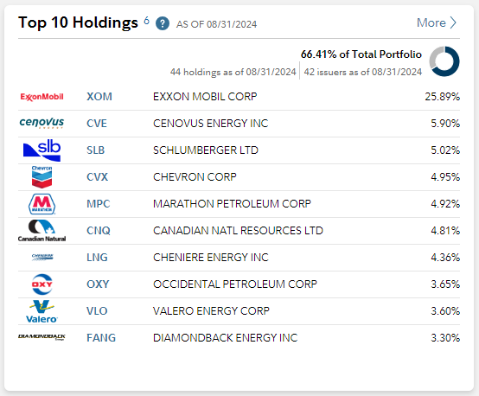
The Holdings of a mutual fund
Fidelity Select Energy Portfolio (FSENX)
Are there any possible issues?
(Source: Fidelity Select Energy Portfolio)

Slide 12
The Holdings of a mutual fund – Explained
Fidelity Select Energy Portfolio (FSENX)
Are there any possible issues?
6. Any holdings, asset allocation, diversification breakdowns or other composition data shown are as of the date indicated and are subject to change at any time. They may not be representative of the fund's current or future investments….
Notes:
Also, Mutual Funds often have many many investors, so that an employee’s portion is a mere drop in the bucket.

Slide 13



You cannot be serious!
I’m gonna be criminally liable for a proportionally minuscule investment in a fund I have no control over?!?!?
Notes:
Reminder: there is also a knowledge element to 208 liability (but we’re not focused on that today)

Slide 14
OGE To the rescue!
18 U.S.C. § 208(b)(2): OGE may exempt by regulation financial interests that are “too remote or too inconsequential to affect the integrity of the services of the Government officers or employees” (i.e. to affect the employee’s consideration of any particular matter).
Notes:
History
Before 1989 – Agencies had authority to make exemptions for their employees by regulation.
Ethics Reform Act of 1989 – Amended § 208 - OGE (not agencies) must make uniform exemptions applicable to the executive branch through regulation (after consultation with A.G.)
From 1996 – 2005, OGE promulgates exemptions applicable to mutual funds (in 1996, exemption for DMF and Sector funds where holding is not invested in sector in which the fund concentrates; in 2002, $50,000 de minimis exemption for sector funds).

Slide 15
OGE To the rescue!
5 C.F.R. § 2640.201: Exemptions for interests in mutual funds, unit investment trusts (UIT), and employee benefit plans.
  Diversified Mutual Funds and Unit Investment Trusts
  Sector Mutual Funds
  Employee benefit plans
  Matters affecting mutual funds and UITs.
Notes:
(d) Particular matters of general applicability (e.g. rulemaking) affecting the mutual fund company itself but not individual holdings of the fund (e.g. an SEC rulemaking).

Slide 16
definitions
5 C.F.R. § 2640.102 Definitions
Mutual fund means an entity which is registered as a management company under the Investment Company Act of 1940, as amended (15 U.S.C. 80a-1 et seq.). For purposes of this part, the term mutual fund includes open-end and closed-end mutual funds and registered money market funds.
Unit investment trust (UIT) means an investment company as defined in 15 U.S.C. 80a-4(2) that is a regulated investment company under 26 U.S.C. 851.
Notes:
Note: Most Exchange-Traded Funds (ETF) that qualify as mutual funds or UITs based on these definitions are eligible for the 2640.201 exemptions. Although commodity-focused ETFs that register with the Commodity Futures Trading Commission but not with the SEC under the 1940 Act are not eligible for the exemptions.

Slide 17
Why the tie to the 1940 Act?
Because:
Standardized and convenient way to determine if a fund is diversified or has a sector focus
Provides employees and ethics officials reliable information needed to apply the exemptions

Slide 18
exemptions
5 C.F.R. § 2640.201
Diversified Mutual Funds and UITs – Full Exemption
  No stated policy of concentrating investments in any industry, business, single country other than the U.S., or bonds of a single State within the U.S.
Sector Mutual Funds and UITs – Limited Exemption

Slide 19
Sector Mutual funds
What is a sector mutual fund?
  A company registered under the Investment Company Act of 1940.
  Concentrates investments in:
    a single business or industry;
    a single country other than the United States; or
    bonds of a single State within the United States.
5 C.F.R. §§ 2640.102(k) and (q).

Slide 20
Sector fund examples (OGE Filer Aid)
Utilities Fund
Telecommunications Fund
Energy Fund
Health Care/Health Sciences/Biotechnology Fund
Financial Services Fund (incl. Cryptocurrency funds)
Precious Metals Fund (e.g. Gold or Silver Funds)
Transportation Fund
Mortgage-Backed Securities (MBS) or Mortgage REIT Fund
Software Fund
Healthcare REIT Fund
Japan Fund
California Bond Fund

Slide 21
Non-Sector examples (OGE Filer Aid)
S&P 500 Fund
Large Cap/Mid Cap/Small Cap Fund
Emerging Markets Fund
Technology Fund
Growth/Value/Income Fund
Targeted Date Fund (e.g. 2035 Fund)
Natural Resources Fund
Industrials Fund
Long-Term Debt Fund
Information Technology Fund
US REIT Fund
Pacific/Asia/European Fund
Municipal Bond Fund

Slide 22
Exemptions applicable to sector funds
  Focus:
  Particular matters affecting the holdings of a Sector Fund. 5 C.F.R. § 2640.201(b)
  Particular matters of general applicability (e.g., rulemaking) affecting the mutual fund company itself but not individual holdings of the fund (e.g., an SEC rulemaking). 5 C.F.R. § 2640.201(d)

Slide 23
Limitation on Exemptions
  Exemptions do not apply to interests held in violation of a statute or agency supplemental ethics regulation or is otherwise prohibited under 5 C.F.R. § 2635.403(b) (agency determination of substantial conflict). 5 C.F.R. § 2640.204

Slide 24
Exemption – Affected holding not in the sector
  5 C.F.R. § 2640.201(b)(1) – an employee may participate in any particular matter affecting one or more holdings of sector mutual fund where the affected holding is not invested in the sector in which the fund concentrates, and where the disqualifying financial interest in the matter arises because of ownership of an interest in the fund.
Notes:
Note: I’m referring now only to sector mutual funds, but the exemptions also apply to sector UITs.

Slide 25
Exemption – De minimis investment in Sector
  5 C.F.R. § 2640.201(b)(2) – an employee may participate in a particular matter affecting one or more holdings of a sector mutual fund where the disqualifying financial interest in the matter arises because of ownership of an interest in the fund and the aggregate market value of interests in any sector fund or funds does not exceed $50,000.
Notes:
Note: the value limit applies to the fund as a whole, not the pro-rata value of any underlying holding of the fund. (DO-00-030 at 5)

Slide 26
Aggregated market value
  To calculate the $50,000 de minimis amount, an employee must aggregate the market value of all sector mutual funds in which the employee has a disqualifying financial interest and that concentrate in the same sector and have one or more holdings that may be affected by the particular matter. 5 C.F.R. § 2640.201(b)(2)(ii)

Slide 27
Example 1
  A Department of Interior (DOI) employee owns shares valued at $65,000 in a mutual fund concentrated in stock of financial services companies. The employee is working on a software procurement matter involving a computer company whose stock is included in the mutual fund’s portfolio.
Potential conflict? Yes: 😲 No: 👍
Notes:
Answer: No. This is covered by the sector mutual fund exemption at 2640.201(b)(1) – the software company holding is not invested in the financial services sector that the mutual fund is concentrating in.

Slide 28
Example 2
  A health regulation agency employee owns shares valued at $25,000 in a mutual fund concentrated in stock of health-related companies, including medical device and instrument manufacturers and pharmaceuticals. The employee is working on a medical instrument labeling regulation.
Potential conflict? Yes: 😲 No: 👍
Notes:
No – this is covered by the de minimis sector mutual fund exemption at 2640.201(b)(2)

Slide 29
Example 3
  The same health regulation agency employee’s spouse inherits $30,000 in XYZ Healthcare Fund, a mutual fund that invests in companies engaged in the design, manufacture, or sale of products or services used for or in connection with health care or medicine.
Potential conflict? Yes: 😲 No: 👍
Notes:
Yes – the employee has a financial interest that could be affected by the particular matter, and no exemption applies. They (and their spouse) own more than $50,000 in the same fund.

Slide 30
Example 4
  An Environmental Protection Agency (EPA) employee owns $15,000 in XYZ S&P 500 index fund, and her spouse owns $35,500 in the same fund, which is registered under the 1940 Act. The fund’s portfolio includes Exxon Mobil stock as one of its holdings. The employee is reviewing an environmental impact study for an oil and gas project proposed by Exxon Mobile on federal land.
Potential conflict? Yes: 😲 No: 👍
Notes:
No. This is a diversified mutual fund, so the full exemption applies.

Slide 31
EXAMPLE 5 – THEMATIC FUND (aka “esg” funds)
  A Department of Education employee invests $55,000 in ABC Engender Equality Fund that invests in companies scoring high on a scale measuring gender balance across the workforce, gender pay equivalency, paid parental leave, and anti-sexual harassment policies.
Potential conflict? Yes: 😲 No: 👍
Notes:
Answer: Depends.
Must analyze in the same way as other mutual funds – is it concentrated in investments in an industry, business, single country other than the U.S., or bonds of a single State within the U.S.? If so, sector; if not, diversified.
No facts here indicating a sector focus.
What if it focused on the same criteria but limited to educational software companies. This would be sector focused.
See LA-24-10 Determining Whether a “Thematic” Fund is a Sector or Diversified Fund for Purposes of the Regulatory Exemptions Applicable to Mutual Funds (September 11, 2024)
ESG = Environmental, Social and Governance Funds – i.e., consider a company’s sustainability and corporate responsibility when making investment decisions.

Slide 32
Oge clarifications
Real Estate Investment Funds – Diversified, unless the fund’s stated policy is to focus on real estate in an industry such as “healthcare” or “hotels and resorts,” or on real estate in a country other than the U.S. (LA-15-09)
Information Technology and Internet Funds – Diversified, unless concentrated in specific I.T. products or services (e.g. computer hardware, semiconductors, software, cybersecurity, social media networks, digital currency software) or on particular segment of the I.T. or internet field (e.g. health-related I.T.). (LA-19-06)
Real Estate Investment Trusts, Master Limited Partnerships, and Business Development Companies – REITs and MLPs not eligible for mutual fund exemptions; BDCs under 1940 Act are eligible. (LA-21-02)
Non-Sector Lines of Business or Subsidiaries – 5 C.F.R. § 2640.201(b)(1) exemption applies to a particular matter affecting a company held in the sector fund, if the particular matter affects only a non-sector line of business or subsidiary of the company. (LA-22-02)

Slide 33
Oge clarifications Cont.
Mutual funds that concentrate investments in cryptocurrencies, stablecoins, cryptocurrency or stablecoin derivatives, or cryptocurrency or stablecoin services are sector mutual funds in the financial service sector and eligible for the de minimis sector fund exemption. (LA-22-04)
Bitcoin Exchange-Traded Products (ETP) – Eleven specific Bitcoin ETPs do not qualify for the mutual fund exemptions because they are not registered under the 1940 Act. (LA-24-02)
Managed Accounts and Robo-Advisor Accounts – Even though such accounts may appear like mutual funds, they do not involve pooling with other investors, they are not mutual funds, and they do not qualify for the mutual fund exemptions. (LA-24-04)
“Thematic” Mutual Funds – Funds focused on a popular business trend, new technology, personal or societal value, etc. (e.g. “Renewable Energy Fund”), should be analyzed in the same way as other mutual funds when determining whether the fund is sector or diversified. (LA-24-10)

Slide 34

Helpful OGE resources
Preambles to proposed and final rules – 60 FR 47208; 61 FR 66830; 65 FR 53942; 67 FR 12443
OGE DO-00-003 – Diversified and Sector Mutual Funds (4/25/2000)
OGE LA-15-09 – Diversified and Sector Real Estate Funds (6/30/15)
OGE LA-19-06 – Treatment of Information Technology and Internet Funds (8/15/19)
OGE LA-21-02 – REITs, Master Limited Partnerships, Business Development Companies (1/6/21)
OGE LA-22-02 – Non-Sector Lines of Business or Subsidiaries of a Company in a Sector (4/25/22)
OGE LA-22-04 – Cryptocurrency, Stablecoins and Related Investments (7/5/22)
OGE LA-24-02 – Bitcoin Exchange-Traded Products (1/31/24)
OGE LA-24-04 – Managed Investment Accounts (4/3/24)
OGE LA-24-10 – Determining Whether a “Thematic” Fund is a Sector or Diversified Fund (9/11/24)
OGE Conflict of Interest Considerations: Legal Entities that Hold Assets
Notes:
So, given the important exemptions for sector mutual funds, it’s important to correctly identify them. Kelsey will now provide helpful practical tips for determining what funds qualify for the exemptions.

Slide 35
Understanding Sector funds- the practical side
Roadmap
Mutual Fund “Territory”
Names Rule – Rule 35d-1
Prospectus
  Investment Company Act of 1940 (and New Tips!!)
  Investment Policy or Statement
OGE Guidance
  General (2000)
  Refined Guidance
Examples and Lessons
Bonus Slide on Thematic Funds (if we have time)

Slide 36
the puzzle pieces
Mutual
Fund
Territory
The
Name
The
Name
Prospectus
Parts
I & II
OGE Guidance

Slide 37
solving the puzzle
Mutual
Fund
Territory
Mutual
Fund
Territory
The
Name
The
Name
Prospectus
Parts
I & II
OGE Guidance

Slide 38
The names rule
Mutual
Fund
Territory
The
Name
In 1996, Congress amended Section 35(d) of the 1940 Act providing the SEC rulemaking authority to define fund names that are materially deceptive and misleading. Using this authority, the SEC proposed the Names Rule and adopted it in January 2001.
The Names Rule:
  Prohibits funds from using materially deceptive or misleading names
  Requires registered investment companies using names suggesting a fund focuses on a particular type of investments to invest at least 80% of its assets in said type of investments

Slide 39
The names rule Cont.
Mutual
Fund
Territory
The
Name
Still, the SEC has long cautioned investors against relying on fund names as the sole source of information about the investments and risks but recognizes that “the name of an investment company may communicate a great deal to an investor.”
The prospectus remains the best source of information – true for investors and just as true for the Federal ethics rules and regulations.

Slide 40
The names rule – diversified names per oge GUIDANCE
Leisure/Entertainment
Research / Venture Capital / Emerging Markets
Generic "Science"/"Technology"
Pacific/European/South Asian/etc.
Generic "Growth"/"Income"/"Capital Appreciation"/"High Yield"/"Value"/etc.
Generic "Index"/"S&P"/etc.
Generic "Equity"/"Bond" / “Municipal” / “Tax-Free”
Small Cap/Mid Cap/Large Cap
Balanced / Cyclicals
Consumer Products/Services
Natural Resources
Basic Materials / Industrial Materials
Mutual
Fund
Territory
The
Name

Slide 41
The names rule – sector names per oge GUIDANCE
Energy / Utilities Telecommunications
Health Care / Health Sciences / Life Sciences
Financial Services / Banking Brokerage & Investment
Precious Metals / Gold ***
Biotechnology Food & Agricultural Products
Media / Automotive / Chemicals
Computers / Electronics Internet / Computer
Real Estate / Information Technology
Japan / Mexico/ Country other than U.S.
Mutual
Fund
Territory
The
Name

Slide 42
Prospectus – part I: Is it really a mutual fund
Mutual fund means an entity which is registered as a management company under the Investment Company Act of 1940, as amended (15 U.S.C. § 80a–1 et seq.). For purposes of this part, the term “mutual fund” includes open-end and closed-end mutual funds and registered money market funds.
5 C.F.R. § 2640.102(k)
Mutual
Fund
Territory
The
Name
Prospectus
Parts I
Prospectus
Parts I

Slide 43
Prospectus – part I: Registered under the “1940 act”
Prospectus
Parts I
How to find a prospectus:
  Financial Management Company websites - look for terms Documents, Fund Literature, Resources, etc.
  SEC EDGAR - www.sec.gov - to search for a mutual fund or ETF click on Company Filings under the search bar at the top of the home page to get to the EDGAR search page. On the left side are tools optimized to search for mutual funds and ETFs.
811: All filers registered under the Investment Company Act of 1940 are assigned a Reporting Filing Number that always starts with an 811-prefix. Most often, the 811-number is on the last page of the prospectus. This is the simplest and surest method to identify funds registered under the 1940 Act.

Slide 44
NEW TIPS!!!
For Diversified Mutual Funds:
OGE released a new Job Aid earlier this year: DETERMINING if an Investment Fund is Registered under the 1940 Act - 1940 Act Job Aid.
SEC Investment Company Series and Class Information

Slide 45
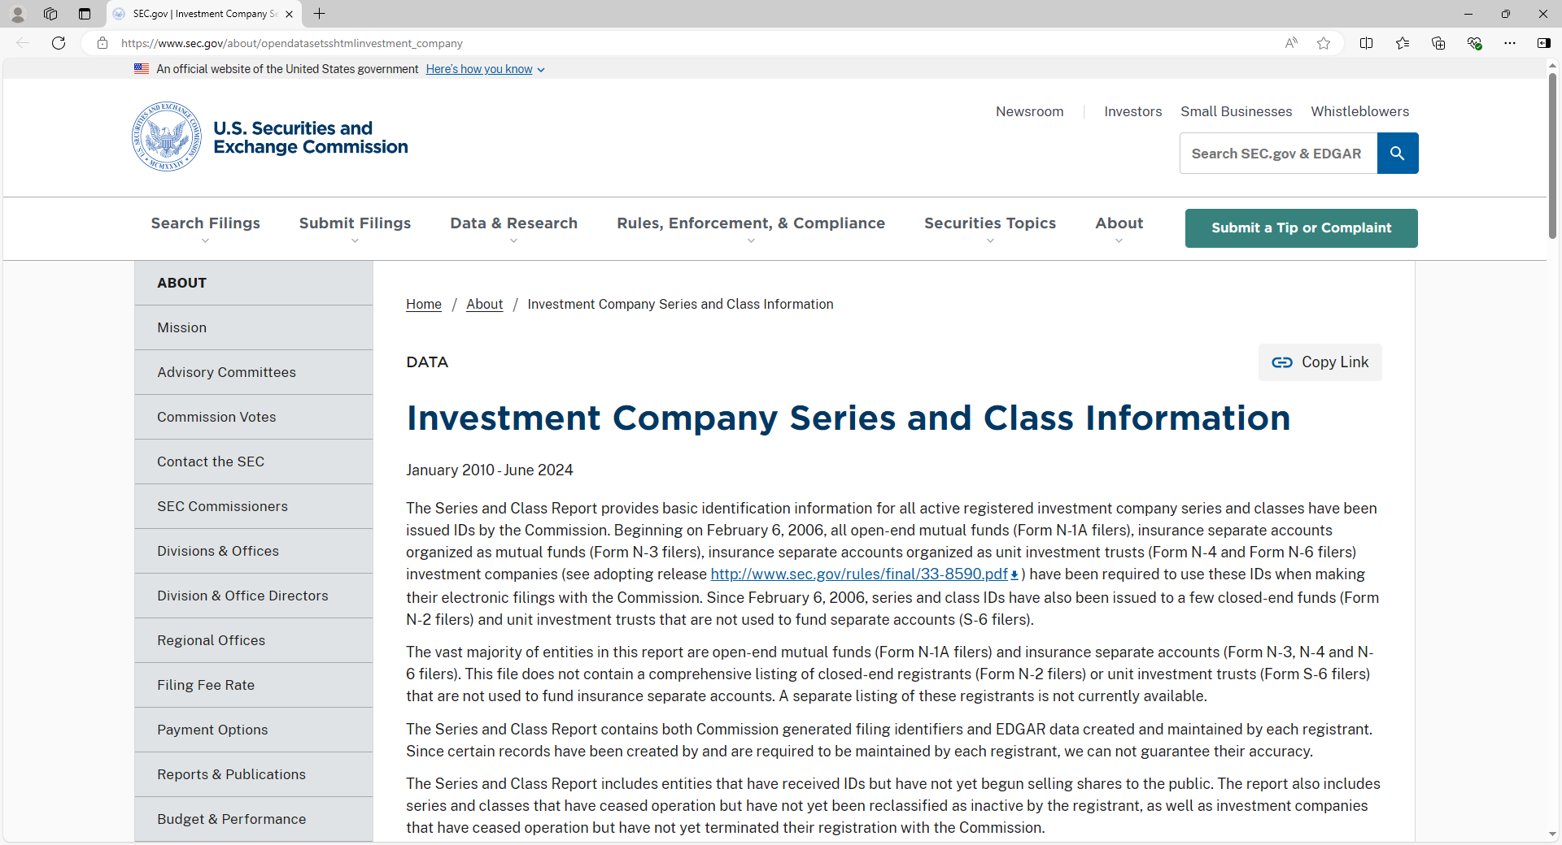
NEW TIPS!!!
SEC Investment Company Series and Class Information

Slide 46
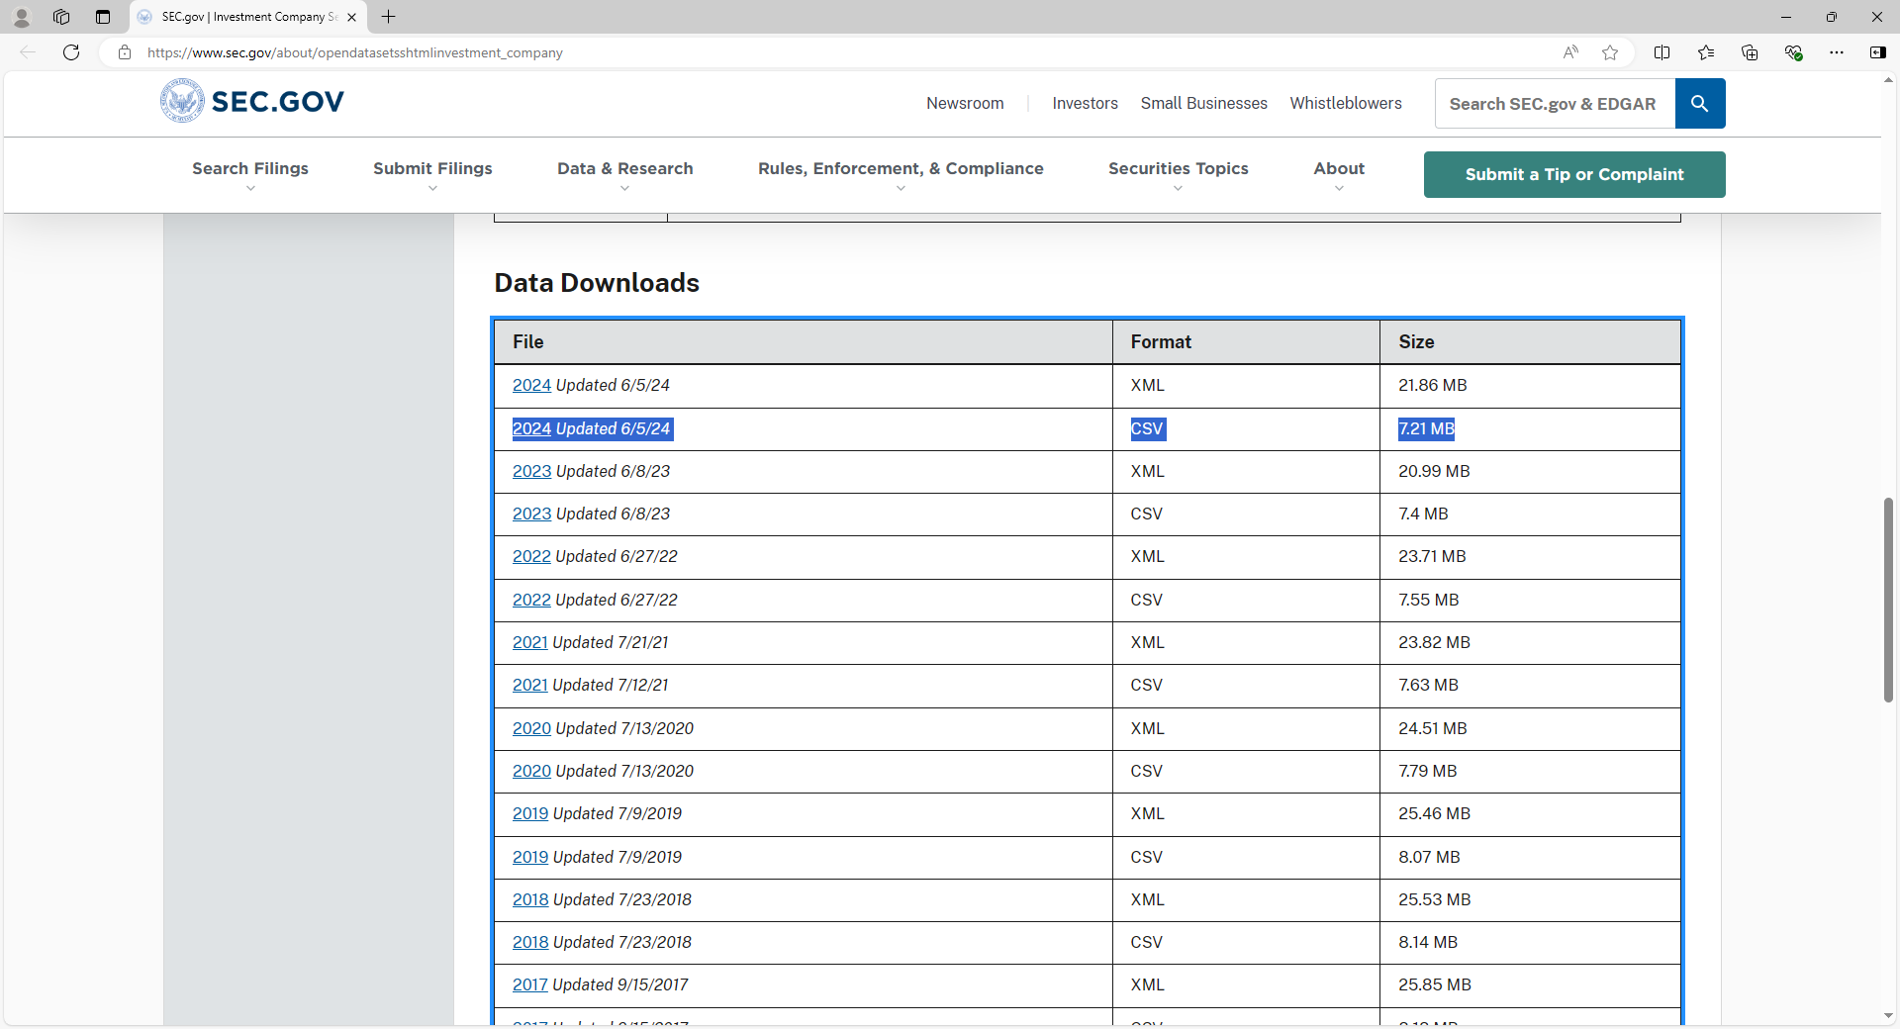
NEW TIPS!!!
Data downloads

Slide 47
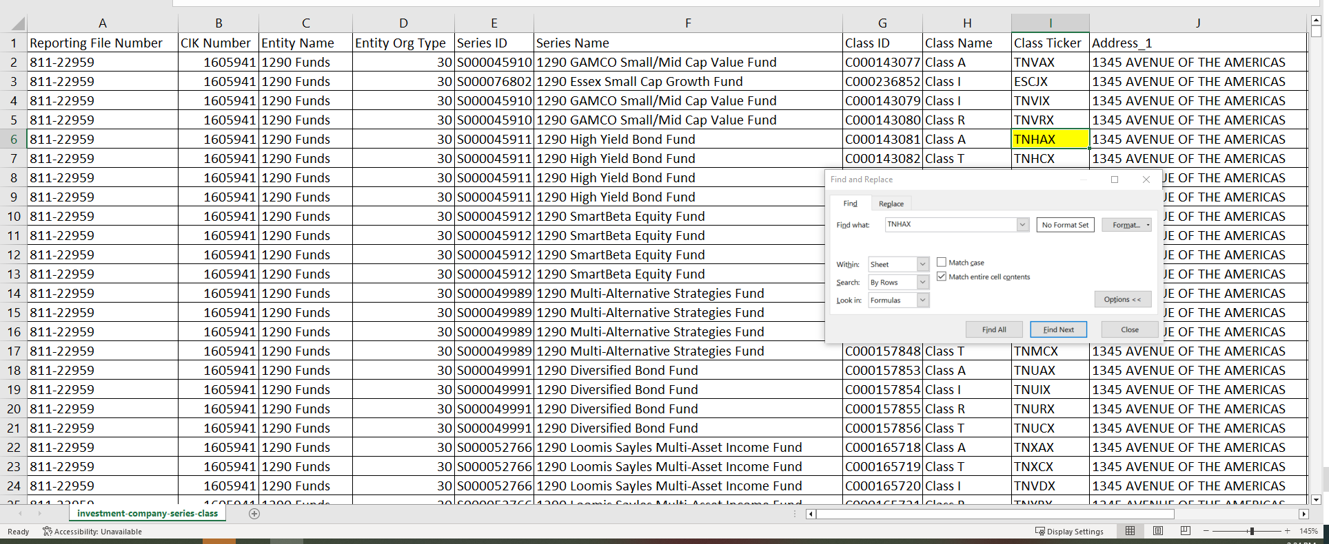
NEW TIPS!!!
Detailed information

Slide 48
A note on Exchange-traded funds (etf)s
Most Exchange-Traded Funds are:
Organized either as open-end investment management companies or as unit investment trusts
Registered with the SEC under the same statutory authorities as traditional mutual funds
Qualify for the exemptions in 5 C.F.R. part 2640 for diversified mutual funds and unit investment trusts
!!! CAUTION !!!
ETFs invested in commodities usually do not meet the definition for mutual fund or unit investment trust
WHY?
Not registered under the 1940 Act

Slide 49
remember
Excepted Investment Funds (EIFs) are a Reporting Tool for Financial Disclosures
EIF = Reporting
EIF ≠ Conflicts

Slide 50
Prospectus – part II: investment policy/Statement
Does the fund have a stated policy of concentrating its investments in a sector?
“Concentrating its investments in any industry, business, single country other than the United States, or bonds of a single State within the [U.S.]” 5 C.F.R. § 2640.102(a)
It creates heightened conflict of interest concerns
Mutual
Fund
Territory
The
Name
Prospectus
Parts II
REMEMBER: OGE’s focus is on the stated policy of the fund manager, not on the actual breakdown of fund holdings at any given point in time.

Slide 51
Oge guidance
OGE Guidance provides:
Rules and Definitions
Examples
Refined Guidance on Real Estate Sectors
Refined Guidance on Information Technology
Mutual
Fund
Territory
The
Name
Prospectus
Parts
I & II
OGE Guidance
OGE Guidance
OGE Guidance is a critical piece of the puzzle – DO NOT SKIP

Slide 52
Oge guidance cont.
OGE Guidance
Examine the degree of relatedness, overlapping interests, and operations among the companies a given mutual fund specializes.
This inquiry is performed in the context of realistic conflict of interest considerations and the need for some measure of common sense.
Factors to consider:
Share a common regulatory environment; or
If Government decisions affecting one type of company would be expected to affect the other, given their interdependence or competition with each other.
Mutual
Fund
Territory
The
Name
Prospectus
Parts
I &II
OGE Guidance
OGE Guidance

Slide 53
Oge guidance Cont. – Steps
Step 1:
Refer to the 2000 OGE guidance DO-00-030
REMEMBER “NOTE: The guidance in this advisory regarding real estate funds was amended by Legal Advisory LA-15-09. The guidance regarding the funds invested in internet, computer, and information technology companies was amended by Legal Advisory LA-19-06.”
Step 2: If the name rule suggests “real estate” or “information technology,” refer to the amended guidance.
Step 3: If you are not familiar with a finance term, use Investopedia as a resource.
Mutual
Fund
Territory
The
Name
Prospectus
Parts
I &II
OGE Guidance
OGE Guidance
OGE Guidance
OGE Guidance

Slide 54
puzzle to system
Sector Fund
Names Rule
Prospectus
OGE Guidance
Mutual
Fund
Territory
Mutual
Fund
Territory
The
Name
The
Name
Prospectus
Parts
I & II
Prospectus
Parts
I &II
OGE Guidance
OGE Guidance
OGE Guidance

Slide 55
Pop quiz
Looking at the name of each fund below, which of the following do you believe are most likely sector funds?
Invesco Real Estate Fund Class A (IARAX)
iShares Gold Trust (IAU)
Royce Pennsylvania Mutual Fund (RYPCX)
Energy Select Sector SPDR Fund (XLE)
Sector Fund
Names Rule
Prospectus
OGE Guidance

Slide 56
Invesco Real Estate Fund Class A (IARAX)
Names Rule
Fund
IARAX – 5 Letters ending with an “X”
“Real Estate” = Per the Names Rule, this fund must have at least 80% of its assets in the real estate sector
Sector Fund
Prospectus
OGE Guidance
Names Rule
Names Rule

Slide 57
Invesco Real Estate Fund Class A (IARAX)
Prospectus
(Part I)
Remember: Funds registered under the 1940 Act will have a file number beginning with 811.
Prospectus
Sector Fund
Names Rule
Prospectus
OGE Guidance

Slide 58
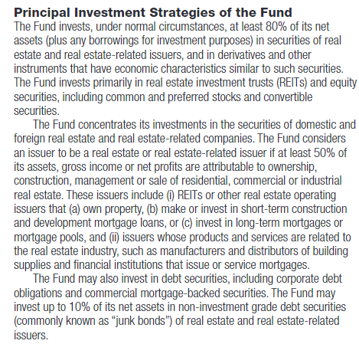
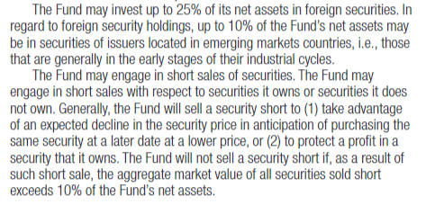
Invesco Real Estate Fund Class A (IARAX)
Prospectus
(Part II)

Slide 59
Invesco Real Estate Fund Class A (IARAX)
Prospectus
(Part II)

Slide 60
Invesco Real Estate Fund Class A (IARAX)
OGE Guidance
DAEOgram DO-00-030 on Diversified and Sector Mutual Funds – Released in 2000, if you read only this you will determine this is a sector fund, but…
Legal Advisory LA-15-09 on Diversified and Sector Real Estate Funds (Exemption under 5 C.F.R. § 2640.201) – OGE refined its guidance regarding real estate funds because general real estate is too remote or inconsequential of services provided by the employee
  Is it a Sector or Diversified Fund?
    Focused on a particular industry? No
    Focused on a country other than the United States? No
Sector Fund
Names Rule
Prospectus
OGE Guidance
OGE Guidance

Slide 61
Invesco Real Estate Fund Class A (IARAX) Conclusion
✓
Names Rule
Prospectus
OGE Guidance
✓
X
Sector Fund
DIVERSIFIED

Slide 62
Ishares gold trust (iau)
IAU – Maybe a unit investment trust or ETF?
“Gold” = Per the names rule, if this is a mutual fund for purposes of 18 U.S.C. §208, it must have at least 80% of its assets in the gold sector
Sector Fund
Names Rule
Prospectus
OGE Guidance

Slide 63
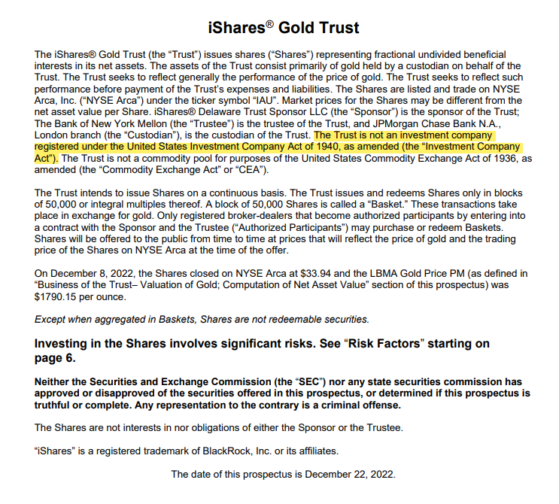
Ishares gold trust (iau)
Prospectus
(Part I)

Slide 64
Ishares gold trust (iau) conclusion
X
Sector Fund
Names
Rule
Prospectus
OGE Guidance
Not a Mutual Fund
5 C.F.R. § 2640.102(k)

Slide 65

Royce Pennsylvania Mutual Fund (RYPCX)
Sector Fund
Names Rule
Prospectus
OGE Guidance
Names Rule
Mutual Fund
RYPCX - 5 Letters ending with an “X”
“Pennsylvania” = at least 80% of its investments in Pennsylvania?
Prospectus
“1940 Act” appears 5 times in this 68-page prospectus
AND it never states it is “Registered”
BUT it does say:

Slide 66
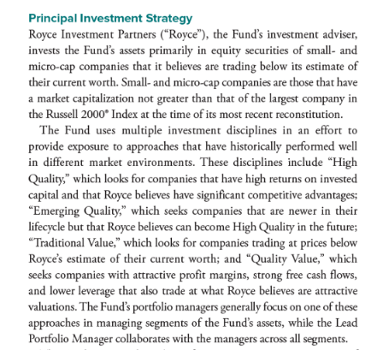
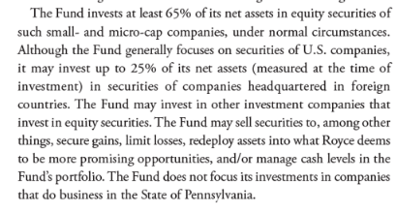
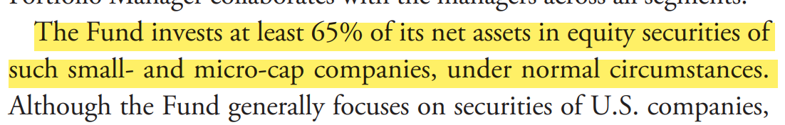
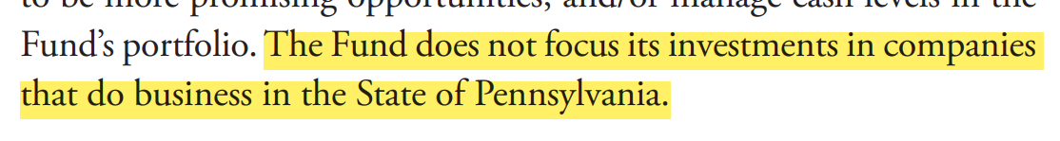
Royce Pennsylvania Mutual Fund (RYPCX)
Prospectus
(Part II)

Slide 67
Royce Pennsylvania Mutual Fund (RYPCX) conclusion
The Lesson?
Names Rule
Pennsylvania
The Names Rule is a HINT you may be in sector territory, but it is NOT definitive.
Always check the prospectus.

Slide 68
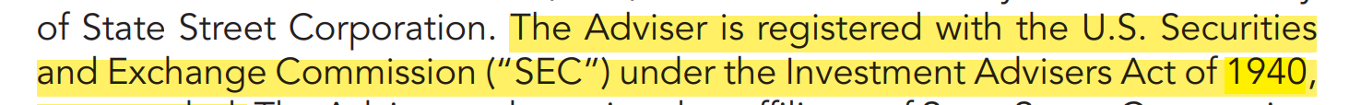

Energy select sector spdr fund (XLE)
Sector Fund
Names Rule
Prospectus
OGE Guidance
Names Rule
XLE – Uses terms like “fund” and “sector”
“Energy” = Must have at least 80% of its assets in the energy sector
Prospectus
“1940 Act” appears 5 times in this 145-page prospectus
AND one of those times it helpfully tells us:

Slide 69
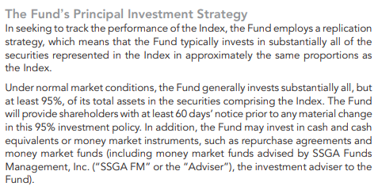
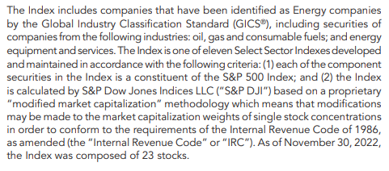
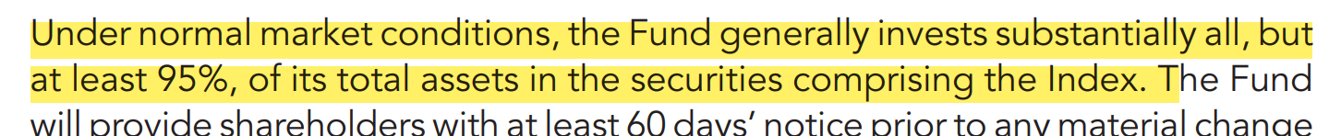
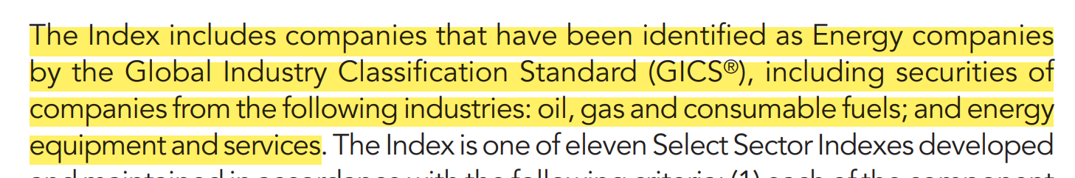
Energy select sector spdr fund (XLE)
Prospectus
(Part II)

Slide 70
Energy select sector spdr fund (XLE)
Sector Fund
Names Rule
Prospectus
OGE Guidance
DAEOgram DO-00-030 on Diversified and Sector Mutual Funds
No Additional OGE Guidance for “Energy” sector
OGE Guidance
Is it a Sector or Diversified Fund?
  Express policy of concentrating its investments in a specific industry? YES
  Is Energy an “industry”? YES - Degree of relatedness and Overlapping Interests
  Focused on a country other than the United States? NO
REMEMBER: OGE’s focus is on the stated policy of the fund manager, not on the actual breakdown of fund holdings at any given point in time.

Slide 71
ENERGY SELECT SECTOR SPDR FUND (Xle) conclusion
Sector Fund
Names Rule
Prospectus
OGE Guidance
SECTOR

Slide 72
Pop quiz – ANSWERS & LESSONS
Invesco Real Estate Fund Class A (IARAX)
  Lesson - OGE Guidance Critical, no assumptions
Royce Pennsylvania Mutual Fund (RYPCX)
  Lesson – Names Rule a HINT not CONCLUSIVE
DIVERSIFIED
DIVERSIFIED
iShares Gold Trust (IAU)
  Lesson – ALWAYS check if registered with 1940 Act
Energy Select Sector SPDR Fund (XLE)
  Lesson – Follow the steps
Not a Mutual Fund
5 C.F.R. § 2640.102(k)
SECTOR

Slide 73
Bonus Slide: How do thematic funds fit in?
Mutual Funds
Diversified
Sector
Thematic Funds
Thematic Funds
Thematic Funds

Slide 74

Questions?

