Slide 1
Introduction to Public Financial Disclosure
Instructor: Cheryl Kane-Piasecki
Part 3:
Play Your Part

Slide 2
Know Your Role
Play Your Part

Slide 3
Who Certifies?

Slide 4
Who Can Review?

Slide 5
Who Can Review?

Slide 6
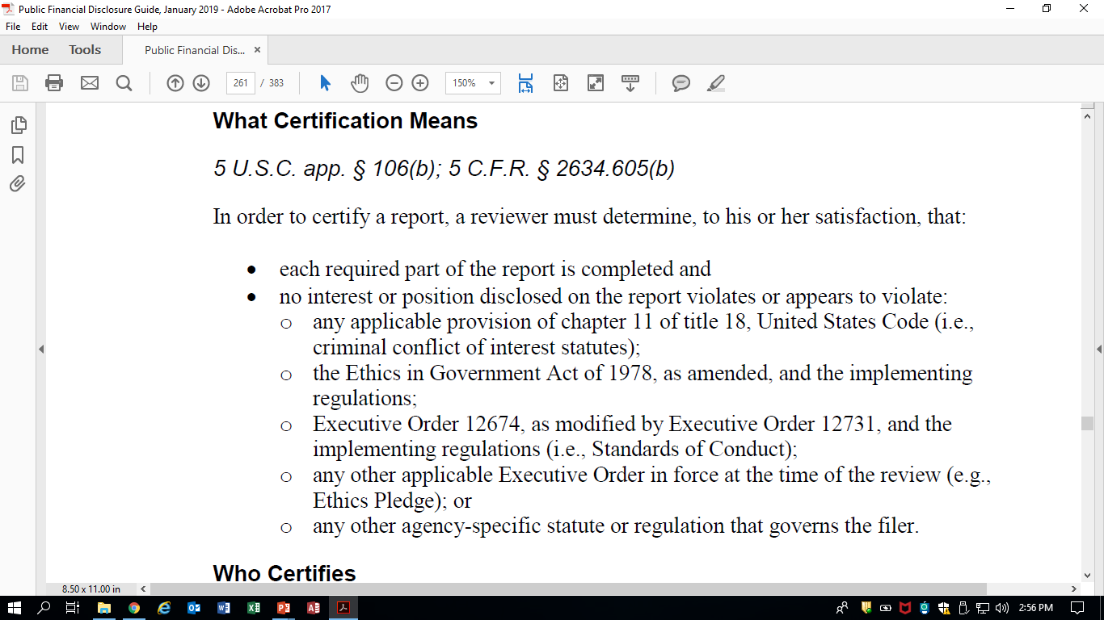

Slide 7
Timely Review
>60 days document

Slide 8
SUBSTANTIVE REVIEW
Criminal statutes—18 USC 201-209
Standards of Conduct—5 CFR 2635
Agency-specific regulations
* This is a non-exhaustive list

Slide 9
REVIEW Goals
Prevent where possible
Fix when found

Slide 10
Primary Authority:
18 USC 208
Financial Conflicts of Interest

Slide 11
Identifying Conflicts
Duties
Might the employee participate in agency work that involves or affects disclosed interests?
Interests
Could any interests disclosed on the 278e be affected by agency programs?
Any “prohibited holdings?”

Slide 12
KEY AGENCY RESOURCES
Description/Knowledge Of Filer’s Duties
Filer’s Prior Reports/Reviewer Notes
Agency Supplemental Regulations/Prohibited Holdings
Contractor/Grantee Source Lists

Slide 13
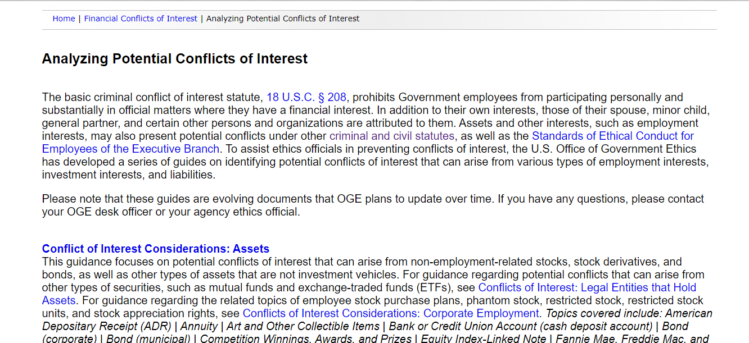
Conflicts of Interest

Slide 14
Other Common Ethics Issues
Impartiality/Misuse
Current/ Former non-federal employer
Spouse’s non-federal employer
Businesses/partnerships
Outside Activity Prior Approval
Teaching, Speaking, Writing (2635.807)
Use of title, position, information
Representational services/advocacy

Slide 15
Remedies
Duties
Recusal (unless/until another remedy is applied)
Interests
Part 2640 Exemptions
Divestiture
Resignation

Slide 16
Substantive Training Resources

Slide 17
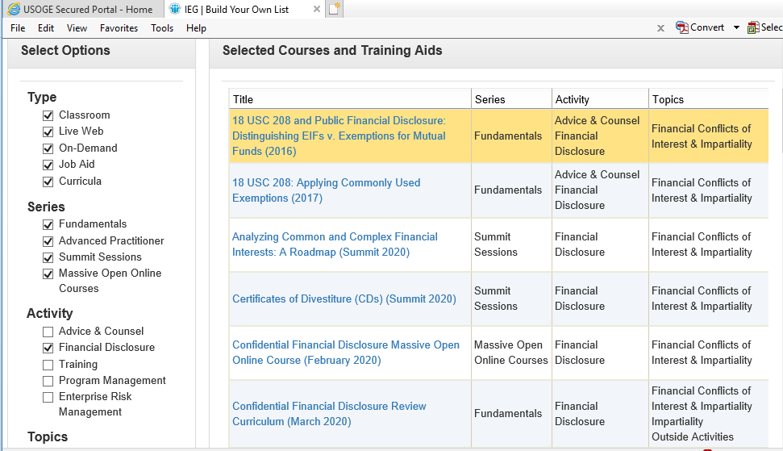
IEG Resource Library

Slide 18
Technical Review
Financial disclosure regulations—5 CFR 2634

Slide 19
Section 2 of The Guide:
FORM 278e

Slide 20
Instructions—They ARE for Everyone

Slide 21
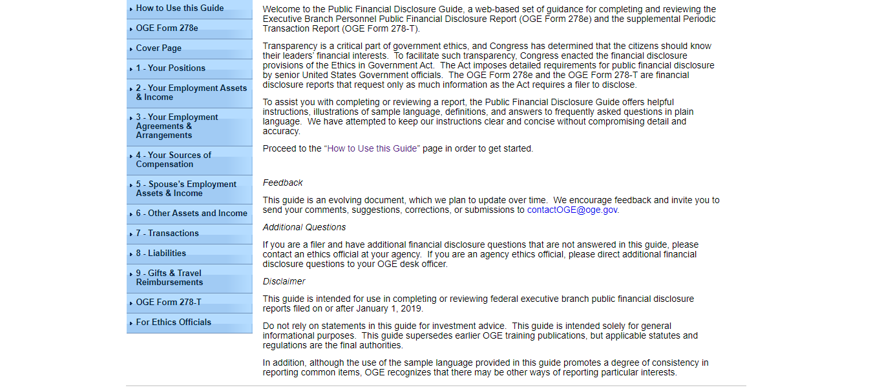
For
Filers

Slide 22
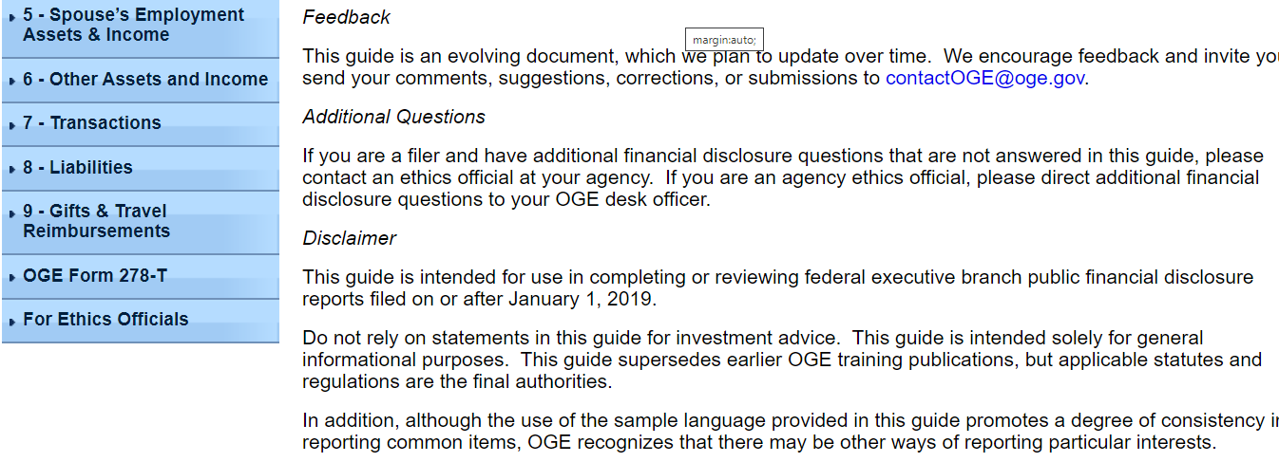
FOR YOU

Slide 23
For
Filers

Slide 24
SECTION 2— The 278e

Slide 25
Whose Information To Report
Filer Only
Filer/Spouse/Dependent Child

Slide 26
Spouses and Dependent Children

Slide 27
For
Filers

Slide 28
Structure of the Guide
FILER INSTRUCTIONS
ETHICS OFFICIAL INSTRUCTIONS
Parts 1, 4, 7, 8 and 9
Tables with illustrative examples of correct reporting
Frequently Asked Questions
Parts 2, 3, 5, 6
Index of assets/sources of income linked to expansive instructions and FAQs
Written directions addressing
What to Report
How to Report
What Is Not Reportable
Nothing to Report
Notes for Reviewer’s Only

Slide 29
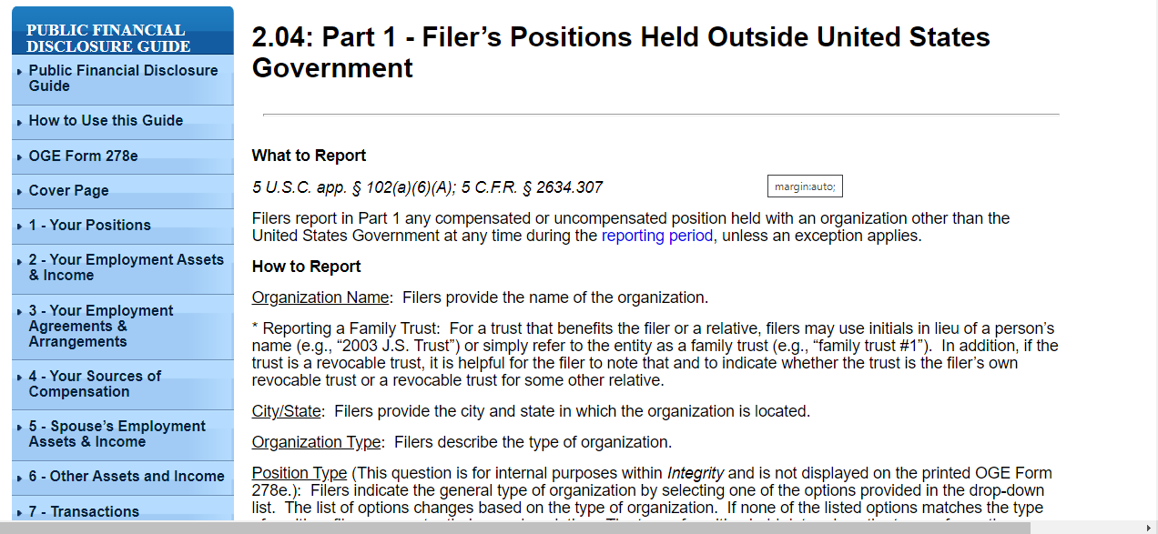
Part 1: Ethics Official View

Slide 31
Part 1: Filer’s View

Slide 32
FAQS for Part 1--Filer’s View

Slide 33
Part 4: Ethics Official View

Slide 34
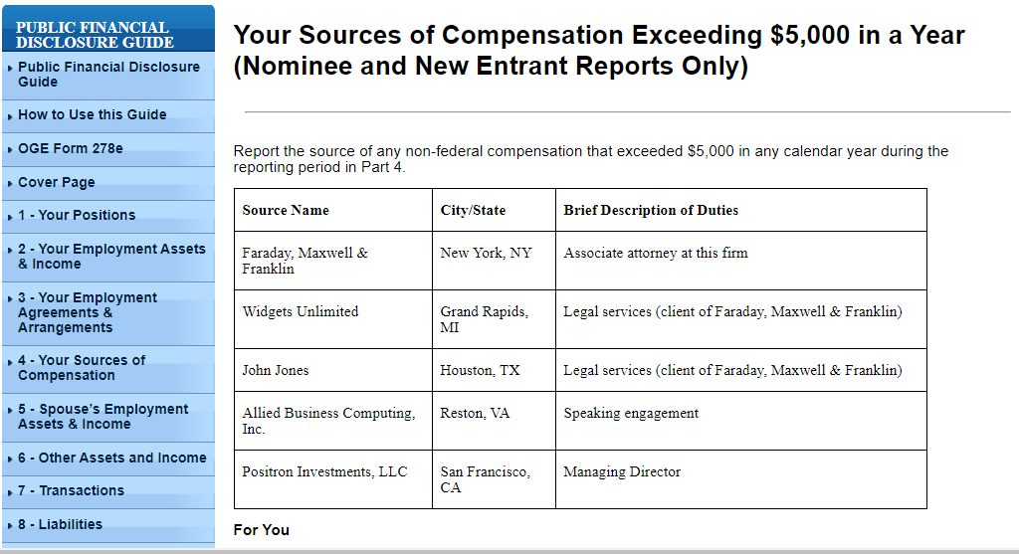
Part 4: Filer’s View

Slide 35
FAQS for Part 4--Filer’s View

Slide 36
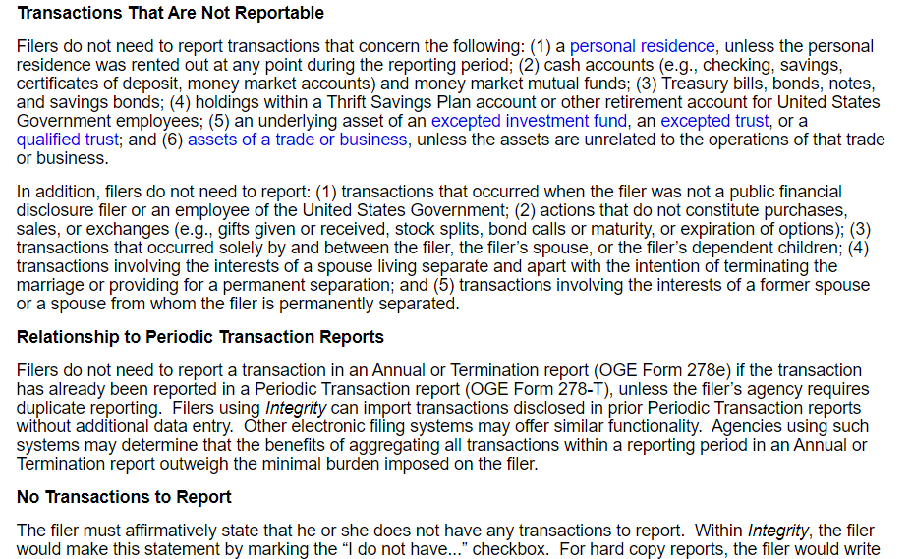

Slide 37
FAQS for Part 7--Filer’s View

Slide 38
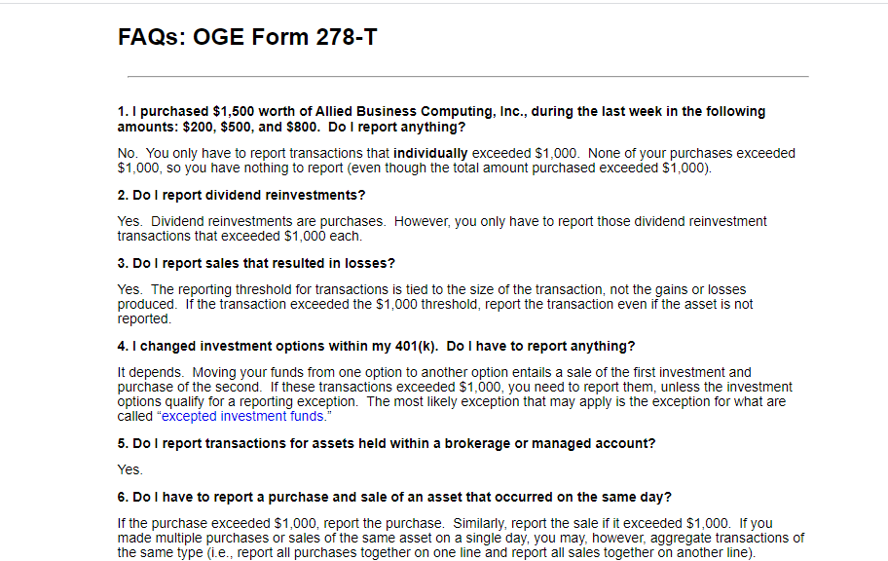
FAQS for Form 278-T

Slide 39
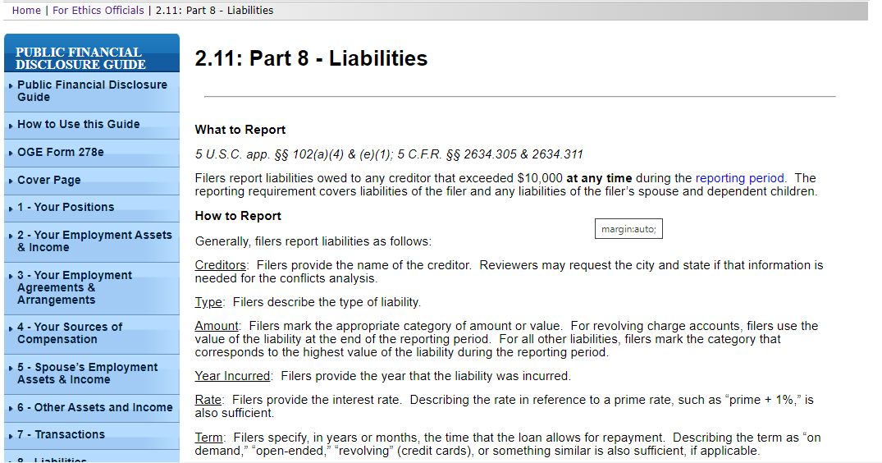
Part 8: Ethics Official View

Slide 40
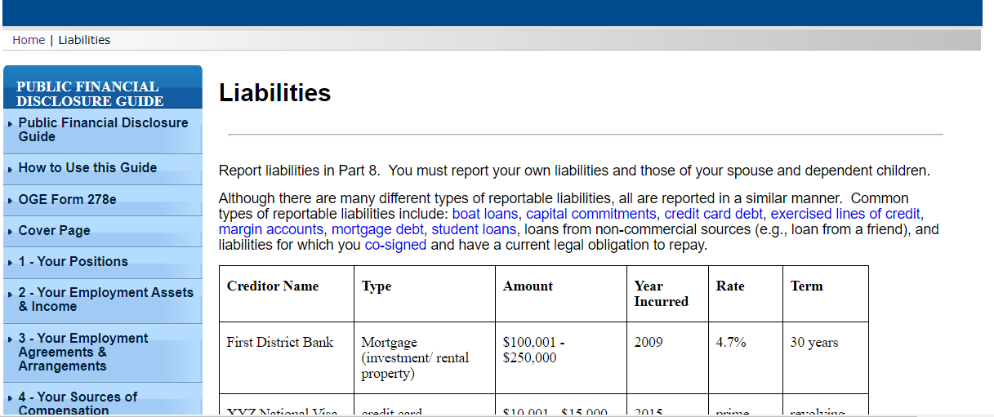
Part 8: Filer’s View

Slide 41
FAQS for Part 8--Filer’s View

Slide 42
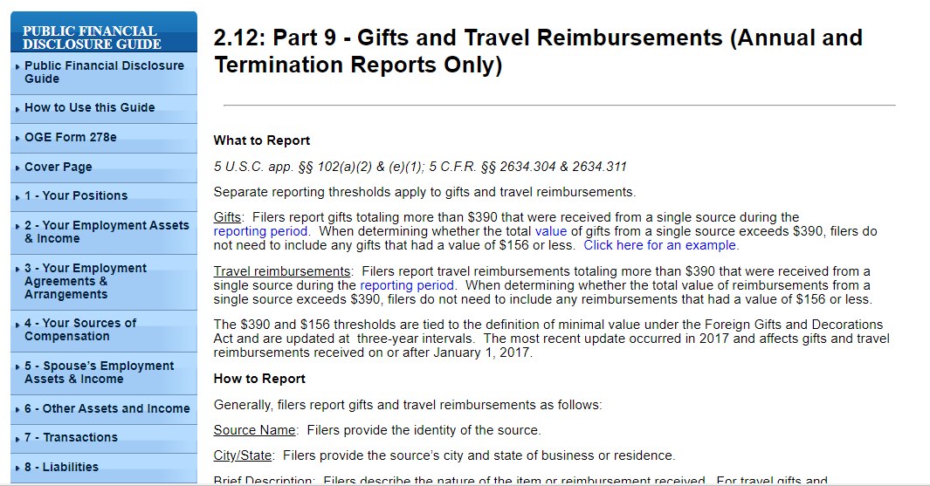
Part 9: Ethics Official View

Slide 43
Part 9: Filer’s View

Slide 44
FAQS for Part 9--Filer’s View

Slide 45
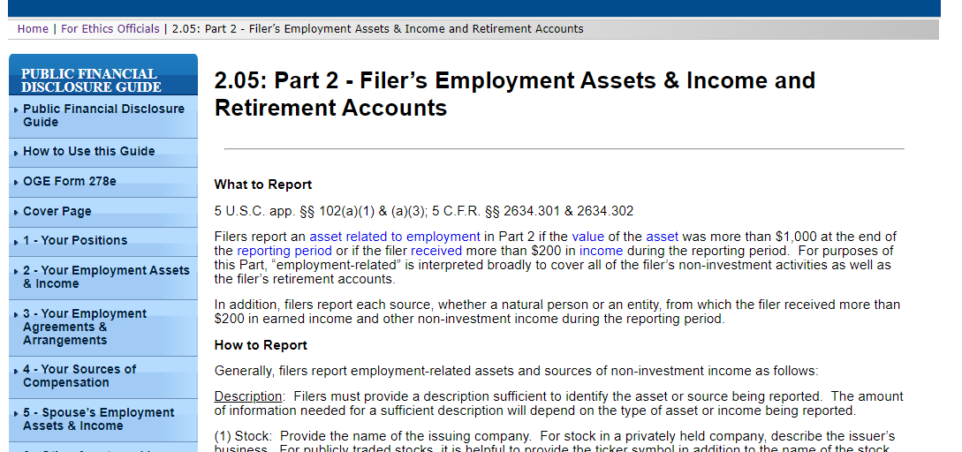
Part 2: Ethics Official View

Slide 46
Part 2: Filer’s View

Slide 47
Part 2: Filer’s View

Slide 48
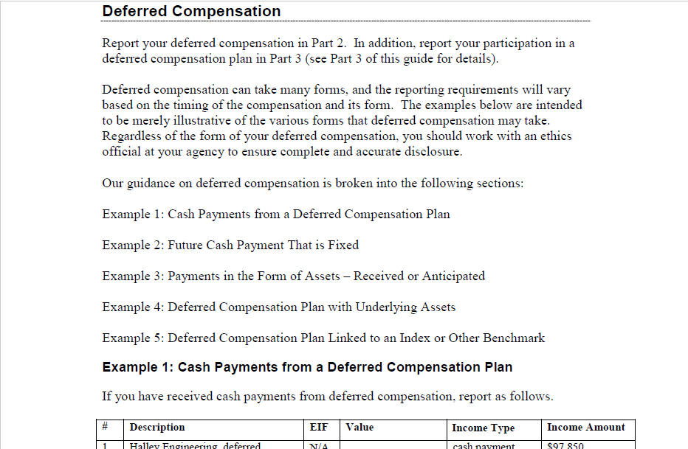
Part 2: Filer’s View

Slide 49
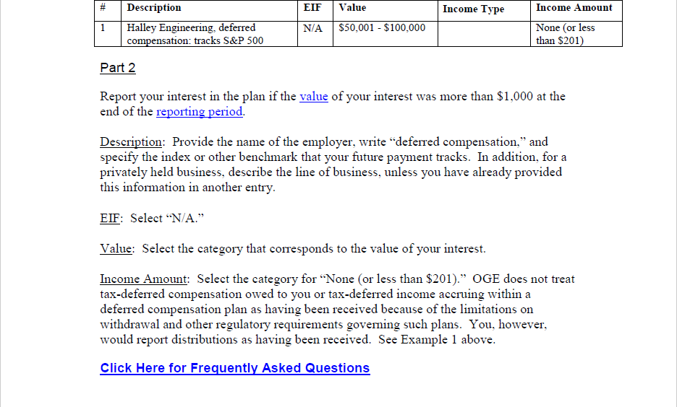
Part 2: Filer’s View

Slide 50
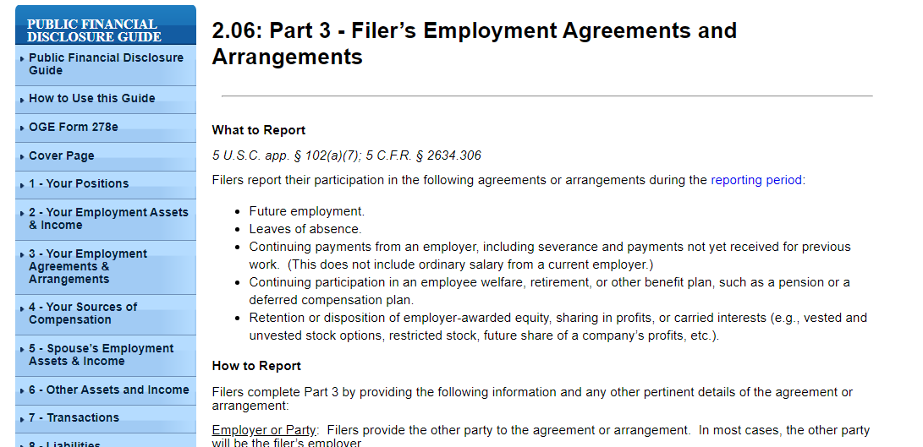
Part 3: Ethics Official View

Slide 51
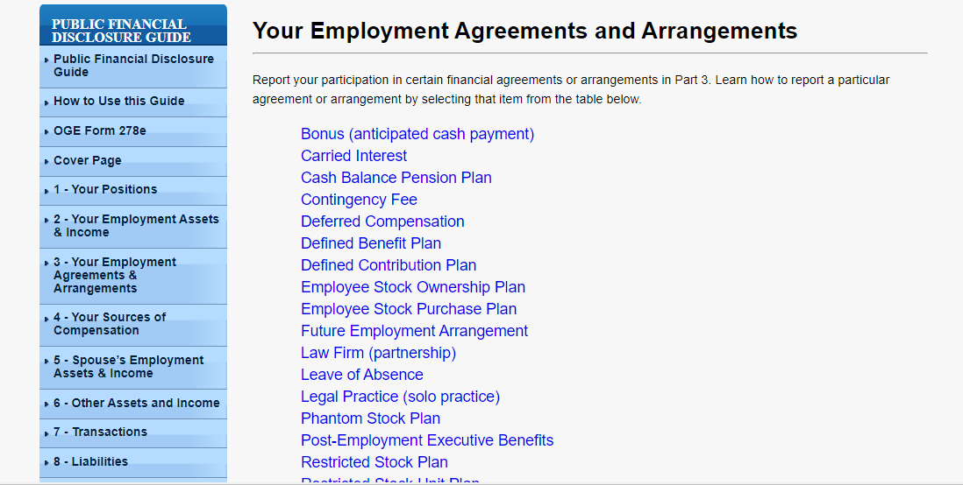
Part 3: Filer’s View

Slide 52
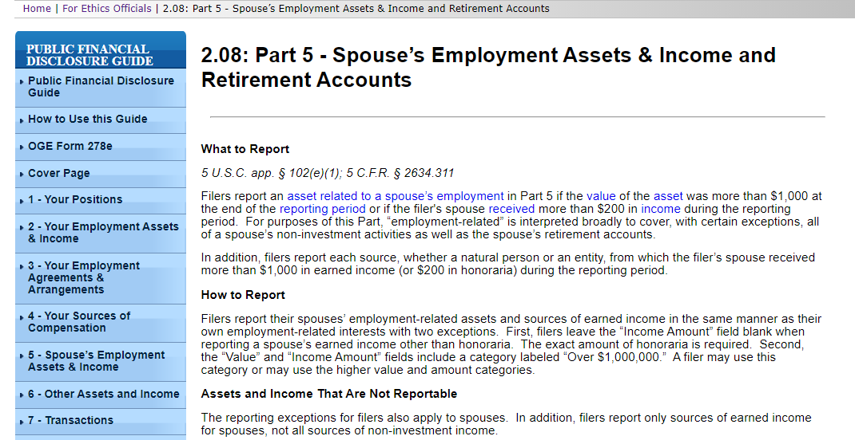
Part 5: Ethics Official View

Slide 53
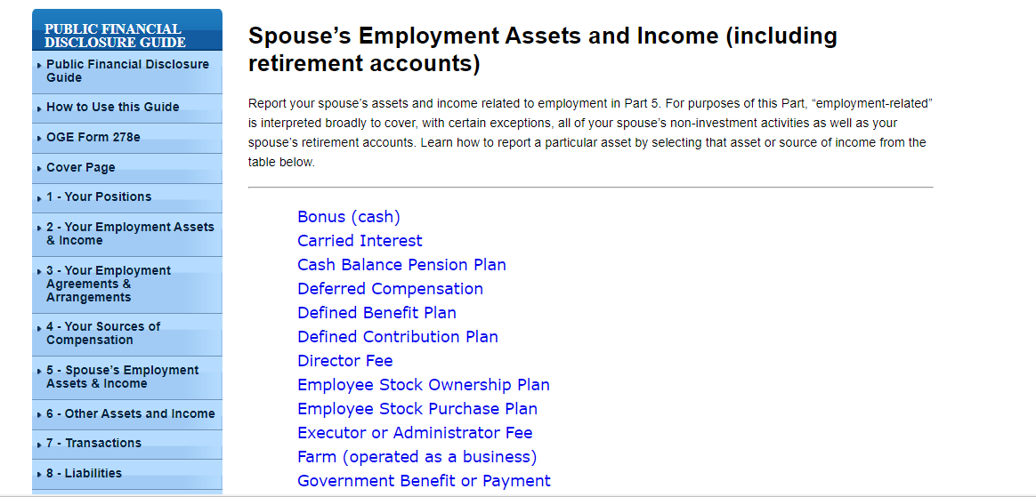
Part 5: Filer’s View

Slide 54
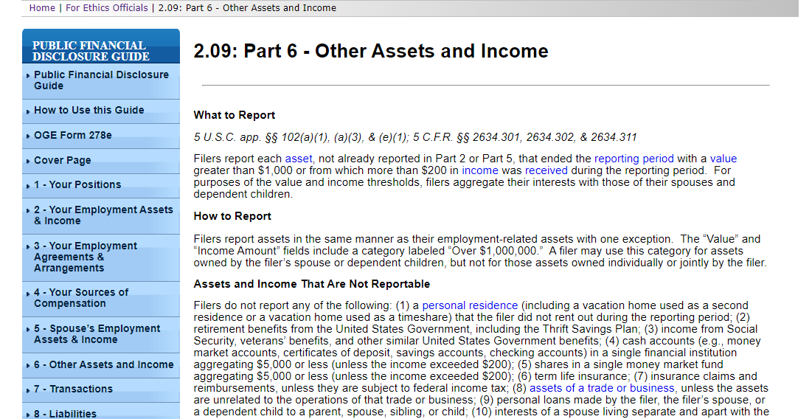
Part 6: Ethics Official View

Slide 55
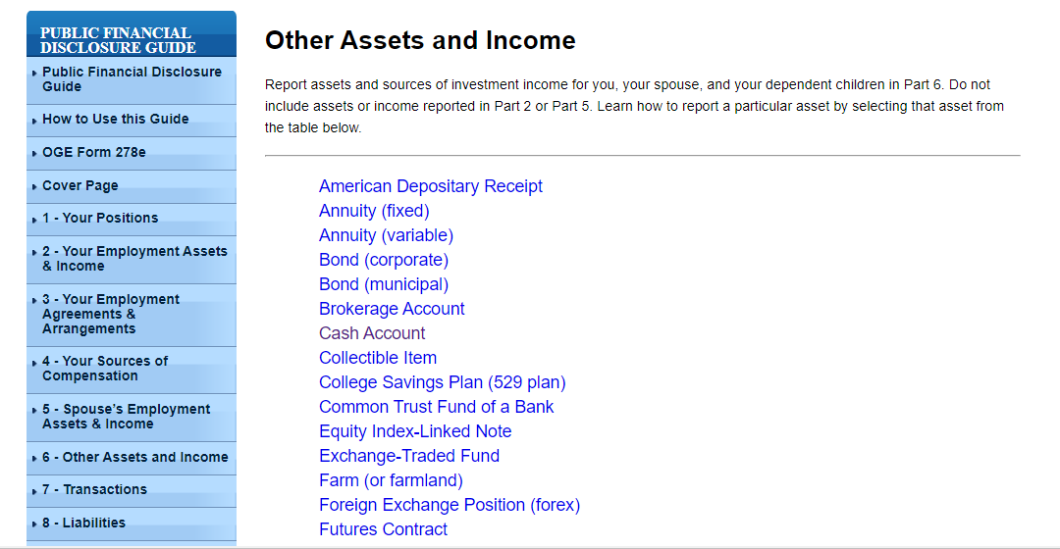
Part 6: Filer’s View

Slide 56
Part 6: Filer’s View

Slide 58
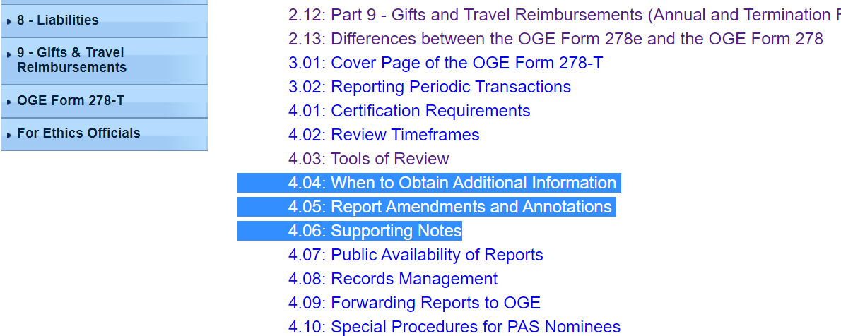

Slide 59
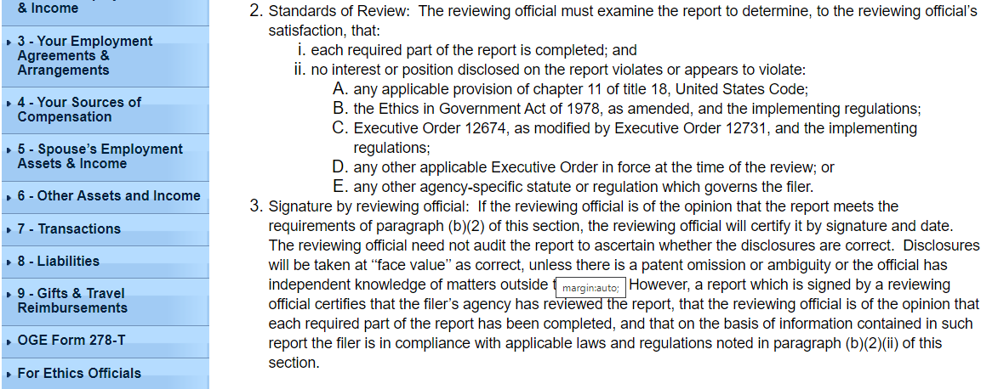

Slide 62
Before Final Certification
After Final Certification by the Agency
After Final Certification by OGE

Slide 64
Goals
Prevent where possible
Fix when found

Slide 65
Technical Review
SUBSTANTIVE REVIEW

Slide 66
What Is Certification?

Slide 67
Know Your Role
Play Your Part

Slide 68
Thank YOu

