Slide 1
OGE
2023
Public Financial Disclosure Review
OGE Form 278
Refresher Training for New/Seasonal Reviewers

Slide 2
Public Financial Report Guide

Slide 3
Diversified Mutual Fund
Sector Mutual Funds
Stocks
Bonds
Unit Investment Trusts
Exchange Traded Funds
Managed Accounts
Retirement Accounts
Common Financial Assets and Income Listings

Slide 4
A mutual fund is a company that is created and managed to hold a portfolio of securities as an investment company registered with the U.S. Securities and Exchange Commission under the Investment Company Act of 1940, as amended.
Investors purchase shares of the mutual fund, and the value of those shares typically rises and falls based on the performance of the mutual fund’s underlying investments. The underlying investments of a mutual fund may include shares of companies in a variety of business sectors, bonds, cash equivalents, etc.
Mutual Fund
5 CFR 2640

Slide 5
Diversified Mutual Funds
Janus Balanced Fund (JDBAX)
Is it an EIF?
If an EIF, no Income Type needed
Need the full name of the fund – not just the ticker symbol

Slide 6
Excepted
Investment
Fund
5 CFR 2634
independently managed,
widely held, and
either “publicly traded or available”
or
widely diversified

Slide 7
A fund that pools investor’s money in a variety of investments. Unlike traditional mutual funds, most investors buy and sell shares of ETFs from other investors on an exchange rather than directly from the issuer.
In addition, ETFs cannot market themselves to consumers a “mutual funds” because they are not necessarily subject to all the requirements applied to traditional mutual funds.
Nevertheless, ETFs are usually registered with the U.S. Securities and Exchange Commission under the same statutory authorities as traditional mutual funds and unit investments trusts.
Exchange Traded
Funds

Slide 8
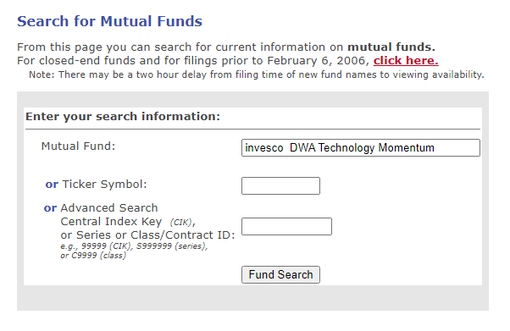
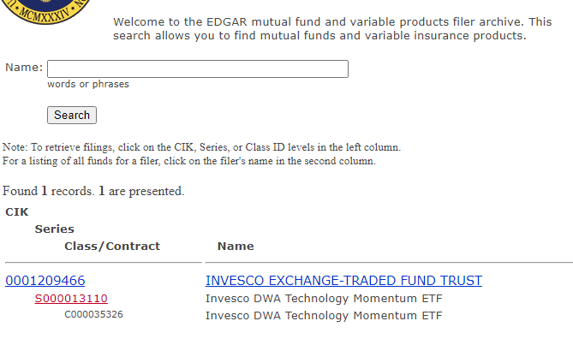
Exchange-Traded Fund
ETFs are normally registered with SEC?
SEC's EDGAR Mutual Fund Search
https://www.sec.gov/edgar/searchedgar/mutualsearch.htm

Slide 9
Exchange Traded Funds
Invesco DWA Technology Momentum
Is it an EIF?
If an EIF, no Income Type needed
Need the full name of the fund – not just the ticker symbol

Slide 10
Managed
Account -Not an EIF
-Not a mutual
Fund
It is also called a “separately managed account” or “controlled account” and is an account that is owned by the investor but managed for a fee by a financial advisor. The investor gives the financial advisor the discretion to buy, sell, and trade investments on behalf of the investor.
An investor usually chooses among predetermined portfolios, which financial institutions sometimes package in categories such as high yield, balanced, large cap, global small cap, strategic fixed income, and other similar descriptors. The investor can usually customize the portfolio to some extent, although this is not necessarily the case with all managed accounts.

Slide 11
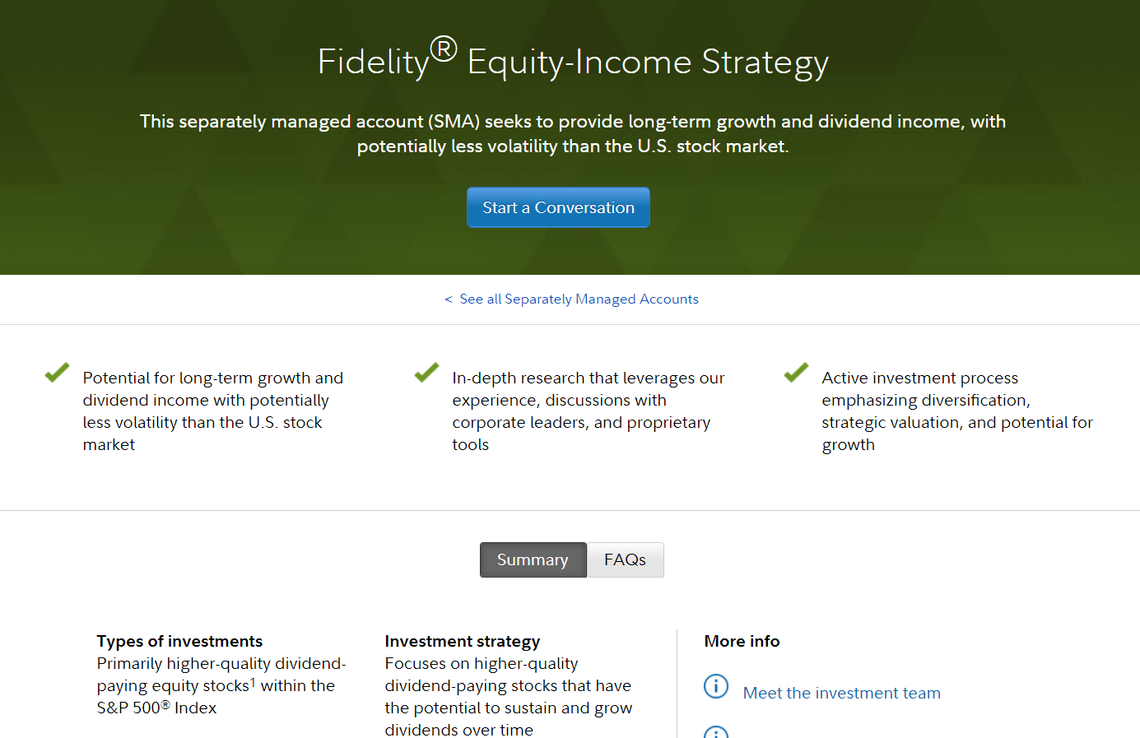
Managed Account

Slide 12
Options Expiration
Inheritance
Bond Maturity
Marriage/Divorce/Legal Separation
Death of a spouse
Assets without reportable transactions

Slide 13
Reportable on a 278T report?
Stocks, bonds, or commodities
Doesn’t constitute a purchase:
Gift given or received
Stock splits
Bond calls or maturity
Expiration of options
Reportable on a Annual 278e Transaction Section
real property or securities
Real estate purchase, stock, corporate or municipal bonds, government agency securities, options, futures, mutual funds, ETFs, or UITs
Transactions
Purchase, Sale, or Exchange of

Slide 14
5 CFR § 2634.201(g)
Agency’s have the discretion to give filing
extension for good cause for up to 90 days
and they must be in writing
5 CFR § 2634.704
When a report is filed more than 30 days
after the due date of the report
Filing
Extensions
AND
Late Filing
Fees

Slide 15
+ workload
+ death in immediate family
+ have to work with Accountant
+ extended travel (depends on agency policy)
+ significant illness
EXTENSION
examples

Slide 16
LATE FILING FEES
+ SECTION 1.05 IN THE GUIDE
Collection of the Late Filing Fee
If successful in collecting a late filing fee, the agency must forward it to the United States Treasury for deposit as miscellaneous receipts. Ethics officials should defer to their agency finance office for appropriate handling of fees collected.

Slide 17
+ OGE has delegated its authority to waive the late filing fee to agencies.
+ The fee may be waived if the delay in filing was caused by extraordinary circumstances.
a family emergency, such as a fire, an illness, or a death;
transfer of position causing confusion over filing;
agency errors (other than notification errors); and
the duties of a filer’s office (only agency emergencies).
Late
FILING
Fee
Waiver

Slide 18
Integrity Demo
Notes:
Thank you

Slide 19
THANK YOU!
Notes:
Thank you

