Slide 1
NOMINEE PROCESs
Speakers:
Teresa Williamson, Joyce Merilos, and Stephanie Dyer
Presidential Nominations Branch, OGE
September 11, 2024

Slide 2
Nominee Process
WH selects person to be considered for PAS position (Nominee)

Slide 3
Nominee Process
WH selects person to be considered for PAS position (Nominee)
Integrity report flows from WH to OGE & agency

Slide 4
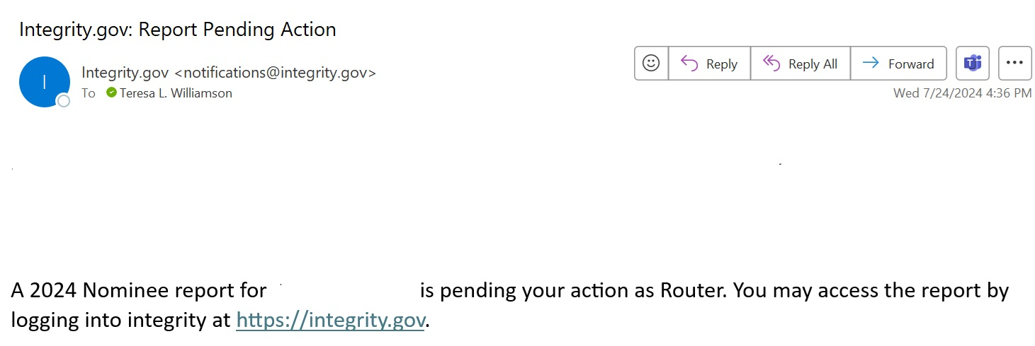
Nominee Process

Slide 5
Nominee Process
WH selects person to be considered for PAS position (Nominee)
Integrity report flows from WH to OGE & agency
OGE & agency reviewers assigned

Slide 6
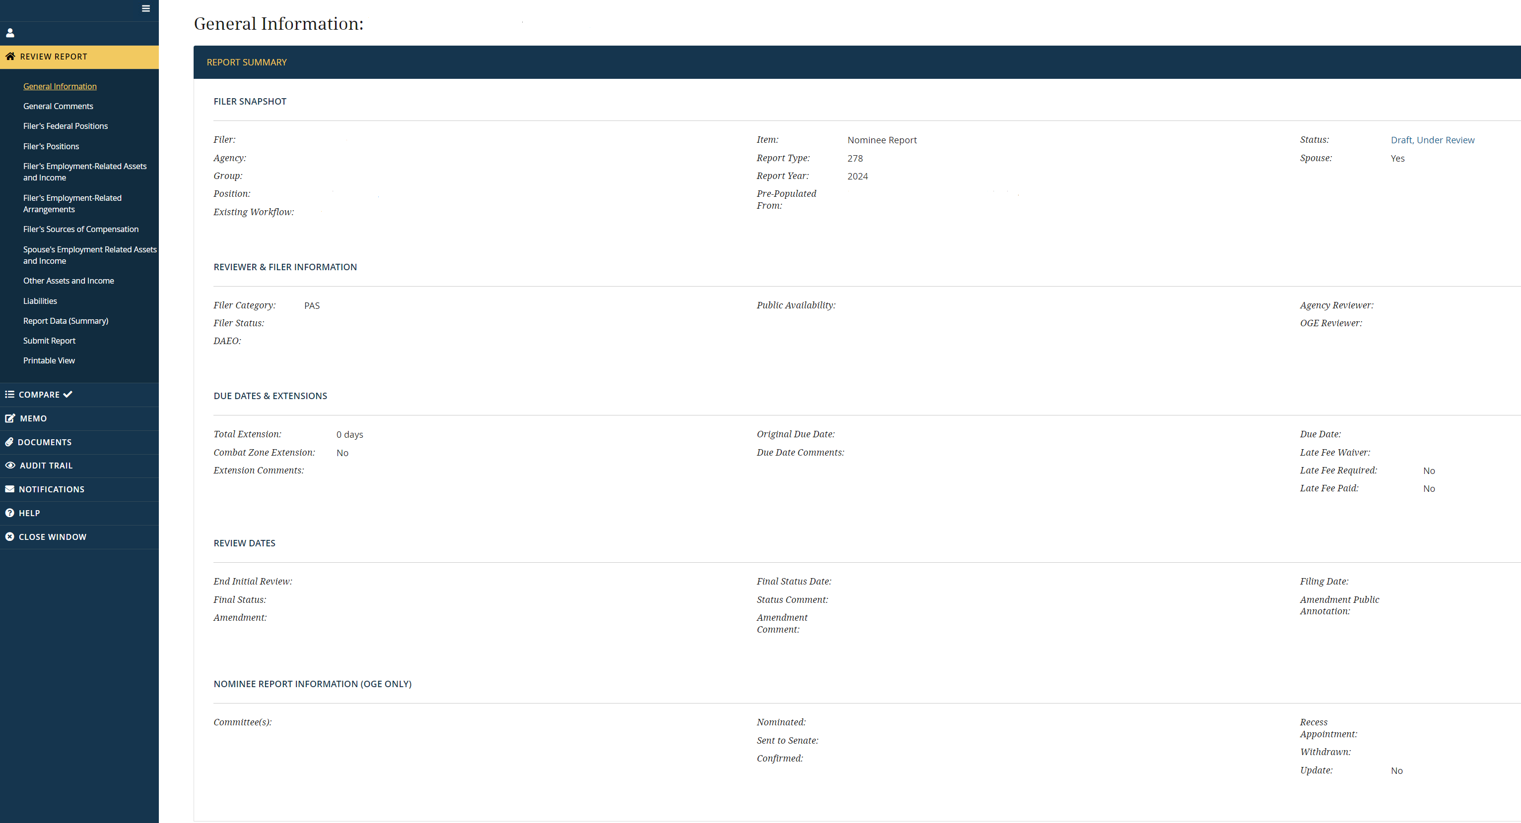

Nominee Process

Slide 7
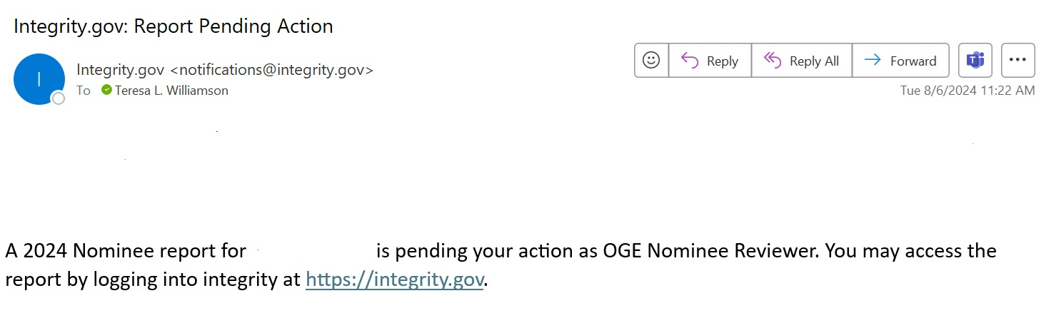
Nominee Process

Slide 8
Nominee Process
WH selects person to be considered for PAS position (Nominee)
Integrity report flows from WH to OGE & agency
OGE & agency reviewers assigned
OGE & agency reviewers review Integrity report & prepare EA

Slide 9
Nominee Process
WH selects person to be considered for PAS position (Nominee)
Integrity report flows from WH to OGE & agency
OGE & agency reviewers assigned
Docs prepared for preclearance/confirmatory email
OGE & agency reviewers review Integrity report & prepare EA

Slide 10
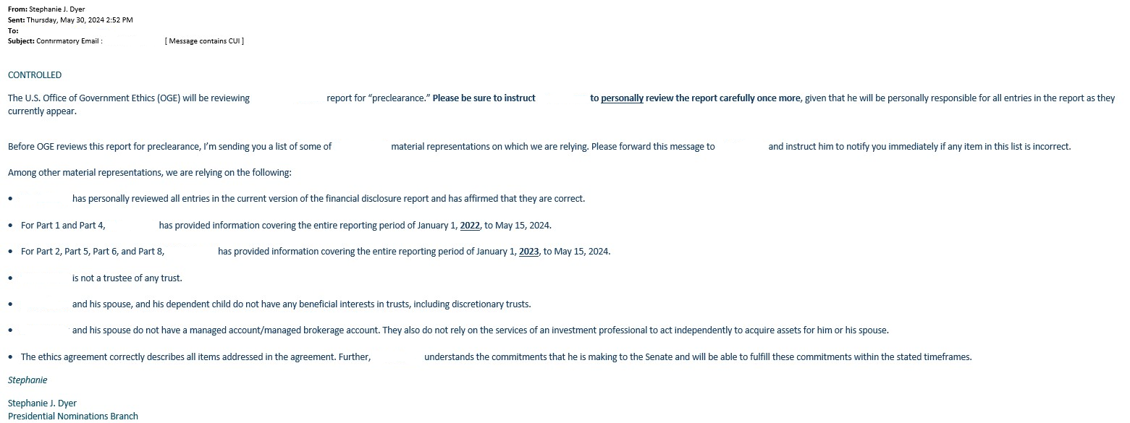
Nominee Process

Slide 11
Nominee Process
WH selects person to be considered for PAS position (Nominee)
Integrity report flows from WH to OGE & agency
OGE & agency reviewers assigned
Docs prepared for preclearance/ confirmatory email
OGE & agency reviewers review Integrity report & prepare EA
Package forwarded for preclearance

Slide 12
Nominee Process
WH selects person to be considered for PAS position (Nominee)
Integrity report flows from WH to OGE & agency
OGE & agency reviewers assigned
Docs prepared for preclearance/ confirmatory email
OGE & agency reviewers review Integrity report & prepare EA
Package forwarded for preclearance
PNB Chief pre-clears report & EA

Slide 13
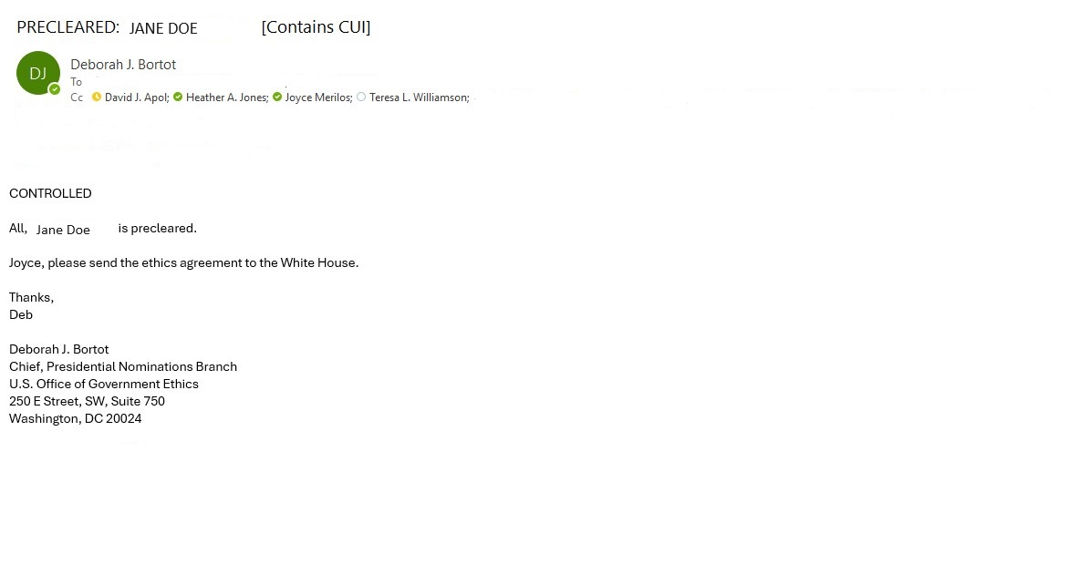
Nominee Process

Slide 14
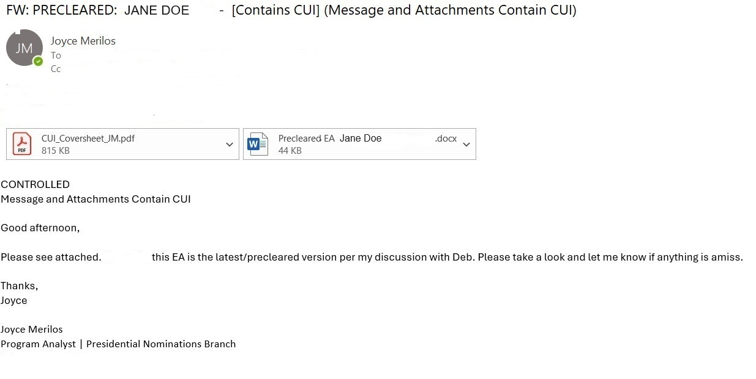
Nominee Process

Slide 15

Nominee Process
STALE report
  6 months from date filed

Slide 16
Nominee Process
WH selects person to be considered for PAS position (Nominee)
Integrity report flows from WH to OGE & agency
OGE & agency reviewers assigned
Docs prepared for preclearance/ confirmatory email
OGE & agency reviewers review Integrity report & prepare EA
Package forwarded for preclearance
PNB Chief pre-clears report & EA
WH nominates Nominee

Slide 17
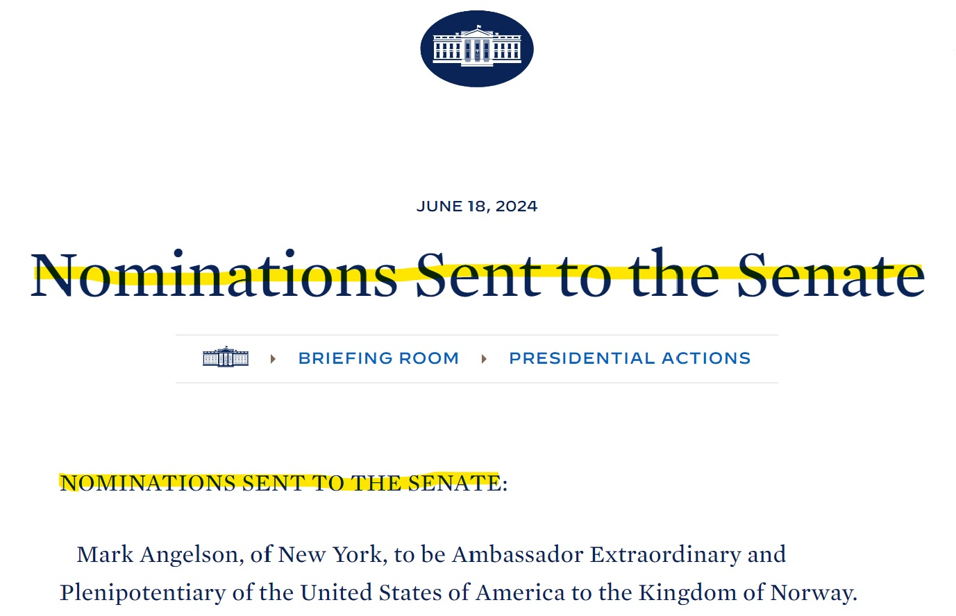
Nominee Process

Slide 18
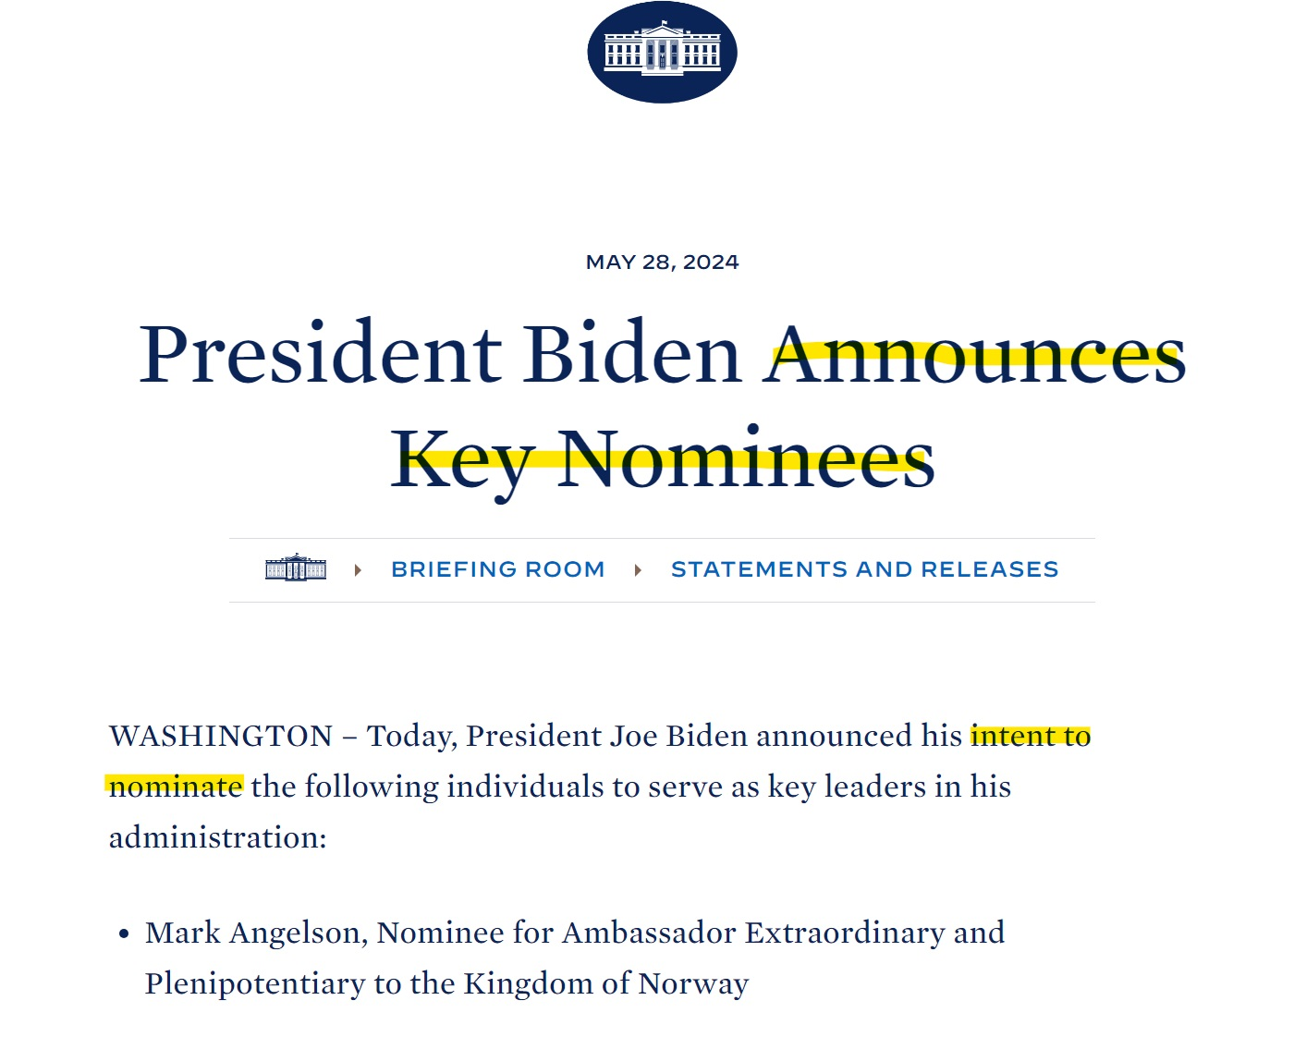
Nominee Process

Slide 19
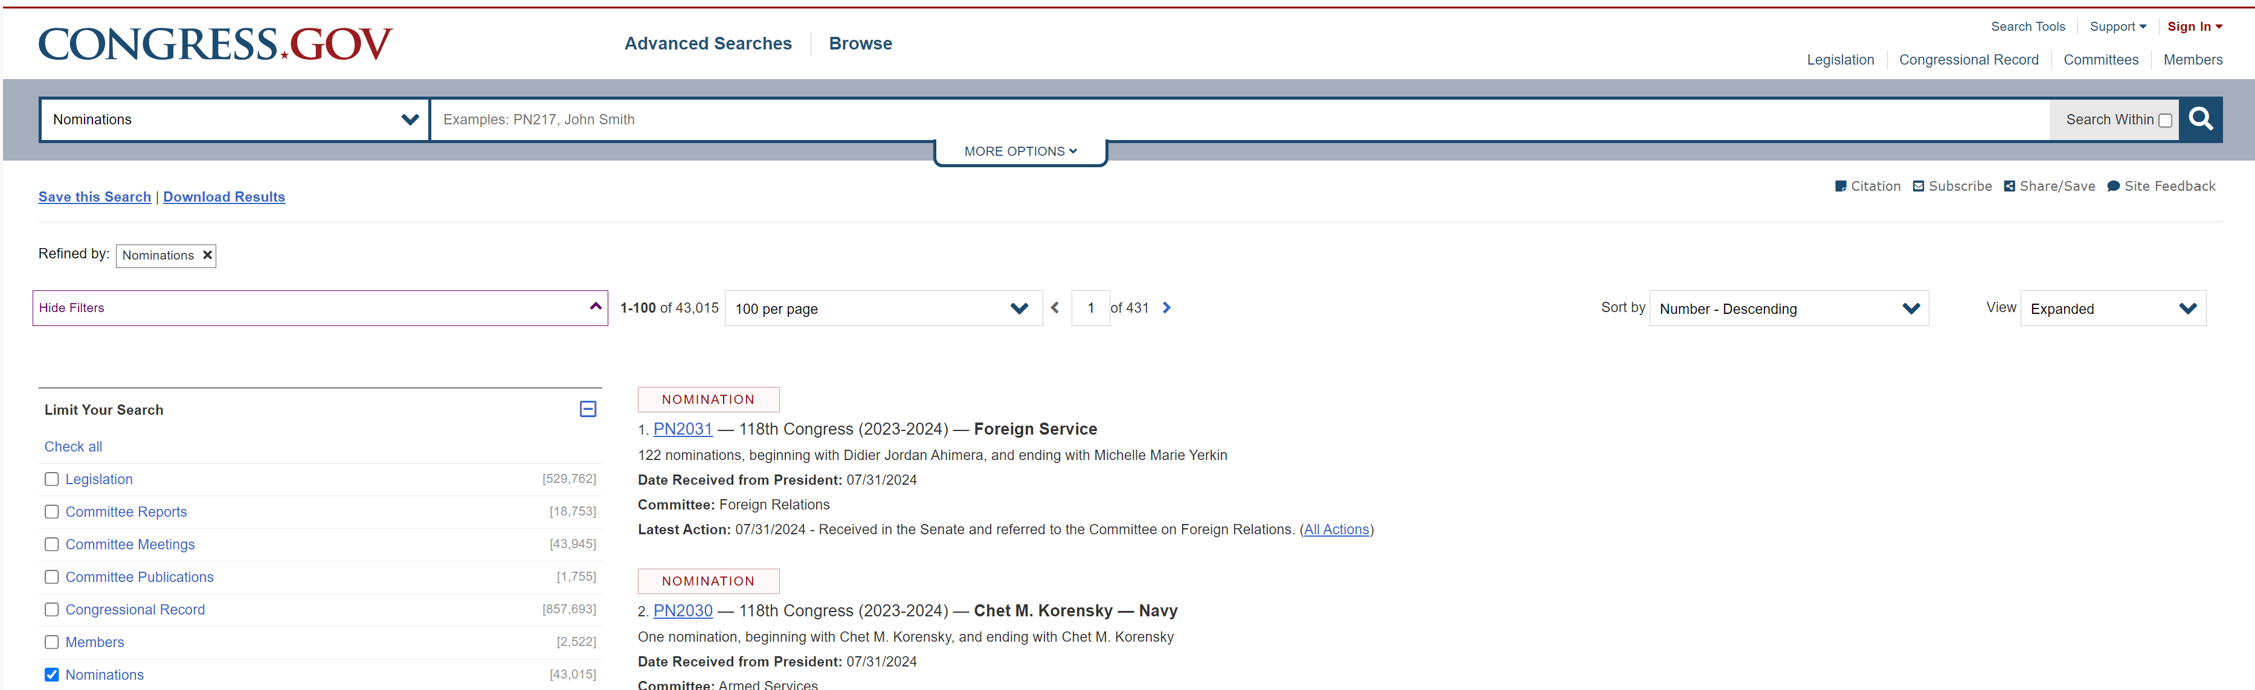
Nominee Process

Slide 20
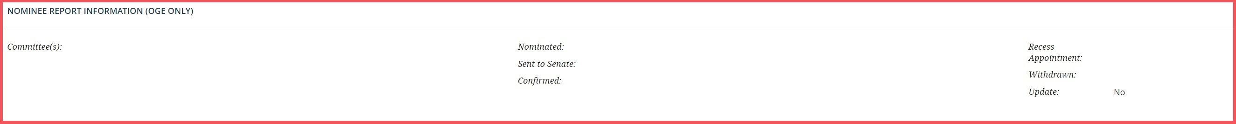
Nominee Process

Slide 21
Nominee Process
WH selects person to be considered for PAS position (Nominee)
Integrity report flows from WH to OGE & agency
OGE & agency reviewers assigned
Docs prepared for preclearance/ confirmatory email
OGE & agency reviewers review Integrity report & prepare EA
Package forwarded for preclearance
PNB Chief pre-clears report & EA
WH nominates Nominee
OGE reviewer reaches out to agency for final package

Slide 22
Nominee Process
What’s a Final Package?
  Integrity report
  Ethics agreement
  Agency transmittal letter
  (5 CFR § 2634.605(c)(2))

Slide 23
Nominee Process
WH selects person to be considered for PAS position (Nominee)
Integrity report flows from WH to OGE & agency
OGE & agency reviewers assigned
Docs prepared for preclearance/ confirmatory email
OGE & agency reviewers review Integrity report & prepare EA
Package forwarded for preclearance
PNB Chief pre-clears report & EA
WH nominates Nominee
OGE reviewer reaches out to agency for final package
Final package received from agency

Slide 24
Nominee Process
WH selects person to be considered for PAS position (Nominee)
Integrity report flows from WH to OGE & agency
OGE & agency reviewers assigned
Docs prepared for preclearance/ confirmatory email
OGE & agency reviewers review Integrity report & prepare EA
Package forwarded for preclearance
PNB Chief pre-clears report & EA
WH nominates Nominee
OGE reviewer reaches out to agency for final package
Final package received from agency
Nomination package processed through OGE

Slide 25
Nominee Process
WH selects person to be considered for PAS position (Nominee)
Integrity report flows from WH to OGE & agency
OGE & agency reviewers assigned
Docs prepared for preclearance/ confirmatory email
OGE & agency reviewers review Integrity report & prepare EA
Package forwarded for preclearance
PNB Chief pre-clears report & EA
WH nominates Nominee
OGE reviewer reaches out to agency for final package
Final package received from agency
Nomination package processed through OGE
Nomination package sent to Senate Committee(s)

Slide 26
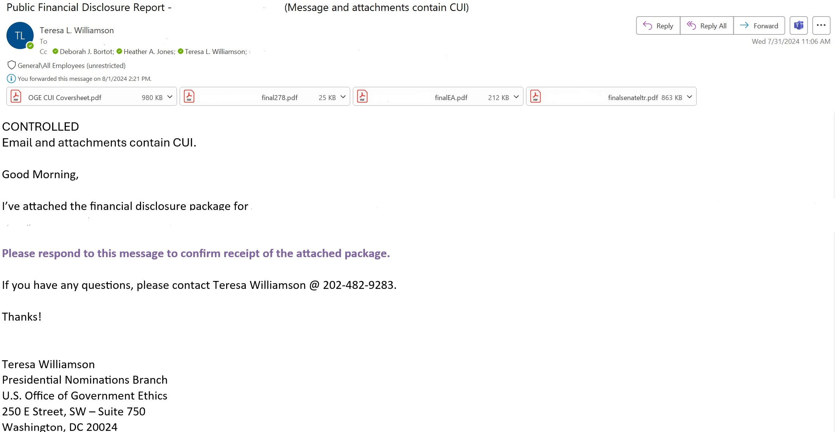
Nominee Process

Slide 27
Nominee Process
WH selects person to be considered for PAS position (Nominee)
Integrity report flows from WH to OGE & agency
OGE & agency reviewers assigned
Docs prepared for preclearance/ confirmatory email
OGE & agency reviewers review Integrity report & prepare EA
Package forwarded for preclearance
PNB Chief pre-clears report & EA
WH nominates Nominee
OGE reviewer reaches out to agency for final package
Final package received from agency
Nomination package processed through OGE
Nomination package sent to Senate Committee(s)
Integrity report & EA posted on OGE website

Slide 28
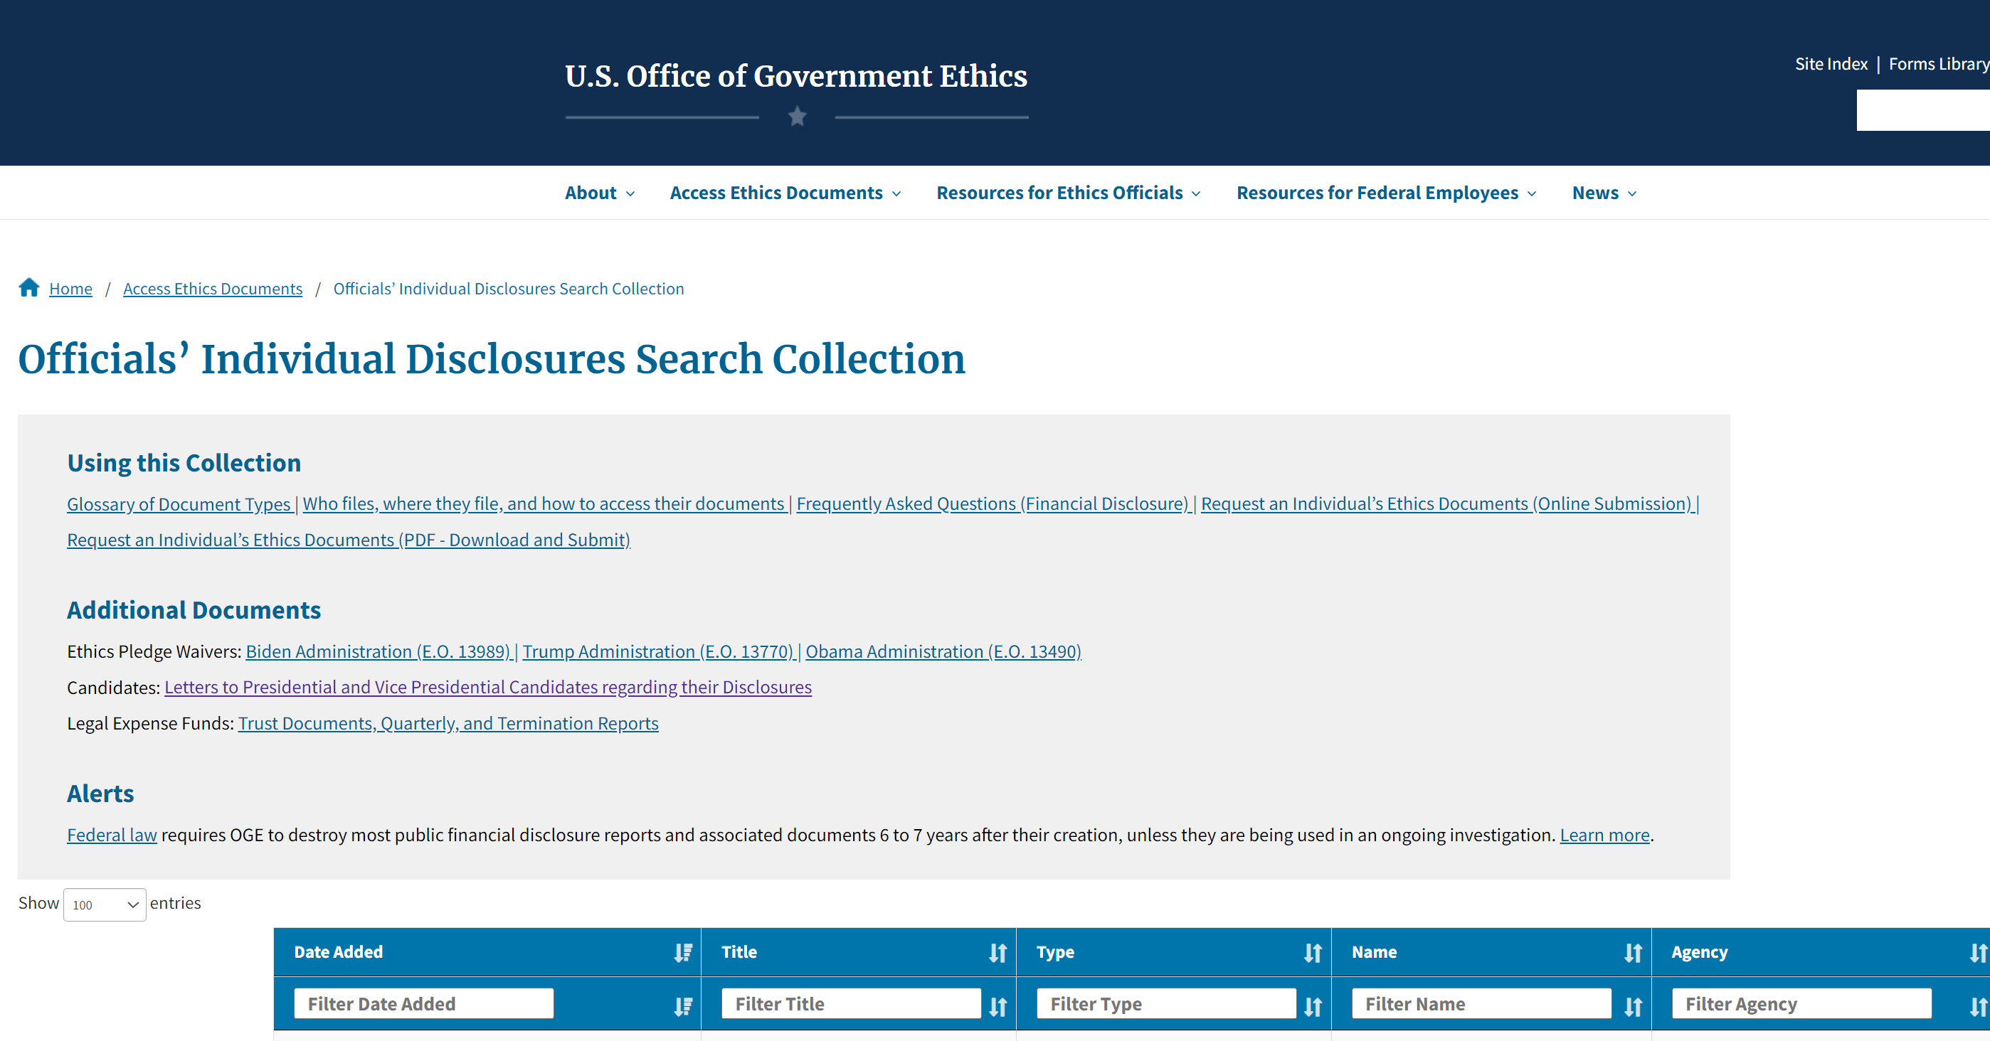
Nominee Process

Slide 29
Nominee Process
WH selects person to be considered for PAS position (Nominee)
Integrity report flows from WH to OGE & agency
OGE & agency reviewers assigned
Docs prepared for preclearance/ confirmatory email
OGE & agency reviewers review Integrity report & prepare EA
Package forwarded for preclearance
PNB Chief pre-clears report & EA
WH nominates Nominee
OGE reviewer reaches out to agency for final package
Final package received from agency
Nomination package processed through OGE
Nomination package sent to Senate Committee(s)
Integrity report & EA posted on OGE website

Slide 30

Nominee Process
Status Updates

Slide 31

Nominee Process
Priority Reports

Slide 32

Nominee Process
Expediting Nomination Packages

Slide 33

Nominee Process
Amendments

Slide 34
Nominee Process
5-Day Letter
5 U.S.C. app. § 101(b)(1); 5 C.F.R. § 2634.606
At or prior to a filer’s first Senate committee hearing, the filer must submit a letter disclosing any non-federal earned income and honoraria received by the filer since the last day of the period covered by the filer’s Nominee report through a date that is no more than 5 days prior to the hearing. For example, if the filer submitted a draft Nominee report on March 12, 2019, and has a Senate committee hearing on May 14, 2019, the letter must disclose non-federal earned income and honoraria for the period March 13, 2019, through May 9, 2019 (or later). The filer submits this update letter to the agency at which the position is located, and the DAEO will transmit this letter to the Senate and OGE.

Slide 35
Nominee Process - OGE 450s
WH selects person to be considered for PAS position (Nominee)
Integrity report flows from WH to OGE & agency
OGE & agency reviewers assigned
Docs prepared for preclearance/ confirmatory email
OGE & agency reviewers review Integrity report & prepare EA
Package forwarded for preclearance
PNB Chief pre-clears report & EA
WH nominates Nominee
OGE reviewer reaches out to agency for final package
Final package received from agency
Nomination package processed through OGE
Nomination package sent to Senate Committee(s)
Integrity report & EA posted on OGE website

Slide 36

Nominee Process
Presidential Transition Team (PTT)

Slide 37
Nominee Process
WH selects person to be considered for PAS position (Nominee)
Integrity report flows from WH to OGE & agency
OGE & agency reviewers assigned
Docs prepared for preclearance/ confirmatory email
OGE & agency reviewers review Integrity report & prepare EA
Package forwarded for preclearance
PNB Chief pre-clears report & EA
WH nominates Nominee
OGE reviewer reaches out to agency for final package
Final package received from agency
Nomination package processed through OGE
Nomination package sent to Senate Committee(s)
Integrity report & EA posted on OGE website

