Slide 1

NATIONAL
March 11
2020
GOVERNMENT ETHICS
SUMMIT
Advising Employees Who
Want to Sell a Book Idea
Seth Jaffe, Office of Government Ethics
Rachel McRae, Office of Government Ethics

Slide 2
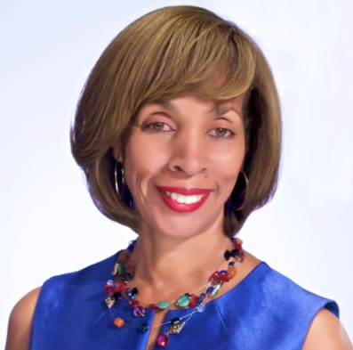
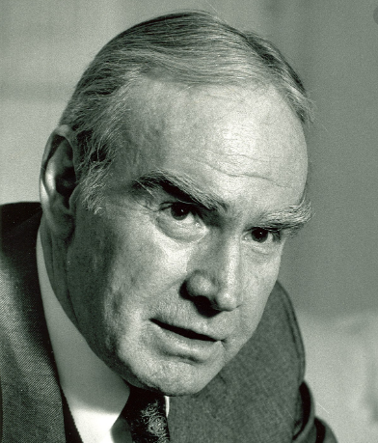
NATIONAL
Purpose of
2635.807
GOVERNMENT ETHICS
SUMMIT

Slide 3
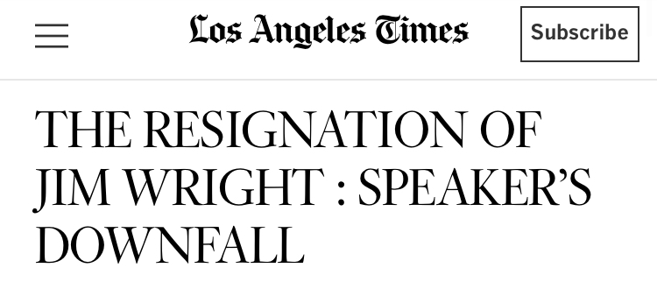
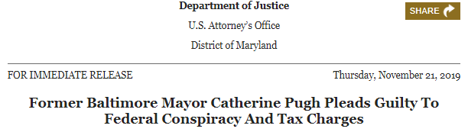

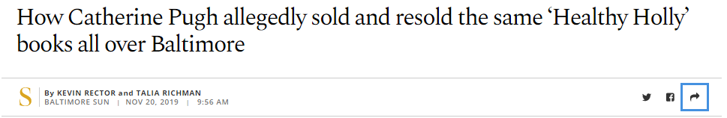
NATIONAL
Purpose of
2635.807
GOVERNMENT ETHICS
SUMMIT

Slide 4
NATIONAL
Purpose of
2635.807
GOVERNMENT ETHICS
SUMMIT
Ensuring that public office is not used for private gain
Employees shall endeavor to avoid actions creating even the appearance of using public office for private gain
Standards of Conduct for Employees of the Executive Branch, 57 FR 35006 (July 23, 1992)

Slide 5
NATIONAL
Book
Deals
GOVERNMENT ETHICS
SUMMIT
When may an employee receive compensation for writing a book?
(Seems like such a simple question!)
OGE Legal Advisory 08x3; 08x3a; and 08x3b

Slide 6
NATIONAL
Simple
Answer
GOVERNMENT ETHICS
SUMMIT
Agency
Supplemental
18 USC 209
2636.303
Other
Considerations
E.O. 12674
CNC
2635.807
2635.704
Colbert
Report
SGE

Slide 7
NATIONAL
Template:
Book Deal Questions
GOVERNMENT ETHICS
SUMMIT
What category of employee is seeking compensation for writing a book?
What is the book about?
When is the writing performed and compensation received?
What is the type of compensation?
Who is offering the compensation and why?
What other ethics rules and considerations may apply?

Slide 8
NATIONAL
What Category of Employee?
GOVERNMENT ETHICS
SUMMIT
Regular Employees are NOT:
special Government employees,
covered noncareer employees, nor
employees appointed by the President.
Special Government Employees (SGEs):
are those executive branch officers or employees specified in 18 U.S.C. § 202(a).
generally are employees who are retained to work temporarily for the Government for no more than 130 days in any 365-day period.

Slide 9
What is the
Book About?
NATIONAL
GOVERNMENT ETHICS
SUMMIT
“Related to Official Duties”
Two Main Classifications:
Based on what the book is about
Based on who is providing the compensation and why

Slide 10
NATIONAL
Timing
GOVERNMENT ETHICS
SUMMIT
Two “rules of thumb” to keep in mind:
The ethics rules do not restrict the ability of an employee to get paid for writing a book unless the writing occurs during Government service
The “receipt” of compensation is attributable to the time the writing occurs, if pursuant to a contract

Slide 11
Government service, compensation, and writing must overlap at some point in time in order for the ethics rules to apply.

Slide 12
NATIONAL
Type of
Compensation
GOVERNMENT ETHICS
SUMMIT
Advance
Royalties
Speaking Fees
Travel Expenses
(All except travel expenses are considered “compensation” for regular employees and SGEs - under 2635.807)

Slide 13
NATIONAL
Other Ethics
Considerations
GOVERNMENT ETHICS
SUMMIT
Writing-related activities
Supplemental agency regulations
Financial conflicts of interest
Impartiality
Supplementation of salary
Misuse of position

Slide 14
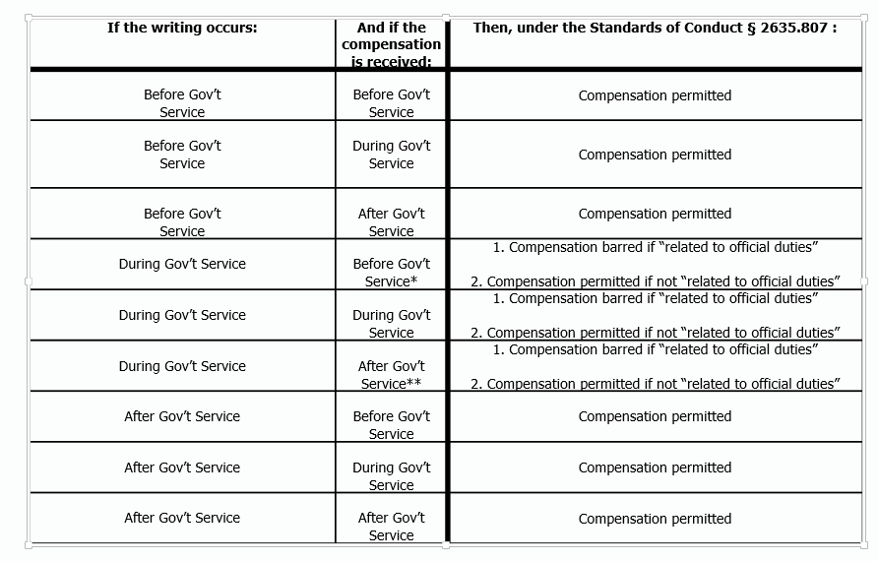
Timing of Writing and Receipt of Compensation
Regular Employees and SGEs

Slide 15
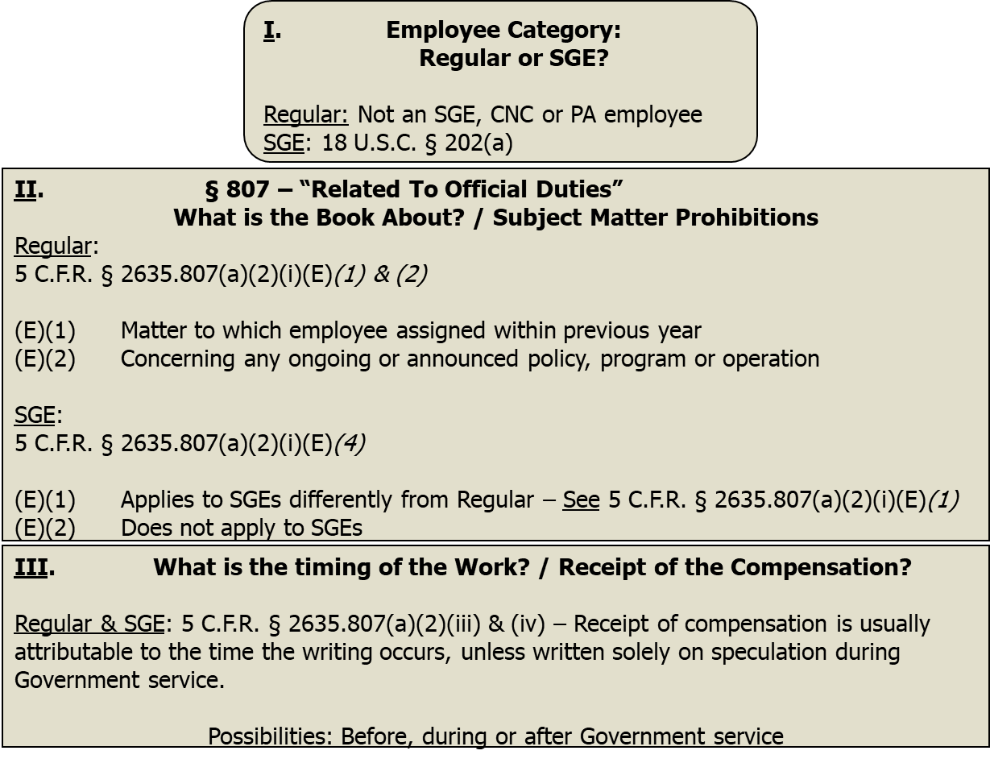
Overview: Determining Whether a Regular Employee or an SGE
May Receive Compensation for Writing a Book

Slide 16
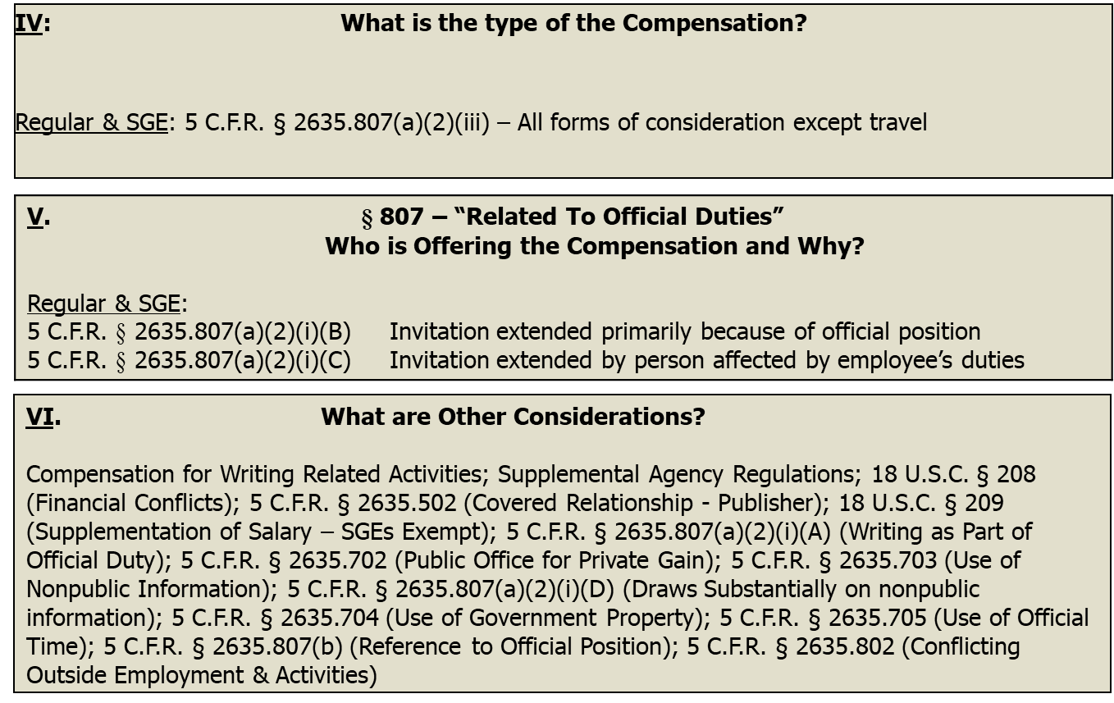
Continued: Determining Whether a Regular Employee or an SGE
May Receive Compensation for Writing a Book

Slide 17
NATIONAL
Category of Employee
GOVERNMENT ETHICS
SUMMIT
Covered Noncareer Employee (CNC):
Appointment must be one of several types of noncareer appointments
Must be in a position classified above GS-15 in the General Schedule or, for positions not under the General Schedule, must be in a position for which the rate of basic pay is at least 120 percent of the minimum rate of basic pay payable for GS-15
Cannot be an SGE
Appointed by the President to a full-time noncareer position (PA):
Employee must be appointed by the President
Employee must be a full-time employee; (i.e. no SGEs)
Employee must not be excluded from coverage. See 5 CFR § 2635.804(c)(2)

Slide 18
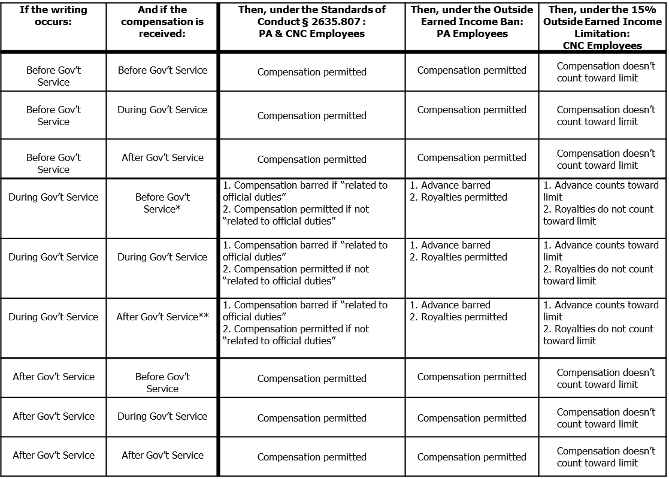
Timing of Writing and Receipt of Compensation
PA and CNC Employees

Slide 19
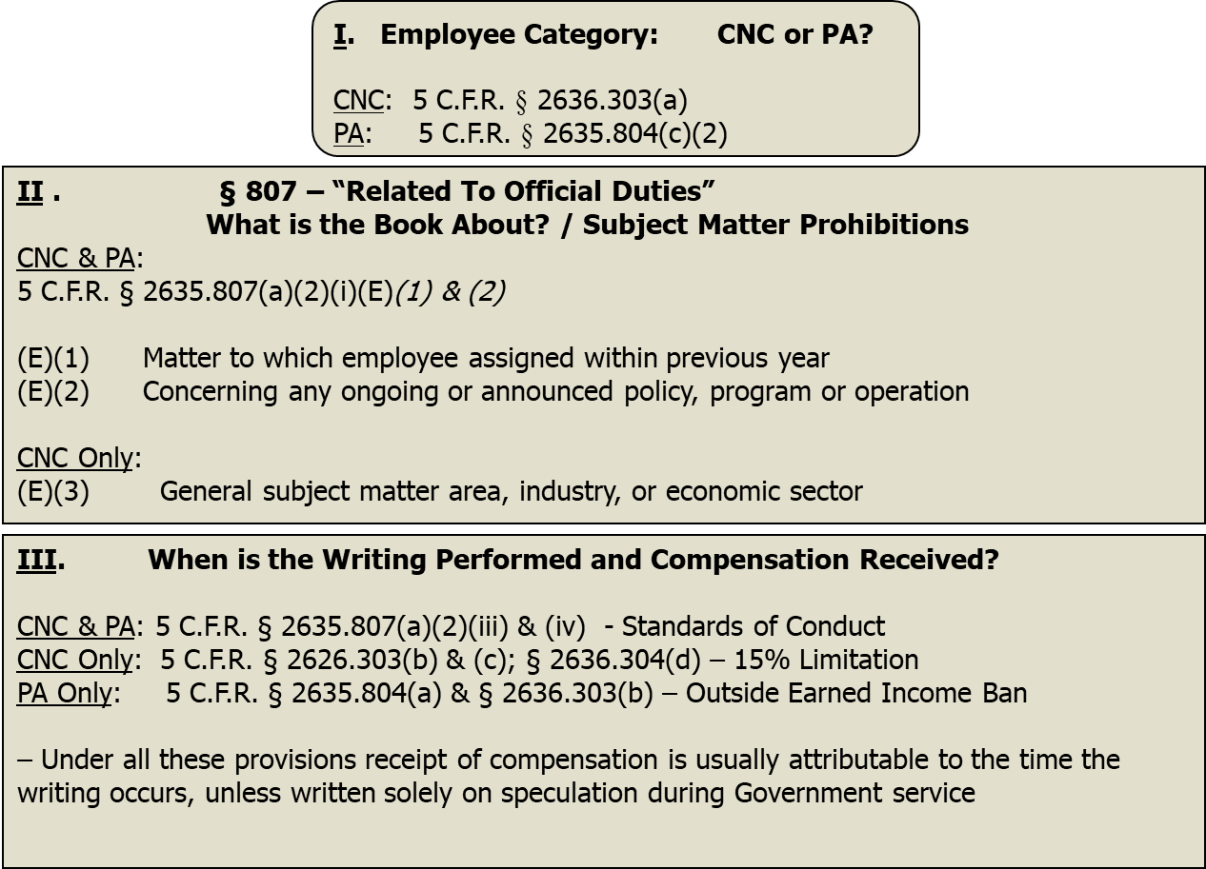
Overview: Determining Whether a CNC Employee or PA Employee
May Receive Compensation for Writing a Book

Slide 20
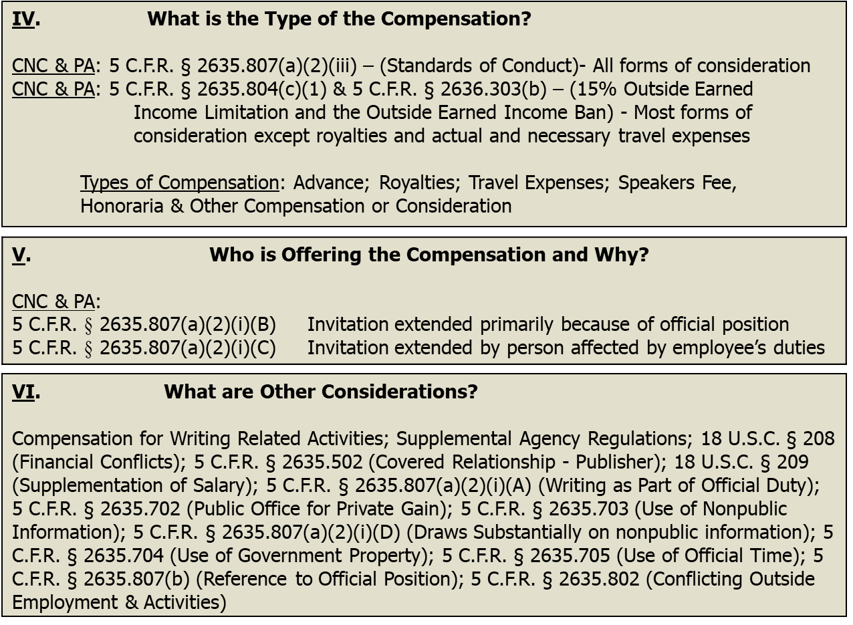
Continued: Determining Whether a CNC Employee or PA Employee
May Receive Compensation for Writing a Book

Slide 21

NATIONAL
Fact
Pattern
GOVERNMENT ETHICS
SUMMIT
What category of employee is seeking compensation for writing a book?
What is the book about?
When is the writing performed and compensation received?
What is the type of compensation?
Who is offering the compensation and why?
What other ethics rules and considerations may apply?

Slide 22
THANK YOU

