Slide 1
Interests of Professors

Slide 2
Review Guides
Public Financial Disclosure Guide (278 Guide)
Guidance on Analyzing Potential Conflicts of Interest (Conflict of Interest Guide)
Guide to Drafting Nominee Ethics Agreements (EA Guide)

Slide 3
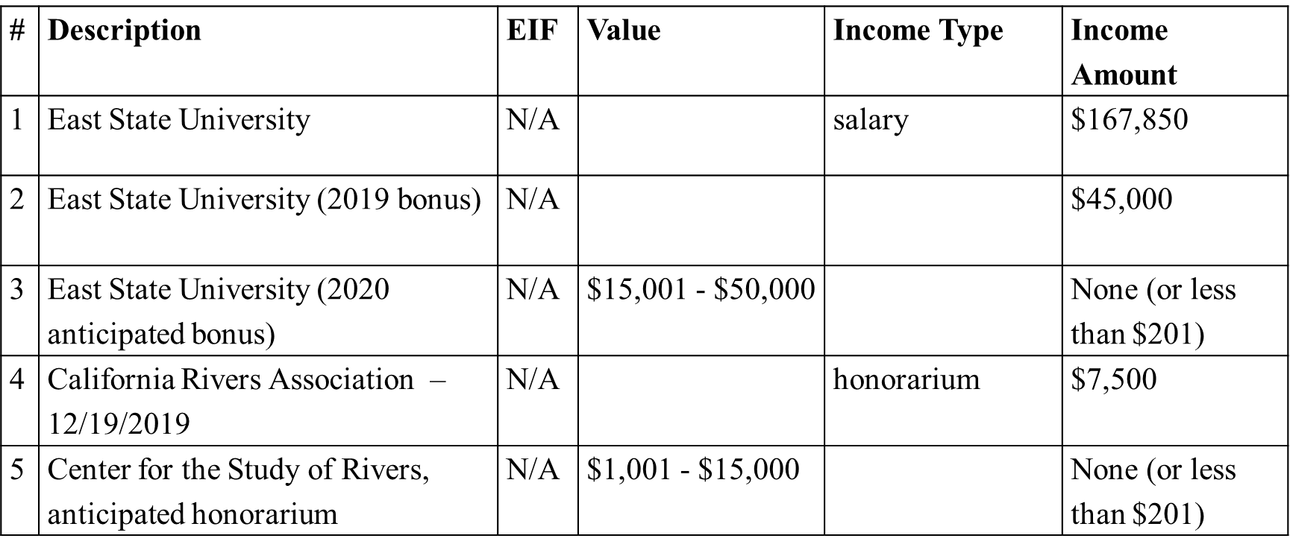
278e Reporting:
Part 2: Filer’s Employment Assets and Income

Slide 4
Executive Order 12731 § 102
Limitations on Outside Earned Income
Section 102 provides in part:
No employee who is appointed by the President to a full-time noncareer position in the executive branch shall receive any earned income for any outside employment or activity performed during that Presidential appointment.

Slide 5
18 U.S.C. § 209
Supplementation of salary
Prohibits an employee from receiving any salary or contribution to or supplementation of salary from any source other than the United States as compensation for services as a Government employee.
Legal advisory DO-02-016 (July 1, 2002): Summary of the Restriction on Supplementation of Salary

Slide 6
18 U.S.C. § 209
Summary Example 2: “A professor at a university accepts a position with the Office of Personnel Management and is granted an unpaid leave of absence from the university. Absent any other benefits, the unpaid leave status is not a supplementation to his salary because it does not have an ascertainable monetary value. (However, under 18 U.S.C. § 208, he may have to be recused from any particular matter that would have a direct and predictable effect on the financial interests of the university.)”

Slide 7
Leave of Absence
Must be unpaid (E.O. 12731 & 18 U.S.C. § 209)
Dean positions (Full-time PAS must resign)
Continuing benefits must be analyzed for conflicts

Slide 8
18 U.S.C. § 208:
Regulatory Exemptions for Leave of Absence
5 CFR 2640.203(b) Employees on leave from institutions of higher education. An employee on a leave of absence from an institution of higher education may participate in any particular matter of general applicability affecting the financial interests of the institution from which he is on leave, provided that the matter will not have a special or distinct effect on that institution other than as part of a class.
5 CFR 2640.203(c) Multi-campus institutions of higher education. An employee may participate in any particular matter affecting one campus of a State multi-campus institution of higher education, if the employee's disqualifying financial interest is employment in a position with no multi-campus responsibilities at a separate campus of the same multi-campus institution.

Slide 9
Unpaid Leave of Absence
Terms of the unpaid leave of absence—
Does university have a policy on the terms of the unpaid leave of absence?
What is the length?
What is the possibility that the unpaid leave of absence will be extended?
If the leave is extended, will any benefits be extended along with the unpaid leave of absence?

Slide 10
Unpaid Leave of Absence:
278e Reporting
Part 3: Filer’s Employment Agreements and Arrangements
Employer or Party | City/State | Status and Terms | Date
East State University | Fresno, CA | Pursuant to University policy, I am eligible to receive a performance bonus for services rendered during the 2020-2021 academic year. This bonus will be paid prior to assuming the duties of the position of Secretary. | 8/2020
East State University | Fresno, CA | Pursuant to University policy, I will take an unpaid, two-year leave of absence from my tenured Associate Professor position. The standard leave is for two years. At the end of that time, I will apply for an additional leave of absence. | 10/2020
East State University | Fresno, CA | I will continue to participate in the East State 403(b) plan. The university will not make contributions during my leave. | 8/1998

Slide 11
Continuing benefits
Bona fide employee benefits plans/programs that do not violate 18 U.S.C. § 209, or the gift rules are OK (e.g., retirement, health insurance, life insurance, etc.)
Other types of benefits are typically problematic (e.g., use of office space, research assistants, research facilities, library system)

Slide 12
Teaching
Cannot provide any services while on leave of absence

Slide 13
Speaking
No honoraria after appointment
  E.O. 12731
  18 U.S.C. § 209

Slide 14
Writing
Full-time PAS nominees will NOT be able to get paid to write a book or update a book during Government service
Book advance not OK if the payment is for a book to be written during Government service
Book royalties OK under Outside Earned Income Ban, but not OK under 5 C.F.R. § 2635.807 if related to official duties

Slide 15
Key OGE Advisories
DAEOGram DO-08-006 (March 06, 2008)(and the corresponding attachments, DO-08-006a and DO-08-006b): Book Deals Involving Government Employees. This Legal Advisory provides guidance on analyzing book deals based on the type of employee.
LA-20-06 (September 24, 2020): Recurring Book Deals Issues for Incoming and Outgoing Government Employees. This Legal Advisory supplements OGE’s 2008 advisory “Book Deals Involving Government Employees” (DO-08-006) by providing guidance on additional book deals issues relevant to incoming and outgoing employees. Specifically, this advisory addresses the ability of employees, during government service, to: (1) receive compensation for updating a textbook or other book that was initially written prior to government service; (2) engage in promotional activities as part of a book deal; and (3) try to sell a book idea or “shop a book around.”

Slide 16
Other Intellectual Property
Patents, copyrights, trademarks
Report in Part 2 of 278e for Nominee

Slide 17
Intellectual Property:
278e Reporting
Part 2: Filer’s Employment Assets and Income
# | Description | EIF | Value | Income Type | Income Amount
1 | “History of Clocks,” Stateburg University Press (value not readily ascertainable) | N/A |  | rent or royalties | $201 - $1,000
2 | “Financial Disclosure,” 4th ed., Zorn & Co. (value not readily ascertainable) | N/A |  | advance | $22,000
3 | “Circular frame and hub system for a conveyance,” Patent # 202,482,924 (value not readily ascertainable) | N/A |  |  | None (or less than $201)

Slide 18
Intellectual Property Conflicts Analysis
Potential Conflicts With Publisher
208 “Ability or Willingness” recusal
5 C.F.R. § 2635.502
Other Issues

Slide 19
Ethics Agreement:
12.2.0 – arrangement to write a book in the future
Sample Language:
Before learning of my consideration for a possible nomination to a position at the U.S. Banking Administration, I received an advance from Mullen Publishers, Inc., for a textbook on economics that I have agreed to write. I understand that I may not work on this textbook or perform any other services for compensation during my appointment to the position of Deputy Administrator if the Senate confirms my nomination. Pursuant to the impartiality regulation at 5 C.F.R. § 2635.502, I will not participate personally and substantially in any particular matter involving specific parties in which I know Mullen Publishers, Inc., is a party or represents a party, unless I am first authorized to participate, pursuant to 5 C.F.R. § 2635.502(d).

Slide 20
Ethics Agreement:
12.2.1 – arrangement with a publisher regarding royalties
Sample Language:
I receive royalties from Mullen Publishers, Inc., for sales of my book, Barlow’s Field Guide to Wilderness Survival Techniques. Pursuant to the impartiality regulation at 5 C.F.R. § 2635.502, I will not participate personally and substantially in any particular matter involving specific parties in which I know Mullen Publishers, Inc., is a party or represents a party, unless I am first authorized to participate, pursuant to 5 C.F.R. § 2635.502(d).

Slide 21
THANK YOU!

