Slide 1
Election Readiness Training
Identifying and Reporting Different Types of Investment Funds and Making an EIF Determination
Fall 2020

Slide 2
Quiz
An asset identified as “BlackRock Diversified Income Portfolio” has the following description:
Investment strategy:
The BlackRock Diversified Income Portfolio seeks to generate income by investing in a broad range of asset classes. This opportunistic approach may be appropriate for investors looking for income and growth potential while managing volatility.
Types of investments:
Primarily exchange-traded funds (ETFs), diversified among traditional (e.g., stocks and bonds) and non-traditional (e.g., REITS and bank loans) income sources.
This asset is an excepted investment fund.
True False

Slide 3
Managed Accounts
What is a managed account?
“Separately managed account,” “controlled account,” or “robo-advisor account”
Owned by the investor but managed for a fee by a financial advisor
Not an “excepted investment fund.” The investor must disclose each asset as a separate line item on the financial disclosure report.
Although some managed accounts may appear similar to mutual funds, they are not mutual funds and do not qualify for the same treatment as mutual funds under conflicts of interest laws.

Slide 4
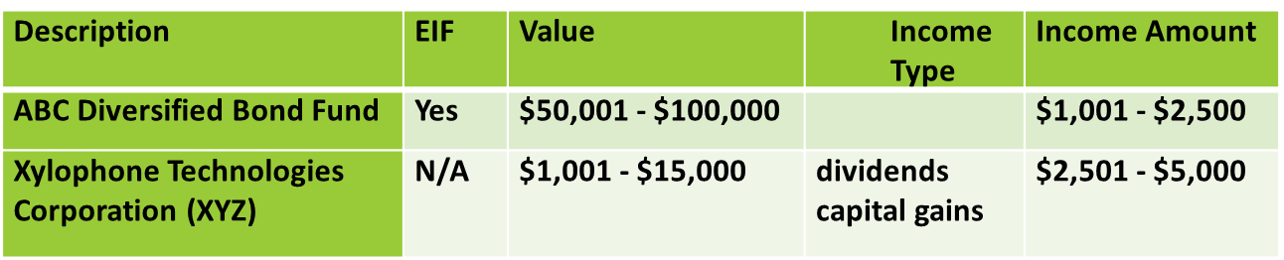
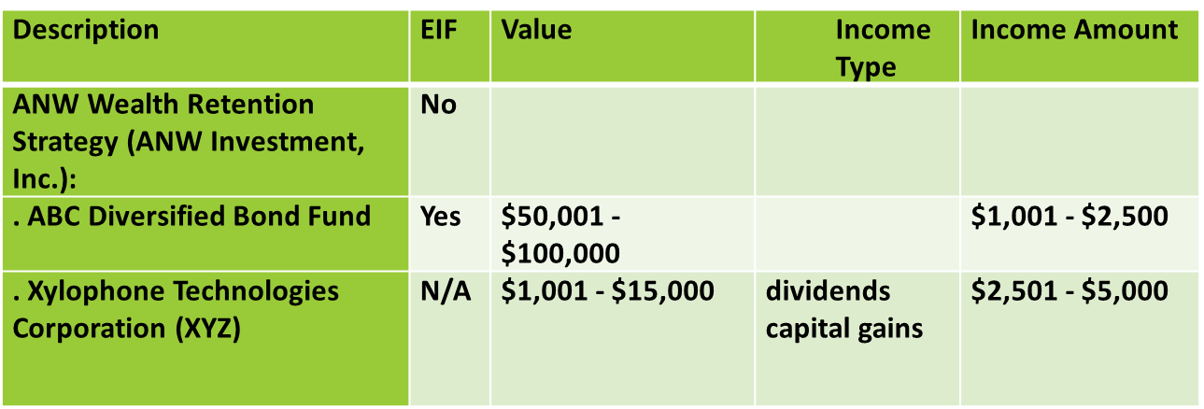
Managed Accounts

Slide 5
Investment Funds
What is an investment fund?
Mutual funds
Exchange traded funds
Hedge funds
Private equity funds

Slide 6
Investment Funds
Excepted Investment Funds
REMEMBER:
EIF = Reporting
EIF ≠ Conflicts

Slide 7
Quiz
Which of the following is not necessary to establish that an asset meets the standard for “excepted investment fund”?
a. The filer neither exercises control over nor has the ability to exercise control over the financial interests held by this asset
b. This asset is publicly traded or available, or its holdings are widely diversified
c. At least 100 individuals have invested in this asset
d. This asset must be a pooled investment vehicle
e. This asset must be registered with the SEC
f. None of the above (i.e., they are all elements of an excepted investment fund)

Slide 8
Investment Funds
Getting to EIF
independently managed,
“widely held,” and
either “publicly traded or available” OR “widely diversified.”

Slide 9
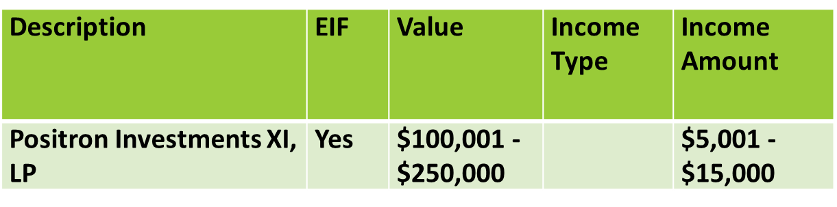
Investment Funds

Slide 10
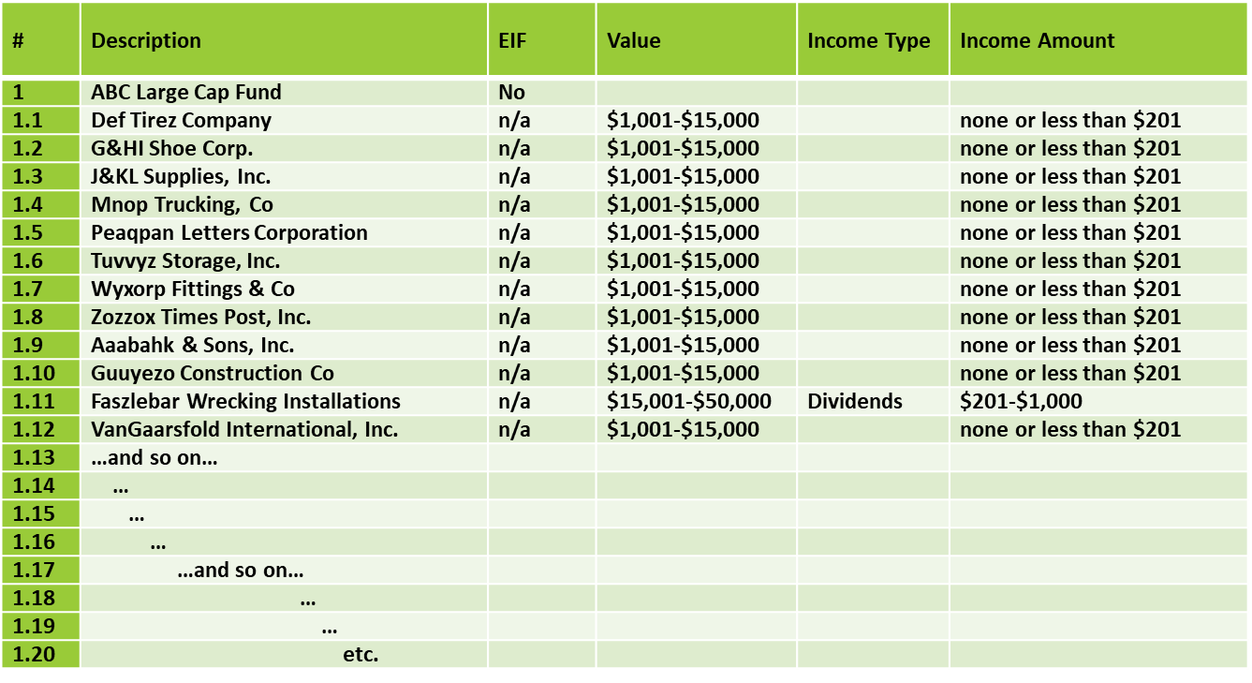
Investment Funds

Slide 11
Investment Funds
What if the filer can’t report the underlying holdings?
OGE Guidance on Financial Disclosure Requirements for Pooled Investment Funds:
LA-14-05 (September 20, 2014)

Slide 12
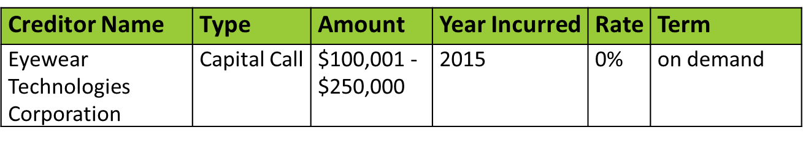
Investment Funds
Liabilities – Capital Calls
Report any capital calls the filer would legally be required to meet upon demand.

Slide 13
THANK YOU

