Slide 1
Gifts In Times of Crisis
Presented by:
Maura Leary, Associate Counsel, Ethics Law & Policy Branch
Melba Melton, Assistant Counsel, Ethics Law & Policy Branch
U.S. Office of Government Ethics

Slide 2


2022 Yellowstone Floods

Slide 3
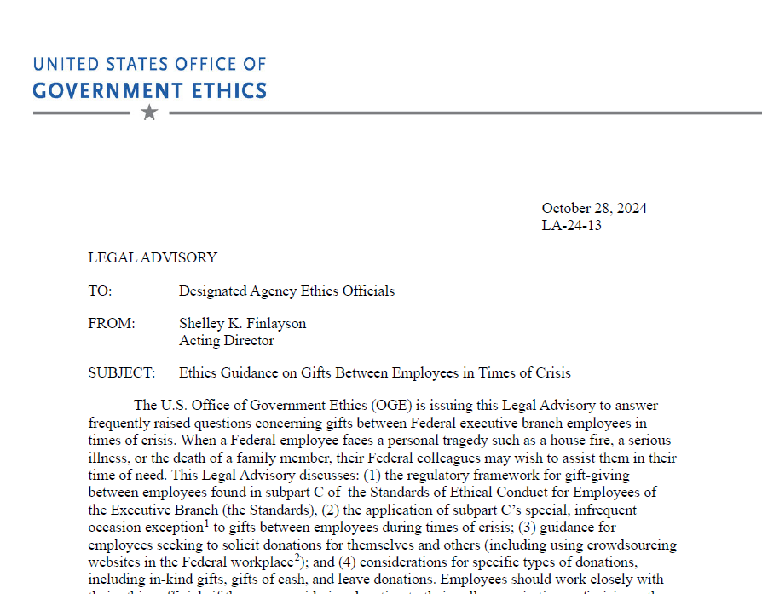
LA-24-13

Slide 4
Agenda
Why Gifts in Times of Crisis?
Overview of subpart C gift rules
Special Infrequent Occasion Exception
Other Common Questions (Solicitation, Types of Gifts)
Questions & Answers

Slide 5
Subpart C Overview
General Standards (2635.302)
Employee cannot accept a gift from an employee receiving less pay unless
Employee cannot give a gift to an official superior.
Exceptions (2635.304):
Non-cash gifts of $10 or less
Food and refreshments shared in the office
Personal hospitality
Leave transferred to non-immediate supervisor.
no subordinate-official superior relationship; and
(1) personal relationship that would justify the gift and the receiving employee is not the official superior of the employee giving the gift; OR
(2) the employee giving the gift is the official superior of the receiving employee.

Slide 6
Special, Infrequent Occasion
Significance: An important life event
Surgery for newborn child
Rarity: An uncommon occurrence
Home burns down
Child sprains ankle while riding a bike
Moving due to military orders
An employee may give a gift “appropriate to the occasion” to an official superior “in recognition of infrequently occurring occasions of personal significance.”

Slide 7
Solicitation in Crisis
Solicit on behalf of self or close relative?
Generally, no.
Bad idea for everyone
Prohibited for supervisors (5 C.F.R. § 2635.302(c)).
Solicit for another employee with relative or friend facing crisis?
Sometimes, if:
Careful to consider workplace solicitation issues
Consider closeness of the relationship if affected person is not employee
Solicit using crowdsourcing platforms?
Discouraged because:
Public nature
Lists names and donation amounts
Donations from contractors must be identified and returned
LA-20-07: Crowdsourced Fundraising

Slide 8

What Donations Are Permissible?
Can We Give In-Kind Donations?
Generally, yes.
Value must be “appropriate to the occasion.”
Donate Cash to Supervisor?
Yes, if “appropriate to the occasion”
Can We Donate Leave?
Yes, if the leave transfer is not to their direct supervisor

Slide 9

Other Q&As
Subpart C applies to employees at different agencies
Employees can accept a gift from an employee receiving less pay if they have a personal relationship
Gifts are reportable on financial disclosure forms

Slide 10
Thank You!
Presented by:
Maura Leary, Associate Counsel, Ethics Law & Policy Branch
Melba Melton, Assistant Counsel, Ethics Law & Policy Branch
U.S. Office of Government Ethics

