Slide 1
18 U.S.C. §208(b)(1) Waiver Training
U.S. Office of Government Ethics
Cheryl L. Kane-Piasecki
Melba Melton

Slide 2
Part 1
Overview

Slide 3
Part 1 Roadmap
Introduction
Overview of (b)(1) Waivers
OGE’s Role
Resources

Slide 4
18 U.S.C. §208

Slide 5

18 U.S.C. §208
bars participation
[W]hoever, being an officer or employee of the executive branch of the United States Government, or of any independent agency of the United States, a Federal Reserve bank director, officer, or employee, or an officer or employee of the District of Columbia, including a special Government employee, participates personally and substantially as a Government officer or employee, through decision, approval, disapproval, recommendation, the rendering of advice, investigation, or otherwise, in a judicial or other proceeding, application, request for a ruling or other determination, contract, claim, controversy, charge, accusation, arrest, or other particular matter in which, to his knowledge, he, his spouse, minor child, general partner, organization in which he is serving as officer, director, trustee, general partner or employee, or any person or organization with whom he is negotiating or has any arrangement concerning prospective employment, has a financial interest—…

Slide 6
The size of the financial interest in the matter
The type of holding that creates the disqualifying interest
The statute is indifferent to:
18 U.S.C. §208
has
no de minimis

Slide 7
Statutory Waivers and Regulatory Exemptions
Agency Issued
Issued to an SGE on a FACA committee
Issued to an individual
18 USC 208(b)(3)
OGE Issued
18 USC 208(b)(2)
18 USC 208(b)(1)
Waives the disqualification requirement
Disqualifying interest is not so substantial to affect integrity of service
Waives the disqualification requirement
Need for SGE’s service outweighs the conflict of interest
Issued by regulation (5 CFR 2640)
Exempts financial interests which are too remote or too inconsequential

Slide 8
18 U.S.C. §208(b)(1) Waivers

Slide 9

What is a §208(b)(1) waiver?
Agency determination that an employee’s disqualification from all or part of a particular matter is not required because the disqualifying financial interest in the matter is not so substantial as to likely affect the integrity of the employee’s service.

Slide 10
When to consider a waiver
No other remedy is available
Participation can be limited
Effect of the matter on the interest is unclear
Financial interest cannot be divested

Slide 11
Are waivers always the answer?
A waiver is inappropriate when…
Another remedy is available that eliminates the conflict.
The scope of the government matter(s) is too broad or ill-defined.
The statutory requirements are not met.
A waiver may be inadvisable when…
Must be issued in writing before any participation in the matter(s)
Includes a determination that the 18 USC 208 (b)(1) standard is met
Fully discloses the disqualifying financial interest and the particular matter(s)

Slide 12
Who Decides?
The agency has the statutory authority to issue the waiver
OGE neither “concurs in” nor “disallows” an agency’s decision to grant a waiver
OGE may sometimes “disagree with” and “advise against” issuing an individual waiver

Slide 13
OGE and
§208(b)(1) Waivers

Slide 14

OGE’s Role
Consult
An OGE attorney reviews the 208(b)(1) waiver to ensure statutory requirements are met.
Advise
Provide agencies with guidance on their 208 analysis.
Receive
Final, issued waivers must be submitted to OGE.

Slide 15
Resources
Authorities
18 U.S.C. §208
5 CFR §2640.301
Executive Order 12731
Guidance Documents
DO-07-006
LA-18-08
DO-10-005

Slide 16
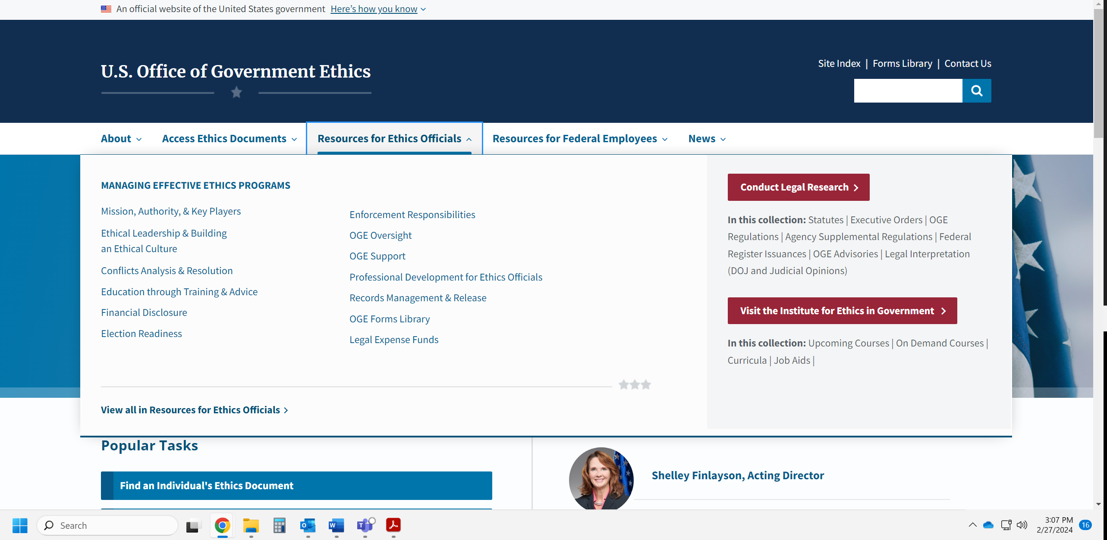
Where To Find These Resources

Slide 17

Stay Tuned for
Part 2!

