Slide 1
What to Expect in a Program Review

Slide 2
Agenda
Introduction
The Notice of Inspection or Review- Materials Submission
Review of the Materials
Drafting the Report
Publication of the Report
Our Goal

Slide 3

Why does OGE conduct ethics program reviews?

Slide 4

The primary purpose of the review is to assess the ethics program’s compliance with applicable requirements and, if appropriate, recommend corrective action.
Inspections
Plenaries

Slide 5
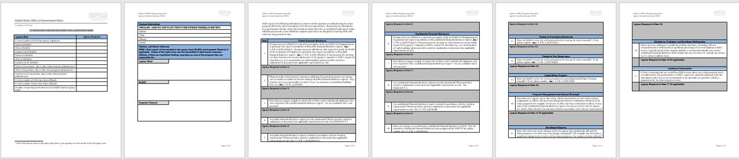
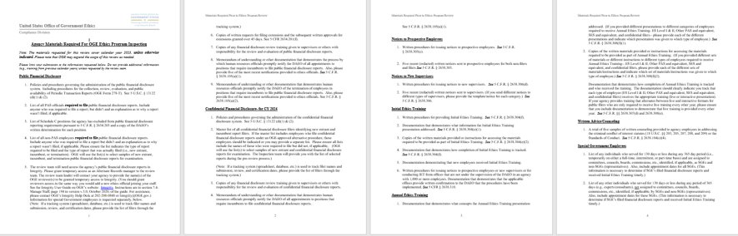
Inspection or Review Scope –Previous calendar year to the present

Slide 6
Notice of Inspection or Review- things that you should know
The due date for the materials is typically between 2 and 4 weeks of the date the notice was sent.
The materials should be sent electronically directly to ProgramReview@oge.gov.
Contact us early if you prefer to submit the materials via an external application.
Contact us early if you need an extension to submit the materials.

Slide 7
Notice of Review-Additional tips for an easier review
Annotate the Request for Materials document to identify all the files that you provide in your submission.
Explain any items that do not apply to your program or that you cannot provide in your submission.
Identify areas for improvement and if possible, address them ahead of the review (for example the lack of written procedures for the administration of elements of the ethics program, etc.).

Slide 8
Review of the Materials
Assess materials for compliance
Identify program strengths and vulnerabilities
Record compliant and non-compliant program areas

Slide 9
Review of the Materials
Select sample of financial disclosures
Generate and send follow-up questions
Arrange phone/virtual meetings

Slide 10
Drafting Phase
Create an Index
Write indexed report
Peer review
During this phase you can expect brief emails and/or calls to tie up loose ends.
Verification questions
Yes/No questions
Supplement existing sources
Questions also driven by peer reviewer

Slide 11

Discussion Draft
Provided for agency review
Typos, factual errors, technical issues
Add comments

Slide 12
Example Comments
We concur with OGE’s findings
Thank us for pointing out areas that need to be improved
Explanations of why an area of a program was deficient
Technical difficulties
Staffing issues
Leadership changes
Restructuring
Presidential transition

Slide 13
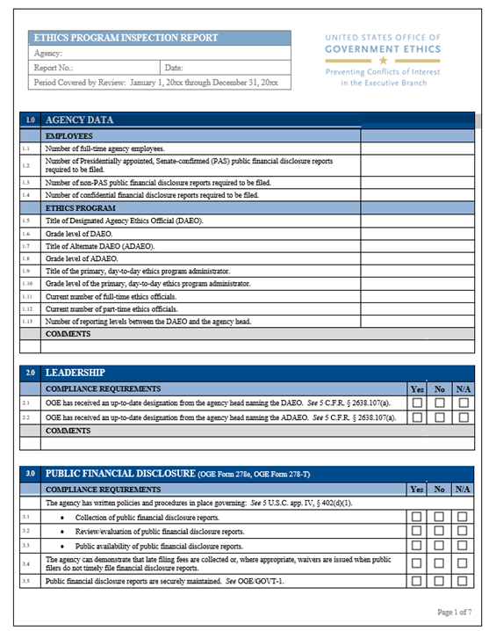
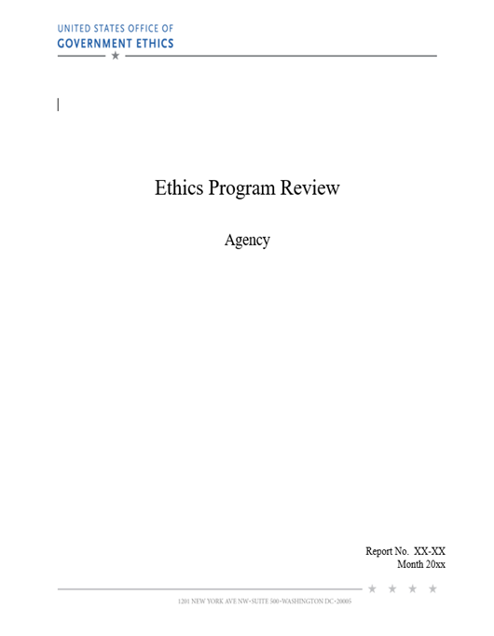
Publication of the Report

Slide 14
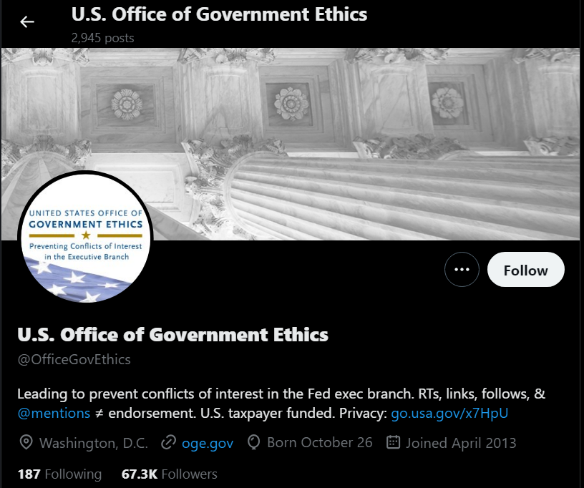
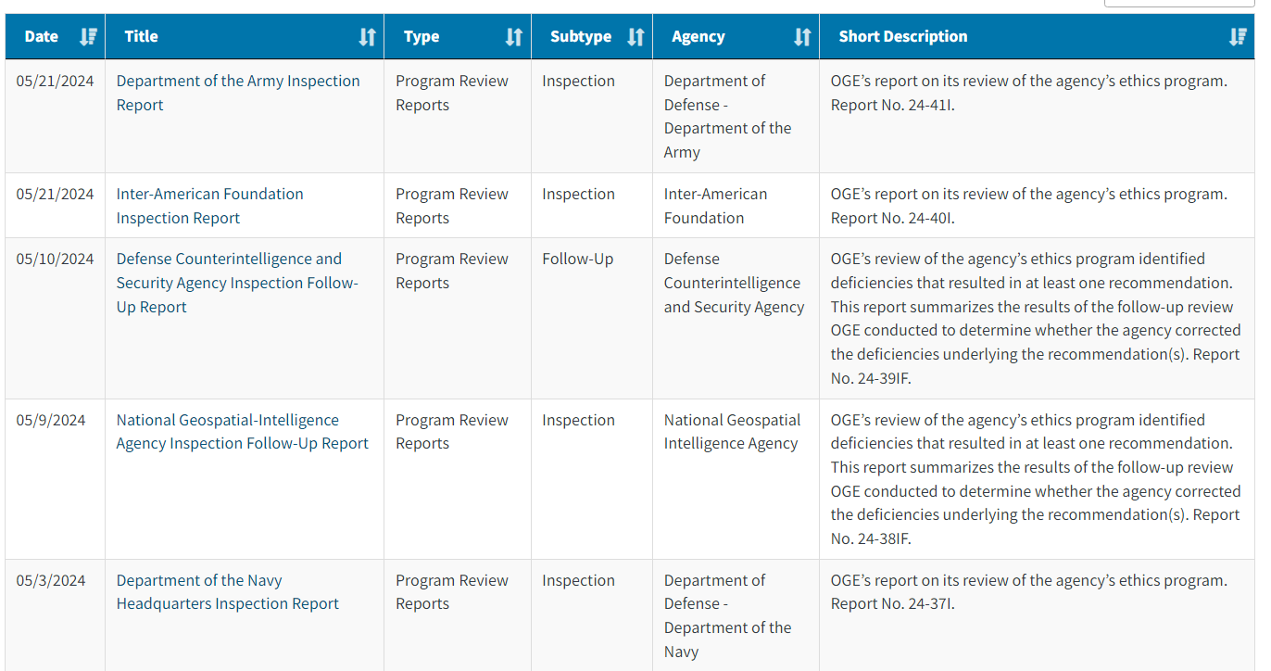
Publication of the Report

Slide 15

Recommendations
Issued when OGE IDs program deficiencies
Not really recommendations- state what agency must do to meet compliance standards
OGE conducts follow-up review to evaluate actions taken by agency

Slide 16
Recommendations
Relatively common
Do not necessarily indicate deeper problems
Can signal to leadership that ethics is understaffed or lacking resources

Slide 17
Recommendations: Examples
Ensure that new entrant public financial disclosure reports are filed timely.
Establish written procedures for issuing the required notices to prospective employees.

Slide 18

Our Goal
Collaborative
Welcome feedback during process
Accurate
Agency Reviews Draft Report
Helpful
Purpose of recommendations is to assist ethics program
Identify areas for improvement

Slide 19

Questions?

Slide 20
Thank you!
Ciara Guzman, Lead Program Analyst
cmguzman@oge.gov
Robert Lubitz, Program Analyst
relubitz@oge.gov

