Slide 1

Gearing Up for the 2016 Election:
What Every Employee Needs to Know about the Hatch Act

Slide 2
Who Is Covered by the Hatch Act?
      The Hatch Act has two categories of employees
Less Restricted
May actively participate in partisan political management and campaigns, subject to the prohibitions we are about to discuss
Further Restricted
Subject to additional restrictions regarding active participation in partisan political management and campaigns
5 U.S.C. § 7323(b)(2)(A); 5 C.F.R. § 734.401

Slide 3
Who Is Further Restricted?
Employees of certain intelligence or enforcement agencies and offices (except PAS)
CIA
NSA
Defense Intelligence Agency
National Geospatial-Intelligence Agency
Office of the Director of National Intelligence
National Security Council
DOJ’s Criminal and National Security Divisions
FBI
Secret Service
IRS’s Office of Criminal Investigation
Federal Elections Commission
Election Assistance Commission
Merit Systems Protection Board
Office of Special Counsel
5 U.S.C. § 7323(b)(2)(A); 5 C.F.R. § 734.401

Slide 4
Who Is Further Restricted?
Employees holding certain positions (in any agency)
Career Senior Executive Service (Career SES)
Administrative Law Judges
Contracts Appeals Board Members
Administrative Appeals Judges
5 U.S.C. § 7323(b)(2)(A); 5 C.F.R. § 734.401

Slide 5
What is political activity?
Political Activity is any activity directed toward the success or failure of a partisan candidate, political party, or partisan political group.
5 C.F.R. § 734.101

Slide 6

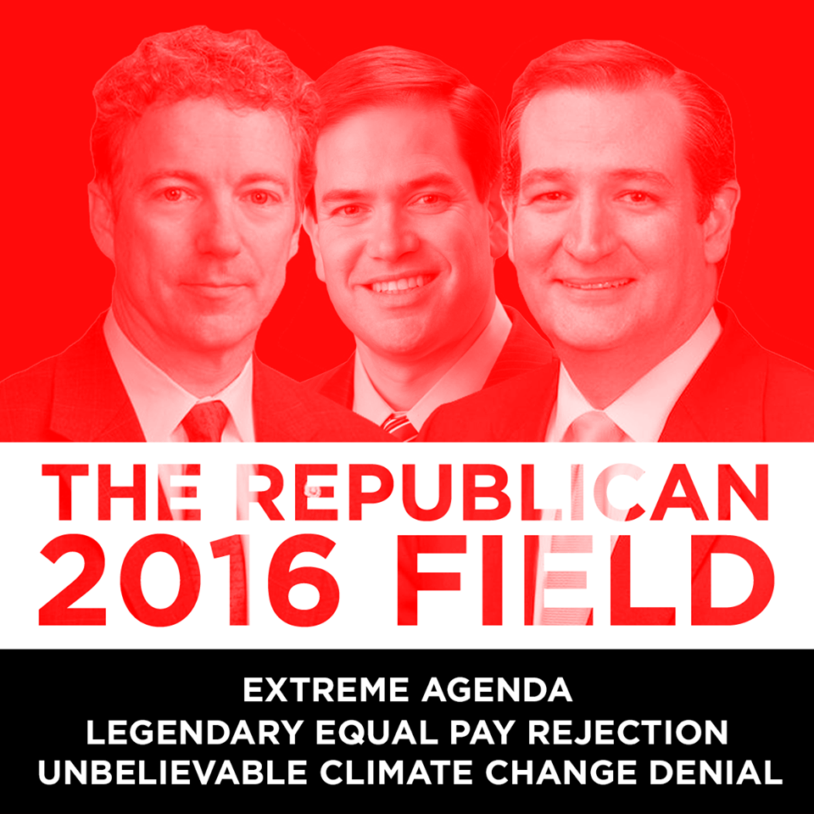
What is political activity?
5 C.F.R. § 734.101

Slide 7
What is not political activity?
  Legislation
  E.g., Affordable Care Act, DOMA
  Ballot Initiatives
  Budget
  Issues
  E.g., Gun control, Pro-choice/Pro-life
  Petitioning Congress
  KEY: Activity must not tie back to a political party, candidate for partisan office or partisan political group
5 C.F.R. § 734.101

Slide 8
What Does the Hatch Act Prohibit?
24/7 Prohibitions
Employees may NOT:
Use their official authority or influence to affect the outcome of an election
Solicit, accept, or receive a political contribution
Be candidates in partisan elections
Solicit or discourage the political activity of a person with business before their employing office
8
5 U.S.C. § 7323(a)

Slide 9
What Does the Hatch Act Prohibit?
No Political Activity at Work Prohibition
Employees may NOT engage in political activity while:
on duty
in the federal workplace
wearing a government uniform or badge
operating a government vehicle
5 U.S.C. § 7324

Slide 10
24/7 Prohibitions
Use of Official Authority
Employees may not use their official authority or influence to affect the outcome of an election
Examples :
Involving subordinates
Using one’s official title or position
Using agency resources, e.g., an official social media account
Using non-public agency information for political purposes
10
5 U.S.C. § 7323(a)(1); 5 C.F.R. § 734.302

Slide 11
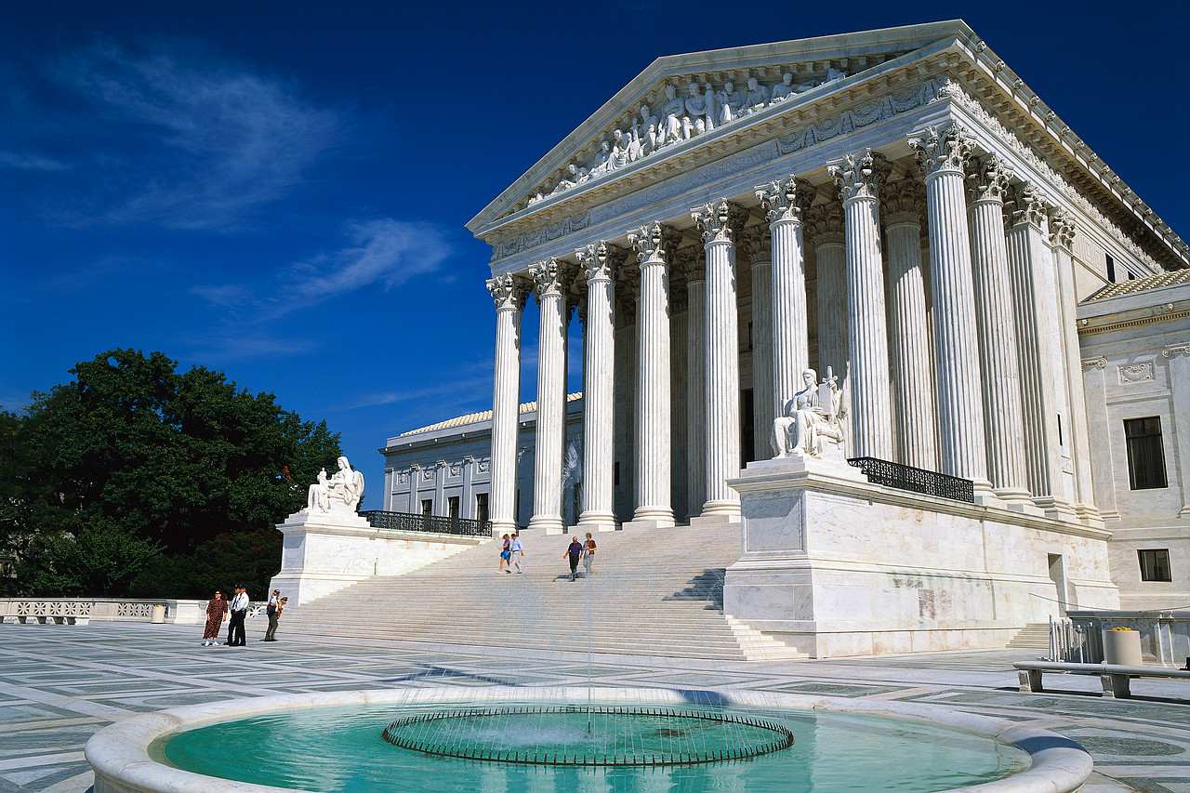



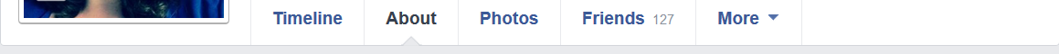
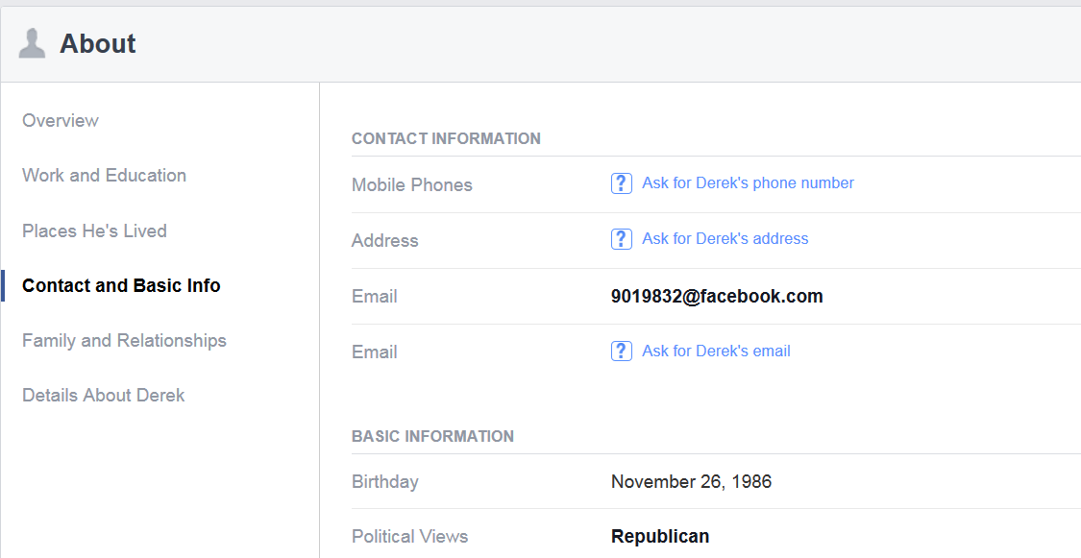
Hatch Actor
555-555-5555
It is OKAY to fill in your political views on your Facebook profile, even if you also identify your place of work elsewhere on your profile.
123 Main Street
HatchActor@facebook.com
ilovethehatchact@
Details about Hatch Actor
August 2, 1939
Republican, Democrat, etc.

Slide 12
24/7 Prohibitions
Fundraising
Employees may not solicit, accept, or receive political contributions
Examples:
Asking for donations, e.g., by mail, email, or social media
Working a phone bank (if asking for contributions)
Hosting a fundraiser
Inviting others to a fundraiser
Sharing or liking fundraising posts on social media
12
12
5 U.S.C. § 7323(a)(2); 5 C.F.R. § 734.303

Slide 13

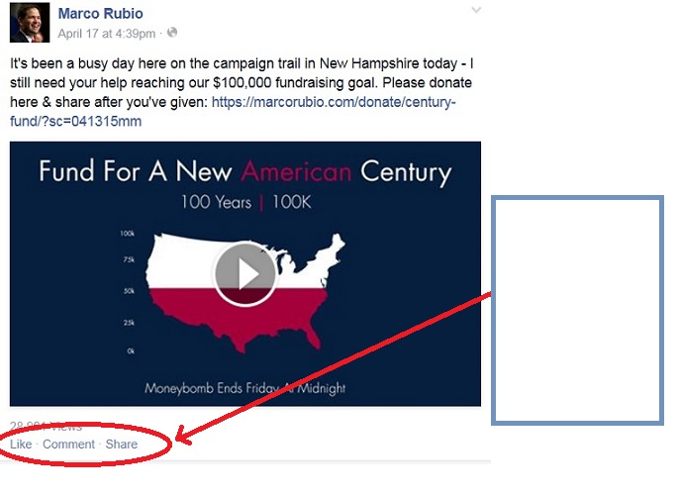
May I “Like” or “Share” a political fundraising post (one that solicits a political contribution) on Facebook?
You click “Like” or “Share” on a post that seeks political contributions
5 U.S.C. § 7323(a)(2); 5 C.F.R. § 734.303

Slide 14
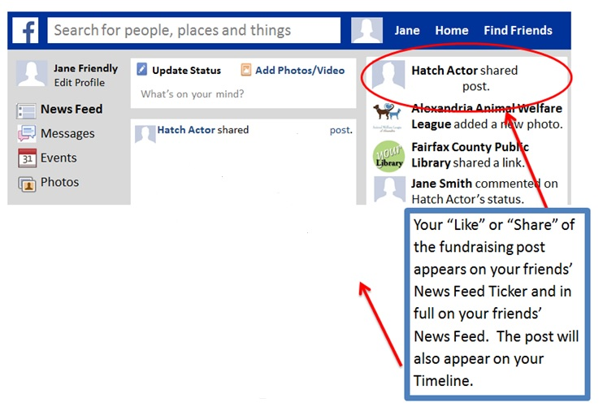
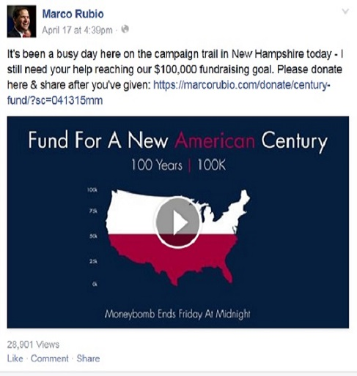
Marco
Rubio’s
Marco Rubio’s
This is NOT OKAY under the Hatch Act because you have distributed and shared the fundraising post with your Facebook friends through News Feed.
5 U.S.C. § 7323(a)(2); 5 C.F.R. § 734.303

Slide 15

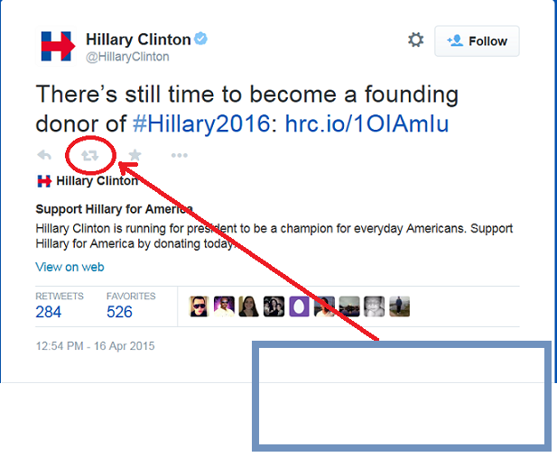
May I “Re-Tweet” a political fundraising post (one that solicits a political contribution) on Twitter?
You click “Retweet” on a tweet that seeks political contributions.
5 U.S.C. § 7323(a)(2); 5 C.F.R. § 734.303

Slide 16
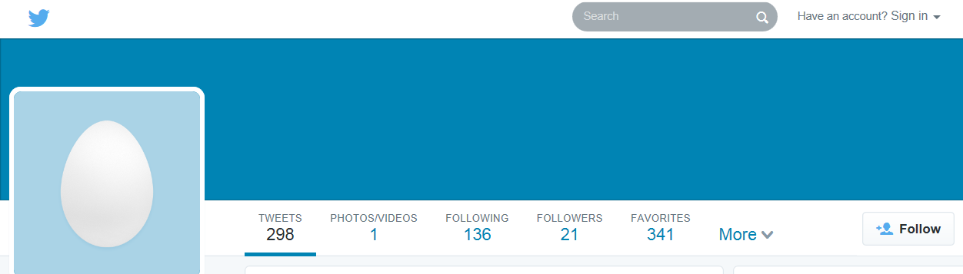
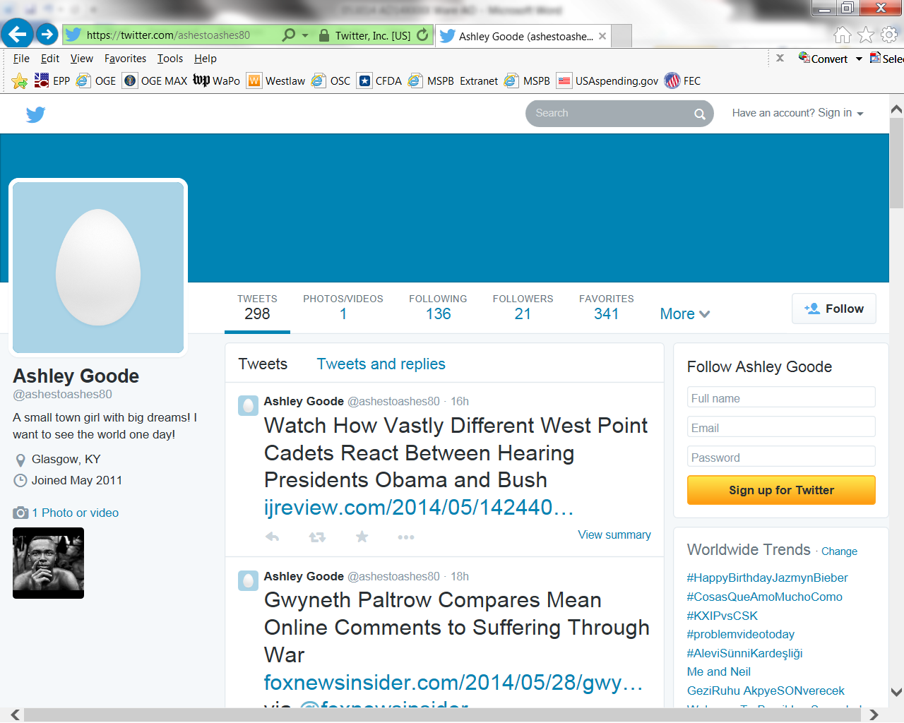
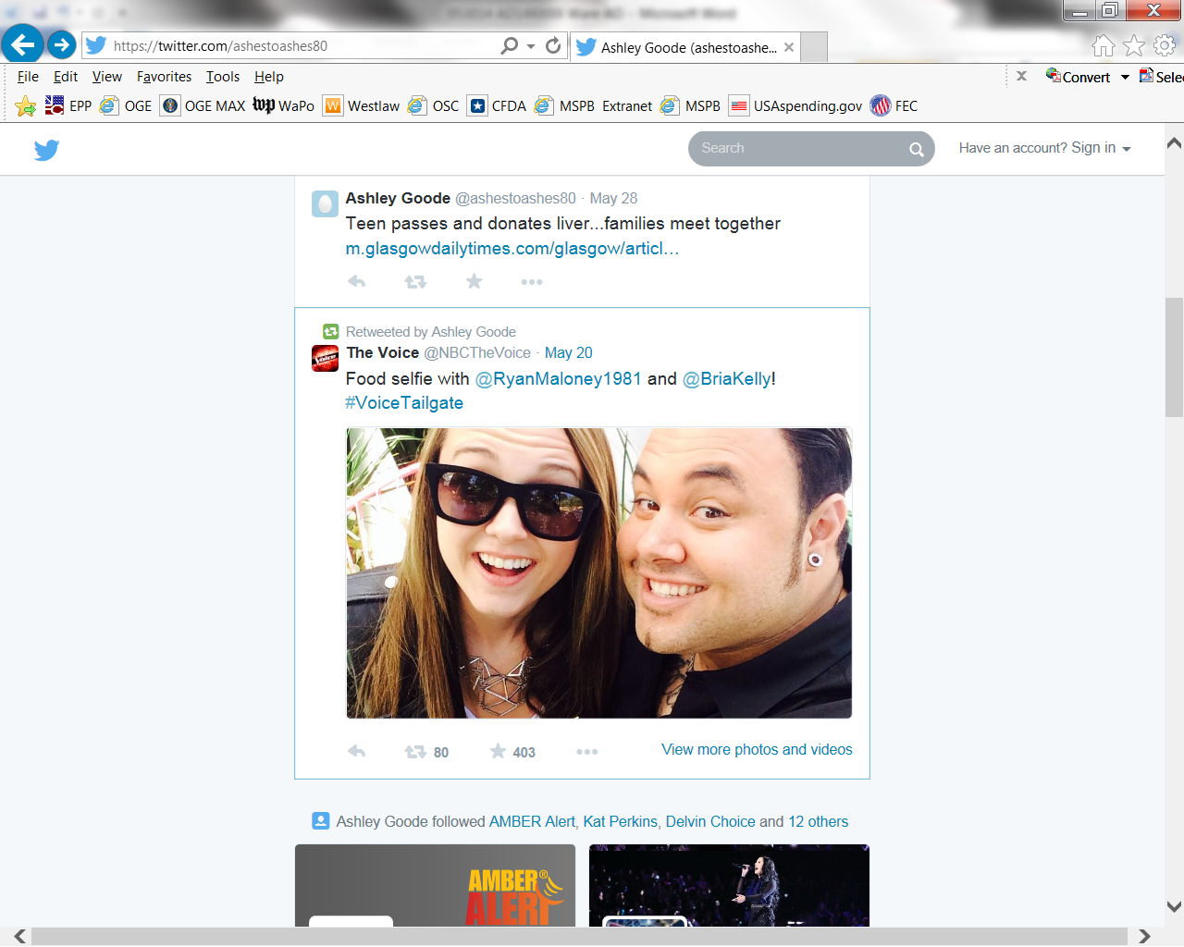
Hatch Act Lover
@ILovetheHatchAct
Retweeted by Hatch Act Lover
Your “Retweet” of the fundraising tweet appears here on your Twitter account page and is shared with your followers on their Twitter feeds.
This is NOT OKAY under the Hatch Act because you have distributed and shared the fundraising post with your followers.
5 U.S.C. § 7323(a)(2); 5 C.F.R. § 734.303

Slide 17
24/7 Prohibitions
Candidacy
Employees may not be candidates for public office in partisan elections
When Does Candidacy Start?
Collecting signatures for nominating petitions
Fundraising
Announcing candidacy to the press or public
Assembling a campaign committee
Filing nominating petitions
17
17
5 U.S.C. § 7323(a)(3); 5 C.F.R. § 734.304

Slide 18
24/7 Prohibitions
Candidacy
Employees are permitted to be candidates for:
  Public office in a nonpartisan election*
  *A nonpartisan election can become partisan if the employee introduces partisan politics into the campaign
Party office, e.g., precinct committeeperson
Local elections in specially designated localities, if running as an independent°
°You should always check with your ethics office and/or OSC to determine if a local election qualifies
5 U.S.C. § 7323(a)(3); 5 C.F.R. § 734.304

Slide 19
24/7 Prohibitions
Business Before Employing Office
Employees may not knowingly solicit or discourage the political activity of anyone with business pending before their employing office.
  Business defined
  - ongoing audit, investigation, or enforcement action
  - application for a grant, contract, license, permit, ruling, compensation or certificate
19
19
19
5 U.S.C. § 7323(a)(4); 5 C.F.R. § 734.305

Slide 20
On Duty/In the Workplace Prohibition
Employees may not engage in political activity while
  On duty
  including when telecommuting or on official time for union duties
In a government room or building
including break rooms, conference rooms, and union offices, if inside a federal building
Wearing an official uniform or insignia
Using a government vehicle
Political Activity is any activity directed toward the success or failure of a partisan candidate, political party, or partisan political group.
20
20
20
20
5 U.S.C. § 7324; 5 C.F.R. § 734.306

Slide 21
On Duty/In the Workplace Prohibition
  Examples
  Wearing buttons, t-shirts, hats, etc.
Displaying screen savers, posters, candidate photographs, etc.
Making online donations
5 U.S.C. § 7324; 5 C.F.R. § 734.306

Slide 22
On Duty/In the Workplace Prohibition
Examples
  Emailing, blogging, tweeting, posting to social media, etc.
    Even if using a personal device or email account
    Even if sharing or forwarding content authored by others
    Even if sharing or forwarding to friends or like-minded coworkers
    Even union email if it meets the definition of political activity

Slide 23


On Duty/In the Workplace
Permitted or Prohibited?
May you display these logos in your office?
5 U.S.C. § 7324; 5 C.F.R. § 734.306

Slide 24
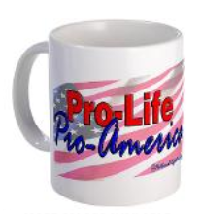
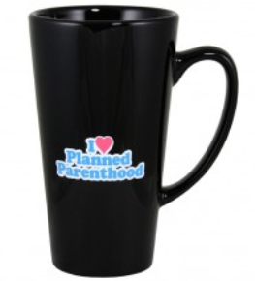
On Duty/In the Workplace
Permitted or Prohibited?
May you use these mugs while at work?
24
5 U.S.C. § 7324; 5 C.F.R. § 734.306

Slide 25

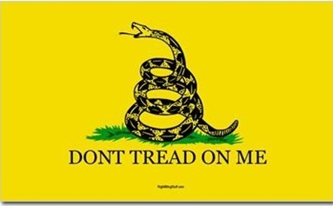

On Duty/In the Workplace
Permitted or Prohibited?
May you display these signs at work?
25
5 U.S.C. § 7324; 5 C.F.R. § 734.306

Slide 26
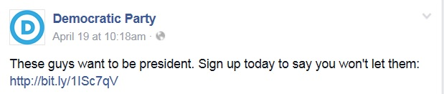
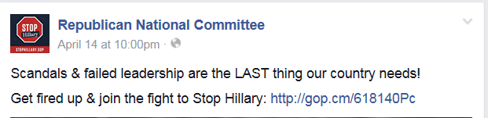
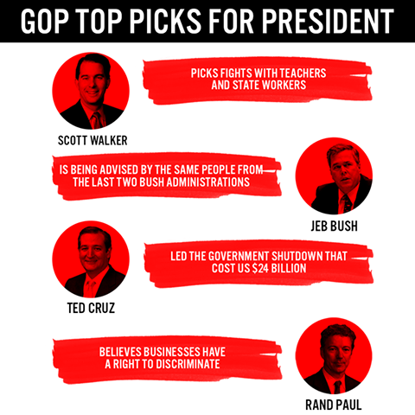

On Duty/In the Workplace
Permitted or Prohibited?
May you share these posts while on duty?
26
26
5 U.S.C. § 7324; 5 C.F.R. § 734.306

Slide 27
On Duty/in the Workplace Prohibition
Exception (for EOP and PAS)
Individual whose duties and responsibilities continue outside normal duty hours and while away from the normal duty post, and who is ―
  an employee paid from an appropriation for the EOP, or
  2. PAS whose
- position is located in the U.S., and
- determines policies to be pursued in relations with foreign powers, or the nationwide administration of federal laws
5 U.S.C § 7324(b); 5 C.F.R. §§ 734.502-734.503

Slide 28
On Duty/in the Workplace Prohibition
Exception (for EOP and PAS)
Such PAS and EOP employees may engage in political activity while
On duty
In a government room or building
Wearing a uniform or official insignia
Using a government vehicle
If costs associated with political activity are not paid for by money from the U.S. Treasury
5 U.S.C § 7324(b); 5 C.F.R. §§ 734.502-734.503

Slide 29
Further Restricted Employees
may not engage in partisan political management or partisan political campaigning
Examples
  Volunteer for a partisan campaign
  Distribute campaign literature
Hold party office
Circulate nominating petitions
Make campaign speeches
Participate in partisan voter registration drives
No activity in concert with a political party or partisan candidate
5 U.S.C. § 7323(b)(2)(A); 5 C.F.R. § 734.401

Slide 30
Penalties
The Merit Systems Protection Board may order:
Removal
Reduction in grade
Debarment from federal employment for a period up to five years
Suspension
Reprimand
Civil penalty up to $1,000
5 U.S.C. § 7326

Slide 31
Need Help?
Hatch Act Unit
  Phone (800) 85-HATCH
  (202) 254-3650
  Email hatchact@osc.gov
OSC Speakers/Outreach
  Phone 202-254-3600
OSC Website
  www.osc.gov

