Slide 1
How-To Session 3
Analyzing Unfamiliar/Challenging Entries in Annual OGE Form 450s
Institute for Ethics in Government

Slide 2
Previous Sessions
Session One
  Stocks
  Exchange Traded Funds (ETF)
  Virtual currency
Session Two
  College Savings Plans (529s)
  Retirement Plans

Slide 3
The 2-2-2 Approach
Two Pieces of Information:
Financial holdings reported on the OGE form 450
Duties and responsibilities of the filer’s position
Two Resources for Reviewing:
Confidential Financial Disclosure Guide
Analyzing Potential Conflicts of Interest Collection
Two Questions:
Is there a nexus between the filer’s duties and the entries on the form?
Do we have enough information to determine whether an entry will pose a potential conflict of interest,
or
that an entry will definitely not pose a potential conflict?
Institute for Ethics in Government

Slide 4
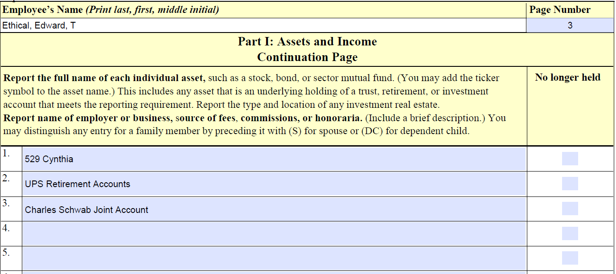
Part I
Charles Schwab Joint Account
Institute for Ethics in Government

Slide 5
Other Investment Accounts
Other Investment Accounts
Retirement Accounts
Individual Retirement Accounts (IRAs), Roth IRAs, Simplified Employee Pension (SEP IRA), or Keogh Plan
Brokerage Accounts
Asset Management Accounts
Institute for Ethics in Government

Slide 6
Brokerage Account Follow-Up Questions
Follow-Up Questions:
What does your Charles Schwab Joint Account contain that was valued at more than $1,000 at the end of the reporting period? Please list those underlying assets (e.g., mutual funds, stocks) for us. Note: You do not need to report cash or underlying assets that qualify as diversified mutual funds within the meaning of 5 C.F.R. Section 2640.201(a). The Confidential Financial Disclosure Guide defines a diversified mutual fund as “a mutual fund that does not have a stated policy of concentrating its investments in any industry, business, single country other than the United States, or bonds of a single state within the United States,” and notes that it must also be registered with the SEC as a management company or unit investment trust under the Investment Company Act of 1940, which can be found in its prospectus.
Please also list underlying assets from which you received more than $1,000 in income during the reporting period (e.g., dividends), if any.

Slide 7
Diversified Mutual Fund
Looking at the investment strategy or objective to determine if one of the regulatory exemptions at 5 CFR 2640.201 applies
Diversified – 5 CFR 2640.201(a)
Sector – 5 CFR 2640.201(b)
Further reading:
Job Aid Determining if an Investment Fund is registered under the 1940 Act
DO-00-030 Differentiating between diversified and sector mutual funds
LA-15-09 Identifying Diversified and Sector Real Estate Fund
LA-24-10 Determining Whether a “Thematic” Fund is a Sector or Diversified Fund for Purposes of the Regulatory Exemptions Applicable to Mutual Funds

Slide 8
Brokerage Account Follow-Up Questions with Responses
Follow-Up Questions:
What does your Charles Schwab Joint Account contain that was valued at more than $1,000 at the end of the reporting period? Please list those underlying assets (e.g., mutual funds, stocks) for us. Note: You do not need to report cash or underlying assets that qualify as diversified mutual funds within the meaning of 5 C.F.R. Section 2640.201(a). iShares U.S. Aerospace & Defense ETF (ITA) and Boeing (BA) are reportable.
Please also list underlying assets from which you received more than $1,000 in income during the reporting period (e.g., dividends), if any.
I received no income.

Slide 9
Revision to Brokerage Account Reported in Part 1
Brokerage Account #1: iShares U.S. Aerospace & Defense ETF (ITA)
Brokerage Account #1: Boeing (BA)
Institute for Ethics in Government

Slide 10
Farm Reported in Part I
Institute for Ethics in Government

Slide 11
Revision to Farm Reported in Part I
Smith Orchards, Mt. Airy, MD, general partner (crops)
Institute for Ethics in Government

Slide 12
Other Considerations
Part II
Part III
18 USC 205 and 18 USC 203

Slide 13
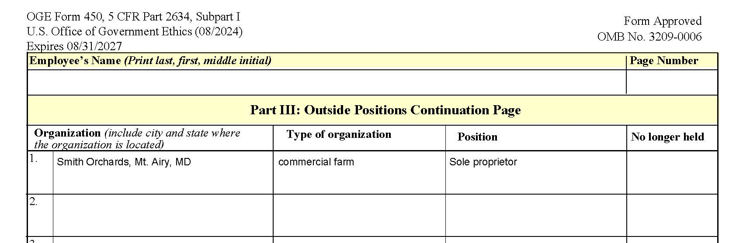
Farm Reported in Part III
General Partner
Institute for Ethics in Government

Slide 14
Trusts – Helpful Resources
Confidential Financial Disclosure Guide
Conflicts of Interest Considerations: Legal Entities that Hold Assets
Public Financial Disclosure Guide
IEG Video - Trusts: Financial Disclosure and Conflicts Analysis

Slide 15
The 2-2-2 Approach Recap
Two Pieces of Information:
Financial holdings reported on the OGE form 450
Duties and responsibilities of the filer’s position
Two Resources for Reviewing:
Confidential Financial Disclosure Guide
Analyzing Potential Conflicts of Interest Collection
Two Questions:
Is there a nexus between the filer’s duties and the entries on the form?
Do we have enough information to determine whether an entry will pose a potential conflict of interest,
or
that an entry will definitely not pose a potential conflict?
Institute for Ethics in Government

