Slide 1
How-To Session 2 for Analyzing Entries in Annual OGE Form 450s
Institute for Ethics in Government

Slide 2
Ultimate Goal
Reviewing Confidential Financial Disclosure Reports
Goal: Prevent conflicts of interest.
Institute for Ethics in Government

Slide 3
The 2-2-2 Approach
Two Pieces of Information:
Financial Holdings Reported on the OGE Form 450
Duties and Responsibilities of the Filer’s Position
Two Resources for Reviewing:
Confidential Financial Disclosure Guide
Analyzing Potential Conflicts of Interest Collection
Two Questions:
Is there a nexus between the filer’s duties and the entries on the form?
Do we have enough information to determine that an entry
will pose a potential conflict of interest
or
will definitely not pose a potential conflict?

Slide 4
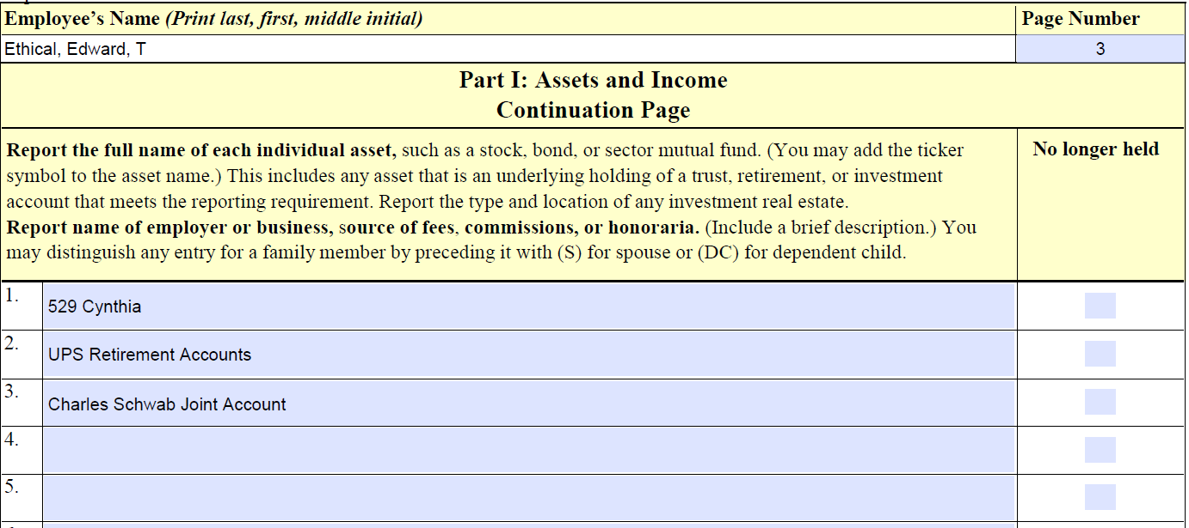
Part I: Assets and Income
Institute for Ethics in Government

Slide 5
529 Plans
529 Plans
College Savings Plans and Prepaid Tuition Plans
Institute for Ethics in Government

Slide 6
529 Plan Follow-Up Questions
Follow-Up Questions:
Who sponsors it? Usually, college savings plans are state-sponsored.
What does it contain? Most college savings plans consist of portfolios that invest in mutual funds based on when your child is anticipated to attend college. If your plan contains a portfolio, or any individual mutual funds or other assets, that meet the reporting threshold – valued at more than $1,000 at the end of the reporting period – please list those for us.
Please also let us know if more than $1,000 was withdrawn from the college savings plan during the reporting period.

Slide 7
529 Plan Follow-Up Questions with Responses
Follow-Up Questions:
Who sponsors it? Usually, college savings plans are state-sponsored. Maryland.
What does it contain? Most college savings plans consist of portfolios that invest in mutual funds based on when your child is anticipated to attend college. If your plan contains a portfolio, or any individual mutual funds or other assets, that meet the reporting threshold – valued at more than $1,000 at the end of the reporting period – please list those for us. Portfolio 2036.
Please also let us know if more than $1,000 was withdrawn from the college savings plan during the reporting period. No funds were withdrawn.

Slide 8
Part I Revision 1
MD 529 College Investment Plan: Portfolio 2036
Institute for Ethics in Government

Slide 9
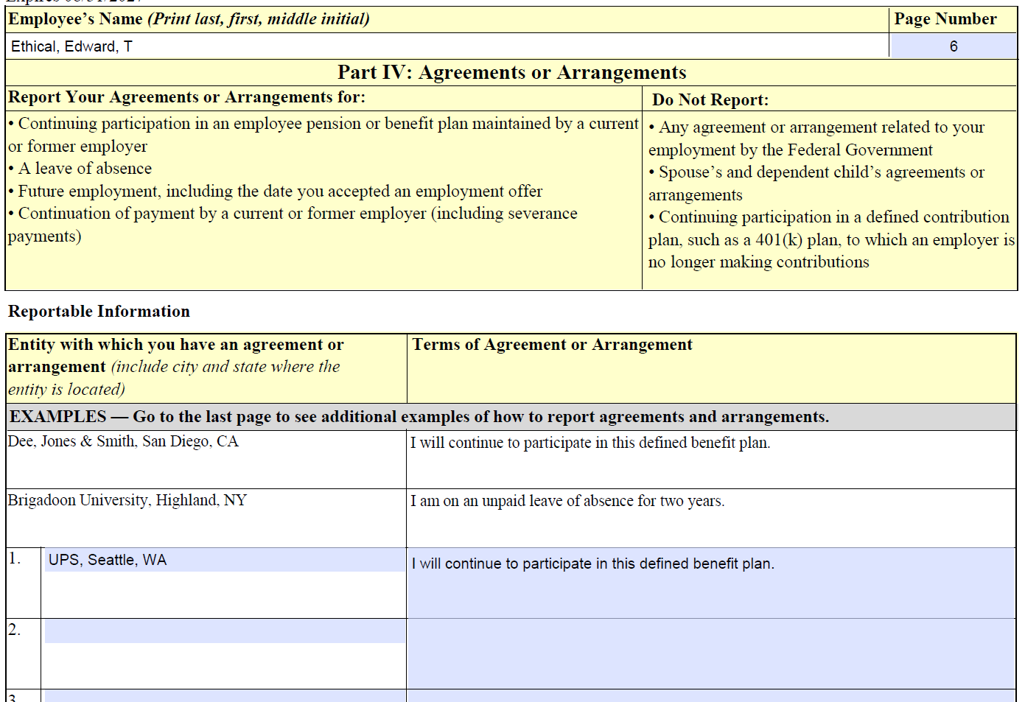
Part IV: Agreements or Arrangements

Slide 10
Retirement Plans Slide 1
Retirement Plans
Defined Benefit Plans
  Pension Plans or Qualified-Benefit Plans
Institute for Ethics in Government

Slide 11
Part I Revision 2
MD 529 College Investment Plan: Portfolio 2036
UPS, Defined Benefit Plan
Institute for Ethics in Government

Slide 12
Retirement Plans Slide 2
Retirement Plans
Defined Benefit Plans
  Pension Plans or Qualified-Benefit Plans
Defined Contribution Plans
  401(k), 403(b), and 457 Plans
Institute for Ethics in Government

Slide 13
401(k) Follow-Up Questions
Follow-Up Questions:
What does your 401(k) contain that was valued at more than $1,000 at the end of the reporting period? Please list those underlying assets (e.g., mutual funds, stocks) for us. Note: You do not need to report underlying assets that qualify as diversified mutual funds within the meaning of 5 C.F.R. Section 2640.201(a) or underlying assets that qualify as diversified investment funds of a bona fide employee benefit plan within the meaning of 5 C.F.R. Sections 2640.201(c)(1)(ii) or 2640.201(c)(1)(iii).
Please also indicate if more than $1,000 was distributed from the 401(k) during the reporting period.

Slide 14
401(k) Follow-Up Questions with Responses
Follow-Up Questions:
What does your 401(k) contain that was valued at more than $1,000 at the end of the reporting period? Please list those underlying assets (e.g., mutual funds, stocks) for us. Note: You do not need to report underlying assets that qualify as diversified mutual funds within the meaning of 5 C.F.R. Section 2640.201(a) or underlying assets that qualify as diversified investment funds of a bona fide employee benefit plan within the meaning of 5 C.F.R. Sections 2640.201(c)(1)(ii) or 2640.201(c)(1)(iii).
Only UPS Stock is reportable.
Please also indicate if more than $1,000 was distributed from the 401(k) during the reporting period. I received no distributions.

Slide 15
Part I Revision 3
MD 529 College Investment Plan: Portfolio 2036
UPS, Defined Benefit Plan
UPS 401(k) Savings Plan:
or
UPS Stock
– UPS Stock
Institute for Ethics in Government

Slide 16
401(k) Additional Follow-Up Question and Answer
Follow-Up Question:
Does UPS still make contributions to your 401(k) Savings Plan? No.
Institute for Ethics in Government

Slide 17
Part IV: Agreements or Arrangements Revisited

Slide 18
Part I Revision 3 Revisited
MD 529 College Investment Plan: Portfolio 2036
UPS, Defined Benefit Plan
UPS 401(k) Savings Plan:
or
UPS Stock
– UPS Stock
Institute for Ethics in Government

Slide 19
Key Take Aways
Key Take Aways
Rely on the Guide and the Analyzing Potential Conflicts of Interest Analysis Collection.
Decide what form(s) of communication work best for you and your filers to share and record information and build rapport.
Review OGE Form 450s in their entirety.
Institute for Ethics in Government

Slide 20
Reminders
Reminders:
Continue to submit unfamiliar/challenging entries. You can do so through the end of this week by completing this one-question survey.
The third and final How-To Session is scheduled for Tuesday, March 10 from 1 to 2pm EST. Stay tuned for an announcement with more details soon.
These How-To Sessions are recorded and made available on the course page.
Each is eligible for Professional Ethics Practitioner (PEP) credit. If you are working towards your PEP certificate for 2026, the new application will launch in March.

Slide 21
Thank You
Contact the IEG at trainingregistration@oge.gov.
Institute for Ethics in Government

