Slide 1
Confidential Financial Disclosure
Institute for Ethics in Government

Slide 2
What is the purpose of the confidential financial disclosure system?
Institute for Ethics in Government

Slide 3
Purpose
What is the purpose of the confidential financial disclosure system?
To prevent conflicts of interest and other ethics concerns.
Institute for Ethics in Government

Slide 4
Who files confidential financial disclosure reports?
Institute for Ethics in Government

Slide 5
Filers
Who files confidential financial disclosure reports?
Employees with duties that pose a risk for conflicts of interest,
as determined by their agencies.
Institute for Ethics in Government

Slide 6
What do employees report on confidential financial disclosure reports?
Institute for Ethics in Government

Slide 7
Things to Report
What do employees report on confidential financial disclosure reports?
Financial holdings, like stocks, bonds, and mutual funds, holdings of retirement accounts, sources of outside income, outside employment and other positions, some debts, and certain gifts. They also report the financial and business holdings and arrangements of close family members.
Institute for Ethics in Government

Slide 8
When do employees file confidential financial disclosure reports?
Institute for Ethics in Government

Slide 9
Timing of Reports
When do employees file confidential financial disclosure reports?
Within 30 days of entering a filing position, and annually on February 15th thereafter.
Institute for Ethics in Government

Slide 10
Goal
Reviewing Confidential Financial Disclosure Reports
Goal: Prevent conflicts of interest.
Institute for Ethics in Government

Slide 11
2-2-2 Review Process
Two Pieces of Information:
Financial holdings reported on the OGE form 450
Duties and responsibilities of the filer’s position
Two Resources for Reviewing:
Confidential Financial Disclosure Guide
Analyzing Potential Conflicts of Interest Collection
Two Questions:
Is there a nexus between the filer’s duties and the entries on the form?
Do we have enough information to determine whether an entry will pose a potential conflict of interest,
or
that an entry will definitely not pose a potential conflict?
Institute for Ethics in Government

Slide 12
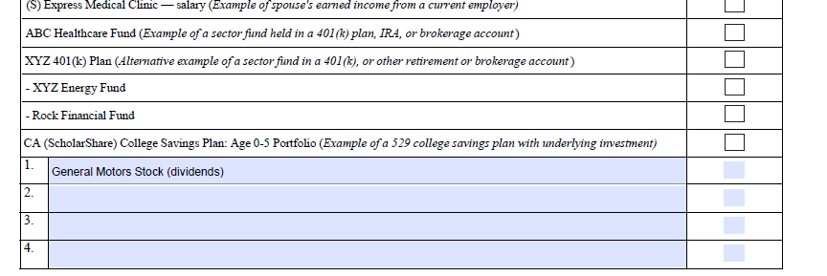
Stock Entry
Institute for Ethics in Government

Slide 13
Updated Stock Entry
(GM)
Institute for Ethics in Government

Slide 14
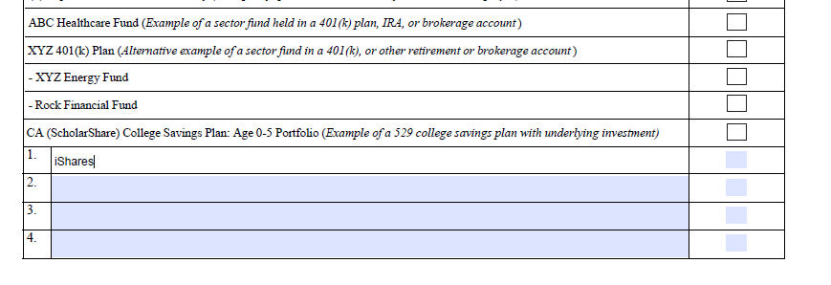
ETF Entry
Institute for Ethics in Government

Slide 15
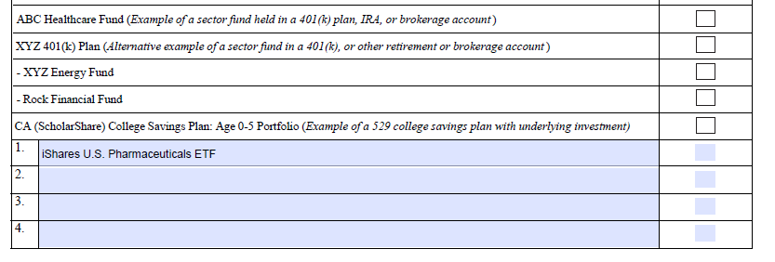
Updated ETF Entry
(IHE)
Institute for Ethics in Government

Slide 16
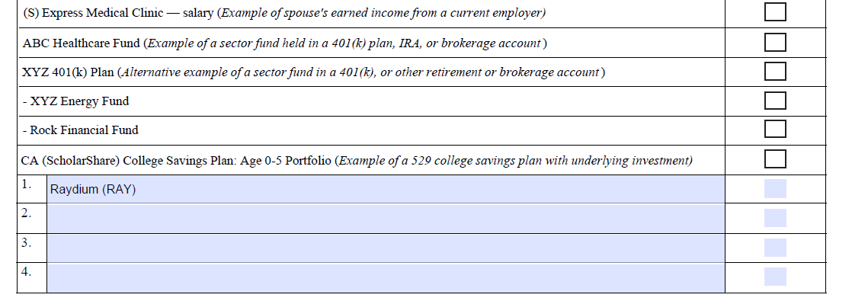
Virtual Currency Entry
Institute for Ethics in Government

Slide 17
Updated Virtual Currency Entry
(Poloniex wallet)
Institute for Ethics in Government

Slide 18
Conclusion: 2-2-2 Review Process
Two Pieces of Information:
Financial holdings reported on the OGE form 450
Duties and responsibilities of the filer’s position
Two Resources for Reviewing:
Confidential Financial Disclosure Guide
Analyzing Potential Conflicts of Interest Collection
Two Questions:
Is there a nexus between the filer’s duties and the entries on the form?
Do we have enough information to determine whether an entry will pose a potential conflict of interest,
or
that an entry will definitely not pose a potential conflict?
Institute for Ethics in Government

