Slide 1
Making Ethics Education Relevant
… and Therefore Interesting
Adhana Davis, NASA Kennedy Space Center
Jennifer Dure, NASA Headquarters
Dawn Feick, NASA Kennedy Space Center

Slide 2
Why bother making education relevant?
I’m overworked and don’t have a lot of time to devote to preventative education;
I lack the resources I need to tailor my education to my agency employees; AND
It’s already “relevant” in that the ethics rules apply, regardless

Slide 3






Common Responses to Ethics Training

Slide 4
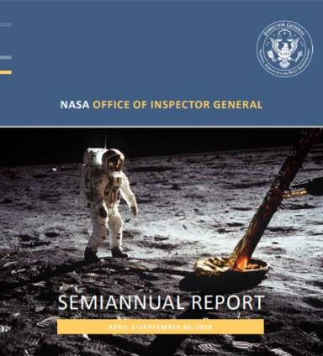
Tools to Make Training Relevant
Use your OIG
Use DOJ
Use other agencies
Use the media

Slide 5
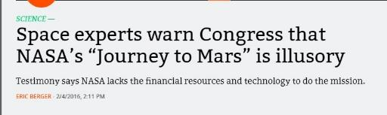

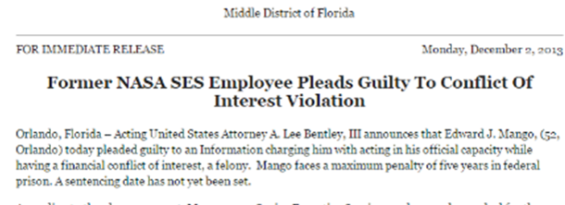
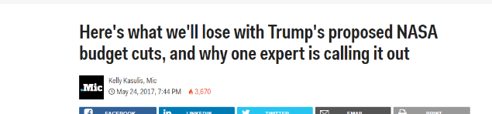
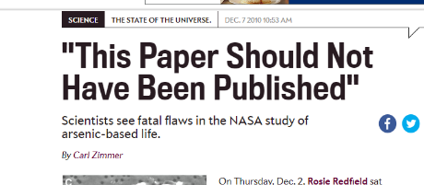
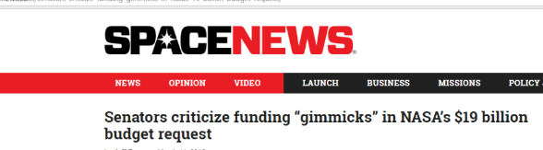

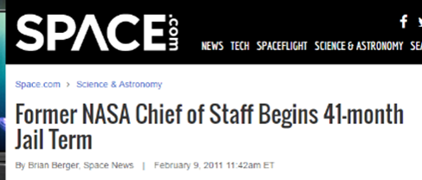
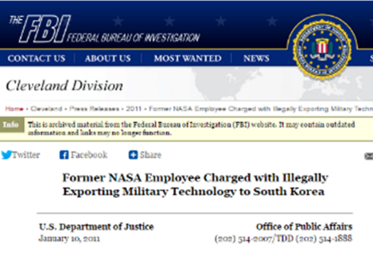
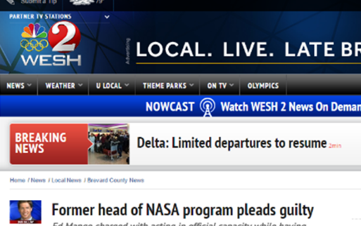
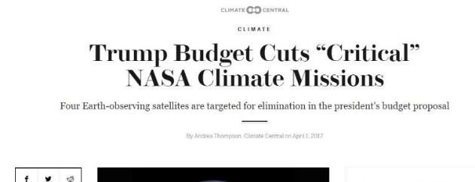

Slide 6
Use Multimedia
Actual news clips
Congressional testimony regarding violations
Even late-night TV!

Slide 7
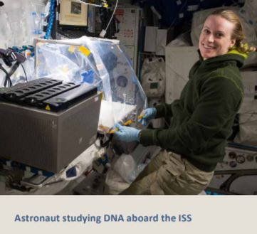

Tailor the Content to the Audience
What’s relevant to a scientist …
… may not be relevant to a CO!
Train to Issue-Spot

Slide 8
Your Own Agency Employees Can Help
Engage management
  Ask what their subordinates deal with
  Have them participate in training
Engage employees … by showing them you care
    Polling options
    Make training entertaining (and delicious?)
    Update your training every year
    Convey that your job is to help

Slide 9
“Education” Isn’t Just “Annual Training”
Convey ethics is always relevant (not just for training)
Incorporate ethics training into mission-specific training
Use all resources at your disposal: memos, agency intranet, email, educational aides
Timely (and therefore relevant) reminders
  Holiday-themed reminders about gifts in Nov./Dec.
  Hatch Act training (at least periodically)
  Gambling

Slide 10

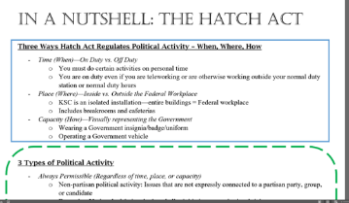
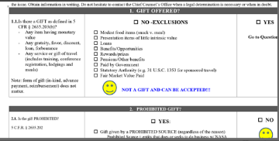
Additional training tools

Slide 11
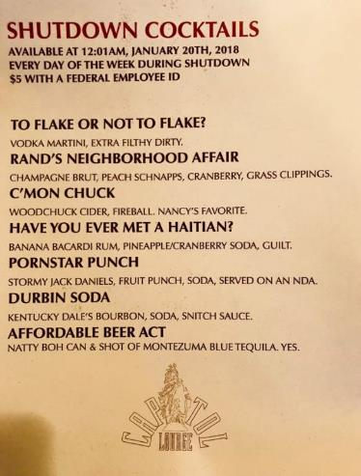
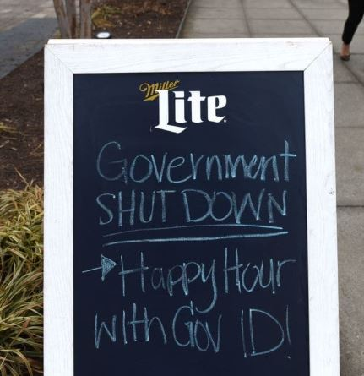
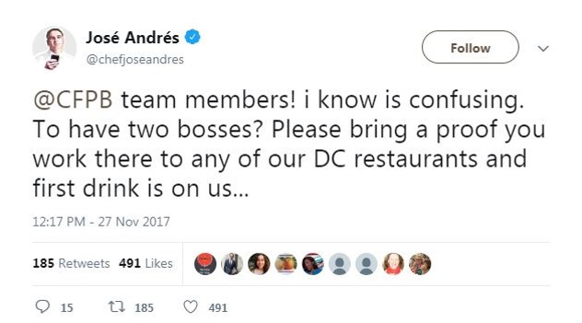
Keep Your Eyes Open…

